Slide 1



Lecture 10
Chapter 2. Basic Structures
2.3 Functions
10-1

Slide 2


2.3 Functions
 From calculus, you are familiar with the concept of a real-valued function f,
which assigns to each number x∈R a value
y = f(x), where y∈R.
 But, the notion of a function can also be naturally generalized to the concept of assigning elements of any set to elements of any set. (Also known as a map.)
10-2

Slide 3

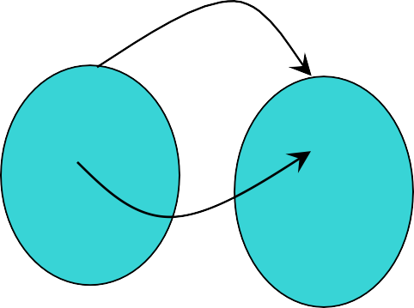
Function: Formal Definition
 For any sets A and B, we say that a function (or “mapping”) f from A to B (f : A → B) is a particular assignment of exactly one element f(x)∈B to each element x∈A.
 Functions can be represented graphically in several ways:
f
A B
•
•
•
•
•
•
•
•
•
y
a
•
•
b
f
A
B
x
Plot
Like Venn diagrams
Bipartite Graph
10-3

Slide 4
Some Function Terminology
 If it is written that f : A → B, and f(a) = b
(where a∈A and b∈B), then we say:
 A is the domain of f
 B is the codomain of f
 b is the image of a under f
 a can not have more than 1 image
 a is a pre-image of b under f
 b may have more than 1 pre-image
 The range R⊆B of f is R = {b | ∃a f(a) = b }
10-4

Slide 5

Range versus Codomain
 The range of a function might not be its whole codomain.
 The codomain is the set that the function is
declared to map all domain values into.
 The range is the particular set of values in the codomain that the function actually maps elements of the domain to.
10-5

Slide 6

Range vs. Codomain: Examp^{Un}l^{ive}e^{rsity}
 Suppose I declare that: “f is a function mapping students in this class to the set of grades {A, B, C, D, F}.”
 At this point, you know f ’s codomain is:
_^{{A,} _^{B, C, D}_,_^{F}_}_, and its range is _unknown!
 Suppose the grades turn out all As and Bs.
 Then the range of f is _^{{A,}_^{B}} , but its codomain is _still {A,_B, C, D_, _F_}_!
10-6

Slide 7
Function Operators
 + , × (“plus”,“times”) are binary operators over R. (Normal addition & multiplication.)
 Therefore, we can also add and multiply two
real-valued functions f,g: R → R:
 (f + g): R → R, where (f + g)(x) = f(x) + g(x)
 (fg): R → R, where (fg)(x) = f(x)g(x)
 Example 6:
Let f and g be functions from R to R such that f(x) = x² and g(x) = x – x². What are the functions f + g and fg?
10-7

Slide 8
Function Composition Operat^{Uni}o^{versity o}r^{f}
Note the match here. It’s necessary!
 For functions g: A → B and f : B → C, there is a special operator called compose (“◦”).
 It composes (creates) a new function from f and
g by applying f to the result of applying g.
 We say (f ◦ g): A → C, where (f ◦ g)(a) = f(g(a)).
 Note: f ◦ g cannot be defined unless range of g
is a subset of the domain of f.
 Note g(a)∈B, so f(g(a)) is defined and ∈C.
 Note that ◦ is non-commuting. (Like Cartesian ×, but unlike +, ∧, ∪) (Generally, f ◦ g ≠ g ◦ f.)
10-8

Slide 9

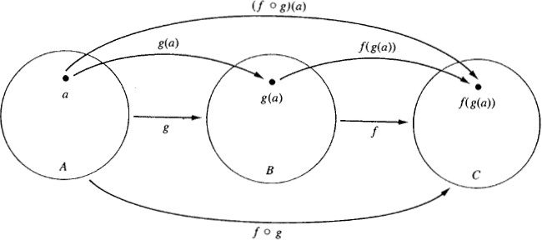
Function Composition
Illustration
 g: A → B, f : B → C

Slide 10

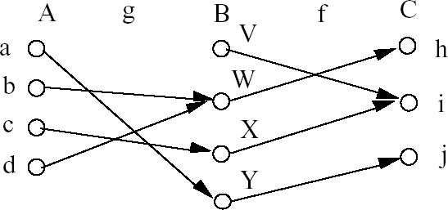
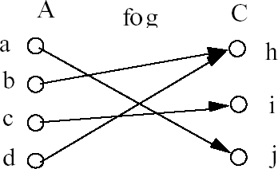
Function Composition:
Example
 g: A → B, f : B → C

Slide 11

Function Composition:
Example
 Example 20: Let g: {a, b, c} → {a, b, c} such that
g(a) = b, g(b) = c, g(c) = a.
Let f : {a, b, c} → {1, 2, 3} such that
f(a) = 3, f(b) = 2, f(c) = 1.
What is the composition of f and g, and what is the composition of g and f ?
 f◦g: {a, b, c} → {1, 2, 3} such that (f◦g)(a) = 2, (f◦g)(b) = 1, (f◦g)(c) = 3.
(f◦g)(a) = f(g(a)) = f(b) = 2
(f◦g)(b) = f(g(b)) = f(c) = 1
(f◦g)(c) = f(g(c)) = f(a) = 3
 g◦f is not defined (why?)

Slide 12
Function Composition:
Example
 If f(x) = x² and g(x) = 2x + 1, then what is the composition of f and g, and what is the composition of g and f ?
 (f◦g)(x) = f(g(x))
= f(2x+1)
= (2x+1)²
 (g◦f)(x) = g(f(x))
= g(x²)
= 2x² + 1
Note that f◦g ≠ g◦f. (4x²+4x+1 ≠ 2x²+1)

Slide 13
Images of Sets under Functio^{U}n^{niversit}s^{y of}
 Given f : A → B, and S⊆A,
 The image of S under f is simply the set of all images (under f) of the elements of S.
f(S) = {f(t) | t∈S}
= {b | ∃t∈S: f(t) = b}.
 Note the range of f can be defined as simply the image (under f) of f ’s domain.

Slide 14


One-to-One Functions
 A function f is one-to-one (1–1), or injective, or an injection, iff f(a) = f(b) implies that a = b for all a and b in the domain of f (i.e. every element of its range has only 1 pre-image).
 Formally, given f : A→B,
“f is injective”: ∀a,b (f(a) = f(b) → a = b) or equivalently ∀a,b (a ≠ b → f(a) ≠ f(b))
 Only one element of the domain is mapped to any given one element of the range.
 Domain & range have the same cardinality.
What about codomain?

Slide 15

One-to-One Illustration
 Bipartite (2-part) graph representations of functions that are (or not) one-to-one:
•
•
•
•
• •
• •
• •
•
•
•
•
•
•
•
•
•
•
•
•
•
•
•
•
•
One-to-one Not one-to-one Not even a function!

Slide 16
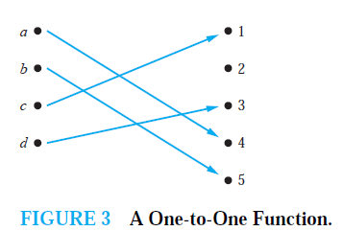
Example 8:
Is the function f : {a, b, c, d} → {1, 2, 3, 4, 5} with
f(a) = 4, f(b) = 5, f(c) = 1, and f(d) = 3 one-to-one?

Slide 17
Example 9:
Let f : Z → Z such that f(x) = x². Is f one-to-one?
Solution: The function f (x) = x2 is not one-to-one because, for instance, f (1) = f (−1) = 1,but 1 = −1.
Note that the function f (x) = x2 with its domain restricted to Z+ is one-to-one. (Technically,
when we restrict the domain of a function, we obtain a new function whose values agree with those of the original function for the elements of the restricted domain. The restricted function is not defined for elements of the original domain outside of the restricted domain.)

Slide 18

Sufficient Conditions for
1–1ness
 For functions f over numbers, we say:
 f is strictly (or monotonically) increasing
iff x > y → f(x) > f(y) for all x, y in domain;
 f is strictly (or monotonically) decreasing
iff x > y → f(x) < f(y) for all x, y in domain;
 If f is either strictly increasing or strictly decreasing, then f is one-to-one.
 E.g. x³

Slide 19

Onto (Surjective) Functions
 A function f : A → B is onto or surjective or a surjection iff for every element b∈B there is an element a∈A with f(a) = b (∀b∈B, ∃a∈A: f
(a) = b) (i.e. its range is equal to its codomain).
 Think: An onto function maps the set A onto (over, covering) the entirety of the set B, not just over a piece of it.
 E.g., for domain & codomain R, x³ is onto, whereas x² isn’t. (Why not?)

Slide 20
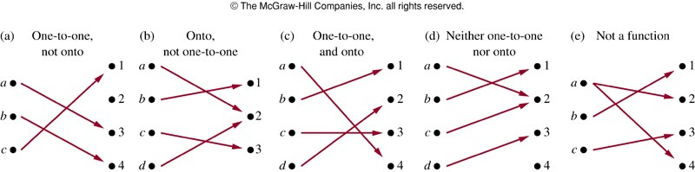
Illustration of Onto
 Some functions that are, or are not, onto their codomains:
 Example13: Is the function f(x) = x + 1 from the set of integers to the set of integers onto?

Slide 21
Bijections and Inverse Functi^{U}o^{niversit}n^{y of}
 A function f is said to be a one-to-one correspondence, or a bijection, or reversible, or invertible, iff it is both one-to-one and onto.
 Let f : A → B be a bijection.
The inverse function of f is the function that assigns to an element b∈B the unique element
a∈A such that f(a) = b.
The inverse function of f is denoted by f ⁻¹: B → A. Hence, f ⁻¹(b) = a when f(a) = b.

Slide 22

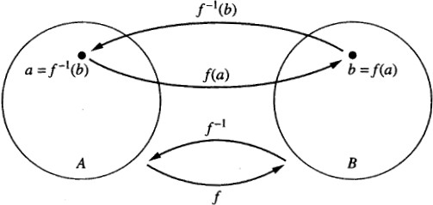
Inverse Function Illustration
 Let f: A → B be a bijection
 Example 16: Let f : {a, b, c} → {1, 2, 3} such that
f(a) = 2, f(b) = 3, f(c) = 1. Is f invertible, and if it is,
what is its inverse? Yes. f^{–1}(1) = c, f^{–1}(2) = a, f^{–1}(3) = b
 Example 18: Let f be the function from R to R with
f(x) = x². Is f invertible?
No. f is not a one-to-one function. So it’s not invertible.

Slide 23

Mappings in Java
 A discrete function can be represented by a Map interface or HashMap class in Java programming language
 Map map<Integer,String>
= new HashMap<Integer,String>() ;
 Here, the domain is Integer, the codomain is String
 We can construct such a mapping by putting all pairs
{a, f(a)} into our map. (a is the key, f(a) is the value.)
 map.put(2,"Jan");
 for (Kid kid:kids) {map.put(kid.id,kid.name);}
 If we put another pair with the same key, it will overwrite the previous pair – it’s not a function! (May be a bug…)

Slide 24
Image, Range, Bijection in Ja^{Un}v^{iversity}a^{of Hawaii}
 Map.keys() returns the image
 it’s a Java Set!
 map.values() returns the range
 it’s a Java Set!
 Is a map a bijection?
Iff the cardinalities of the image and range are the same:
 if (map.keys().size()==map.values().size()) { System.out.println("map is a bijection”);
}

Slide 25
Inverse Function in Java
 Let’s construct an inverse!
 Prepare the inverse function:
 Map inverse<String,Integer>
= new HashMap<String,Integer>() ;
 Here, the domain is String, the codomain is Integer
 Go through all keys in map (all elements of the image) and put each pair {value,key} into inverse:
 for (Integer id:map.keys()) { String name = map.get(id); inverse.put(id:name,id);
}

