Slide 1


Summation Notation
 Given a sequence {a_{n}}, an integer lower bound
(or limit) j ≥ 0, and an integer upper bound
k ≥ j, then the summation of {a_{n}} from a_{j} to a_{k}
is written and defined as follows:
k
∑a_{i} = a_{j} + a_{j +1} + ... + a_{k}
i= j
 Here, i is called the index of summation.
k k k
∑ªi ⁼ ∑ªm ⁼ ∑ªl
i= j m= j l = j
12-<number>

Slide 2

Generalized Summations
 For an infinite sequence, we write:
∞
∑a_{i} = a _{j} + a_{j +1} +☹
i= j
 To sum a function over all members of a set
X = {x₁, x₂,…}:
∑ f (x) = f (x₁) + f (x₂ ) +☹
x∈X
 Or, if X = {x| P(x)}, we may just write:
∑ f (x) = f (x₁ ) + f (x₂ ) +☹
P( x)
12-<number>

Slide 3

Simple Summation Example
∑(i² +1)=
4

(2² +1) + (3² +1) + (4² +1)
i=2
= (4 +1) + (9 +1) + (16 +1)
= 5 +10 +17
= 32
100 ₁
1 1 1
2 3 4 100
1
∑
1+
+ + ☹+ =

i=1 ^{i}
12-<number>

Slide 4
More Summation Examples
 An infinite sequence with a finite sum:
∞
∑
1 1
2 ⁺ 4
−i 0 −1
2 = 2 + 2 +☹ = 1+
+☹ = 2
i=0
 Using a predicate to define a set of elements to sum over:
∑ x² = 2² + 3² + 5² + 7²
( x is prime) ∧
x<10
= 4 + 9 + 25 + 49 = 87
12-<number>

Slide 5
Summation Manipulations
 Some handy identities for summations:
 Summing constant value
Number of terms in the summation
j
∑c = ( j − i +1) ⋅ c
n=i
3
∑2 =
2 + 2 + 2 = 3⋅ 2 = 6
n=1
2
∑2i
= 2i + 2i + 2i + 2i
= 4 ⋅ (2i) = 8i
n=−1
12-<number>

Slide 6
Summation Manipulations
 Distributive law
j j
∑cf (n) = c∑ f (n)
n=i n=i
∑(4 ⋅ n² )= 4 ⋅1² + 4 ⋅ 2² + 4 ⋅ 3²
3
n=1
= 4 ⋅ (1² + 2² + 3² )
3
= 4∑ n²
n=1
12-<number>

Slide 7
Summation Manipulations
 An application of commutativity
j j j
∑( f (n) + g(n)) = ∑ f (n) + ∑ g(n)
n=i n=i n=i
4
∑(n + 2n) = (2 + 2 ⋅ 2) + (3 + 2 ⋅ 3) + (4 + 2 ⋅ 4)
n=2
= (2 + 3 + 4) + (2 ⋅ 2 + 2 ⋅ 3 + 2 ⋅ 4)
4 4
= ∑n + ∑2n
n=2 n=2
12-<number>

Slide 8

Index Shifting
m m+n
∑ f (i) = ∑ f (k − n)
i= j k = j+n
4
∑i² =1² + 2² + 3² + 4²
i=1
 Let k = i + 2, then i = k – 2
4+2 6
∑(k − 2)² =∑(k − 2)²
k =1+2 k =3
= (3 − 2)² + (4 − 2)² + (5 − 2)² + (6 − 2)²
12-<number>

Slide 9

More Summation Manipulations
 Sequence splitting
k m k
∑ f (i) = ∑ f (i) + ∑ f (i) if j ≤ m < k
i= j i= j i=m+1
4
∑i³ = 0³ +1³ + 2³ + 3³ + 4³
i=0
= (0³ +1³ + 2³ ) + (3³ + 4³ )
2 4
= ∑i³ + ∑i³
i=0 i=3
12-<number>

Slide 10

More Summation Manipulations
 Order reversal
k k
∑ f (i) = ∑ f (k − i)
i=0 i=0
3
∑i³ = 0³ +1³ + 2³ + 3³
i=0
= (3 − 0)³ + (3 −1)³ + (3 − 2)³ + (3 − 3)³
3
3
= ∑(3 − i)
i=0
12-<number>

Slide 11

Example: Geometric Progression
 A geometric progression is a sequence of the form a, ar, ar², ar³, …, ar^{n} ,… where a,r∈R.
 The sum of such a sequence is given by:
n
S = ∑ ar ^{i}
i=0
 We can reduce this to closed form via clever manipulation of summations...
12-<number>

Slide 12
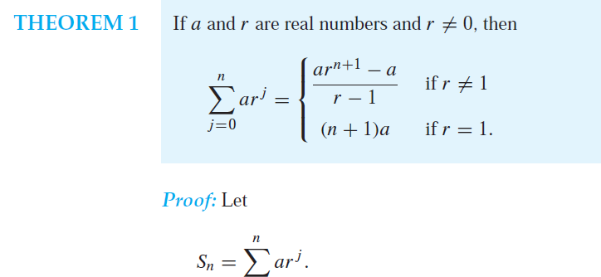

Slide 13
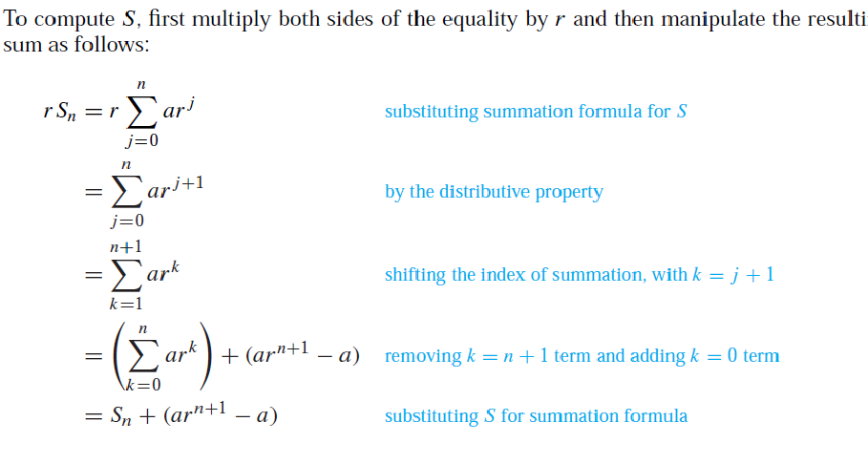

Slide 14
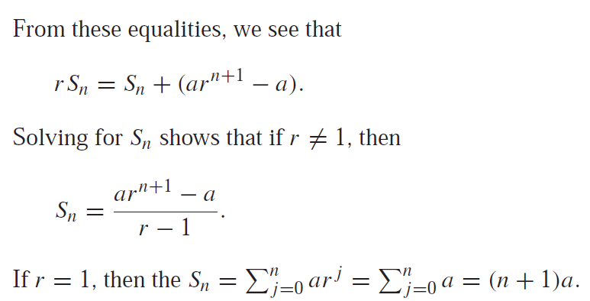

Slide 15

Gauss’ Trick, Illustrated
 Consider the sum: 1+2+…+(n/2)+((n/2)+1)+…+(n-1)+n
n+1
n+1 n+1
 We have n/2 pairs of elements, each pair summing to n+1, for a total of (n/2)(n+1).
…
12-<number>

Slide 16
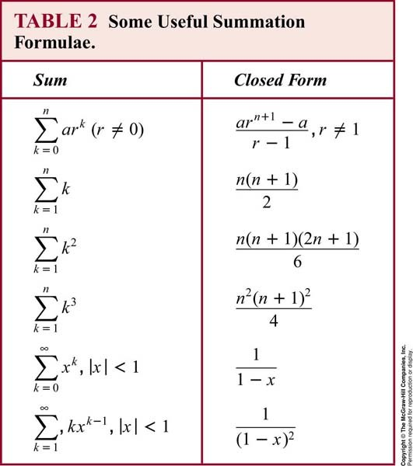
Some Shortcut Expressions
Geometric sequence
Gauss’ trick Quadratic series
Cubic series
12-<number>

Slide 17

Using the Shortcuts
_{∑ k} 2
100
 Example: Evaluate
k =50
 Use series splitting. ∑ k
⎛⎛ 49
₂ ⎞⎞
100
100
= ⎜⎜∑ k ⎟⎟ + ∑ k
2
2
⎝⎝ k =1 ⎠⎠
k =1
k =50
⎛⎛ 100
₂ ⎞⎞
100
49
 Solve for desired summation.
 Apply quadratic series rule.
 Evaluate.
∑ k = ⎜⎜∑ k ⎟⎟ − ∑ k
2
2
⎝⎝ k =1 ⎠⎠ k =1
k =50
100 ⋅101⋅ 201
6
49 ⋅ 50 ⋅ 99
− ₆
=
= 338,350 − 40,425
= 297,925.
12-<number>

Slide 18

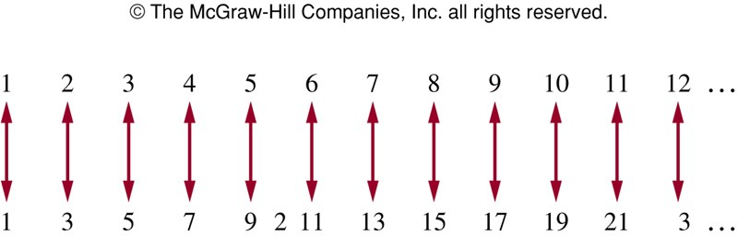
Cardinality
 The sets A and B have the same cardinality if and only if there is a one-to-one correspondence from A to B.
 A set that is either finite or has the same cardinality as the set of positive integers is called countable.
 A set that is not countable is called uncountable.
 Example: Show that the set of odd positive integers is a countable set.
Consider the function f(n) = 2n – 1 from Z⁺ to the set of odd positive integers
A one-to-one correspondence
between Z⁺ and the set of odd positive integers.
12-<number>

Slide 19
Summation Manipulations
 Useful identities:
k m k
∑ f (i) = ∑ f (i) + ∑ f (i)
i= j i= j i=m+1
if j ≤ m < k
(Sequence splitting.)
k k
∑ f (i) = ∑ f (k − i)
i=0 i=0
(Order reversal.)
2k k
∑ f (i) = ∑( f (2i −1) + f (2i))
i=1 i=1
(Grouping.)
12-<number>

