Slide 1


The Identity Function
 For any domain A, the identity function I: A → A (also written as I_{A}, 1, 1_{A}) is the unique function such that ∀a∈A: I(a) = a.
 Note that the identity function is always both one-to-one and onto (i.e., bijective).
 For a bijection f : A → B and its inverse function f ⁻¹: B → A,
f ⁻¹ □ f = I
A
 Some identity functions you’ve seen:
 + 0, × 1, ∧ T, ∨ F, ∪ ∅, ∩ U.
11-<number>

Slide 2

Graphs of Functions
 We can represent a function f : A → B as a set of
ordered pairs {(a, f(a)) | a∈A}.
← The function’s graph.
 Note that ∀a∈A, there is only 1 pair (a, b).
 For functions over numbers, we can represent an ordered pair (x, y) as a point on a plane.
 A function is then drawn as a curve (set of points), with only one y for each x.
11-<number>

Slide 3

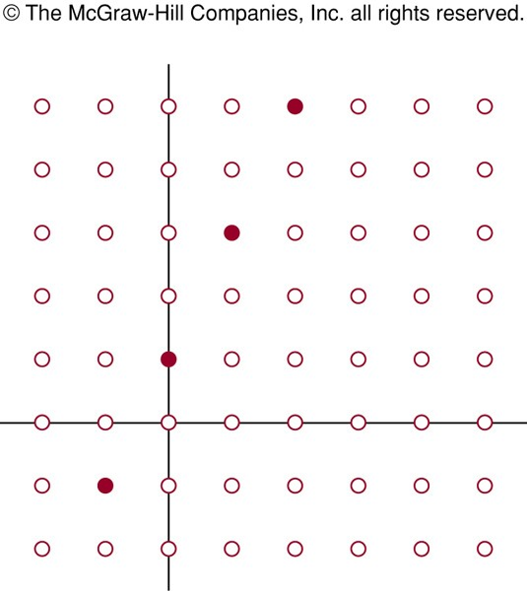
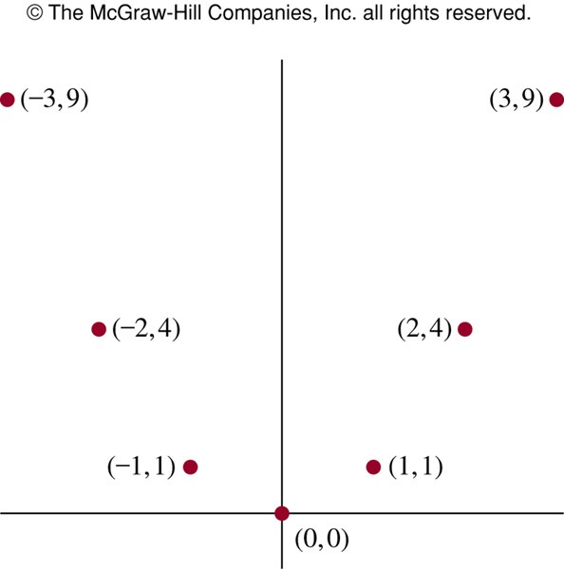
Graphs of Functions: Examples
The graph of f(n) = 2n + 1 from Z to Z
The graph of f(x) = x²
from Z to Z
11-<number>

Slide 4
Floor&Ceiling Functions
In discrete math, we frequently use the following two functions over real numbers:
The floor function ⎣・⎦ : R → Z, where ⎣x⎦(“floorof x”) means the largest integer ≤ x,
i.e., ⎣x⎦ = max( {i∈Z | i ≤ x} ).
E.g. ⎣2.3⎦ = 2, ⎣5⎦ = 5, ⎣–1.2⎦ = –2
The ceiling function ⎡・⎤ : R → Z, where
⎡x⎤(“ceiling of x”) means the smallest integer ≥ x,
i.e., ⎡x⎤ = min( {i∈Z | i ≥ x} )
E.g. ⎡2.3⎤ = 3, ⎡5⎤ = 5, ⎡–1.2⎤ = –

Slide 5

Visualizing Floor & Ceiling
 Real numbers “fall to their floor” or “rise to
their ceiling.”
3
2
1
0
-1
-2
-3
⎡1.6⎤= 2
.
 Note that if x∉Z,
⎣-x⎦ ≠ - ⎣x⎦ &
⎡-x⎤ ≠ - ⎡x⎤
1.6
.
⎡1.6⎤= 1
. ⎡-1.6⎤= -1
 Note that if x∈Z,
⎣x⎦ = ⎡x⎤ = x.
-1.6 .
.
-3 .
. .
⎣-1.6⎦= -2
⎡-3⎤ = ⎣-3⎦= -3
11-<number>

Slide 6

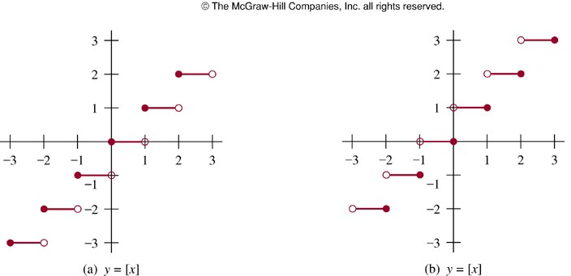
Plots with Floor/Ceiling:
Example
y=⎣x⎦
y = ⎡x⎤
11-<number>

Slide 7

Plots with Floor/Ceiling
 Note that for f(x) = ⎣⎣x⎦⎦, the graph of f includes the point (a, 0) for all values of a such that
0 ≤ a < 1, but not for the value a = 1.
 We say that the set of points (a, 0) that is in f
does not include its limit or boundary point (a,1).
 Sets that do not include all of their limit points are called open sets.
 In a plot, we draw a limit point of a curve using an open dot (circle) if the limit point is not on the curve, and with a closed (solid) dot if it is on the curve.
11-<number>

Slide 8


Plots with Floor/Ceiling: Another Example
 Plot of graph of function f(x) = ⎣⎣x/3⎦⎦:
f(x)
Set of points (x, f(x))
2
-6
-3
3
6
x
-2
11-<number>

Slide 9

2.4 Sequences and Summations
 Sequences are ordered lists of elements, represents solutions to certain counting problems.
A sequence is a discrete structure used to represent an ordered list.
A sequence is a function from a subset of the set of integers.
Notation an to denote the image of the integer n. an a term of the sequence.
 A summation is a compact notation for the sum of the terms in a (possibly infinite) sequence.
11-<number>

Slide 10
Sequences
 A sequence or series {a_{n}} is identified with a generating function f : I → S for some subset I⊆N and for some set S.
 Often we have I = N or I = Z⁺ = N - {0}.
 If f is a generating function for a sequence {a_{n}}, then for n∈I, the symbol a_{n} denotes f(n), also called term n of the sequence.
 The index of a_{n} is n. (Or, often i is used.)
 A sequence is sometimes denoted by listing its first and/or last few elements, and using ellipsis (…) notation.
 E.g., “{a_{n}} = 0, 1, 4, 9, 16, 25, …” is taken to mean
∀n∈N, a_{n} = n².
11-<number>

Slide 11

Sequence Examples
 Some authors write “the sequence a₁, a₂,…” instead of {a_{n}}, to ensure that the set of indices is clear.
 Be careful: Our book often leaves the indices ambiguous.
 An example of an infinite sequence:
 Consider the sequence {a_{n}} = a₁, a₂,…, where (∀n≥1) a_{n}= f(n) = 1/n.
 Then, we have {a_{n}} = 1, 1/2, 1/3,…
 Called “harmonic series”
11-<number>

Slide 12

Example with Repetitions
 Like tuples, but unlike sets, a sequence may contain repeated instances of an element.
 Consider the sequence {b_{n}} = b₀, b₁, … (note that 0 is an index) where b_{n} = (-1)^{n}.
 Thus, {b_{n}} = 1, -1, 1, -1, …
 Note repetitions!
 This {b_{n}} denotes an infinite sequence of 1’s and -1’s, not the 2-element set {1, -1}.
11-<number>

Slide 13

Geometric Progression
 A geometric progression is a sequence of the form
a, ar, ar², …, ar^{n},…
where the initial term a and the common ratio r
are real numbers.
 A geometric progression is a discrete analogue of the exponential function f(x) = ar^{x}
 Examples
 {b_{n}} with b_{n} = (–1)^{n}
 {c_{n}} with c_{n} = 2·5^{n}
 {d_{n}} with d_{n} = 6·(1/3)^{n}
Assuming n = 0, 1, 2,…
initial term 1, common ratio –1
initial term 2, common ratio 5 initial term 6, common ratio 1/3
11-<number>

Slide 14
Arithmetic Progression
 An arithmetic progression is a sequence of the form
a, a+d, a+2d, …, a+nd,…
where the initial term a and the common difference d are real numbers.
 An arithmetic progression is a discrete analogue of the linear function f(x) = a + dx
 Examples
Assuming n = 0, 1, 2,…
{s_{n}} with s_{n} = –1 +4n initial term –1, common diff. 4

 {t_{n}} with t_{n} = 7 – 3n
initial term 7, common diff. –3
11-<number>

Slide 15

Recognizing Sequences (I)
 Sometimes, you’re given the first few terms of a sequence,
 and you are asked to find the sequence’s generating function,
 or a procedure to enumerate the sequence.
 Examples: What’s the next number?
 1, 2, 3, 4,…
 1, 3, 5, 7, 9,…
 2, 3, 5, 7, 11,...
5 (the 5th smallest number > 0)
11 (the 6th smallest odd number > 0) 13 (the 6th smallest prime number)
11-<number>

Slide 16
Recognizing Sequences (II)
 General problems
 Given a sequence, find a formula or a general rule that produced it
 Examples: How can we produce the terms of a sequence if the first 10 terms are
 1, 2, 2, 3, 3, 3, 4, 4, 4, 4?
Possible match: next five terms would all be 5, the following six terms would all be 6, and so on.
 5, 11, 17, 23, 29, 35, 41, 47, 53, 59?
Possible match: nth term is 5 + 6(n – 1) = 6n – 1
(assuming n = 1, 2, 3,…)
11-<number>

Slide 17

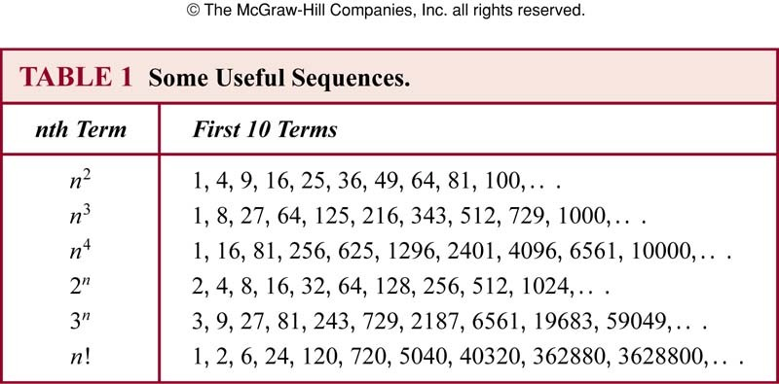
Special Integer Sequences
 A useful technique for finding a rule for generating the terms of a sequence is to compare the terms of a sequence of interest with the terms of a well-known integer sequences (e.g. arithmetic/geometric progressions, perfect squares, perfect cubes, etc.)
11-<number>

Slide 18

Coding: Fibbonaci Series
 Series {a_{n}} = {1, 1, 2, 3, 5, 8, 13, 21, …}
 Generating function (recursive definition!):
 a₀ = a₁ = 1 and

ªn ^{= a}n-1 ^{+ a}n-2
for all n > 1
 Now let's find the entire series {a_{n}}:
 int [] a[0] =
a[1] =
a = new int [n]; 1;
1;
for (int i = 2; i < n; i++) { a[i] = a[i-1] + a[i-2];
}
return a;
11-<number>

Slide 19
Coding: Factorial Series
 Factorial series {a_{n}} = {1, 2, 6, 24, 120, …}
 Generating function:
 a_{n} = n! = 1 x 2 x 3 x … x n
 This time, let's just find the term a_{n}:
 int an = 1;
for (int i = 1; i <= n; i++) { an = an * i;
}
return an;
11-<number>

