Slide 1



Lecture
Chapter 4. Induction and Recursion
4.3 Recursive Definitions and Structural Induction

Slide 2
Recursive Definitions
 In induction, we prove all members of an infinite set satisfy some predicate P by:
 proving the truth of the predicate for larger members in terms of that of smaller members.
 In recursive definitions, we similarly define a function, a predicate, a set, or a more complex structure over an infinite domain (universe of discourse) by:
 defining the function, predicate value, set membership, or structure of larger elements in terms of those of smaller ones.

Slide 3


Recursion
 Recursion is the general term for the practice of defining an object in terms of itself
 or of part of itself.
 This may seem circular, but it isn’t necessarily.
 An inductive proof establishes the truth of
P(k+1) recursively in terms of P(k).
 There are also recursive algorithms, definitions, functions, sequences, sets, and other structures.

Slide 4
Recursively Defined Functions
 Simplest case: One way to define a function
f:N→S (for any set S) or series a_{n}= f(n) is to:
 Define f(0)
 For n > 0, define f(n) in terms of f(0),…,f(n−1)
 Example: Define the series a_{n} = 2^{n} where n is a nonnegative integer recursively:
 a_{n} looks like 2⁰, 2¹, 2², 2³,…
 Let a₀ = 1
 For n > 0, let a_{n} = 2⋅a_{n–1}

Slide 5
Another Example
 Suppose we define f(n) for all n∈N recursively by:
 Let f(0) = 3
 For all n > 0, let f(n) = 2⋅f(n−1) + 3
 What are the values of the following?
 f(1) =
 f(2) =
 f(3) =
 f(4) =
2⋅f(0) + 3 = 2⋅3 + 3 = 9
2⋅f(1) + 3 = 2⋅9 + 3 = 21
2⋅f(2) + 3 = 2⋅21 + 3 = 45
2⋅f(3) + 3 = 2⋅45 + 3 = 93

Slide 6
Recursive Definition of
Factorial
 Give an inductive (recursive) definition of the factorial function,
F(n) = n! = ∏_{1≤i≤n} i = 1·2☹n
 Basis step: F(1) = 1
 Recursive step: F(n) = n·F(n−1) for n > 1
 F(2) = 2·F(1) = 2·1 = 2
 F(3) = 3·F(2) = 3·{2·F(1)} = 3·2·1 = 6
 F(4) = 4·F(3) = 4·{3·F(2)} = 4·{3·2·F(1)}
= 4·3·2·1 = 24

Slide 7
The Fibonacci Numbers
 The Fibonacci numbers f_{n≥0} is a famous series defined by:
f₀ = 0, f₁ = 1,
0
^{f}n≥2 ^{= f}n−1 ^{+ f}n−2
1
1
2
3
5
8
13

Slide 8
Inductive Proof about
Fibonacci Numbers
 Theorem: f_{n} < 2^{n}.
 Proof: By induction
Implicitly for all n∈N
Note: use of base cases of
recursive definition
 Basis step: f₀ = 0 < 2 = 1
0
f₁ = 1 < 2¹ = 2
 Inductive step: Use 2nd principle of induction (strong induction).
Assume ∀0 ≤ i ≤ k, f_{i} < 2^{i}. Then
f_{k+1} = f_{k} + f_{k−1} is
_{< 2}k ₊ ₂k−1
< 2^{k} + 2^{k} = 2^{k+1}. ■

Slide 9

A Lower Bound on Fibonacci
Numbers
 Theorem: For all integers n≥3, f_{n} > α^{n−2}, where α = (1 + 5^{1/2})/2 ≈ 1.61803.
 Proof. (Using strong induction.)
 Let P(n) = (f_{n} > α^{n−2}).
 Basis step:
For n = 3, note that α^{n−2} = α < 2 = f₃. For n = 4, α^{n−2} = α²
= (1 + 2·5^{1/2} + 5)/4
= (3 + 5^{1/2})/2
≈ 2.61803 (= α + 1)
< 3 = f₄.

Slide 10

A Lower Bound on Fibonacci
 Inductive step: For k≥4, assume P(j) for 3≤j≤k, prove P(k+1).
 f_{k+1} = f_{k} + f_{k−1} > α^{k−2} + α^{k−3} (by inductive hypothesis, f_{k−1} > α^{k−3} and f_{k} > α^{k−2}).
 Note that α² = α + 1.
since (3 + 5^{1/2})/2 = (1 + 5^{1/2})/2 + 1
 Thus, α^{k−1} = α²α^{k−3} = (α + 1)α^{k−3}
_{= αα}k−3 _{+ α}k−3 _{= α}k−2 _{+ α}k−3.
 So, f_{k+1} = f_{k} + f_{k−1} > α^{k−2} + α^{k−3} = α^{k−1}.
 Thus P(k+1). ■

Slide 11
Recursively Defined Sets
 An infinite set S may be defined recursively, by giving:
 A small finite set of base elements of S.
 A rule for constructing new elements of S
from previously-established elements.
 Implicitly, S has no other elements but
these.
base element (basis step)
construction rule (recursive step)
 Example: Let 3∈S, and let x+y∈S if x,y∈S. What is S?

Slide 12

Example cont.
 Let 3∈S, and let x+y∈S if x,y∈S. What is S?
 3 ∈ S (basis step)
 6 (= 3 + 3) is in S (first application of recursive step)
 9 (= 3 + 6) and 12 (= 6 + 6) are in S (second application of the recursive step)
 15 (= 3 + 12 or 6 + 9), 18 (= 6 + 12 or 9 + 9), 21
(= 9 + 12), 24 (= 12 + 12) are in S (third application of the recursive step)
 … so on
 Therefore,
S = {3, 6, 9, 12, 15, 18, 21, 24,…}
= set of all positive multiples of 3

Slide 13
The Set of All Strings
 Given an alphabet Σ, the set Σ* of all strings over Σ
can be recursively defined by:
 Basis step: λ ∈ Σ* (λ : empty string)
 Recursive step: (w∈Σ* ∧ x∈Σ) → wx∈Σ*
 Example: If Σ = {0, 1} then
 λ∈ Σ* (basis step)
 0 and 1 are in Σ* (first application of recursive step)
 00, 01, 10, and 11 are in Σ* (second application of the recursive step)
 … so on
 Therefore, Σ* consists of all finite strings of 0’s and 1’s together with the empty string

Slide 14
String: Example
 Show that if Σ = {a, b} then aab is in Σ*.
Proof: We construct it with a finite number of applications of the basis and recursive steps in the definition of Σ*:
λ∈Σ* by the basis step.
By step 1, the recursive step in the definition of Σ* and the fact that a∈Σ, we can conclude that λa = a∈Σ*.

Slide 15
Proof cont.
Since a∈Σ* from step 2, and a∈Σ, applying the recursive step again we conclude that aa∈Σ*.
Since aa∈Σ* from step 3 and b∈Σ, applying the recursive step again we conclude that aab∈Σ*.
 Since we have shown aab∈Σ* with a finite number of applications of the basis and recursive steps in the definition we have finished the proof.

Slide 16
Rooted Trees
 Trees will be covered in more depth in chapter 10.
 Briefly, a tree is a graph in which there is exactly one undirected path between each pair of nodes.
 An undirected graph can be represented as a set of unordered pairs (called arcs) of objects called nodes.
 Definition of the set of rooted trees:
 Basis step: Any single node r is a rooted tree.
 Recursive step: If T₁,…, T_{n} are disjoint rooted trees with respective roots r₁, …, r_{n}, and r is a node not in any of the T_{i}’s, then another rooted tree is {(r, r₁),…, (r, r_{n})} ∪ T₁ ∪ ☹ ∪ T_{n}.

Slide 17



Illustrating Rooted Tree
 How rooted trees can be combined to form a new rooted tree…
r
…
r₁
r₂
r_{n}
T₁
T₂
T_{n}

Slide 18
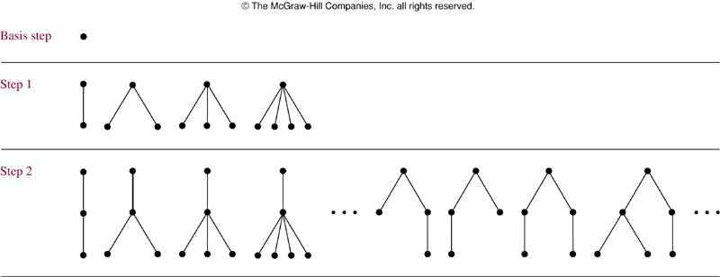
Building Up Rooted Trees
⋅⋅⋅

Slide 19
Extended Binary Trees
 A special case of rooted trees.
 Recursive definition of extended binary trees:
 Basis step: The empty set ∅ is an extended binary tree.
 Recursive step: If T₁, T₂ are disjoint extended binary trees, then e₁ ∪ e₂ ∪ T₁ ∪ T₂ is an extended binary tree, where e₁ = ∅ if T₁ = ∅, and e₁ = {(r, r₁)} if T₁ ≠ ∅ and has root r₁, and similarly for e₂. (T₁ is the left subtree and T₂ is the right subtree.)

Slide 20
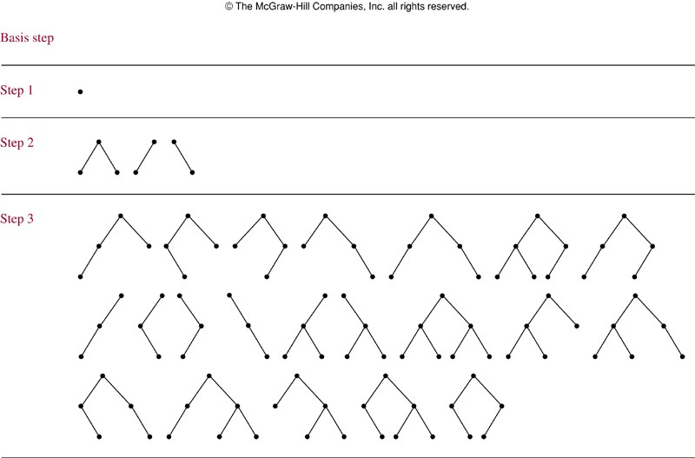
Building Up Extended BinaryTrees

Slide 21
Lamé’s Theorem
 Theorem: ∀a,b∈N, a≥b>0, and let n be the number of steps Euclid’s algorithm needs to compute gcd(a,b).
Then n ≤ 5k, where k = ⎣⎣log₁₀ b⎦⎦+1 is the number of decimal digits in b.
 Thus, Euclid’s algorithm is linear-time in the number of digits in b.
(or, Euclid’s algorithm is O(log a))
 Proof:
 Uses the Fibonacci sequence! (See next!)

Slide 22
Proof of Lamé’s Theorem
 Consider the sequence of division-algorithm equations used in Euclid’s alg.:
r₀ = r₁q₁ + r₂ r₁ = r₂q₂ + r₃
…
with 0 ≤ r₂ < r₁
with 0 ≤ r₃ < r₂
Where a = r₀, b = r₁, and gcd(a,b)=r_{n}.
^{r}n−2 ^{= r}n−1^{q}n−1 ^{+ r}n ^{r}n−1 ^{= r}n^{q}n ^{+ r}n+1
with 0 ≤ r_{n} < r_{n−1}
with r_{n+1} = 0 (terminate)
 The number of divisions (iterations) is n.
Continued on next slide…

Slide 23
Lamé Proof cont.
 Since r₀ ≥ r₁ > r₂ > … > r_{n}, each quotient q_{i} ≡ ⎣⎣r_{i−1}/r_{i}⎦⎦ ≥ 1.
 Since r_{n−1} = r_{n}q_{n} and r_{n−1} > r_{n}, q_{n} ≥ 2.
 So we have the following relations between r and f: r_{n} ≥ 1 = f₂
r_{n−1} ≥ 2r_{n} ≥ 2f₂ = f₃
r_{n−2} ≥ r_{n−1} + r_{n} ≥ f₂ + f₃ = f₄
…
r₂ ≥ r₃ + r₄ ≥ f_{n−1} + f_{n−2} = f_{n}
b = r₁ ≥ r₂ + r₃ ≥ f_{n} + f_{n−1} = f_{n+1}.
 Thus, if n > 2 divisions are used, then b ≥ f_{n+1} > α^{n−1}.
 Thus, log₁₀ b > log₁₀(α^{n−1}) = (n−1)log₁₀ α ≈ (n−1)0.208 > (n−1)/5.
 If b has k decimal digits, then log₁₀ b < k, so n−1 < 5k, so n ≤ 5k.

