Slide 1



Lecture
Chapter 4. Induction and Recursion
Recursive Definitions and Structural Induction
Recursive Algorithms

Slide 2


Review: Recursive Definitions
 Recursion is the general term for the practice of defining an object in terms of itself or of part of itself.
 In recursive definitions, we similarly define a function, a predicate, a set, or a more complex structure over an infinite domain (universe of discourse) by:
 defining the function, predicate value, set membership, or structure of larger elements in terms of those of smaller ones.

Slide 3

Full Binary Trees
 A special case of extended binary trees.
 Recursive definition of full binary trees:
 Basis step: A single node r is a full binary tree.
 Note this is different from the extended binary tree base case.
 Recursive step: If T₁, T₂ are disjoint full binary trees with roots r₁ and r₂, then
{(r, r₁), (r, r₂)} ∪ T₁ ∪ T₂ is an full binary tree.

Slide 4

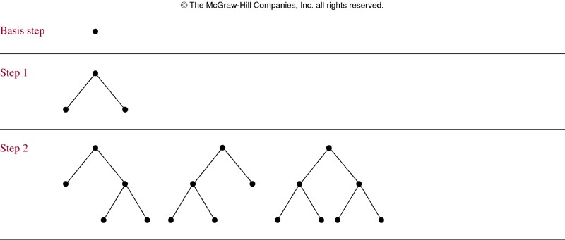
Building Up Full Binary Trees

Slide 5
Structural Induction
 Proving something about a recursively defined object using an inductive proof whose structure mirrors the object’s definition.
 Basis step: Show that the result holds for all elements in the set specified in the basis step of the recursive definition
 Recursive step: Show that if the statement is true for each of the elements in the new set constructed in the recursive step of the definition, the result holds for these new elements.

Slide 6
Structural Induction: Example
 Let 3∈S, and let x+y∈S if x,y∈S.
Show that S is the set of positive multiples of 3.
 Let A = {n∈Z⁺| (3|n)}. We’ll show that A = S.
 Proof: We show that A⊆S and S⊆A.
 To show A⊆S, show [n∈Z⁺ ∧ (3|n)] → n∈S.
 Inductive proof. Let n∈Z⁺ and P(n) = 3n∈S. Induction over positive multiples of 3.
Basis case: n = 1, thus 3∈S by definition of S.
Inductive step: Given P(k), prove P(k+1). By inductive hypothesis 3k∈S, and 3∈S, so by definition of S, 3(k + 1) = 3k + 3 ∈S.

Slide 7

Example cont.
 To show S⊆A: let n∈S, show n∈A.
 Structural inductive proof. Let P(n) = n∈A.
Two cases: n = 3 (basis case), which is in A, or n = x + y for x,y∈S (recursive step).
We know x and y are positive, since neither rule generates negative numbers.
So, x < n and y < n, and so we know x and y
are in A, by strong inductive hypothesis.
Since 3|x and 3|y, we have 3|(x+y), thus x + y = n ∈ A. ■

Slide 8

Recursive Algorithms
 Recursive definitions can be used to describe functions and sets as well as algorithms.
 A recursive procedure is a procedure that invokes itself.
 A recursive algorithm is an algorithm that contains a recursive procedure.
 An algorithm is called recursive if it solves a problem by reducing it to an instance of the same problem with smaller input.

Slide 9
Example
 A procedure to compute a^{n}.
procedure power(a≠0: real, n∈N)
if n = 0 then return 1
else return a·power(a, n−1)
subproblems of the same type
as the original problem
problem
divide-and-conquer technique

Slide 10

Recursive Euclid’s Algorithm
 gcd(a, b) = gcd((b mod a), a)
procedure gcd(a,b∈N with a < b )
if a = 0 then return b
else return gcd(b mod a, a)
 Note recursive algorithms are often simpler to code than iterative ones…
 However, they can consume more stack space
 if your compiler is not smart enough

Slide 11
Recursive Linear Search
{Finds x in series a at a location ≥i and ≤j
procedure search
(a: series; i, j: integer; x: item to find)
if a_{i} = x return i {At the right item? Return it!}
if i = j return 0 {No locations in range? Failure!}
return search(a, i +1, j, x) {Try rest of range}
 Note there is no real advantage to using recursion here over just looping
for loc := i to j…
recursion is slower because procedure call costs

Slide 12
Recursive Binary Search
{Find location of x in a, ≥i and ≤ j}
procedure binarySearch(a, x, i, j)
m := ⎣⎣(i + j)/2⎦⎦
if x = a_{m} return m
if x < a_{m} ∧ i < m
{Go to halfway point}
{Did we luck out?}
{If it’s to the left, check that ½}
return binarySearch(a, x, i, m−1)
else if x > a_{m} ∧ j > m {If it’s to right, check that ½}
return binarySearch(a, x, m+1, j)
else return 0 {No more items, failure.}

Slide 13
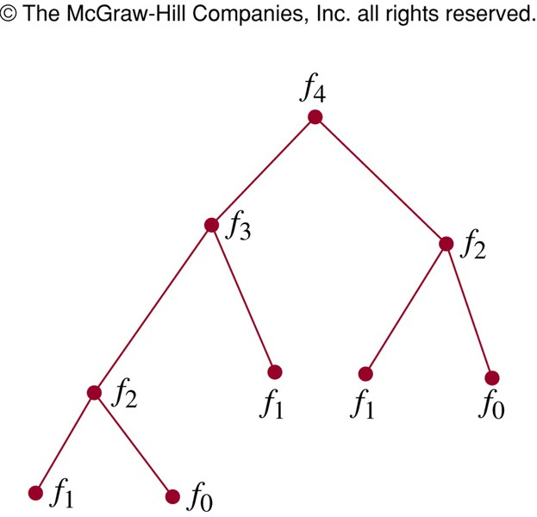
Recursive Fibonacci Algorithm
procedure fibonacci(n ∈ N) if n = 0 return 0
if n = 1 return 1
return fibonacci(n − 1) + fibonacci(n − 2)
 Is this an efficient algorithm?
 How many additions are performed?

Slide 14
Analysis of Fibonacci Procedure
 Theorem: The recursive procedure fibonacci(n) performs f_{n+1} − 1 additions.
 Proof: By strong structural induction over n, based on the procedure’s own recursive definition.
 Basis step:
 fibonacci(0) performs 0 additions, and f₀₊₁ − 1 = f₁ − 1 = 1 − 1 = 0.
 Likewise, fibonacci(1) performs 0 additions, and f₁₊₁ − 1 = f₂ − 1 = 1 − 1 = 0.

Slide 15
Analysis of Fibonacci Procedure
 Inductive step:
fibonacci(k+1) = fibonacci(k) + fibonacci(k−1)
by P(k):
f_{k+1} − 1 additions
by P(k −1):
f_{k} − 1 additions
 For k >1, by strong inductive hypothesis, fibonacci(k) and fibonacci(k−1) do f_{k+1} − 1 and f_{k} − 1 additions respectively.
 fibonacci(k+1) adds 1 more, for a total of (f_{k+1} − 1) + (f_{k} − 1) + 1 = f_{k+1} + f_{k} − 1
= f_{k+2} − 1. ■

Slide 16
Iterative Fibonacci Algorithm
procedure iterativeFib(n ∈ N) if n = 0 then
return 0
else begin
x := 0
y := 1
for i := 1 to n – 1 begin
z := x + y x := y
y := z
end
Requires only
n – 1 additions
end
return y {the nth Fibonacci number}

Slide 17

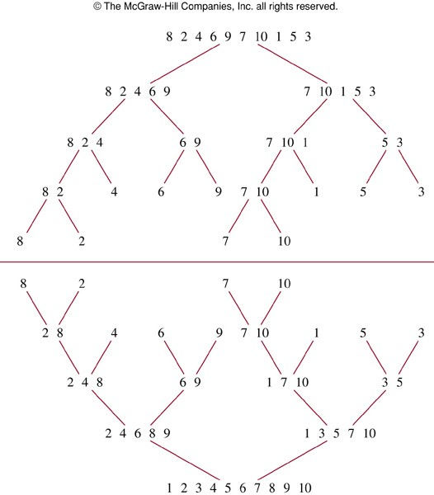
Recursive Merge Sort Example
Split
Merge

Slide 18
Recursive Merge Sort
procedure mergesort(L = ₁,…, _{n})
if n > 1 then
m := ⎣⎣n/2⎦⎦ {this is rough ½-way point}
L₁ := ₁,…, _{m}
L₂ := _{m+1},…, _{n}
L := merge(mergesort(L₁), mergesort(L₂))
return L
 The merge takes Θ(n) steps, and therefore the merge-sort takes Θ(n log n).

Slide 19
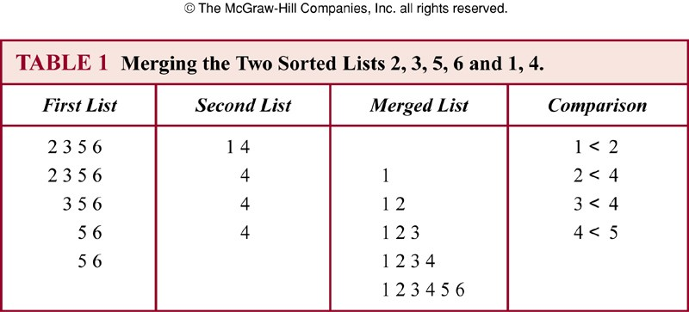
Merging Two Sorted Lists

Slide 20
Recursive Merge Method
{Given two sorted lists A = (a₁,…, a_{|A|}),
B = (b₁,…, b_{|B|}), returns a sorted list of all.}
procedure merge(A, B: sorted lists)
if A = empty return B if B = empty return A if a₁ < b₁ then
{If A is empty, it’s B.}
{If B is empty, it’s A.}
return (a₁, merge((a₂,…, a_{|A|}), B))
else
return (b₁, merge(A, (b₂,…, b_{|B|})))

Slide 21
Efficiency of Recursive Algorithm
 The time complexity of a recursive algorithm may depend critically on the number of recursive calls it makes.
 Example: Modular exponentiation to a power n can take log(n) time if done right, but linear time if done slightly differently.
 Task: Compute b^{n} mod m, where m≥2, n≥0, and 1≤b<m.

Slide 22

Modular Exponentiation #1
 Uses the fact that b^{n} = b·b^{n−1} and that x·y mod m = x·(y mod m) mod m. (Prove the latter theorem at home.)
{Returns b^{n} mod m.}
procedure mpower
(b, n, m: integers with m≥2, n≥0, and 1≤b<m)
if n=0 then return 1 else
return (b·mpower(b,n−1,m)) mod m
 Note this algorithm takes Θ(n) steps!

Slide 23

Modular Exponentiation #2
 Uses the fact that b^{2k} = b^{k·2} = (b^{k})².
 Then, b^{2k} mod m = (b^{k} mod m)² mod m.
procedure mpower(b,n,m) {same signature}
if n=0 then return 1
else if 2|n then
return mpower(b,n/2,m)² mod m
else return (b·mpower(b,n−1,m)) mod m
 What is its time complexity? Θ(log n) steps

Slide 24
A Slight Variation
 Nearly identical but takes Θ(n) time instead!
procedure mpower(b,n,m) {same signature}
if n=0 then return 1
else if 2|n then
return (mpower(b,n/2,m)·
mpower(b,n/2,m)) mod m
else return (mpower(b,n−1,m)·b) mod m
The number of recursive calls made is critical!

