Slide 1



Lecture
Chapter 4. Induction and Recursion
4.5 Program Correctness
Chapter 5. Counting
5.1 The Basics of Counting
13-<number>

Slide 2
Quiz
 Develop a recursive procedure for computing the minimum item in a list of integer numbers.
 Given is the recursive definition:
 f(0) = f(1) = 2
 f(n+1) = f(n) * f(n-1)
 Develop a recursive procedure for this definition
 What is your most time-efficient way to compute f(n)?
 What are the complexities of the recursive method and of yours?
13-<number>

Slide 3


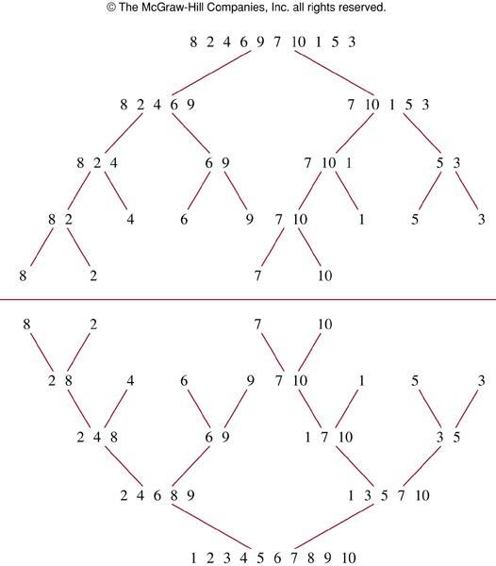
Recursive Merge Sort
Split
Merge
13-<number>

Slide 4
Recursive Merge Sort
procedure mergesort(L = ₁,…, _{n})
if n > 1 then
m := ⎣⎣n/2⎦⎦ {this is rough ½-way point}
L₁ := ₁,…, _{m}
L₂ := _{m+1},…, _{n}
L := merge(mergesort(L₁), mergesort(L₂))
return L
 The merge takes Θ(n) steps, and merge-sort takes Θ(n log n).
13-<number>

Slide 5
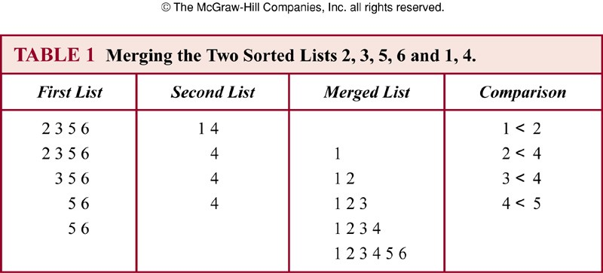
Merging Two Sorted Lists

Slide 6

Recursive Merge Method
procedure merge(A, B: sorted lists)
{Given two sorted lists A = (a₁,…, a_{|A|}),
B = (b₁,…, b_{|B|}), return a sorted list of all.}
if A = empty return B if B = empty return A if a₁ < b₁ then
{If A is empty, it’s B.}
{If B is empty, it’s A.}
L := (a₁, merge((a₂,…, a_{|A|}), B))
else
L := (b₁, merge(A, (b₂,…, b_{|B|})))
return L
13-<number>

Slide 7

Merge Routine
procedure merge(A, B: sorted lists)
L = empty list
i:=0, j:=0, k:=0
while i < |A| ∧ j < |B| {|A| is length of A}
if i=|A| then L_{k} := B_{j}; j := j + 1
else if j=|B| then L_{k} := A_{i}; i := i + 1 else if A_{i} < B_{j} then L_{k} := A_{i}; i := i + 1 else L_{k} := B_{j}; j := j + 1
k := k+1
Takes Θ(|A|+|B|) time
return L
13-<number>

Slide 8
Program Correctness
 We want to be able to prove that a given program meets the intended specifications.
 This can often be done manually, or even by
automated program verification tools.
 A program is correct if it produces the correct output for every possible input.
 A program is partially correct if it produces the correct output for every input for which the program eventually halts.
13-<number>

Slide 9

Initial & Final Assertions
 A program’s I/O specification can be given using initial
and final assertions.
 The initial assertion p is the condition that the program’s input (its initial state) is guaranteed to satisfy (by its user).
 The final assertion q is the condition that the output produced by the program (in its final state) is required to satisfy.
 Hoare triple notation:
 The notation p{S}q means that, for all inputs I such that p(I) is true, if program S (given input I) halts and produces output O = S(I), then q(O) is true.
 That is, S is partially correct with respect to specification p, q.
13-<number>

Slide 10
A Trivial Example
 Let S be the program fragment “y := 2; z := x + y”
 Let p be the initial assertion “x = 1”.
 The variable x will hold 1 in all initial states.
 Let q be the final assertion “z = 3”.
 The variable z must hold 3 in all final states.
 Prove p{S}q.
 Proof: If x = 1 in the program’s input state, then after running y := 2 and z := x + y,
z will be 1 + 2 = 3.
13-<number>

Slide 11
Hoare Triple Inference Rules
 Deduction rules for Hoare Triple statements.
 A simple example: the composition rule: p{S₁}q
q{S₂}r
∴ p{S₁; S₂}r
 It says: If program S₁ given condition p produces condition q, and S₂ given q produces r, then the program “S₁ followed by S₂”, if given p, yields r.
13-<number>

Slide 12

Inference Rule for if Statements
 Program segment that is the conditional statement
if condition then
S
 Rule of inference
(p ∧ condition){S}q
(p ∧ ¬condition) → q
∴ p{if condition then S}q
Initial assertion
Final assertion
 Example: Show that T {if x > y then y := x} y ≥ x.
 Proof: When the initial assertion is true and if x > y, then the if body is executed, which sets y = x,
and so afterwards y ≥ x is true.
Otherwise, x ≤ y and so y ≥ x. In either case y ≥ x is true. So the fragment meets the specification.
13-<number>

Slide 13

if-then-else Rule
 Program segment that is the conditional statement if condition then
S₁
else
S₂
 Rule of inference
(p ∧ condition){S₁}q
(p ∧ ¬condition){S₂}q
∴ p{if condition then S₁ else S₂}q
 Example: Show that
T {if x < 0 then abs := −x else abs := x} abs = |x|
 If x < 0 then after the if body, abs = -x = |x|.
If ¬(x < 0), i.e., x ≥ 0, then after the else body, abs = x = |x|. So the rule applies and the program segment is correct.
13-<number>

Slide 14
Loop Invariants
 For a while loop “while condition S”, we say that
p is a loop invariant of this loop if (p ∧ condition){S}p.
 If p (and the continuation condition condition) is true before executing the body, then p remains true afterwards.
 And so p stays true through all subsequent iterations.
 This leads to the inference rule: (p ∧ condition){S}p
p is a loop invariant
∴ p{while condition S}(¬condition ∧ p)
13-<number>

Slide 15
Loop Invariant Example
i := 1
fact := 1
while i < n
i := i + 1;
fact := fact ⋅ i
end while
S
 Prove that the following Hoare triple holds when n is a
positive integer: T {S} (fact = n!)
 Proof. Note that p: “fact = i! ∧ i ≤ n” is a loop invariant, and is true before the loop. Thus, after the loop we have (¬condition ∧ p) ⇔ ¬(i < n) ∧ (fact = i! ∧ i ≤ n) ⇔ i = n ∧ fact = i! ⇔ fact = n!. ■
13-<number>

Slide 16
Big Example
 S = S₁; S₂; S₃; S₄ (compute the product of two integers m, n)
p
m, n∈Z
q p ∧ (a = |n|)
^{r} q ∧ (k = 0) ∧ (x = 0)
procedure multiply(m, n: integers)
if n < 0 then a := −n else a := n
k := 0; x := 0
S₁
S₂
Loop invariant
x = mk ∧ k ≤ a
while k < a {
x = x + m; k = k + 1
}
Maintains loop invariant:
x = mk ∧ k ≤ a x = mk ∧ k = a ∴ x = ma = m|n|
S₃
s
∴ (n < 0 ∧ x = −mn) ∨ (n ≥ 0 ∧ x = mn)
S₄
if n < 0 then prod := −x else prod :=x prod = mn t
13-<number>

Slide 17
Chapter 5: Counting
 Combinatorics
 The study of the number of ways to put things together into various combinations.
 E.g. In a contest entered by 100 people,
 how many different top-10 outcomes could occur?
 E.g. If a password is 6~8 letters and/or digits,
 how many passwords can there be?
13-<number>

Slide 18
Sum and Product Rules
 Let m be the number of ways to do task 1 and n the number of ways to do task 2,
 with each number independent of how the other task is done,
 and also assume that no way to do task 1 simultaneously also accomplishes task 2.
 Then, we have the following rules:
 The sum rule: The task “do either task 1 or task 2, but not both” can be done in m + n ways.
 The product rule: The task “do both task 1 and task 2” can be done in mn ways.
13-<number>

Slide 19
The Sum Rule
 If a task can be done in one of n₁ ways, or in one of n₂ ways, …, or in one of n_{m} ways, where none of the set of n_{i} ways of doing the task is the same as any of the set of n_{j} ways, for all pairs i and j with 1 ≤ i < j ≤ m.
 Then the number of ways to do the task is
n₁ + n₂ + ☹ + n_{m}.
13-<number>

Slide 20
The Sum Rule: Example 1
 A student can choose a computer project from one of three lists A, B, and C:
 List A: 23 possible projects
 List B: 15 possible projects
 List C: 19 possible projects
 No project is on more than one list
 How many possible projects are there to choose from?
23 + 15 + 19 = 57
13-<number>

Slide 21
The Sum Rule: Example 2
 What is the value of k after the following code has been executed?
k := 0
for i₁ := 1 to n₁ k := k + 1
for i₂ := 1 to n₂ k := k + 1
…
for i_{m} := 1 to n_{m} k := k + 1
n₁ + n₂ + ··· + n_{m}
13-<number>

Slide 22
The Product Rule
 Suppose that a procedure can be broken down into a sequence of m successive tasks.
If the task T₁ can be done in n₁ ways;
the task T₂ can then be done in n₂ ways; ...; and the task T_{m} can be done in n_{m} ways, then there are n₁·n₂···n_{m} ways to do the procedure.
13-<number>

Slide 23
The Product Rule: Example
 Show that a set {x₁,…, x_{n}} containing n elements has 2^{n} subsets.
 A subset can be constructed in
n successive steps:
 Pick or do not pick x₁, pick or do not pick
x₂, …, pick or do not pick x_{n} .
 Each step can be done in two ways.
 Thus the number of possible subsets is 2·2···2 = 2^{n}.
n factors
13-<number>

