Slide 1



Lecture
Chapter 5. Counting
The Basics of Counting
The Pigeonhole Principle
Permutations and Combinations

Slide 2


Review
 Sum Rule: If a task can be done in one of n₁ ways, or in one of n₂ ways, …, or in one of n_{m} ways, where none of the set of n_{i} ways of doing the task is the same as any of the set of n_{j} ways, for all pairs i and j with 1 ≤ i < j ≤ m. Then the number of ways to do the task is n₁ + n₂ + ☹ + n_{m}.
 Product Rule: Suppose that a procedure can be broken down into a sequence of m successive tasks. If the task T₁ can be done in n₁ ways; the task T₂ can then be done in n₂ ways; ...; and the task T_{m} can be done in n_{m} ways, then there are n₁·n₂···n_{m} ways to do the procedure.

Slide 3
The Product Rule: Example
 Show that a set {x₁,…, x_{n}} containing n
elements has 2^{n} subsets.
 A subset can be constructed in n successive steps:
 Pick or do not pick x₁, pick or do not pick
x₂, …, pick or do not pick x_{n} .
 Each step can be done in two ways.
 Thus the number of possible subsets is 2·2···2 = 2^{n}.
n factors

Slide 4
The Product Rule: Example
 What is the value of k after the following code has been executed?
k := 0
for i₁ := 1 to n₁
for i₂ := 1 to n₂
…
for i_{m} := 1 to n_{m} k := k + 1
n₁·n₂···n_{m}

Slide 5
The Product Rule: Example
 How many functions are there from a set with m
elements to one with n elements?
_{n}m
 How many one-to-one functions are there from a set with m elements to one with n elements?
n·(n – 1)(n – 2) ··· (n – m + 1)
 More examples in the textbook

Slide 6
IP Address Example
 In version 4 of the Internet Protocol (IPv4)
 Internet address is a string of 32 bits
 Network number (netid) + host number (hostid)
 Valid computer addresses are in one of 3 types:
 A class A IP address consists of 0, followed by a 7-bit “netid” ≠ 1⁷, and a 24-bit “hostid”
 A class B address has 10, followed by a 14-bit netid and a 16-bit hostid.
 A class C address has 110, followed by a 21- bit netid and an 8-bit hostid.
 The 3 classes have distinct headers (0, 10, 110)
 Hostids that are all 0s or all 1s are not allowed.
128.171.224.100

Slide 7
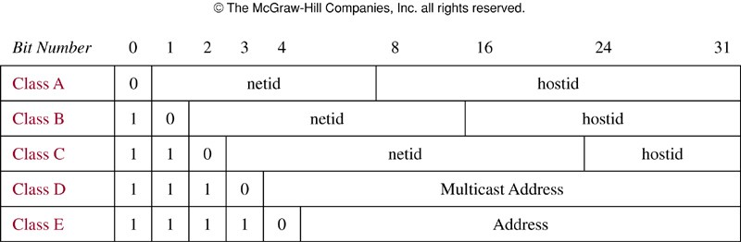
IP Address Example
 How many valid computer addresses are there?

Slide 8
IP Address Solution
 # of addresses
= (# class A) + (# class B) + (# class C)
(by sum rule)
 # class A = (# valid netids)×(# valid hostids) (by product rule)
 # valid class A netids = 2⁷ − 1 = 127.
 # valid class A hostids = 2²⁴ − 2 = 16,777,214.
 Continuing in this fashion we find the answer is: 3,737,091,842 (3.7 billion IP addresses)

Slide 9
Set Theoretic Version
 If A is the set of ways to do task 1, and B the set of ways to do task 2, and if A and B are disjoint, then:
 The ways to do either task 1 or 2 are A ∪ B, and |A ∪ B| = |A| + |B|
 The ways to do both task 1 and 2 can be represented as A × B, and |A × B| = |A|·|B|

Slide 10
Inclusion-Exclusion Principle
 Suppose that k out of m ways of doing task 1 also simultaneously accomplish task 2.
 And there are also n ways of doing task 2.
 Then, the number of ways to accomplish “Do either task 1 or task 2” is m + n - k.
 Set theory: If A and B are not disjoint, then
|A ∪ B| = |A| + |B| - |A ∩ B|.
 If they are disjoint, this simplifies to |A| + |B|.

Slide 11
Inclusion-Exclusion Example
 Some hypothetical rules for passwords:
 Passwords must be 2 characters long
 Each character must be a letter a ~ z, a digit 0 ~ 9, or one of the 10 punctuation characters ! @ # $ % ^ & * ( )
 Each password must contain at least one
digit or punctuation character

Slide 12
Setup of Problem
 A legal password has a digit or punctuation character in position 1 or position 2.
 These cases overlap, so the principle applies.
 # of passwords with OK symbol in position #1
= (10 + 10) × (10 + 10 + 26) = 20 × 46 = 920
 # with OK symbol in pos. #2 = 46 × 20 = 920
 # with OK symbol both places = 20 × 20 = 400
 Answer: 920 + 920 − 400 = 1,440

Slide 13
Tree Diagrams
 A tree diagram can be used in many different counting problems.
 To use trees in counting, we use a branch to represent each possible choice.
 We represent the possible outcomes by the leaves, which are the endpoints of branches not having other branches starting at them.

Slide 14
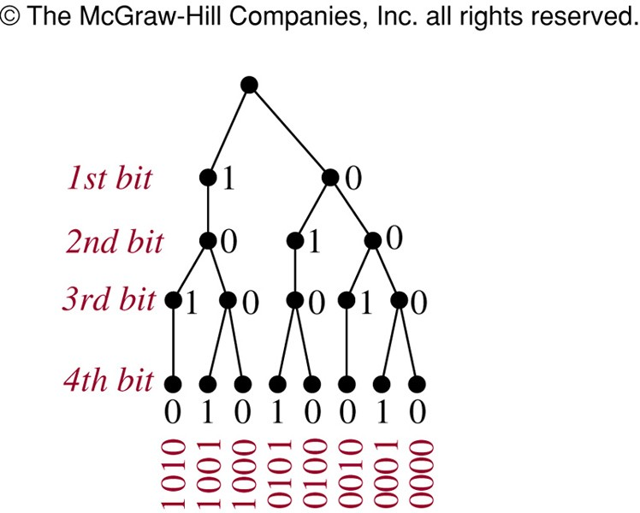
Tree Diagrams: Example
How many bit strings of length four do not have two consecutive 1s?

Slide 15
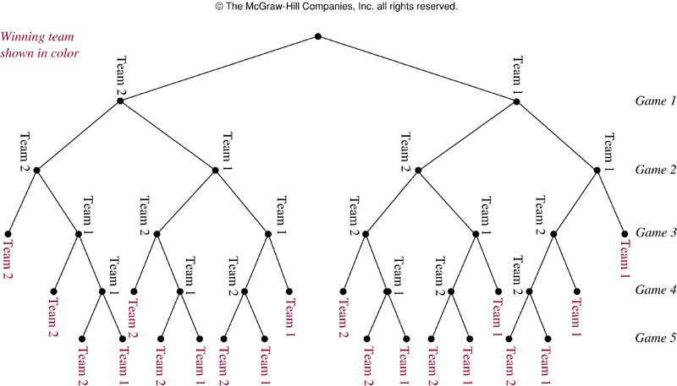
Tree Diagrams: Example
 A playoff between two teams consists of at most five games. The first team that wins three games wins the playoff. In how many different ways can the playoff occur?

Slide 16

The Pigeonhole Principle
 A.k.a. the “Dirichlet drawer principle” or the “Shoe Box Principle”.
 If k + 1 or more objects are assigned to k places, then at least 1 place must be assigned 2 or more objects.
 In terms of the assignment function:
 If f: A → B and |A| ≥ |B| + 1, then some element of B has more than two preimages under f.
 I.e., f is not one-to-one.

Slide 17
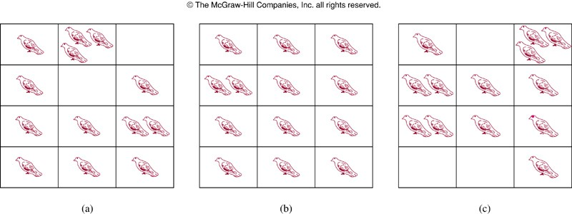
The Pigeonhole Principle
 Proof by contradiction:
 If the conclusion is false, each pigeonhole contains at most one pigeon and in this time, we can account for at most k pigeons.
 Since there are k + 1 pigeons, we have a contradiction.

Slide 18
Pigeonhole Principle: Example
 There are 101 possible numeric grades
(0% ~ 100%) rounded to the nearest integer.
 Also, there are >101 students in a class.
 Therefore, there must be at least one (rounded) grade that will be shared by at least 2 students at the end of the semester.
 i.e., the function from students to rounded grades is not a one-to-one function.

Slide 19
Another Example of P.P.
 10 persons have first names as Alice, Bernare, and Charles, and last names as Lee, McDuff, and Ng. Show that at least two persons have the same first and last names.
 Solution:
 9 possible names for the 10 persons → 10 pigeons and 9 pigeonholes.
 Assignment of names to people = assignment of pigeonholes to the pigeons
 By the Pigeonhole Principle, some name (pigeonhole) is assigned to at least two persons (pigeons).

Slide 20
Generalized Pigeonhole
Principle
 If N objects are assigned to k places, then at least one place must be assigned at least
⎡⎡N/k⎤⎤ objects.
 E.g., there are N = 280 students in a class.
There are k = 52 weeks in the year.
 Therefore, there must be at least 1 week during which at least ⎡⎡280/52⎤⎤ = ⎡⎡5.38⎤⎤ = 6 students in the class have a birthday.

Slide 21
Proof of G.P.P.
 By contradiction.
Suppose every place has < ⎡⎡N/k⎤⎤ objects, thus ≤ ⎡⎡N/k⎤⎤ − 1.
 Then the total number of objects is at most
_{k}⎛⎛ ⎡⎡ N ⎤⎤
⎞⎞ ⎛⎛⎛⎛ N
⎞⎞
⎞⎞ ⎛⎛ N ⎞⎞
⎜⎜ _{⎢⎢ k ⎥⎥} −1⎟⎟ < k⎜⎜⎜⎜ _{k}
+1⎟⎟ −1⎟⎟ = k⎜⎜ _{k} ⎟⎟ = N
⎝⎝ ⎢⎢ ⎥⎥
⎝⎝⎝⎝ ⎠⎠ ⎝⎝ ⎠⎠
⎠⎠ ⎠⎠
 So, there are less than N objects, which contradicts our assumption of N objects! ■

Slide 22
G.P.P. Example I
 Given: There are 280 students in a class.
 Without knowing anybody’s birthday, what is the largest value of n for which we can prove using the G.P.P. that at least n students must have been born in the same month?
 Answer:
⎡⎡280/12⎤⎤ = ⎡⎡23.3⎤⎤ = 24

Slide 23
G.P.P. Example II
 What is the least number of area codes needed to guarantee that the 25 million phones in a state can be assigned distinct 10-digit telephone numbers?
 Phone #: NXX-NXX-XXXX
 N: 2 ~ 9 and X: any digit
 Solution
 NXX-XXXX: (8·10·10) ·(10·10·10·10) = 8 million
 By G.P.P. at least ⎡⎡25,000,000/8,000,000⎤⎤ = 4 phones have the identical numbers
 Hence, at least 4 area codes are required

Slide 24
Fun Pigeonhole Proof
 Example 4: ∀n∈N, ∃ a multiple m > 0 of n such that m has only 0’s and 1’s in its decimal expansion!
 Proof: Consider the n+1 decimal integers 1, 11, 111, …, 1☹1. They have only n possible
remainders mod n.
n+1
So, take the difference of two that have the same remainder. The result is the answer! □

Slide 25
A Specific Case
 Let n=3. Consider 1, 11, 111, 1111.
 1 mod 3 = 1
Note same residue
 11 mod 3 = 2
 111 mod 3 = 0 ⬅⬅ Lucky extra solution.
 1,111 mod 3 = 1
 1,111 − 1 = 1,110 = 3·370.
 It has only 0’s and 1’s in its expansion.
 Its remainder mod 3 = 0, so it’s a multiple of 3.

Slide 26
Baseball Example
 Suppose that next June, the Marlins baseball team plays at least 1 game a day, but ≤ 45 games total. Show there must be some sequence of consecutive days in June during which they play exactly 14 games.
 Proof: Let a_{j} be the number of games played on or before day j. Then, a₁,…,a₃₀ ∈ Z⁺ is a sequence of 30 distinct integers with 1 ≤ a_{j} ≤ 45.
Therefore a₁+14,…,a₃₀+14 is a sequence of 30 distinct integers with 15 ≤ a_{j}+14 ≤ 59.
Thus, (a₁,…,a₃₀,a₁+14,…,a₃₀+14) is a sequence of 60 integers from the set {1,..,59}.
By the Pigeonhole Principle, two of them must be equal, but a_{i}≠a_{j} for i≠j. So, ∃ij: a_{i} = a_{j}+14.
Thus, 14 games were played on days a_{j}+1, …, a_{i}.

Slide 27

Baseball Problem Illustrated
 Example of {a_{i}}: Note all elements are distinct.
 1, 2, 4, 5, 7, 8, 10, 11, 13, 14,
16, 17, 19, 21, 22, 23, 25, 27, 29, 30,
31, 33, 34, 36, 37, 39, 40, 41, 43, 45
 Then {a_{i}+14} is the following sequence: 15, 16, 18, 19, 21, 22, 24, 25, 27, 28,
30, 32, 33, 35, 36, 37, 39, 41, 43, 44,
45, 47, 48, 50, 51, 53, 54, 55, 57, 59
Thus, for example, exactly 14 games were played during days
3 to 11:
2+1+2+1+2+1+2
+1+2
 In any 60 integers from 1-59 there must be some duplicates, indeed we find the following ones:
 16, 19, 21, 22, 25, 27, 30, 33, 36, 37, 39, 41, 43, 45

