Slide 1



Lecture
Chapter 5. Counting
  Permutations and Combinations
  Binomial Coefficients
  Generalized Permutations and Combinations
13-<number>

Slide 2


Permutations
 A permutation of a set S of distinct elements is an ordered sequence that contains each element in S exactly once.
 E.g. {A, B, C} → six permutations:
ABC, ACB, BAC, BCA, CAB, CBA
 An ordered arrangement of r distinct elements of
S is called an r-permutation of S.
 The number of r-permutations of a set with n = |S| elements is
n! (n − r)!
P(n, r) = n(n −1)(n − 2)☹(n − r +1) =
, 0 ≤ r ≤ n .
 P(n,n) = n!/(n – n)! = n!/0! = n! (Note: 0! = 1)
13-<number>

Slide 3

Permutation Examples
 Example: Let S = {1, 2, 3}.
 The arrangement 3, 1, 2 is a permutation of S (3! = 6 ways)
 The arrangement 3, 2 is a 2-permutation of S (3·2=3!/1! = 6 ways)
 Example: There is an armed nuclear bomb planted in your city, and it is your job to disable it by cutting wires to the trigger device. There are 10 wires to the device. If you cut exactly the right three wires, in exactly the right order, you will disable the bomb, otherwise it will explode! If the wires all look the same, what are your chances of survival?
P(10,3) = 10×9×8 = 720,
so there is a 1 in 720 chance that you’ll survive!
13-<number>

Slide 4

More Permutation Examples
 Example 6: Suppose that a sales woman has to visit eight different cities. She must begin her trip in a specified city, but she can visit the other seven cities in any order she wishes. How many possible orders can the saleswoman use when visiting these cities?
First city is determined, and the remaining seven can be ordered arbitrarily: 7! = 7·6·5·4·3·2·1 = 5040
 Example 7: How many permutations of the letters ABCDEFGH contain the string ABC?
ABC must occur as a block, i.e. consider it as one object Then, it’ll be the number of permutations of six objects (ABC, D, E, F, G, H), which is 6! = 720
13-<number>

Slide 5
Another Example
 How many ways are there to pick a set of 3 people from a group of 6?
 There are 6 choices for the first person, 5 for the second one, and 4 for the third one, so there are 6⋅5⋅4 = 120 ways to do this.
 This is not the correct result!
 For example, picking person C, then person A, and then person E leads to the same group as first picking E, then C, and then A.
 However, these cases are counted separately in the above equation.
 So how can we compute how many different subsets of people can be picked (that is, we want to disregard the order of picking)?
13-<number>

Slide 6

Combinations
 How many different committees of three students can be formed from a group of four students?
An r-combination of elements of a set S is an unordered selection of r elements from the set. Thus, an r-combination is simply a subset T⊆S with r members, |T| = r.
 Example: S = {1, 2, 3, 4}, then {1, 3, 4} is a 3-combination from S
 Example: How many distinct 7-card hands can be drawn from a standard 52-card deck?
 The order of cards in a hand doesn’t matter.
13-<number>

Slide 7
Calculate C(n, r)
 Consider that we can obtain the r-permutation of a set in the following way:
 First, we form all the r-combinations of the set (there are C(n, r) such r-combinations)
 Then, we generate all possible orderings in each of these r-combinations (there are P(r, r) such orderings in each case).
 Therefore, we have:
P(n, r) = C(n, r) ⋅ P(r, r)
_{C(n, r) =} P(n, r) ₌ n(n −1)☹(n − r +1)
P(r, r) r!
n! 1 n!
⁼ (n − r)!⋅ r! ⁼ r!(n − r)!
13-<number>

Slide 8
Combinations
 The number of r-combinations of a set with
n = |S| elements is
_{C(n, r) =} ⎛⎛ n⎞⎞ ₌ P(n, r) ₌ n!/(n − r)! ₌ n!
r!(n − r)!
⎜⎜ _{r} ⎟⎟
⎝⎝ ⎠⎠
P(r, r) r!
 Note that C(n, r) = C(n, n − r)
 Because choosing the r members of T is the same thing as choosing the (n − r) non- members of T.
n
⎞⎞
=
n!
(n − r)![n − (n − r)]! ⁼
n!
(n − r)!r!
C(n, n − r) = ⎛⎛
⎜⎜ n − r ⎟⎟
⎝⎝
⎠⎠
13-<number>

Slide 9
Combination Example I
 How many distinct 7-card hands can be drawn from a standard 52-card deck?
 The order of cards in a hand doesn’t matter.
 Answer:
C(52, 7) = P(52, 7) / P(7, 7) = 52! / (7!·45!)
= (52·51·50·49·48·47·46) / (7·6·5·4·3·2·1)
17 10
7 8
2
52·17·10·7·47·46 = 133,784,560
13-<number>

Slide 10
Combination Example II
 C(4, 3) = 4, since, for example, the 3-combinations of a set {1, 2, 3, 4} are {1, 2, 3}, {1, 3, 4}, {2, 3, 4}, {1, 2, 4}.
 C(4, 3) = P(4, 3) / P(3, 3) = 4! / (3! × 1!)
= (4 × 3 × 2) / (3 × 2 × 1) = 4
 How many ways are there to pick a set of 3 people from a group of 6 (disregarding the order of picking)?
 C(6, 3) = 6! / (3! × 3!)
= (6 × 5 × 4) / (3 × 2 × 1) = 20
 There are 20 different groups to be picked
13-<number>

Slide 11

Combination Example III
 A soccer club has 8 female and 7 male members.
For today’s match, the coach wants to have 6 female and 5 male players on the grass.
How many possible configurations are there?
 C(8, 6) × C(7, 5)
= {P(8, 6) / P(6, 6)} × {P(7, 5) / P(5, 5)}
= {8!/ (2! × 6!)} × {7!/ (2! × 5!)}
= {(8 × 7) / 2!} × {(7 × 6) / 2!}
= 28 × 21
= 588
13-<number>

Slide 12
Binomial Coefficients
 Expressions of the form C(n, r) are also called
binomial coefficients
 Coefficients of the expansion of powers of binomial expressions
 Binomial expression is a simply the sum of two terms such as x + y
 Example:
(x + y)³ = (x + y)(x + y)(x + y)
= (xx + xy + yx + yy)(x + y)
= xxx + xxy + xyx + xyy + yxx + yxy + yyx + yyy
= C(3,0)x³ + C(3,1)x² y + C(3,2)xy² + C(3,3) y³
= x³ + 3x² y + 3xy² + y³
13-<number>

Slide 13
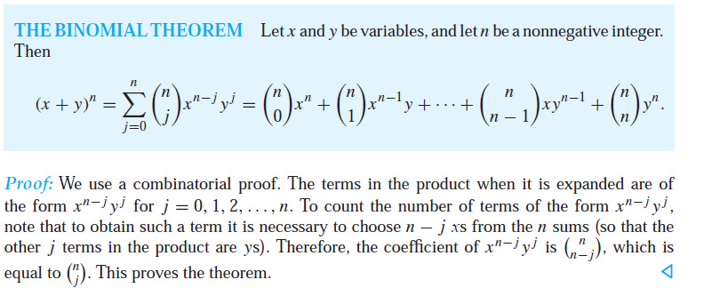
The Binomial Theorem

Slide 14
Examples
 (a + b)⁹ → the coefficient of a⁵b⁴ = C(9, 4)
 The coefficient of x¹²y¹³ in the expansion of (2x – 3y)²⁵
 By binomial theorem
25
( 3y))
25
∑
⎛⎛
25
⎞⎞ 25− j j
2x + (− =
⎜⎜ _{j} ⎟⎟
(2x) (−3y)
⎠⎠
j=0 ⎝⎝
 The coefficient of x¹²y¹³ is obtained when j = 13
25!
₂12₃13
C(25,13) ⋅ 2¹² ⋅ (−3)¹³ = −
13!⋅12!
 (x + y + z)⁹ → the coefficient of x²y³z⁴ = C(9, 2)·C(7, 3).C(9,4).
13-15

Slide 15
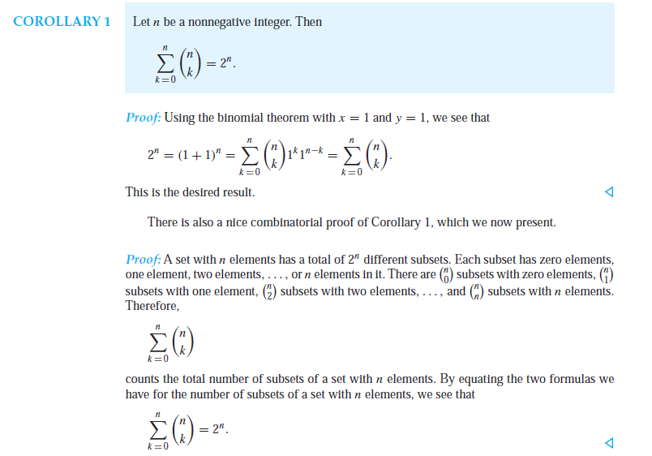
COROLLARY 1

Slide 16
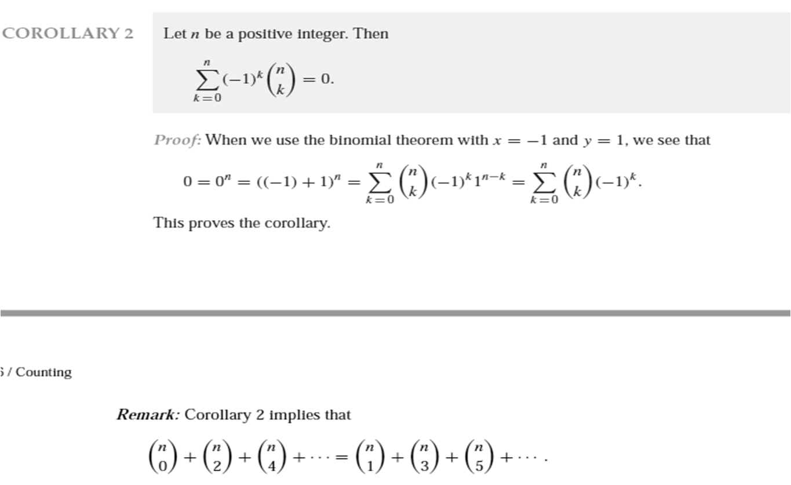
COROLLARY 2

Slide 17
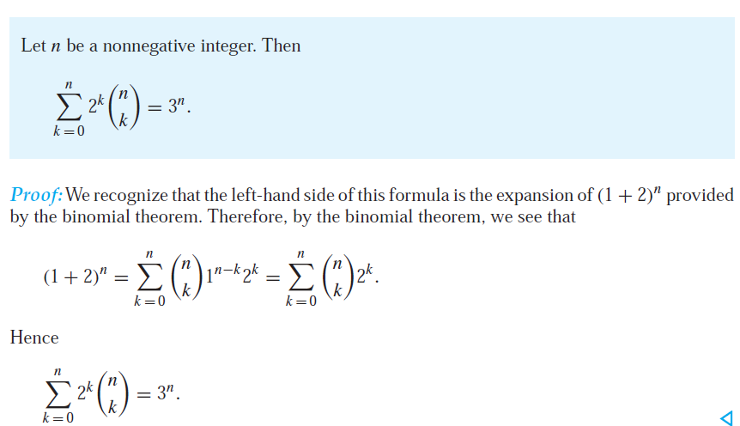
COROLLARY 3

Slide 18

Generalized Permutations
Combinations
 Permutations and combinations allowing repetitions.
 How many strings of length r can be formed from the English alphabet?
 How many different ways are possible when we select a dozen donuts from a box that contains four different kinds of donuts?
 Permutations where not all objects are distinguishable.
 The number of ways we can rearrange the letters of the word MISSISSIPPI
13-<number>

Slide 19
Permutations with Repetitions
 Theorem 1: The number of r-permutations of n objects with repetition allowed is n^{r}.
 Proof: There are n ways to select an element of the set for each of r positions with repetition allowed. By the product rule, the answer is given as r multiples of n.
 Example: How many strings of length r can be formed from the English alphabet?
 Answer: 26^{r}
13-<number>

Slide 20
Combinations with Repetitio ns
 An example
 How many ways are there to select four pieces of fruit from a bowl containing apples, oranges, and pears if there are at least four pieces of each type of fruit in the bowl?
 In this case, the order in which the pieces are selected does not matter, only the types of fruit, not the individual piece, matter.
13-<number>

Slide 21
Combinations with Repetitio ns
 Example Rephrased: The number of 4-combinations with repetition allowed from a 3-element set {apple, orange, pear}
 All four in same type: 4 apples, 4 oranges, 4 pears [3 ways]
 Three in same type: two cases for each of 3 apples, 3 oranges, 3 pears [2*3=6 ways]
 Two diff. pairs with each pair in same type [3 ways]
 Only one pair in same type [3 ways]
 Total 15 ways
 Can be generalized:
 The number of ways to fill 4 slots from 3 categories with repetition allowed
13-<number>

Slide 22
Combinations with Repetitio ns
4 apples
3 apples, 1 orange
3 oranges, 1 pear
2 apples, 2 oranges
2 apples, 1 orange, 1 pear
4 oranges
3 apples, 1 pear
3pears, 1 apple
2 apples, 2 pears
2 oranges, 1apple, 1 pear
4 pears
3 oranges, 1 apple
3 pears, 1 orange
2 pears, 2 oranges
1apple, 1 orange, 2 pears

Slide 23
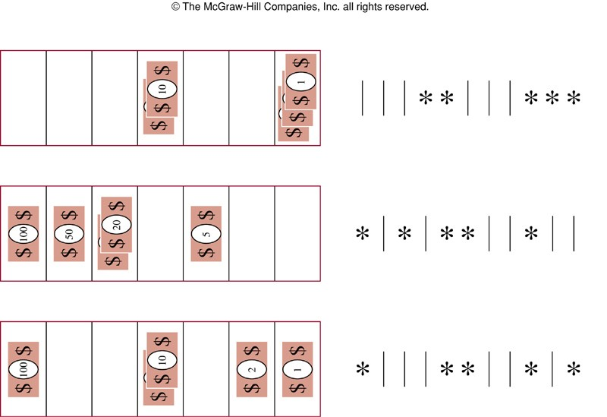
Example
 How many ways are there to select five bills from a cash box containing $1 bills, $2 bills, $5 bills, $10 bills,
$20 bills, $50 bills, and $100 bills?
 The order in which the bills are chosen doesn’t matter
 The bills of each denomination are indistinguishable
 At least five bills of each type
 C(7–1+5, 5)
= C(11, 5)
= 11! / (5!·6!)
= 462
13-<number>

Slide 24
Combinations with Repetitio ns
 Theorem 2: The number of r-combinations from a set with n elements with repetition allowed is:
C(n + r −1, r) = C(n + r −1, n −1)
 Other representations with the same meaning
 # of ways to fill r slots from n categories with repetition allowed
 # of ways to select r elements from n categories of elements with repetition allowed
13-<number>

Slide 25
Proof of Theorem 2
 Represent each r-combinations from a set with n elements with repetition allowed by a list of n – 1 bars and r stars.
 n – 1 bars: used to mark off n different cells (categories)
 r stars: each star in i-th cell (if any) represents an element that is selected for the i-th category
 # of different lists that containing n – 1 bars and r stars
 = # of ways to chose the r positions to place the r stars from n + r – 1 positions [C(n + r – 1, r)]
 = # of ways to chose the n – 1 positions to place the
n – 1 bars from n + r – 1 positions [C(n + r – 1, n –1)]
13-<number>

Slide 26

More Examples
 How many ways can I fill a box holding 100 pieces of candy from 30 different types of candy?
 Solution: Here #stars = 100, #bars = 30 – 1, so there are C(100+29,100) = 129! / (100!·29!) different ways to fill the box.
 How many ways if I must have at least 1 piece of each type?
 Solution: Now, we are reducing the #stars to choose over to (100 – 30) stars, so there are C(70+29, 70) = 99! / (70!29!)
13-<number>

Slide 27
When to Use Generalized
Combinations
■ Besides categorizing a problem based on its order and repetition requirements as a generalized combination, there are a couple of other characteristics which help us sort:
 In generalized combinations, having all the slots filled in by only selections from one category is allowed;
 It is possible to have more slots than categories.
13-<number>

Slide 28
More Integer Solutions &
Restrictions
 How many integer solutions are there to:
a + b + c + d = 15,
when a ≥ -3, b ≥ 0, c ≥ -2 and d ≥ -1?
 In this case, we alter the restrictions and equation so that the restrictions “go away.” To do this, we need each restriction ≥ 0 and balance the number of slots accordingly.
 Hence a ≥ -3+3, b ≥ 0, c ≥ -2+2 and d ≥ -1+1, yields a + b + c + d = 15+3+2+1 = 21
 So, there are C(21+4–1,21) = C(24,21) = C(24,3) = (24x23x22)/(3x2) = 2024 solutions.
13-<number>

Slide 29
Distributing Objects into
Distinguishable Boxes
 Distinguishable (or labeled) objects to distinguishable boxes
 How many ways are there to distribute hands of 5 cards to each of four players from the standard deck of 52 cards?
C(52,5)C(47,5)C(42,5)C(37,5)
 Indistinguishable (or unlabeled) objects to distinguishable boxes
 How many ways are there to place 10 indistinguishable balls into 8 distinguishable bins?
C(8+10-1, 10) = C(17,10) = 17! / (10!7!)
13-<number>

Slide 30

Distributing Distinguishable Objects
into Indistinguishable Boxes
 How many ways are there to put 4 different employees into 3 indistinguishable offices, when each office can contain any number of employees?
 all four in one office: C(4,4) = 1
 three + one: C(4,3) = 4
 two + two: C(4,2)/2 = 3
 two + one + one: C(4,2) = 6
13-<number>

Slide 31

Distributing Indistinguishable
Objects into Indistinguishable Boxes
 How many ways are there to pack 6 copies of same book into 4 identical boxes, where each box can contain as many as six books?
 List # of books in each box with the largest # of books, followed by #s of books in each box containing at least 1 book, in order of decreasing # of books in a box.
6
5,1
4,2 4,1,1
3,3 3,2,1 3,1,1,1
2,2,2
2,2,1,1
13-<number>

Slide 32
Another Combination Example
 How many routes are there from the lower left corner of an n×n square grid to the upper right corner if we are restricted to traveling only to the right or upward.
 Solution
R: right
U: up
 route → RUURRURU : a string of n R’s and n U’s
 Any such string can be obtained by selecting n positions for the R’s, without regard to the order of selection, from among the 2n available positions in the string and then filling the remaining position with U’s.
 Thus there are C(2n,n) possible routes.
13-<number>

