Slide 1
Motivation
Combinatorics is the study of collections of objects. Specifically, counting objects, arrangement, derangement, etc. along with their mathematical properties
Counting objects is important in order to analyze algorithms and compute discrete probabilities
Originally, combinatorics was motivated by gambling: counting configurations is essential to elementary probability
  A simple example: How many arrangements are there of a deck of 52 cards?
In addition, combinatorics can be used as a proof technique
  A combinatorial proof is a proof method that uses counting arguments to prove a statement

Slide 2
Outline
Introduction
Counting:
  Product rule, sum rule, Principal of Inclusion Exclusion (PIE)
  Application of PIE: Number of onto functions
Pigeonhole principle
  Generalized, probabilistic forms
Permutations
Combinations
Binomial Coefficients
Generalizations
  Combinations with repetitions, permutations with indistinguishable objects
Algorithms
  Generating combinations (1), permutations (2)
More Examples

Slide 3
Product Rule
If two events are not mutually exclusive (that is we do them separately), then we apply the product rule
Theorem: Product Rule
Suppose a procedure can be accomplished with two disjoint subtasks. If there are
  n₁ ways of doing the first task and
  n₂ ways of doing the second task,
  then there are n₁.n₂ ways of doing the overall procedure

Slide 4
Sum Rule (1)
If two events are mutually exclusive, that is, they cannot be done at the same time, then we must apply the sum rule
Theorem: Sum Rule. If
  an event e₁ can be done in n₁ ways,
  an event e₂ can be done in n₂ ways, and
  e₁ and e₂ are mutually exclusive
  then the number of ways of both events occurring is n₁+ n₂

Slide 5
Sum Rule (2)
There is a natural generalization to any sequence of m tasks; namely the number of ways m mutually events can occur
n₁ + n₂ + … + n_{m-1} + n_{m}
We can give another formulation in terms of sets. Let A₁, A₂, …, A_{m} be pairwise disjoint sets. Then
|A₁ ∪ A₂ ∪ … ∪ A_{m} | = |A₁| ∪ |A₂| ∪ … ∪ |A_{m}|
  (In fact, this is a special case of the general Principal of
  Inclusion-Exclusion (PIE))

Slide 6
Principle of Inclusion-Exclusion (PIE)
Say there are two events, e₁ and e₂, for which there are n₁ and n₂ possible outcomes respectively.
Now, say that only one event can occur, not both
In this situation, we cannot apply the sum rule. Why?
… because we would be over counting the number of possible outcomes.
Instead we have to count the number of possible outcomes of e₁ and e₂ minus the number of possible outcomes in common to both; i.e., the number of ways to do both tasks
If again we think of them as sets, we have
|A₁ ∪ A₂| =|A₁| + |A₂| - |A₁∩ A₂|

Slide 7
PIE (2)
More generally, we have the following
Lemma: Let A, B, be subsets of a finite set U. Then
  |A∪B| = |A| + |B| - |A∩B|
  |A ∩ B| ≤ min {|A|, |B|}
  |A\B| = |A| - |A∩B| ≥ |A|-|B|
  |A| = |U| - |A|
  |A⊕B| =|A∪B|-|A∩B|= |A|+|B|-2|A∩B|= |A\B|+ |B\A|
  |A × B| = |A|×|B|

Slide 8
PIE: Theorem
Theorem: Let A₁,A₂, …,A_{n} be finite sets, then
|A₁∪ A₂ ∪...∪A_{n}|= Σ_{i}|A_{i}|
- Σ_{i<j}|A_{i} ∩ A_{j}|
+ Σ_{i<j<k}|A_{i} ∩ A_{j} ∩ A_{k}|
- …
+(-1)^{n+1} |A₁∩A₂∩...∩A_{n}|
  Each summation is over
    all i,
    pairs i,j with i<j,
    triples with i<j<k, etc.

Slide 9
PIE Theorem: Example 1
To illustrate, when n=3, we have
|A₁∪ A₂ ∪A₃|= |A₁|+ |A₂| +|A₃|
- [|A₁∩A₂|+|A₁∩A₃|+|A₂∩A₃|]
+|A₁ ∩ A₂ ∩ A₃|

Slide 10
PIE Theorem: Example 2
To illustrate, when n=4, we have
|A₁∪A₂∪A₃∪A₄|= |A₁|+|A₂|+|A₃|+|A₄|
- [|A₁∩A₂|+|A₁∩A₃|+|A₁∩A₄|
+|A₂∩A₃|+|A₂∩A₄|+|A₃∩A₄|]
+ [|A₁∩A₂∩A₃|+|A₁∩A₂∩A₄|
+|A₁∩A₃∩A₄|+|A₂∩A₃∩A₄|]
- |A₁ ∩A₂ ∩A₃ ∩A₄|

Slide 11
Application of PIE: Example A (1)
How many integers between 1 and 300 (inclusive) are
  Divisible by at least one of 3,5,7?
  Divisible by 3 and by 5 but not by 7?
  Divisible by 5 but by neither 3 or 7?
Let
A = {n∈Z | (1 ≤ n ≤ 300)∧ (3|n)}
B = {n∈Z | (1 ≤ n ≤ 300)∧ (5|n)}
C = {n∈Z | (1 ≤ n ≤ 300)∧ (7|n)}
How big are these sets? We use the floor function
|A| = ⎣300/3⎦ = 100
|B| = ⎣300/5⎦ = 60
|C| = ⎣300/7⎦ = 42

Slide 12
Application of PIE: Example A (2)
How many integers between 1 and 300 (inclusive) are divisible by at least one of 3,5,7?
Answer: |A∪B ∪C|
By the principle of inclusion-exclusion
|A∪B ∪C|= |A|+|B|+|C|-[|A∩B|+|A∩C|+|B∩C|]+|A∩B∩C|
How big are these sets? We use the floor function
|A| = ⎣300/3⎦ = 100 |A∩B| = ⎣300/15⎦ = 20
|B| = ⎣300/5⎦ = 60 |A∩C| = ⎣300/21⎦ = 100
|C| = ⎣300/7⎦ = 42 |B∩C| = ⎣300/35⎦ = 8
|A∩B∩C| = ⎣300/105⎦ = 2
Therefore:
|A∪B ∪C| = 100 + 60 + 42 - (20+14+8) + 2 = 162

Slide 13
Application of PIE: Example A (3)
How many integers between 1 and 300 (inclusive) are divisible by 3 and by 5 but not by 7?
Answer: |(A ∩ B)\C|
By the definition of set-minus
|(A ∩ B)\C| = |A ∩ B| - |A ∩ B ∩ C| = 20 – 2 = 18
Knowing that
|A| = ⎣300/3⎦ = 100 |A∩B| = ⎣300/15⎦ = 20
|B| = ⎣300/5⎦ = 60 |A∩C| = ⎣300/21⎦ = 100
|C| = ⎣300/7⎦ = 42 |B∩C| = ⎣300/35⎦ = 8
|A∩B∩C| = ⎣300/105⎦ = 2

Slide 14
Application of PIE: Example A (4)
  How many integers between 1 and 300 (inclusive) are divisible by 5 but by neither 3 or 7?
Answer: |B\(A ∪C)| = |B| - |B ∩ (A ∪C)|
Distributing B over the intersection
|B ∩ (A ∪ C)| = |(B ∩ A) ∪ (B ∩ C)|
= |B ∩ A| + |B ∩ C| - | (B ∩ A) ∩ (B ∩ C) |
= |B ∩ A| + |B ∩ C| - | B ∩ A ∩ C |
= 20 + 8 – 2 = 26
Knowing that
|A| = ⎣300/3⎦ = 100 |A∩B| = ⎣300/15⎦ = 20
|B| = ⎣300/5⎦ = 60 |A∩C| = ⎣300/21⎦ = 100
|C| = ⎣300/7⎦ = 42 |B∩C| = ⎣300/35⎦ = 8
|A∩B∩C| = ⎣300/105⎦ = 2

Slide 15
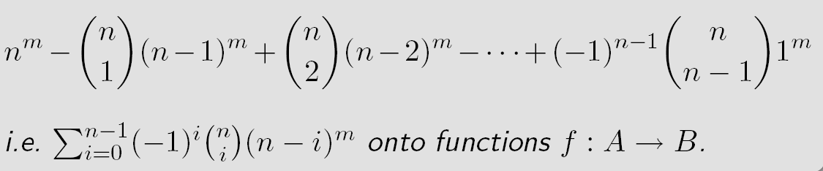
Application of PIE: #Surjections (Section 7.6)
The principle of inclusion-exclusion can be used to count the number of onto (surjective) functions
Theorem: Let A, B be non-empty sets of cardinality m,n with m≥n. Then there are
${n \choose i}$
See textbook, Section 7.6 page 509

Slide 16
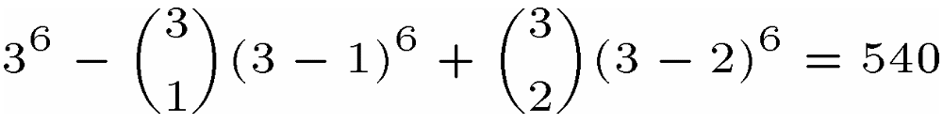
#Surjections: Example
How many ways of giving out 6 pieces of candy to 3 children if each child must receive at least one piece?
This problem can be modeled as follows:
  Let A be the set of candies, |A|=6
  Let B be the set of children, |B|=3
  The problem becomes “find the number of surjective mappings from A to B” (because each child must receive at least one candy)
Thus the number of ways is thus (m=6, n=3)

Slide 17
Outline
Introduction
Counting:
  Product rule, sum rule, Principal of Inclusion Exclusion (PIE)
  Application of PIE: Number of onto functions
Pigeonhole principle
  Generalized, probabilistic forms
Permutations
Combinations
Binomial Coefficients
Generalizations
  Combinations with repetitions, permutations with indistinguishable objects
Algorithms
  Generating combinations (1), permutations (2)
More Examples

Slide 18
Pigeonhole Principle (1)
If there are more pigeons than there are roots (pigeonholes), for at least one pigeonhole, more than one pigeon must be in it
Theorem: If k+1 or more objects are placed in k boxes, then there is at least one box containing two or more objects
This principal is a fundamental tool of elementary discrete mathematics.
It is also known as the Dirichlet Drawer Principle or Dirichlet Box Pinciple

Slide 19
Pigeonhole Principle (2)
It is seemingly simple but very powerful
The difficulty comes in where and how to apply it
Some simple applications in Computer Science
  Calculating the probability of hash functions having a collision
  Proving that there can be no lossless compression algorithm compressing all files to within a certain ration
Lemma: For two finite sets A,B there exists a bijection f:A→B if and only if |A|=|B|

Slide 20
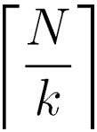
Generalized Pigeonhole Principle (1)
Theorem: If N objects are placed into k boxes then there is at least one box containing at least
Example: In any group of 367 or more people, at least two of them must have been born on the same date.

Slide 21
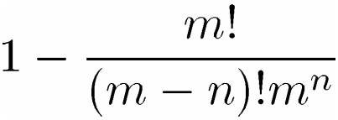
Generalized Pigeonhole Principle (2)
A probabilistic generalization states that
  if n objects are randomly put into m boxes
  with uniform probability
  (i.e., each object is place in a given box with probability 1/m)
  then at least one box will hold more than one object with probability

Slide 22
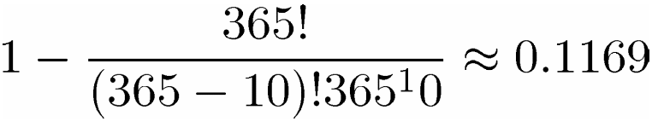
Generalized Pigeonhole Principle: Example
Among 10 people, what is the probability that two or more will have the same birthday?
  Here n=10 and m=365 (ignoring leap years)
  Thus, the probability that two will have the same birthday is
  So, less than 12% probability

Slide 23
Pigeonhole Principle: Example A (1)
Show that
  in a room of n people with certain acquaintances,
  some pair must have the same number of acquaintances
Note that this is equivalent to showing that any symmetric, irreflexive relation on n elements must have two elements with the same number of relations
Proof: by contradiction using the pigeonhole principle
Assume, to the contrary, that every person has a different number of acquaintances: 0, 1, 2, …, n-1 (no one can have n acquaintances because the relation is irreflexive).
There are n possibilities, we have n people, we are not done ☹

Slide 24
Pigeonhole Principle: Example A (2)
Assume, to the contrary, that every person has a different number of acquaintances: 0, 1, 2, …, n-1 (no one can have n acquaintances because the relation is irreflexive).
There are n possibilities, we have n people, we are not done ☹
We need to use the fact that acquaintanceship is a symmetric irreflexive relation
In particular, some person knows 0 people while another knows n-1 people
This is impossible. Contradiction! ☺ So we do not have 10 possibilities, but less
Thus by the pigeonhole principle (10 people and 9 possibilities) at least two people have to the same number of acquaintances

Slide 25
Pigeonhole Principle: Example B
Example: Say, 30 buses are to transport 2000 Cornhusker fans to Colorado. Each bus has 80 seats.
Show that
  One of the buses will have 14 empty seats
  One of the buses will carry at least 67 passengers
One of the buses will have 14 empty seats
  Total number of seats is 80.30=2400
  Total number of empty seats is 2400-2000=400
  By the pigeonhole principle: 400 empty seats in 30 buses, one must have ⎡400/30 ⎤ = 14 empty seats
One of the buses will carry at least 67 passengers
  By the pigeonhole principle: 2000 passengers in 30 buses, one must have ⎡2000/30 ⎤ = 67 passengers

Slide 26
Outline
Introduction
Counting:
  Product rule, sum rule, Principal of Inclusion Exclusion (PIE)
  Application of PIE: Number of onto functions
Pigeonhole principle
  Generalized, probabilistic forms
Permutations
Combinations
Binomial Coefficients
Generalizations
  Combinations with repetitions, permutations with indistinguishable objects
Algorithms
  Generating combinations (1), permutations (2)
More Examples

Slide 27
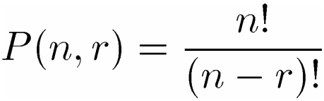

Permutations
A permutation of a set of distinct objects is an ordered arrangement of these objects.
An ordered arrangement of r elements of a set of n elements is called an r-permutation
Theorem: The number of r permutations of a set of n distinct elements is
It follows that
In particular
Note here that the order is important. It is necessary to distinguish when the order matters and it does not

Slide 28
Application of PIE and Permutations: Derangements (I)
(Section 7.6)
Consider the hat-check problem
  Given
    An employee checks hats from n customers
    However, s/he forgets to tag them
    When customers check out their hats, they are given one at random
  Question
    What is the probability that no one will get their hat back?

Slide 29
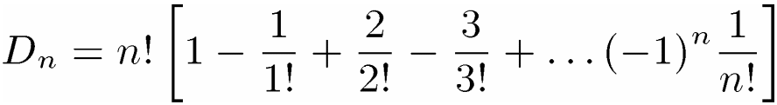

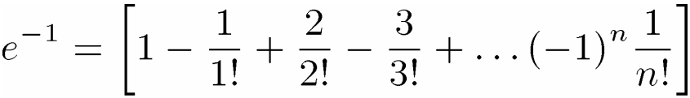
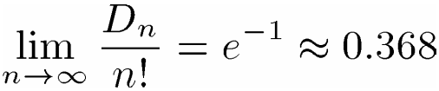
Application of PIE and Permutations: Derangements (II)
The hat-check problem can be modeled using derangements: permutations of objects such that no element is in its original position
- Example: 21453 is a derangement of 12345 but 21543 is not
The number of derangements of a set with n elements is
Thus, the answer to the hatcheck problem is
Note that
Thus, the probability of the hatcheck problem converges
See textbook, Section 7.6 page 510

Slide 30
Permutations: Example A
How many pairs of dance partners can be selected from a group of 12 women and 20 men?
  The first woman can partner with any of the 20 men, the second with any of the remaining 19, etc.
  To partner all 12 women, we have
  P(20,12) = 20!/8! = 9.10.11…20

Slide 31
Permutations: Example B
In how many ways can the English letters be arranged so that there are exactly 10 letters between a and z?
  The number of ways is P(24,10)
  Since we can choose either a or z to come first, then there are 2P(24,10) arrangements of the 12-letter block
  For the remaining 14 letters, there are P(15,15)=15! possible arrangements
  In all there are 2P(24,10).15! arrangements

Slide 32
Permutations: Example C (1)
How many permutations of the letters a, b, c, d, e, f, g contain neither the pattern bge nor eaf?
  The total number of permutations is P(7,7)=7!
  If we fix the pattern bge, then we consider it as a single block. Thus, the number of permutations with this pattern is P(5,5)=5!
  If we fix the pattern bge, then we consider it as a single block. Thus, the number of permutations with this pattern is P(5,5)=5!
  Fixing the patter eaf, we have the same number: 5!
  Thus, we have (7! – 2.5!). Is this correct?
  No! we have subtracted too many permutations: ones containing both eaf and bfe.

Slide 33
Permutations: Example C (2)
  There are two cases: (1) eaf comes first, (2) bge comes first
  Are there any cases where eaf comes before bge?
  No! The letter e cannot be used twice
  If bge comes first, then the pattern must be bgeaf, so we have 3 blocks or 3! arrangements
  Altogether, we have
  7! – 2.(5!) + 3! = 4806

Slide 34
Outline
Introduction
Counting:
  Product rule, sum rule, Principal of Inclusion Exclusion (PIE)
  Application of PIE: Number of onto functions
Pigeonhole principle
  Generalized, probabilistic forms
Permutations
Combinations
Binomial Coefficients
Generalizations
  Combinations with repetitions, permutations with indistinguishable objects
Algorithms
  Generating combinations (1), permutations (2)
More Examples

Slide 35
Combinations (1)
Whereas permutations consider order, combinations are used when order does not matter
Definition: A k-combination of elements of a set is an unordered selection of k elements from the set.
  (A combination is imply a subset of cardinality k)

Slide 36
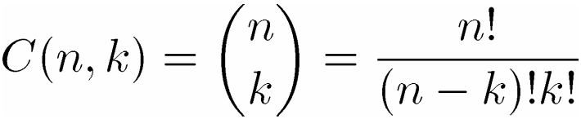
Combinations (2)
Theorem: The number of k-combinations of a set of cardinality n with 0 ≤ k ≤ n is
is read ‘n choose k’. ${n \choose k}$

Slide 37
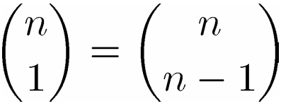
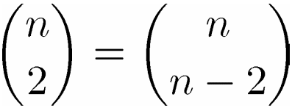

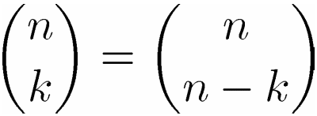
Combinations (3)
A useful fact about combinations is that they are symmetric
Corollary: Let n, k be nonnegative integers with k ≤ n, then

Slide 38

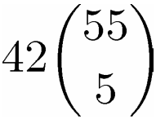
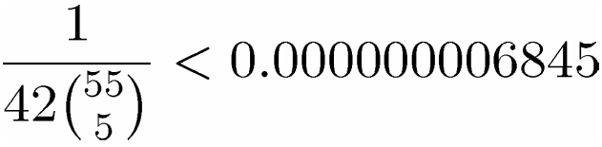
Combinations: Example A
In the Powerball lottery, you pick
  five numbers between 1 and 55 and
  A single ‘powerball’ number between 1 and 42
  How many possible plays are there?
Here order does not matter
  The number of ways of choosing 5 numbers is
  There are 42 possible ways to choose the powerball
  The two events are not mutually exclusive:
  The odds of winning are

Slide 39
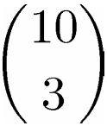
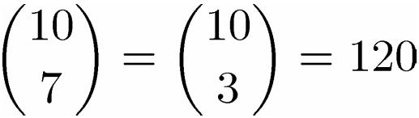
Combinations: Example B
In a sequence of 10 coin tosses, how many ways can 3 heads and 7 tails come up?
  The number of ways of choosing 3 heads out of 10 coin tosses is
  It is the same as choosing 7 tails out of 10 coin tosses
  … which illustrates the corollary

Slide 40
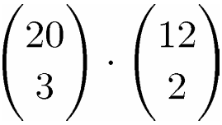
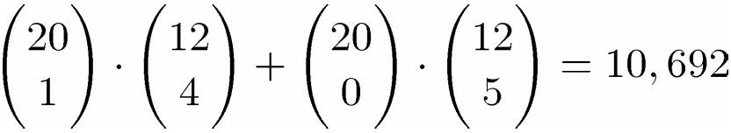
Combinations: Example C
How many committees of 5 people can be chosen from 20 men and 12 women
  If exactly 3men must be on each committee?
  If at least 4 women must be on each committee?
  If exactly three men must be on each committee?
  We must choose 3 men and 2 women. The choices are not mutually exclusive, we use the product rule
  If at least 4 women must be on each committee?
  We consider 2 cases: 4 women are chosen and 5 women are chosen. Theses choices are mutually exclusive, we use the addition rule:

Slide 41
Outline
Introduction
Counting:
  Product rule, sum rule, Principal of Inclusion Exclusion (PIE)
  Application of PIE: Number of onto functions
Pigeonhole principle
  Generalized, probabilistic forms
Permutations
Combinations
Binomial Coefficients
Generalizations
  Combinations with repetitions, permutations with indistinguishable objects
Algorithms
  Generating combinations (1), permutations (2)
More Examples

Slide 42
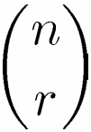
Binomial Coefficients (1)
The number of r-combinations is also called the binomial coefficient
The binomial coefficients are the coefficients in the expansion of the expression, (multivariate polynomial),
(x+y)^{n}
A binomial is a sum of two terms

Slide 43
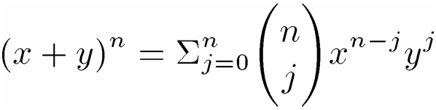
Binomial Coefficients (2)
Theorem: Binomial Theorem
Let x, y, be variables and let n be a nonnegative integer. Then
Expanding the summation we have
Example

Slide 44
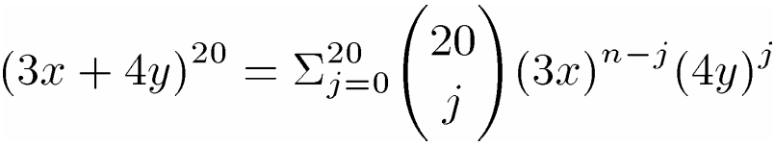
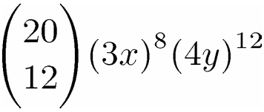
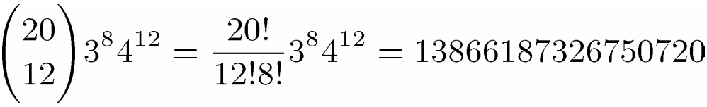
Binomial Coefficients: Example
What is the coefficient of the term x⁸y¹² in the expansion of (3x+4y)²⁰?
  By the binomial theorem, we have
  When j=12, we have
  The coefficient is

Slide 45
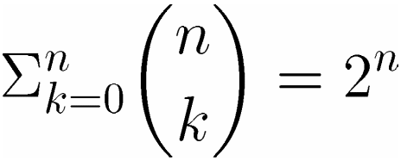
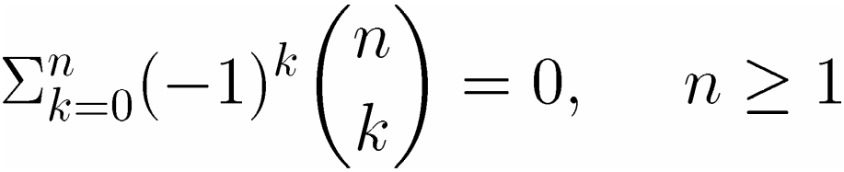
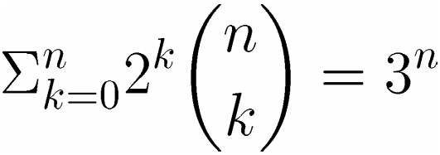
Binomial Coefficients (3)
Many useful identities and facts come from the Binomial Theorem
Corollary:
Equalities are based on (1+1)^{n}=2^{n}, ((-1)+1)^{n}=0^{n}, (1+2)^{n}=3^{n}

Slide 46
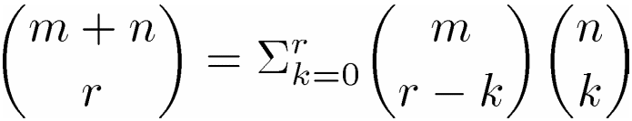
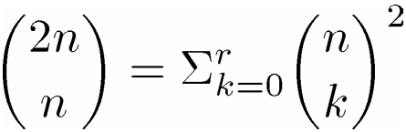
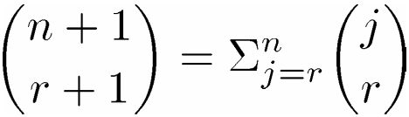
Binomial Coefficients (4)
Theorem: Vandermonde’s Identity
Let m,n,r be nonnegative integers with r not exceeding either m or n. Then
Corollary: If n is a nonnegative integer then
Corollary: Let n,r be nonnegative integers, r≤n, then

Slide 47
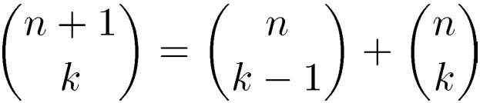
Binomial Coefficients: Pascal’s Identity & Triangle
The following is known as Pascal’s identity which gives a useful identity for efficiently computing binomial coefficients
Theorem: Pascal’s Identity
Let n,k ∈Z⁺ with n≥k, then
Pascal’s Identity forms the basis of a geometric object known as Pascal’s Triangle

Slide 48





















Pascal’s Triangle

Slide 49
What is the sum of numbers in n’th row in Pascal’s triangle (starting at n = 0)?
Observe: This is exactly the corollary earlier!
Pascal’s triangle is perfectly symmetric
Numbers on left are mirror image of numbers on right

Slide 50
Outline
Introduction
Counting:
  Product rule, sum rule, Principal of Inclusion Exclusion (PIE)
  Application of PIE: Number of onto functions
Pigeonhole principle
  Generalized, probabilistic forms
Permutations
Combinations
Binomial Coefficients
Generalizations
  Combinations with repetitions, permutations with indistinguishable objects
Algorithms
  Generating combinations (1), permutations (2)
More Examples

Slide 51
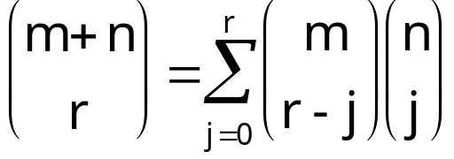
Vandermonde’s Identity
Let m, n, and r be nonnegative integers with r not exceeding either m or n. Then
B
n items
To choose r items, take some [(r-j)] from A and some [j] from B. All possible ways of doing this gives the result. (note: items should all be distinct.)
A
m items

Slide 52
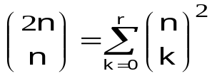
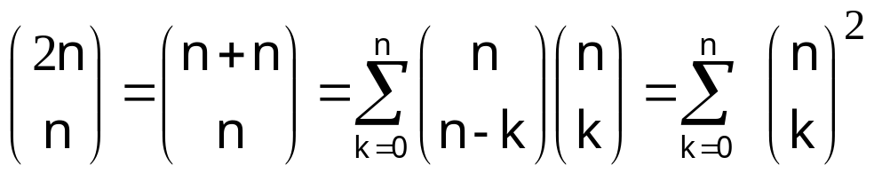
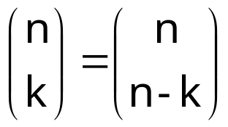
Follows directly from the Vandermonde’s identity with m = r = n:

Slide 53
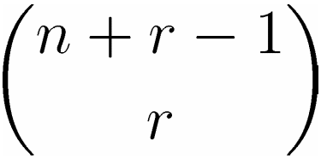
Generalized Combinations & Permutations (1)
Sometimes, we are interested in permutations and combinations in which repetitions are allowed
Theorem: The number of r-permutations of a set of n objects with repetition allowed is n^{r}
…which is easily obtained by the product rule
Theorem: There are
r-combinations from a set with n elements when repetition of elements is allowed

Slide 54
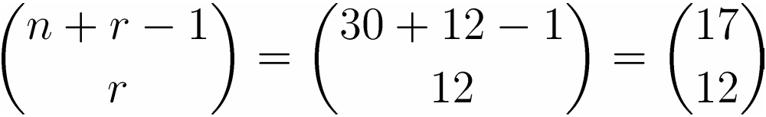
Generalized Combinations & Permutations: Example
There are 30 varieties of donuts from which we wish to buy a dozen. How many possible ways to place your order are there?
Here, n=30 and we wish to choose r=12.
Order does not matter and repetitions are possible
We apply the previous theorem
The number of possible orders is

Slide 55
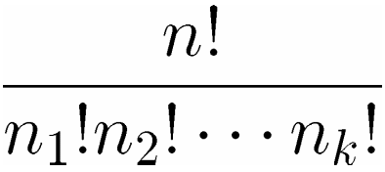
Generalized Combinations & Permutations (2)
Theorem: The number of different permutations of n objects where there are n₁ indistinguishable objects of type 1, n₂ of type 2, and n_{k} of type k is
An equivalent ways of interpreting this theorem is the number of ways to
  distribute n distinguishable objects
  into k distinguishable boxes
  so that n_{i} objects are place into box i for i=1,2,3,…,k

Slide 56
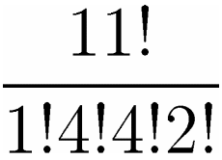
Example
How many permutations of the word Mississipi are there?
‘Mississipi’ has
  4 distinct letters: m,i,s,p
  with 1,4,4,2 occurrences respectively
  Therefore, the number of permutations is

Slide 57
Outline
Introduction
Counting:
  Product rule, sum rule, Principal of Inclusion Exclusion (PIE)
  Application of PIE: Number of onto functions
Pigeonhole principle
  Generalized, probabilistic forms
Permutations
Combinations
Binomial Coefficients
Generalizations
  Combinations with repetitions, permutations with indistinguishable objects
Algorithms
  Generating combinations (1), permutations (2)
More Examples

Slide 58
Algorithms
In general, it is inefficient to solve a problem by considering all permutation or combinations since there are exponential (worst, factorial!) numbers of such arrangements
Nevertheless, for many problems, no better approach is known.
When exact solutions are needed, backtracking algorithms are used to exhaustively enumerate all arrangements

Slide 59
Algorithms: Example
Traveling Salesperson Problem (TSP)
Consider a salesman that must visit n different cities. He wishes to visit them in an order such that his overall distance travelled is minimized
This problem is one of hundred of NP-complete problems for which no known efficient algorithms exist. Indeed, it is believed that no efficient algorithms exist. (Actually, Euclidean TSP is not even known to be in NP.)
The only way of solving this problem exactly is to try all possible n! routes
We give several algorithms for generating these combinatorial objects

Slide 60
Generating Combinations (1)
Recall that combinations are simply all possible subsets of size r. For our purposes, we will consider generating subsets of
{1,2,3,…,n}
The algorithm works as follows
  Start with {1,…,r}
  Assume that we have a₁a₂…a_{r}, we want the next <number>
  Locate the last element ai such that a_{i} ≠ n-r-I
  Replace a_{i} with a_{i}+1
  Replace a_{j} with a_{i}+j-I for j=i+1, i+2,…,r

Slide 61
Generating Combinations (2)
Next r-Combinations
Input: A set of n elements and an r-combination a₁,a₂,…,a_{r}
Output: The next r-combination
i ← r
While a_{i} =n-r+i Do
i ← i-1
End
a_{i} ← a_{i} +1
For j ← (i+1) to r Do
a_{j} ← a_{i} + j - i
End

Slide 62
Generating Combinations: Example
Find the next 3-combination of the set {1,2,3,4,5} after {1,4,5}
Here a₁=1, a₂=4, a₃=5, n=5, r=3
The last i such that a_{i} ≠5-3+i is 1
Thus, we set
a₁ = a₁ + 1 = 2
a₂ = a₁ + 2 -1 = 3
a₃ = a₁ + 3 -1 = 4
Thus, the next r-combinations is {2,3,4}

Slide 63
Generating Permutations
The textbook gives an algorithm to generate permutations in lexicographic order. Essentially, the algorithm works as follows. Given a permutation
  Choose the left-most pair a_{j},a_{j+1} where a_{j}<a_{j+1}
  Choose the least items to the right of a_{j} greater than a_{j}
  Swap this item and a_{j}
  Arrange the remaining (to the right) items in order

Slide 64
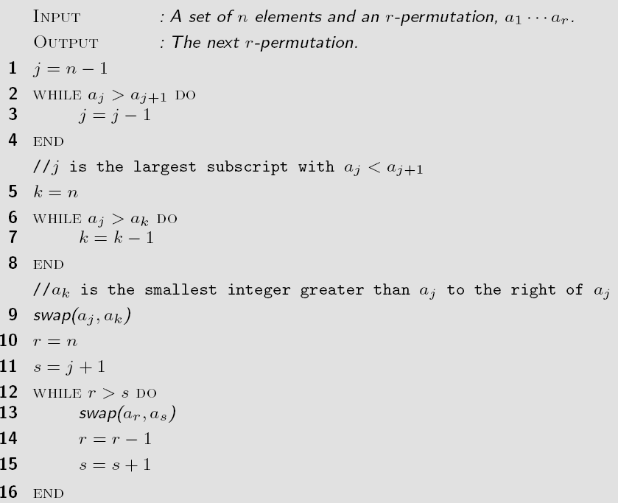
Next Permutation (lexicographic order)

Slide 65
Generating Permutations (2)
Often there is no reason to generate permutations in lexicographic order. Moreover even though generating permutations is inefficient in itself, lexicographic order induces even more work
An alternate method is to fix an element, then recursively permute the n-1 remaining elements
The Johnson-Trotter algorithm has the following attractive properties. Not in your textbook, not on the exam, just for your reference/culture
  It is bottom up (non-recursive)
  It induces a minimal-change between each permutation

Slide 66
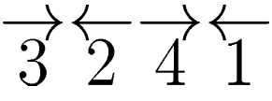
Johnson-Trotter Algorithm
We associate a direction to each element, for example
A component is mobile if its direction points to an adjacent component that is smaller than itself.
Here 3 and 4 are mobile, 1 and 2 are not

Slide 67
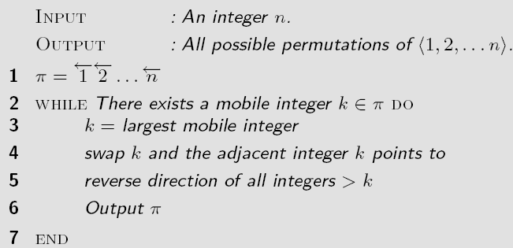
Algorithm: Johnson Trotter

