Slide 1
EEE207
ANALOG CIRCUITS
1
LOW FREQUENCY TRANSFER FUNCTION
PRESENTED BY:
SHAIK SUHANA NAAZ - AP24110040006
DHANA SRI KEERTHI - AP24110040009

Slide 2
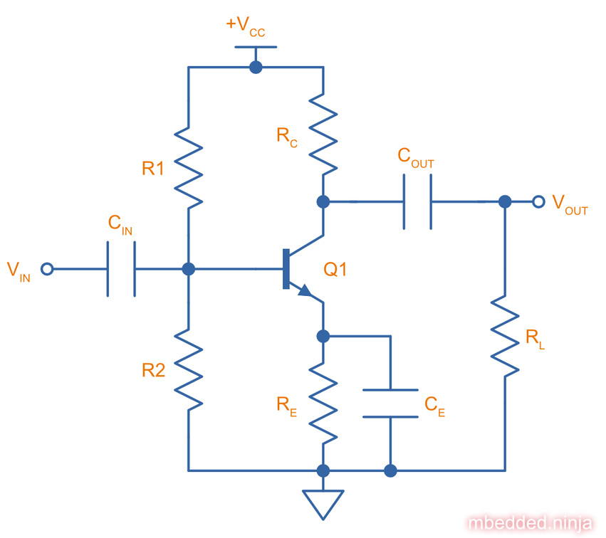
INTRODUCTION
2
The Low Frequency Transfer Function Method is used to analyze how an amplifier behaves at low frequencies.
Amplifiers do not provide the same gain at all frequencies.
Our main goal is to determine the transfer function:
Av(s)=Vo(s)/Vi(s)

Slide 3

LOW FREQUENCY ASSUMPTIONS
3
1. Coupling Capacitors Matter
2. Small Signal Model is Used
3. High-Frequency Capacitors Are Ignored
4. One Capacitor Is Analyzed at a Time

Slide 4
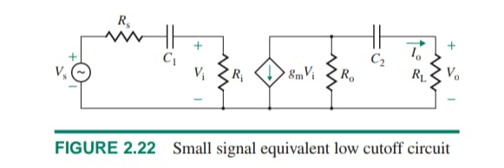
SMALL SIGNAL LOW FREQUENCY EQUIVALENT CIRCUIT
4

Slide 5
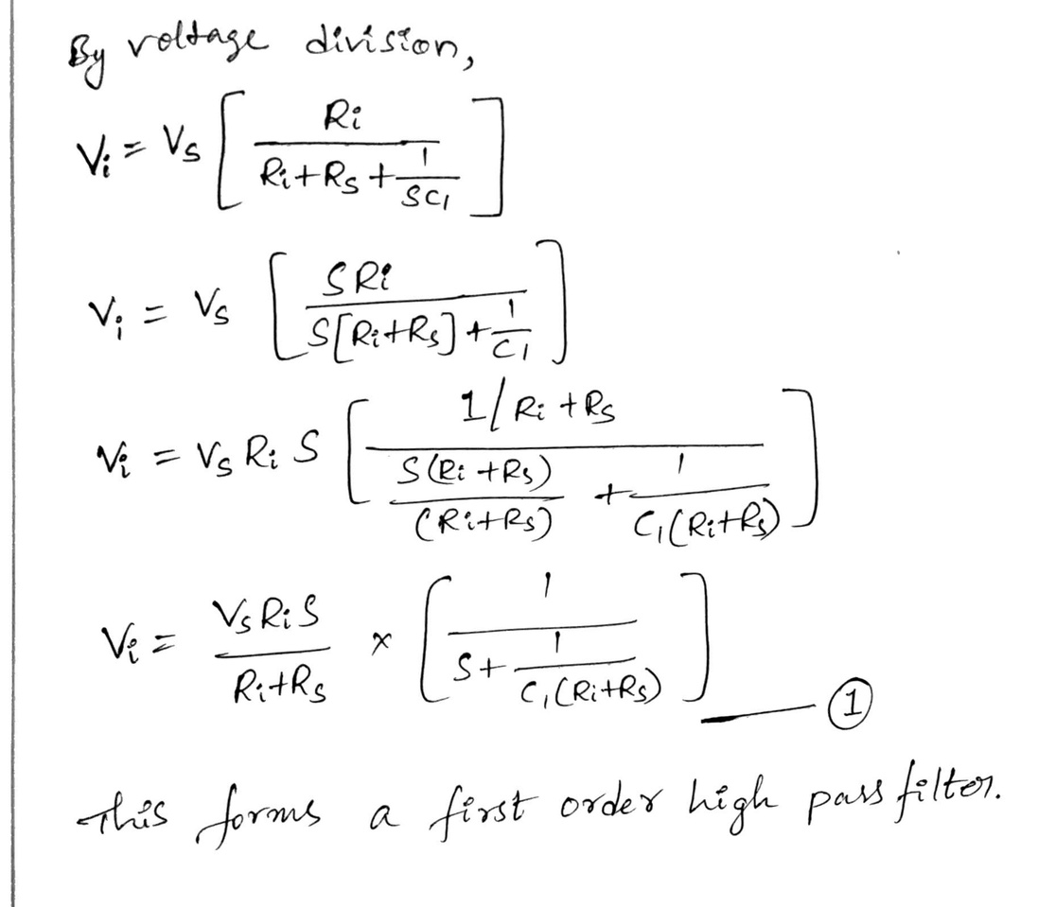
INPUT SIDE ANALYSIS
5
Now we analyze the input coupling capacitor.

Slide 6

FIRST BREAK FREQUENCY
6

Slide 7
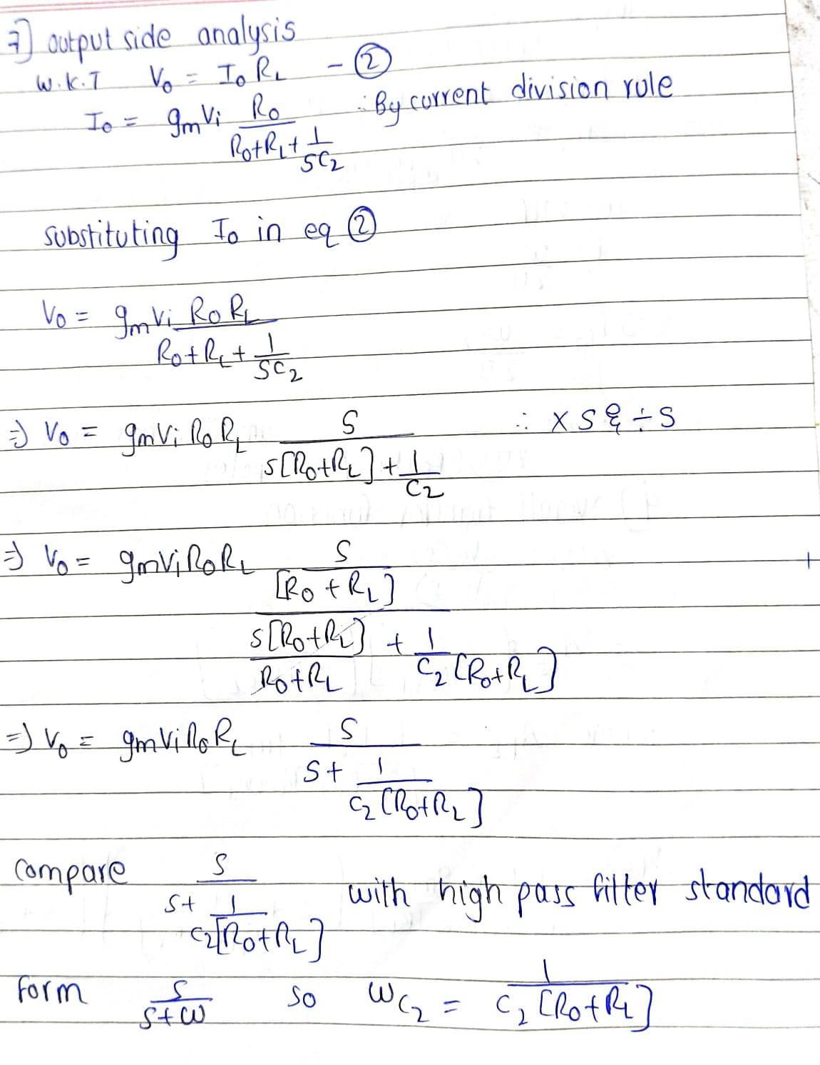
OUTPUT SIDE ANALYSIS
7

Slide 8
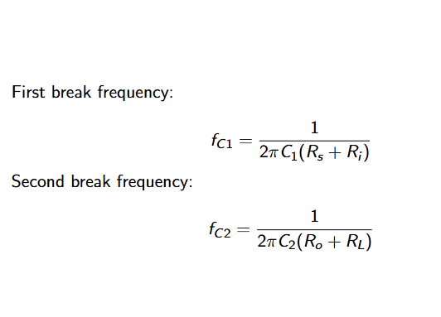
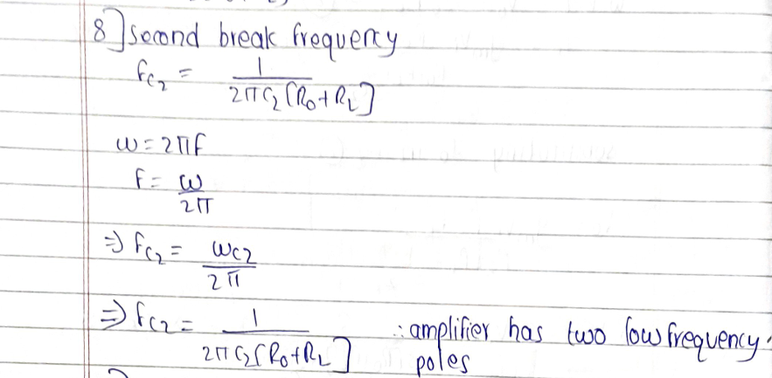
SECOND BREAK FREQUENCY
8

Slide 9
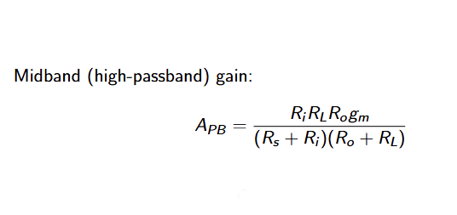
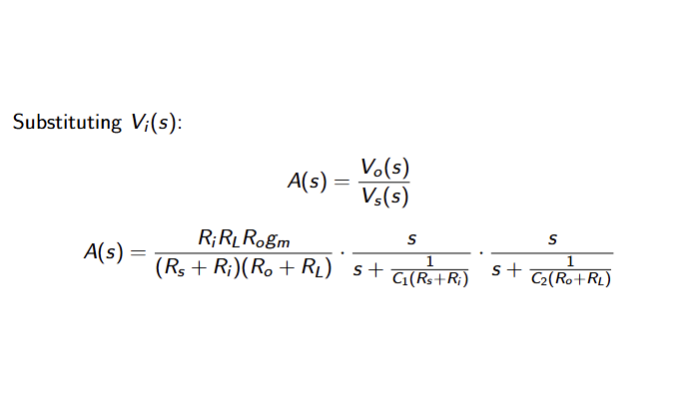
OVERALL TRANSFER FUCTION
9

Slide 10
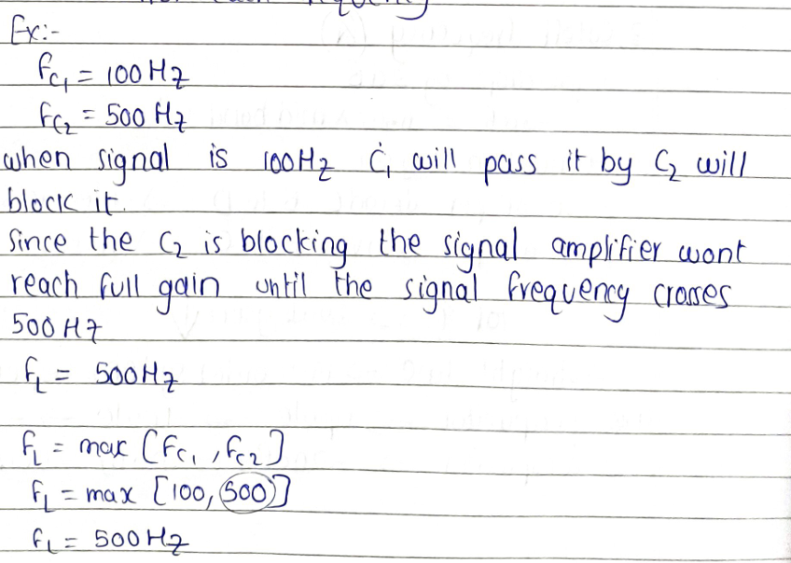
LOW CUTOFF FRQUENCY
10
Each capacitor causes
Gain increases by +20dB/decade
Below its cutoff thee gain reduces
Total slope at very low frequency = +40dB/decade
+20dB from each frequency

Slide 11
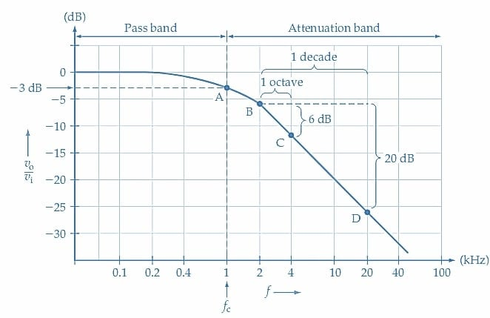

FREQUENCY RESPONSE CURVE
Bone magnitude plot
x axis - frequency in log scale
y axis - gain in dB
Pass band
capacitors gets short circuit and gain is constant
cutoff frequency
gain drops by 3dB which means =
0.707xmid band value
Attenuation Band
20dB per decade Bto D
10 dB per octave B to C
1 decade =fx10
1octave =fx2
10f increases 20dBgain decreases
one capacitor represents 1pole
one pole have 20dB gain loss
11
EXPLANATION

Slide 12

CONCLUSION
12
IN CONCLUSION
The low frequency transfer function method helps us to determine how coupling capacitors influence the amplifiers gain and cutoff frequency enabling proper design of amplifier bandwidth

Slide 13
13
THANK YOU!
THANK YOU!
AP24110040006
AP24110040009

