Slide 2
1. What is version control system?
2. Version Control system flow
3. Version Control Tools
4. Introduction to Git & GitHub
5. Git terminology ( Working repo, Staging area, Local Repo, Remote Repo)
6. Git work flow
7. Git features
8. Installation of git In windows
9. Git hub account Management
10. GIT CMD (Git Add status, Git Commit -m Git Push, Git Fetch, Git Checkout)
11. Operations and Usage.

Slide 3
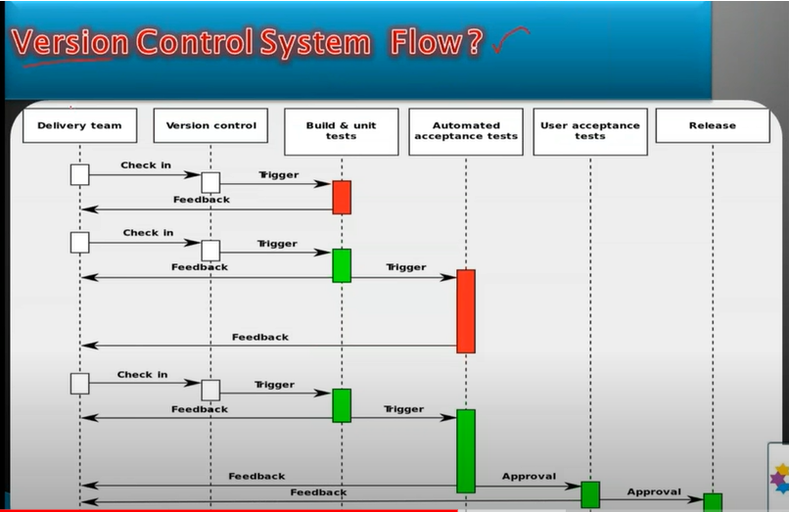
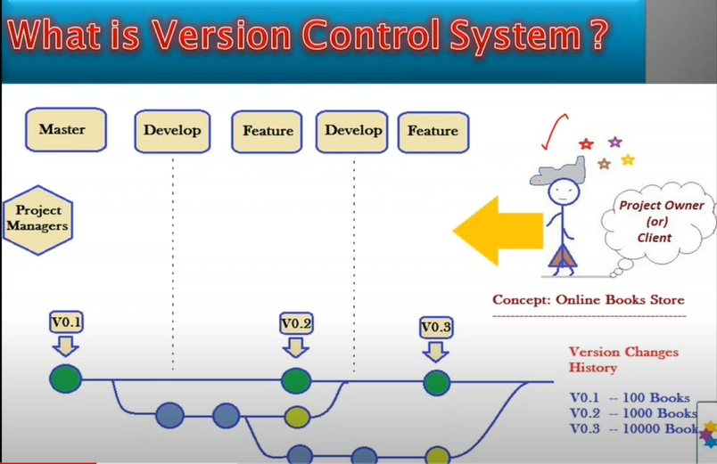
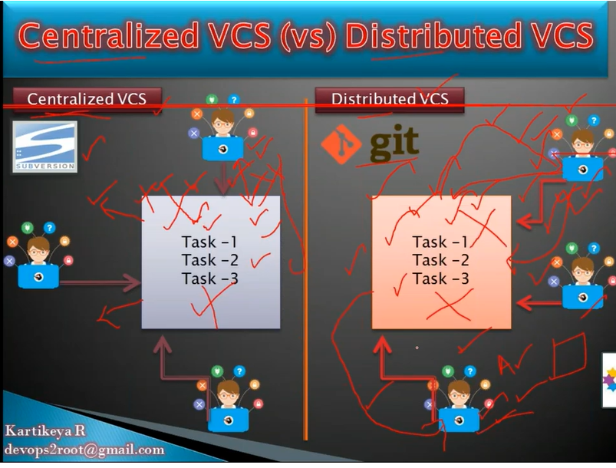
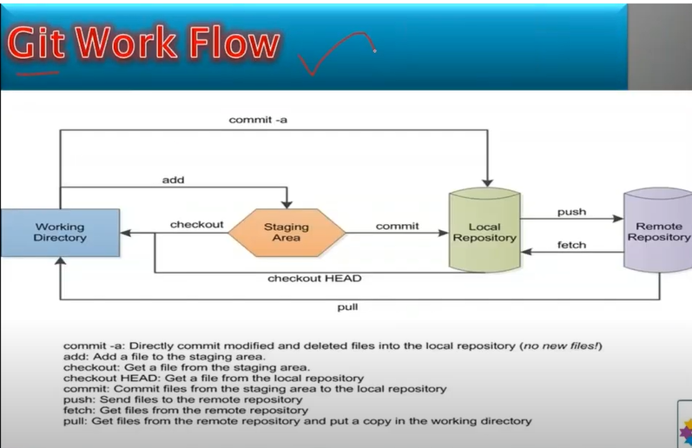
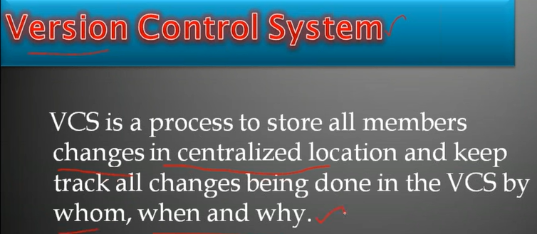
2. Version Control system flow
What is version control system?
vcs tools – Git , bit keeper, subversion

Slide 4
Git-bash Commands:
git init
ls
mkdir dir_name
cd dir_name
Touch filename
git add .
git status
git commit -- to execute git commit we need to provide global config like email and username.
vi gitignore
git checkout branch name

