Slide 1

Network Protocols and Security Title:DNSGuard: A Comprehensive Tool for DNS Security, Monitoring, and Performance Optimization

Slide 2
INTRODUCTION
The DNS Analysis Tool provides real-time monitoring, performance optimization, and threat detection for DNS infrastructure. It enables administrators to track DNS traffic, analyze query response times, detect anomalies, and identify vulnerabilities such as DNS spoofing, cache poisoning, and DDoS attacks. By offering insights into DNS performance metrics, traffic patterns, and security risks, the tool helps ensure reliable domain name resolution, mitigate threats, and enhance overall network security. It supports proactive threat intelligence, alerts on suspicious activities, and assists in troubleshooting DNS failures, ultimately improving system stability and resilience against cyber threats.

Slide 3
Objective
Retrieve and validate DNS records – Ensures domain-related records (A, MX, CNAME, etc.) are correctly configured.
Detect security threats like DNS hijacking – Identifies unauthorized changes or attacks on domain resolution.
Verify domain propagation – Checks if DNS changes have been updated across global servers.
Identify misconfigurations – Detects incorrect DNS settings that may cause resolution failures.
Measure performance and response time – Evaluates how quickly DNS queries are resolved.

Slide 4
Procedure
Step-1: In the first step of DNS analysis, the user inputs a domain name (e.g., example.com) into the tool. The tool then retrieves various DNS records associated with the domain, such as A, CNAME, MX, and TXT records. This helps in verifying whether the domain is correctly configured and resolving properly. It also checks for any discrepancies or potential misconfigurations in the DNS setup. Ensuring accurate DNS records is essential for smooth website access and email functionality.
Step-2: In this step, the tool retrieves various DNS records, including A, CNAME, MX, TXT, and NS, to gather domain-related information. These records are essential for domain resolution, email routing, and security configurations. The tool then validates the correctness of these records to detect misconfigurations or potential issues.

Slide 5
Step-3:
DNS lookup is crucial to verify if recent DNS changes have propagated globally. It ensures that domain name records are accessible from multiple locations worldwide. This step helps confim that users across different regions can resolve the domain correctly.
Step -4:
Measuring DNS response time helps in identifying slow-performing DNS servers. High latency can lead to delays in website loading and connectivity issues. Optimizing DNS configurations can significantly enhance speed and performance.

Slide 6
Step-5:
DNS security analysis helps detect vulnerabilities such as spoofing and hijacking. It is essential to verify that DNSSEC is correctly configured to prevent unauthorized modifications. Ensuring secure DNS practices helps protect against cyber threats and domain hijacking.
Step-6:
The final step involves compiling a report that summarizes all findings. It includes identifying misconfigurations, security threats, and performance bottlenecks. The report provides actionable recommendations to improve DNS security, reliability, and efficiency.

Slide 7
Code
from flask import Flask, render_template, request
import whois
import json
import datetime
app = Flask(__name__)
def serialize_dates(obj):
"""Convert datetime objects to strings for rendering."""
if isinstance(obj, datetime.datetime):
return obj.strftime("%Y-%m-%d %H:%M:%S")
return obj
def get_whois_info(domain):
"""Fetch WHOIS information for a domain."""
try:
w = whois.whois(domain)
return {
"Domain Name": w.domain_name,
"Registrar": w.registrar,
"Creation Date": serialize_dates(w.creation_date),
"Expiration Date": serialize_dates(w.expiration_date),
"Updated Date": serialize_dates(w.updated_date),
"Status": w.status,
"Name Servers": w.name_servers
}
except Exception as e:
return {"Error": str(e)}
@app.route("/", methods=["GET", "POST"])
def index():
if request.method == "POST":
domain = request.form["domain"]
whois_info = get_whois_info(domain)
return render_template("result.html", domain=domain, whois_info=whois_info)
return render_template("index.html")
if __name__ == "__main__":
app.run(debug=True)

Slide 8
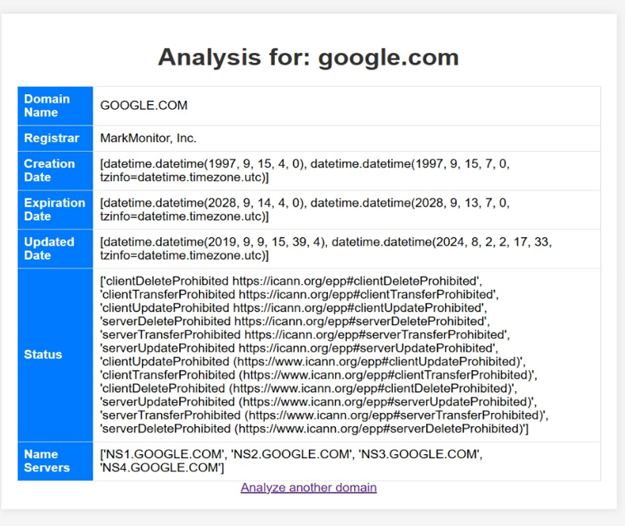
Output

Slide 9
Real World Examples
Brazilian Bank Attack (2017): Hackers compromised the bank’s DNS, redirecting customers to a fake website that stole login credentials and financial data.
MyEtherWallet DNS Hack (2018): Attackers hijacked Google’s DNS servers, directing MyEtherWallet users to a phishing site, leading to cryptocurrency theft worth $150,000.
Microsoft Office 365 Phishing Attack (2020): Attackers used DNS spoofing to redirect users to fake Office 365 login pages, harvesting corporate credentials.
Bank of America DNS Hijack (2014): Cybercriminals altered DNS settings, redirecting users to fraudulent banking sites to steal login credentials.

Slide 10
Conclusion
DNS spoofing is a serious cybersecurity threat that has led to financial losses, data breaches, and large-scale disruptions worldwide. Real-world cases, such as the MyEtherWallet attack (2018), Brazil bank hijacking (2019), and Google Vietnam DNS attack (2020), demonstrate how attackers manipulate DNS records to redirect users to fraudulent websites, steal sensitive information, and disrupt services.
To mitigate these risks, organizations and individuals must adopt preventive security measures such as DNSSEC (Domain Name System Security Extensions), encrypted DNS protocols (DNS over HTTPS/TLS), SSL certificates, and multi-factor authentication (MFA). Additionally, monitoring DNS traffic for anomalies and using reputable DNS services like Google Public DNS or Cloudflare can significantly reduce the risk of DNS-based attacks.
By implementing a multi-layered defense strategy, organizations can protect themselves against DNS spoofing and ensure safer online experiences for users. Cybersecurity awareness and best practices remain key in preventing such attacks in the future.

Slide 11
Thank You

