Slide 1
Digital Portfolio
STUDENT NAME: Keerthana.R
REGISTER NO AND NMID: 24131130500122010/asanm11324131130500122010
DEPARTMENT: BCA
COLLEGE: 113-Vallalar Arts and Science College,Vadalur-Affiliated to Annamalai University.

Slide 2
PROJECT TITLE:
MY PORTFOLIO

Slide 3


AGENDA
Problem Statement
Project Overview
End Users
Tools and Technologies
Portfolio design and Layout
Features and Functionality
Results and Screenshots
Conclusion
Github Link
3/21/2024 Annual Review

Slide 4

PROBLEM STATEMENT
IN TODAY’S DIGITAL ERA, MANY PEOPLE MAKES RESUME,THAT’S TELLS ABOUT THEIR SELF IS NOT ENOUGH TO PROVE THEIR SKILLS AND PROJECTS.THEREFORE, IF WE MAKE DIGITAL PORTFOLIO,IT WILL MAKE A ACCESSIBLE PLATFORM TO SHOW OUR ACHIVEMENTS AND SKILLS.

Slide 5

PROJECT OVERVIEW
This Project is about an author who wrote 10 books and got an National Award.
This contains name of an Author and their books and contact for buy their new chapters.
It shows their skills and Achievements

Slide 6

WHO ARE THE END USERS?
Book readers ( they cant break their routine)
Movie directors (A reference for their movies)
Senior citizens (for their entertainment)

Slide 7

TOOLS AND TECHNIQUES
HTML for structures
CSS for Styling (color ,layouts)
JAVASCRIPT for Interactivity (navigation menu ,form validation)

Slide 8
PORTFOLIO DESIGN AND LAYOUT
THE INCLUDED SECTIONS ARE:
Home
Books
Skills
Contact for buy a books
8

Slide 9
FEATURES AND FUNCTIONALITY
It shows about their works by clicking the “Books”
By clicking the button(contact for new chapters) it is take you to the send email option with smooth scrolling.

Slide 10
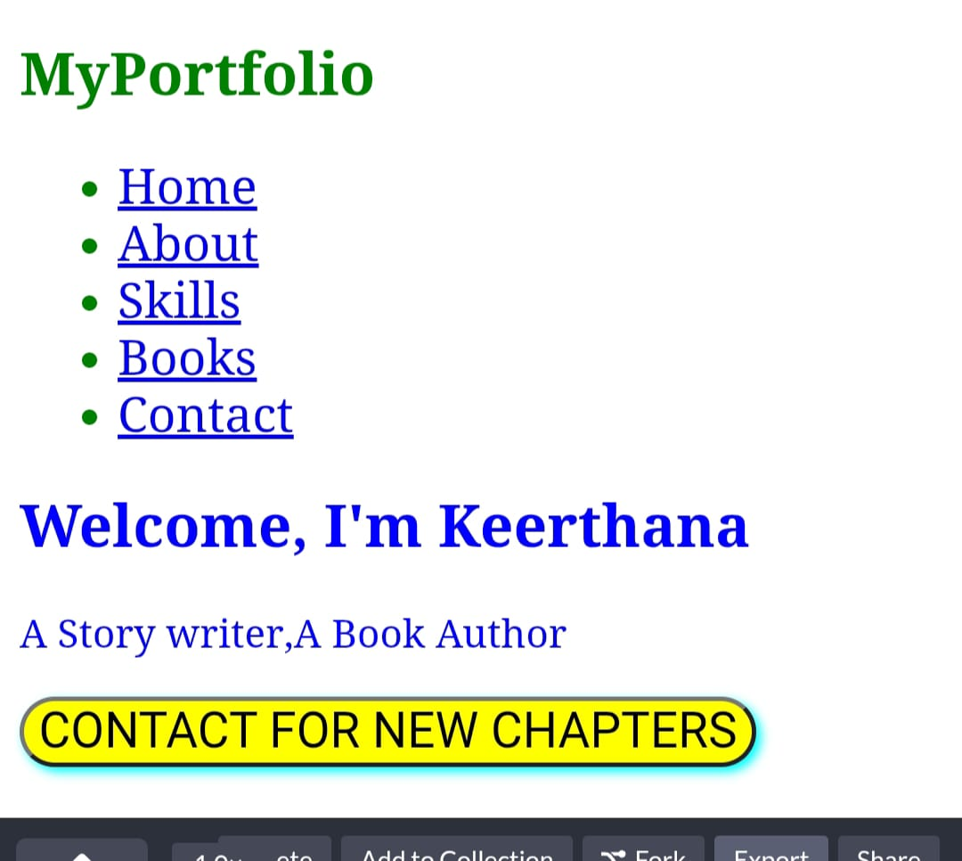

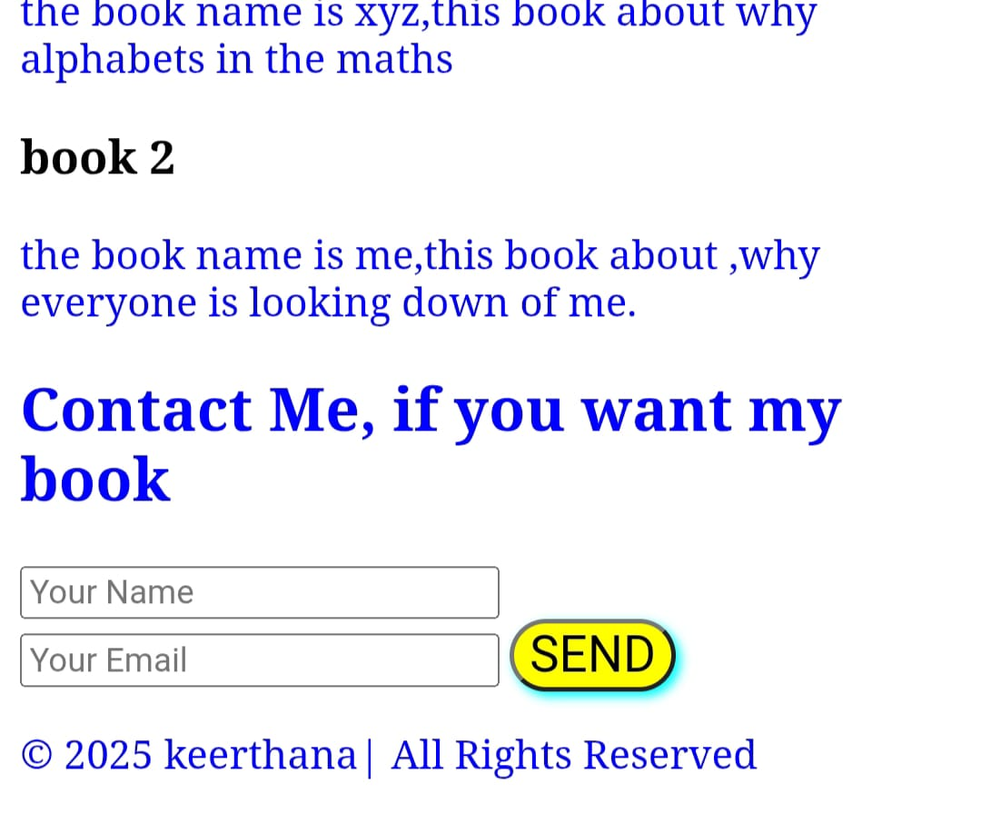
RESULTS AND SCREENSHOTS
3/21/2024 Annual Review
10

Slide 11
CONCLUSION
Portfolio became very valuable in nowadays such as to show our skills and achievements and experiences.
In this portfolio, an Author shows about their books and skills and their digital contact info. Moreover this is not possible in resumes.
11

