Slide 1
Intrusion Detection System Using Rough Set Classification Approach
under the guidance of Dr. Shekhar Verma
R.Keerthi Reddy(IIT2009171)

Slide 2
Goal
I am designing and implementing a Rough Set Classification (RSC) [5].And using RSC I am going to get intrusion detection system feature ranking and generate intrusion detection rules .

Slide 3
What is IDS [4] ?
An intrusion detection system is a security system that detect intrusion made by malicious cracker whose intends to compromise a system . The system will alert the host or server is an intrusion is detecting.

Slide 4
Motivation
Firewalls are mostly employed at the boundary of the network ,and yet a greater percentage of potential hackers may be from within the network.
IDS’s can monitor both internal and external attacks.
IDS’s can analyse the vulnerability of a network

Slide 5
Literature Survey
1. Firewalls^{[11]}:-
A common misunderstanding is that firewalls recognize attacks and block them. This is not true. Firewalls are simply a device or application that shuts off everything, then turns back on only a few well-chosen items. In a perfect world, systems would already be "locked down" and secure, and firewalls would be unneeded. The reason we have firewalls is precisely because security holes are left open accidentally.
A firewall is simply a fence around the network, with a couple of well-chosen gates. A fence has no capability of detecting somebody trying to break in (such as digging a hole underneath it), nor does a fence know if somebody coming through the gate is allowed in. It simply restricts access to the designated points.

Slide 6
2 .Intrusion Detection System[13] :-
The Intrusion detection system in a similar way complements the firewall security. an Intrusion detection system (IDS) is a security system that monitors computer systems and network traffic and analyses that traffic for possible hostile attacks originating from outside the organization and also for system misuse or attacks originating from inside the organization.
A )Machine Learning Approach for Intrusion Detection ^{[12]}:-
Machine learning is based heavily on statistical analysis of data and some algorithms can use patterns found in previous data to make decisions about new data.
1 ) Support Vector Machine^{[12]} :-
Support vector machines, or SVMs, are learning machines that plot the training vectors in high-dimensional feature space, labeling each vector by its class. SVMs view the classification problem as a quadratic optimization problem. They combine generalization control with a technique to avoid the "curse of dimensionality“[12] by placing an upper bound on the margin between the different classes, making it a practical tool for large and dynamic data sets. SVMs classify data by determining a set of support vectors, which are members of the set of training inputs that outline a hyper plane in feature space. The primary advantage of SVMs is binary classification and regression that they provide to a classifier with a minimal dimension , which implies' low expected probability of generalization errors.

Slide 7
2. Neural Network Approach for Intrusion Detection^{[12]} :-
Applying the Neural Network (NN) approach to Intrusion Detection, we first have to expose NN to normal data and to attacks to automatically adjust coefficients of the NN during the training phase. Performance tests are then conducted with real network traffic and attacks.
In order to apply this approach to Intrusion Detection, we would have to introduce data representing attacks and non-attacks to the Neural Network to adjust automatically coefficients of this Network during the training phase. In other words, it will be necessary to collect data representing normal and abnormal behavior to train the Neural Network. After training is accomplished, a certain number of performance tests with real network traffic and attacks were be conducted .

Slide 8
In the research of detection model generation, it is desirable that the detection model be explainable and have high detection rate, but the existing methods cannot achieve these two goals. For example, neural networks (James, 1998) could achieve high detection rate but the detection rules generated are not explainable. decision trees (Wenke, 1999)[13] could yield explainable rules but the detection rate is low. And SVM needs many iterations and is very time-consuming. So i am using Rough Set Classcification approach in intrusion detection system to generate decision rule to classify the attack data or normal data this approach is explainable and have high detection rate

Slide 9
Problem Definition and Scope :-
This thesis is focus on the features extracting and generating decision rules for intrusion detection system using Rough Set Classification approach.
In intrusion detection process intrusion is happening or not this will be decide by the connection record. A connection record is a sequence of TCP packets starting and ending at some well defined times, between which data flows to and from a source IP address to a target IP address under some well defined protocol. Each connection sequence is have 41 features and using some of these features we can decide that intrusion is happening or not .
Using these important features to decide intrusion we generate explainable decision rule .Decision rule explain that on persence of which features is reason for intrusion and these are very valuable for improving detector design.

Slide 10
Using these decision rules we can find out that which feature attribute have role in intrusion and what value is reason for intrusion so intrusion detector design system in such a way that in future that type of situation not happen or minimize intrusion happening probability.
These intrusion detection system are also have ability to control internal attacks log intrusion attempts,provide a hsory for attacks,send alerts ,detect attacks and reacting to attacks.

Slide 11
Description of Hardware and Software
Hardware –
For this thesis i am using my HP dv4 Window 7 operating system installed computer and it have 3 GB ram and Intel core 2 dua 2.20 GHz processor.
Monitor
Keybord
Computer Storage
Software And Tools –
Code Block C++ IDE (Integrated Development Environment) or Devcpp
C++ language
Any text editor

Slide 12
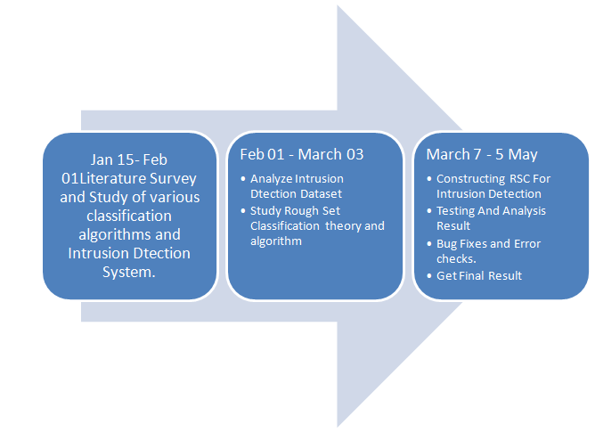
ACIVITY TIME CHART

Slide 13
Methodology
Designing an intrusion detection system [4] based on learning algorithm can be described in the following steps:
1.Capture network data by using tools such as Tcpdump, Dsniff, etc.
2. Process these data into suitable input format.
3. Normalize the network flow and extract features of attack behaviour or normal usage pattern from raw data.
4. Design and use learning algorithm to get detection rules.
5. Use the detection rules into detecting intrusion for new objects.

Slide 14
we choose the 1999 KDD^{[5]} intrusion detection contest dataset to design this system. One of the following main attacks data point is included in each connection –
Normal : Normal data connection.
DOS: Denial of Service, e.g syn flood.
R2L: Remote to Local, Unauthorized access from a remote machine to a local machine, e.g. guessing password.
U2R: Unauthorized access to local super user (root) privileges by a local unprivileged user, e.g. various “buffer overflow” attacks.
PROBE: surveillance and other probing, port monitoring or scanning, e.g. port-scan, ping-sweep.

Slide 15
Detection Rules Auto-Generation
For Feature extraction depend on the data source and the attacks to be detected. For Decision rule auto generation we use rough set classification. For this approach we procced in three step –
Preprocessing.
Training Decision System
Testing Decision System

Slide 16
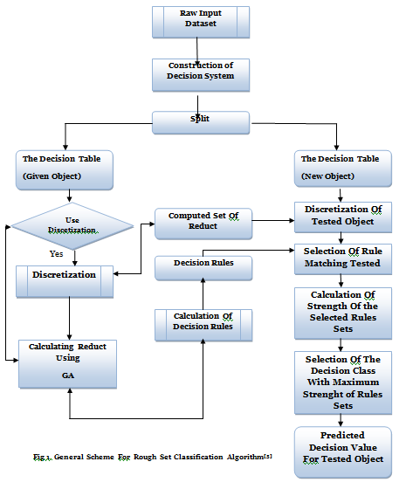

Slide 17
Preprocessing
The raw data are first partitioned into three groups of attacks
DoS attack detection dataset,
Probe attack detection dataset,
U2R&R2L attack detection dataset.
For each dataset, a decision system is constructed . Each decision system is subsequently split into two parts:
The training decision system,
The testing decision system.

Slide 18
Training Decision System
Each training dataset uses the corresponding input features and fall into two classes- normal (0) and attack (+1) .We use these step to develop Training Decision System for all three traning dataset

Slide 19
1 ) Discretization :-
On real value attribute to get the higher quality of classification rule we use this strategy.For this purpose we use Equal Width Discretization method.It divides the number line between Amin and Amax into k intervals of equal width. Thus theintervals have width –
w = (Amax - Amin) / k
Amax= Attribute A maximum value for all objects
Amin= Attribute A minimum value for all objects
K is user predefined parameter which is set 4 in this model
and the cut points are at Amin + w; Amin + 2w; .......; Amin + (k - 1) w.

Slide 20
2.Decision Rule Generation
For decision rule generation we are using Reduct which are generating from attribute reduction Hybride Genetic algorithm which is based on attributes significance heuristic rules^{[5]} to find minimal reducts.
This algorithm reduce the training time and make classifier more effective. We are going to extend this algorithm to find minimul reduct problem using rough set theory.

Slide 21
A ) Frame of Hybride Genetic Algorithm
Finding the rough set minimul reduct is taken as hitting set problem . For discretized decision system
L = { U, AU{d} ,V,F}
We are creating a multi set .For creating multi set we first create discernibility matrix for decision system L. For decision system L discernibility matrix is defined as –
M(U) = [M^{d} _{A}(i , j)]n×n
Is defined as

Slide 22
Where ak(xj) is the value of objects xj on attribute ak , d(x) is the value of object x on decision attribute d.
M(U) = [M^{d} _{A}(i , j)]n×n as a list {p1,…, pt}.
Each p_{i} is called a discernibility entry, and is usually written as pi=ai1, …, aim, where each aik corresponds to a condition attribute of the information system, k=q,…,m; i=1,…,t.
Discernibility matrix^{[4][9]} can be represented by the discernibility function f, f=p1 ∩ … ∩ pt, where each pi=a_{i1}U…U a_{im} is called a clause.
f is a CNF Boolean function, so it has a multiset^{[5]} . Let M( f ) denote the multiset of discernibility function f,
M(f) = {{a11,…,a1m},…,{ai1,…,aim},…, {at1,…,atm}}.
Subsequantly the hiting set of multiset is constructed by using hybrid genetic algorithm. Hitting set of a given multiset M of elements from2^{A} is a set B ⊆ A such that the intersection between B and every set in M is nonempty.
HS (M) = {B ⊆ A | B ∩ Si ≠ Ø for all Si in M}

Slide 23
B )Generation of the Initial Population
For the minimal hitting set problem, a straightforward choice of population is a set P , encoded as bit-vectors, where each bit indicates the presence of a particular element in the set. For example, assume that we have 10 condition attributes {a1, a2, …, a10} and we have a reduct candidate as {a1, a4, a6, a9}. Then the reduct candidate should be represented as: 1001010010

Slide 24

C) Function of Fitness
Let n denote the number of condition attributes, M the multiset of discernibility function of L and B⊆A,
The first term rewards the shorter elements and the second tries to ensure that we reward sets that are hitting sets to guarantee the decision ability. The parameter ε controls the degree of approximation decision ability.

Slide 25
D) Selection and Recombination Method
STEP 1 :-
1 .Calculate the fitness for each chromosome in the current generation
2 .Use heuristic rule to make genetic algorithm converge faster ^{[2][12]}. This rule operator operates on the whole population
Let R be the attribute set represented by current chromosome. If R is not a hitting set (It is judged in the fitness function computation)
Then find an attribute C-R which has maximum SGF(a,R,D) = P(a) value . P(a ) is the number of time attribute a present in remaining discernibility matrix[5]. Which remove non empty interaction with R.
If there are more then one a_{j} {j = 1,2 ….m} for maximal value then stocasticaly choose one attribute from them.
Set the corresponding to a_{j} as ‘1’.
3. Then according to fitness value we select the parent.

Slide 26
STEP 2 :-
Let minsingle(Offspring) be the worst individual in the new population, minfit(Offspring) be the corresponding fitness.
Let maxsingle(Parent) be the best individual in the old population, maxfit( Parent) be the corresponding fitness.
If minfit( Offspring)<maxfit(Parent), we replace minsingel( Offspring) with maxsingle(Parent).

Slide 27
D ) Crossover and Mutation :-
I use classical, one-point crossover. Crossing- over process affects chromosome selected for reproduction with probability of Pc. In this model we use Pc = 1 .
In the mutation process, we first select a chromosome to be mutated with probability Pm and then choose a single gene of the chromosome randomly. Mutation of a single gene means replacement of “1” by “0” or “0” by “1”. In our model we use Pm = 0.01

Slide 28

E ) Decision Rule Generation [8]
In this step we generate the rule using reduct .Reduct is the reduced set of relation that conserve the same classification ability of relation. We further by using the confidence or strength ( α) of the attribute find another indispensable attribute of the table.The confidence or strength for an association rule x ->D is :-
After calculating strength for each reduc attribute .we choose the maximum strength attribute as optimize reduct.
And after that using this attribute we reduce table by merging duplicate rows

Slide 29
3 ) Testing Decision System
In this step model test the perpormance of model on testing data These following step we follows –
Discretization method first use to dicretize the row testing data object.
Generated rules are use to check the strength of the rule for matching object to it decision class.
The object is assigned to the class which has maximum strength for decision rule set.

Slide 30
Testing and Analysis
For each input dataset, this model construct a decision system using the following method:
For each attack detection dataset, different connection record feature set are selected as the condition attributes of the decision system. For Probe and DoS attack, intrinsic and traffic features are used; for U2R&R2L attack, intrinsic and content features used.
The label (normal ‘0’, attack ‘1’) variable of each record is used as the decision attribute of the decision system.
A connection record data point is used as an object in the decision system. Each of the constructed decision systems will be processed by RSC subsequently.
Data points are used for training using the RSC algorithm. The generated rules are used to predict the tested objects

Slide 31
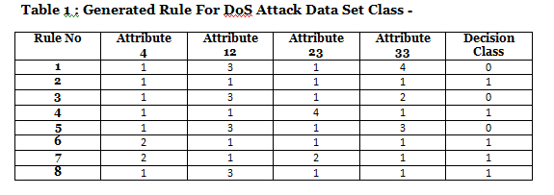
Result For DoS Class
Training data of DoS attack detection dataset i gave as input in DoS Attack training system and it generate the decision rule in given table 1 format -

Slide 32
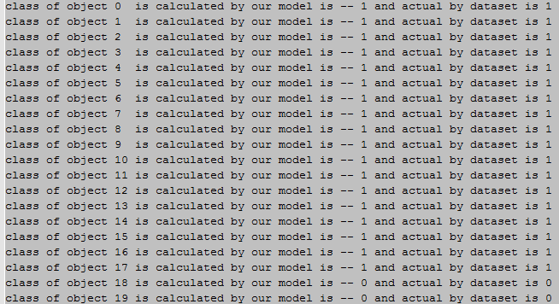
After geting these decision rule we give Testing data of the DoS Attack dataset as input in DoS Attack testing system and testing system use these generated decision rule and classify the newly object in class ‘1’(for intrusion) and ‘0’ for normal object .

Slide 33
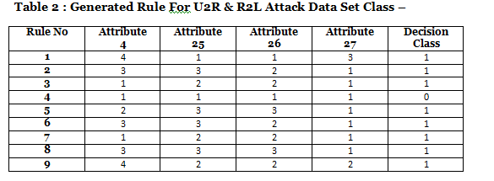
2) Result For U2R & R2l Class :-
Training data of U2R & R2L attack detection dataset i gave as input in U2R & R2L Attack training system and it generate the decision rule in given table 2 formate –

Slide 34
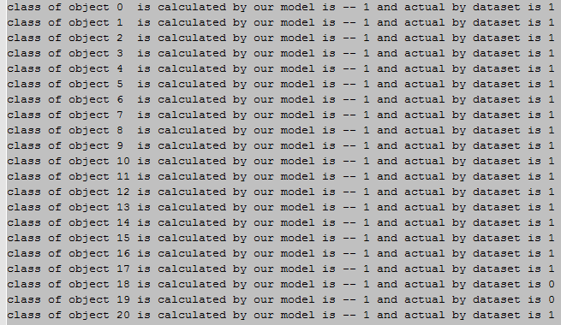
After getting these decision rule we give Testing data of the U2R & R2L Attack dataset as input in U2R & R2L Attack testing system and testing system use these generated decision rule and classify the newly object in class ‘1’(for intrusion) and ‘0’ for normal object .

Slide 35
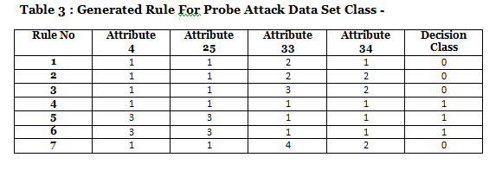
3 ) Result For Probe Class :-
Training data of Probe attack detection dataset i gave as input in Probe Attack training system and it generate the decision rule in given table 3 formate-

Slide 36
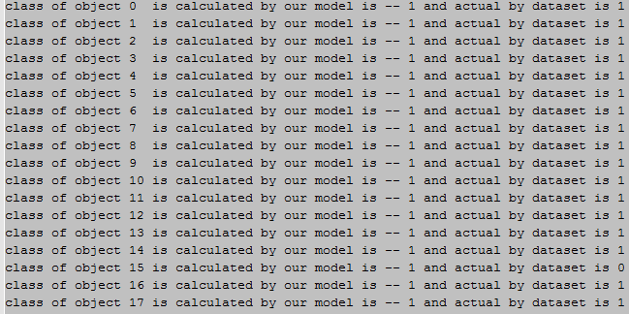
After getting these decision rule we give Testing data of the Probe Attack dataset as input in Probe Attack testing system and testing system use these generated decision rule and classify the newly object in class ‘1’(for intrusion) and ‘0’ for normal object .

Slide 37
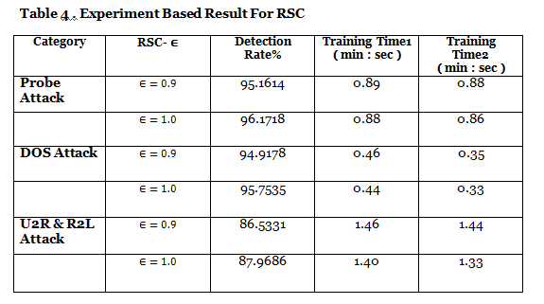
Experiment Result For All Attacks:-

Slide 38
Analysis
For detection rule generation for all three dataset i take discretization coefficient k as 4 And this value is taken after experimental analysis. And for Equal width discretization method i predefined min and max value for the attributes according to their range.For k=4 we can get result more accurate .If we increase k value then our result will not efficient take more time to generate the rule.
For fitness function we take ∈ = 1 or ∈= 0.9 both value as decision coefficient.And after analysis all three data set generated decision rule we can find 6 most significant feature attribute are 3 , 24 , 25, 28, 31, 32 .these attribute set are minimul reduct for classification .
Using reduct we can generate rule for each classifier and get result that which decision class a new object will get .RSC generate decision rule in explainable “IF-THEN” format. For instance, one of the Probe attack detection rules is:
“IF ATTRIBUTE 4 = 1 AND ATTRIBUTE 24 = 1 AND ATTRIBUTE 26 = 1 AND ATTRIBUTE 32 = 4 THEN RESULT IS 1 ”

Slide 39
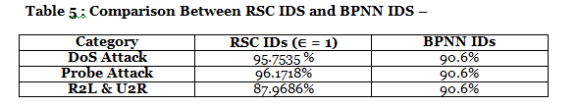
Comparison Of RSC IDs and Back Propagation Neural Network Approach IDs
For DoS attack and Probe attack the detection rate is high (above 99 %) But for U2R&R2L attack detection, RSC IDs is worse than BPNN IDs. The reason is that RSC algorithm can get good performance when the samples are enough while it performs a little worse for small attack sample case (In the DARPA dataset, U2R&R2L attack samples are low but DoS and Probe attack samples are enough).But BPNN algorithm IDS work well with both small and big dataset .So we can say that for DoS and Probe attacks our RSC Ids working very well but for R2L & U2R attack BPNN IDs is working well then RSC Ids.

Slide 40
6 ) Conclusion:-
I use rough set classification (RSC) for intrusion detection system (IDS) feature ranking and intrusion detection rules generation. Intrusion detection using RSC can yield both explainable detection rules and high detection rate for some attacks (DoS and Probe Attack). And feature ranking using RSC for IDS is simple and fast.
I used a hybrid genetic algorithm based on the attribute significance to compute the rough set reduct and accelerate the convergence speed and decrease the training time of RSC. But for the real-time IDS, the training time of RSC is still long and needs further improvement.

Slide 41
REFERENCES
[1]Pawlak Z. Rough Set. International Journal of Computer and Information Science,pp 341-356, 1982
[2] Wong S KM, Ziarko W. On “optimal decision rules in decision tables”. Bulletin of Polish Academy of Sciences. 1985
[3]Wa'el M. Mahmud, Hamdy N.Agiza, and Elsayed Radwan” Intrusion Detection Using Rough Sets based Parallel Genetic Algorithm Hybrid Model” Proceedings of the World Congress on Engineering and Computer Science 2009 San Francisco, USA
[4]Kanchan S. Tiwari, Ashwin G. Kothari, and Avinash G. Keskar” Reduct Generation from Binary Discernibility Matrix: An Hardware Approach” International Journal of Future Computer and Communication, October 2012
[5] Zhang, G. Zhang, L. Yu, J. Zhang, and Y. Bai, “Intrusion detection using rough set classification.” Journal of Zheijiang University Science. 2004
[6]Pawan Lingras “Unsupervised Rough Set Classification Using GAs” Journal of Intelligent Information Systems, 2001 Netherlands
[7]Suman Saha, C.A. Murthy_ and Sankar K. Pal “Rough set Based Ensemble Classifier forWeb Page Classification” Fundamenta Informaticae 2007 india

Slide 42
[8] Hong-Hai Feng, Bao-Yan Liu , Li-Yun He , Bing-Ru Yang , Yu-Mei Chen , Yu-Li Li “A New Measure Of Significance Of Condition Attribute And Its Use In Attribute Reduction” Fifth International Conference on Machine Learning and Cybernetics, Dalian, 13-16 August 2006
[9] Rao Hong, Xia Yejuan, Li Meizhu “An Algorithm for Classification Rules Extraction
Based on Discernibility Matrix and Attribute Significance” 2008 China
[10]Fen Zhou, Gaizhen Yang” Network intrusion detection using rough sets based parallel genetic algorithm hybrid model” International Symposium on Intelligence Information Processing and Trusted Computing 2010 China
[11] Yair Bartal , Alain Mayer , Kobbi Nissm, Avishai Wool , “Firmato: A novel firewall management toolkit ”, ACM Transactions on Computer Systems (TOCS) , New York, NY, USA ,2004
[12] Srinivas Mukkamala, Guadalupe Janoski, Andrew Sung,” Intrusion Detection Using Neural Networks and Support Vector Machines” International Joint Conference 2002.
[13] Deepika P Vinchurkar, Alpa Reshamwala.” A Review of Intrusion Detection System Using Neural Network and Machine Learning Technique” International Journal of Engineering Science and Innovative Technology (IJESIT) , November 2012

