Slide 1

SMART INDIA HACKATHON 2026
TITLE PAGE
Problem Statement ID –SIH26104
Problem Statement Title - AI - Powered Real-Time Detection and Prevention of Voice Cloning Impersonation Attacks
Theme- Blockchain & Cybersecurity
PS Category- Software
Team Name - VoiceX

Slide 2

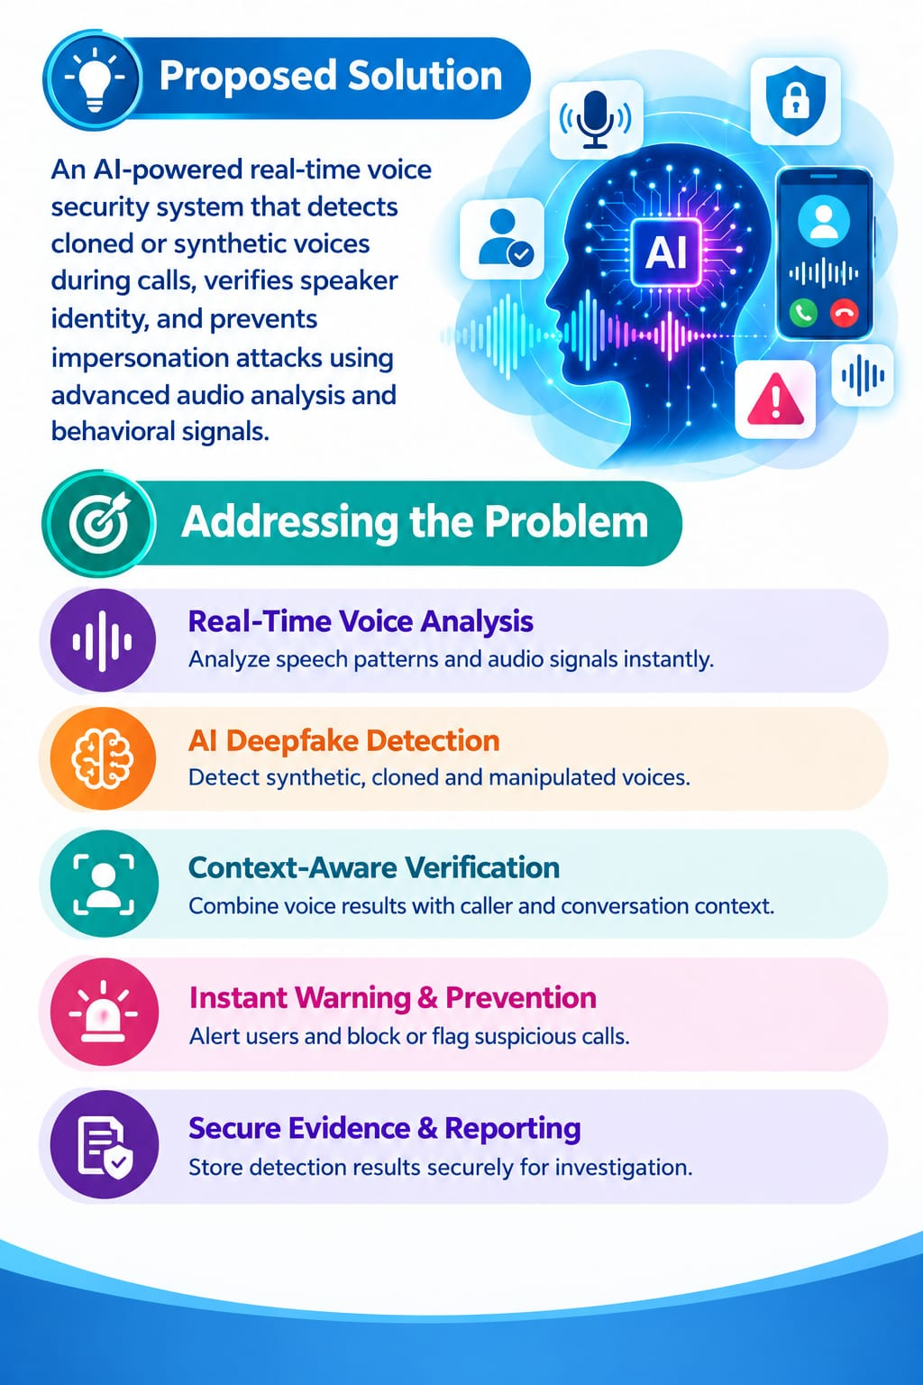
IDEA TITLE
VOICEX
PROPOSED SOLUTION:
An AI-powered real-time voice security system that detects cloned or
synthetic voices during call, and prevents impersonation attacks using advanced audio analysis and behavioral signals.
ADDRESSING THE PROBLEM:
Real-Time Voice Analysis
Analyze speech patterns and audio signals instantly.
AI Deepfake Detection
Detect synthetic, cloned, and manipulated voices.
Verify the caller using voice biometrics and contextual information.
Live Risk Assessment
Generate a dynamic impersonation risk score in real time.
Instant Warning & Prevention
Alert users and block or flag suspicious calls.
Secure Evidence & Reporting
Store detection results securely for investigation and reporting.

Slide 3
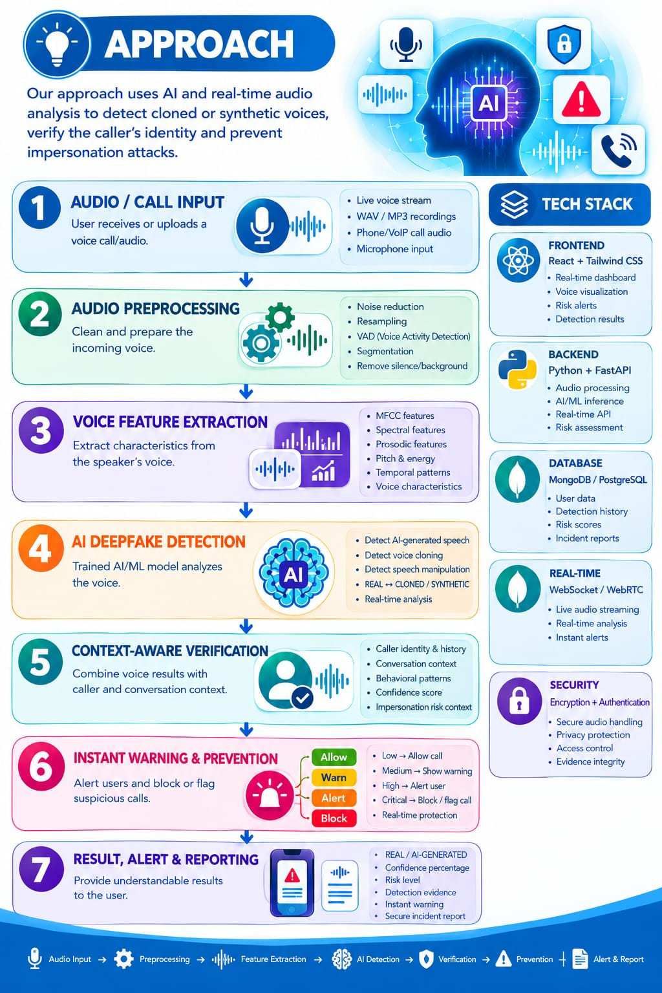
TECHNICAL APPROACH
1. REAL-TIME AUDIO CAPTURE
The system continuously monitors incoming voice signals during a call. Audio is captured without interrupting normal communication.
2. SIGNAL QUALITY ENHANCEMENT
The captured speech is enhanced to improve detection accuracy.
Unwanted background sounds and distortions are minimized.
3. VOICE PATTERN ANALYSIS
The system studies unique characteristics of human speech.
It analyzes pronunciation, rhythm, pitch, tone, and speaking style.
4. SYNTHETIC VOICE IDENTIFICATION
AI identifies subtle artifacts produced by voice-cloning systems.
The model distinguishes natural speech from generated speech.
5. CONTEXT-AWARE VERIFICATION
Voice results are combined with caller and conversation context.
This helps identify suspicious impersonation attempts more reliably.
6. DYNAMIC THREAT SCORING
The system continuously calculates the likelihood of an impersonation attack.
The risk score changes as new voice evidence becomes available.
7. AUTOMATED SECURITY RESPONSE
The system responds according to the detected threat level.
Suspicious activity is highlighted and recorded for further action.

Slide 4

FEASIBILITY AND VIABILITY
Your Team Name
TECHNICALLY FEASIBLE:
AI/ML, deepfake detection, and voice biometrics enable real-time
voice analysis and accurate impersonation detection.
DATA FEASIBLE:
Uses publicly available datasets such as ASVspoof and genuine/synthetic
speech samples for training and validation.
EASY IMPLEMENTATION:
Modular web-based system using Python, FastAPI, PyTorch, and Librosa
with API-based architecture.
SCALABLE:
Can expand to support more voice-cloning techniques, languages, users,
and real-time communication platforms.
USER-FRIENDLY:
Provides instant detection results, risk scores, and clear alerts through a
simple and intuitive interface.
SUSTAINABLE:
Reduces manual voice verification, prevents fraud losses, and provides
continuous automated protection against voice impersonation attacks.

Slide 5
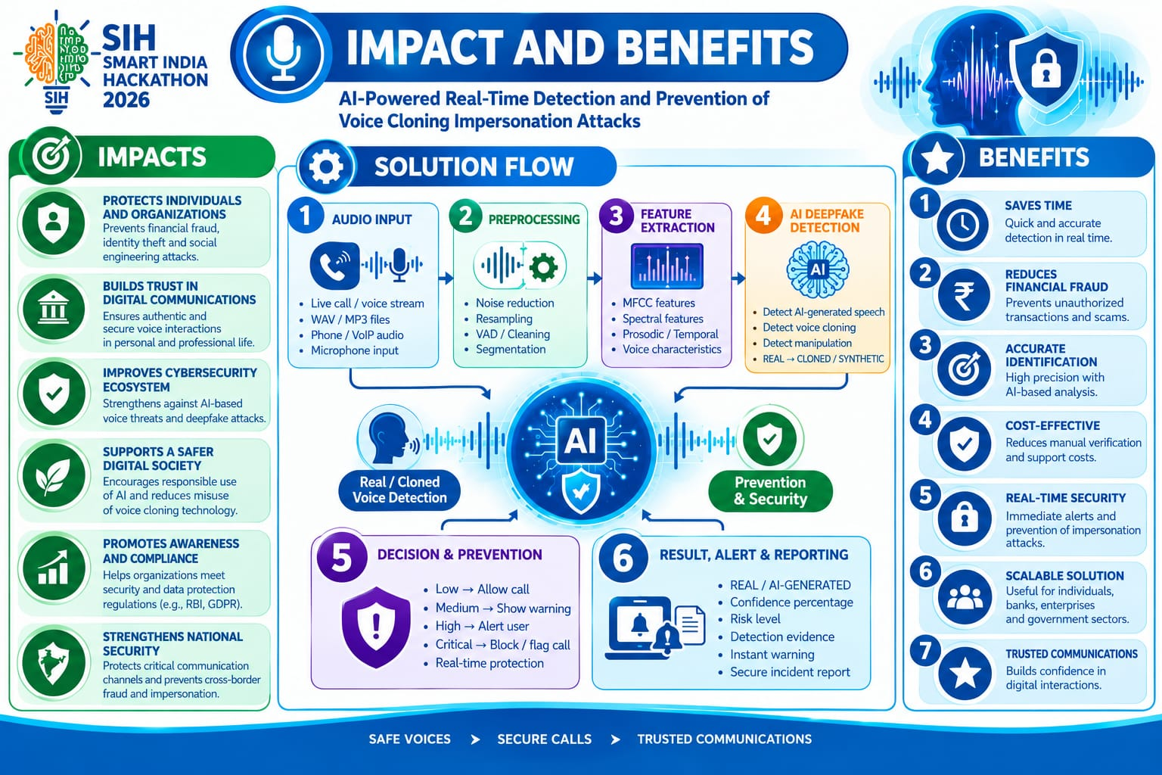
IMPACT AND BENEFITS
Your Team Name

Slide 6
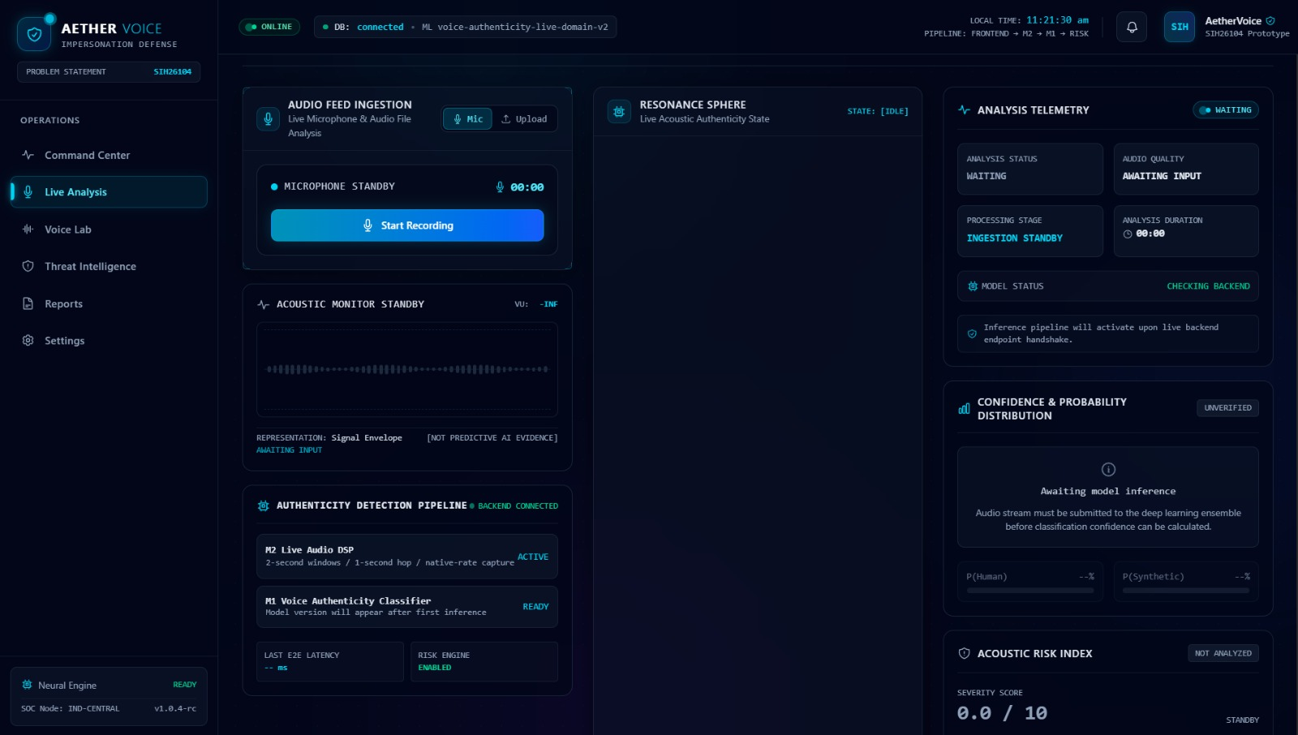
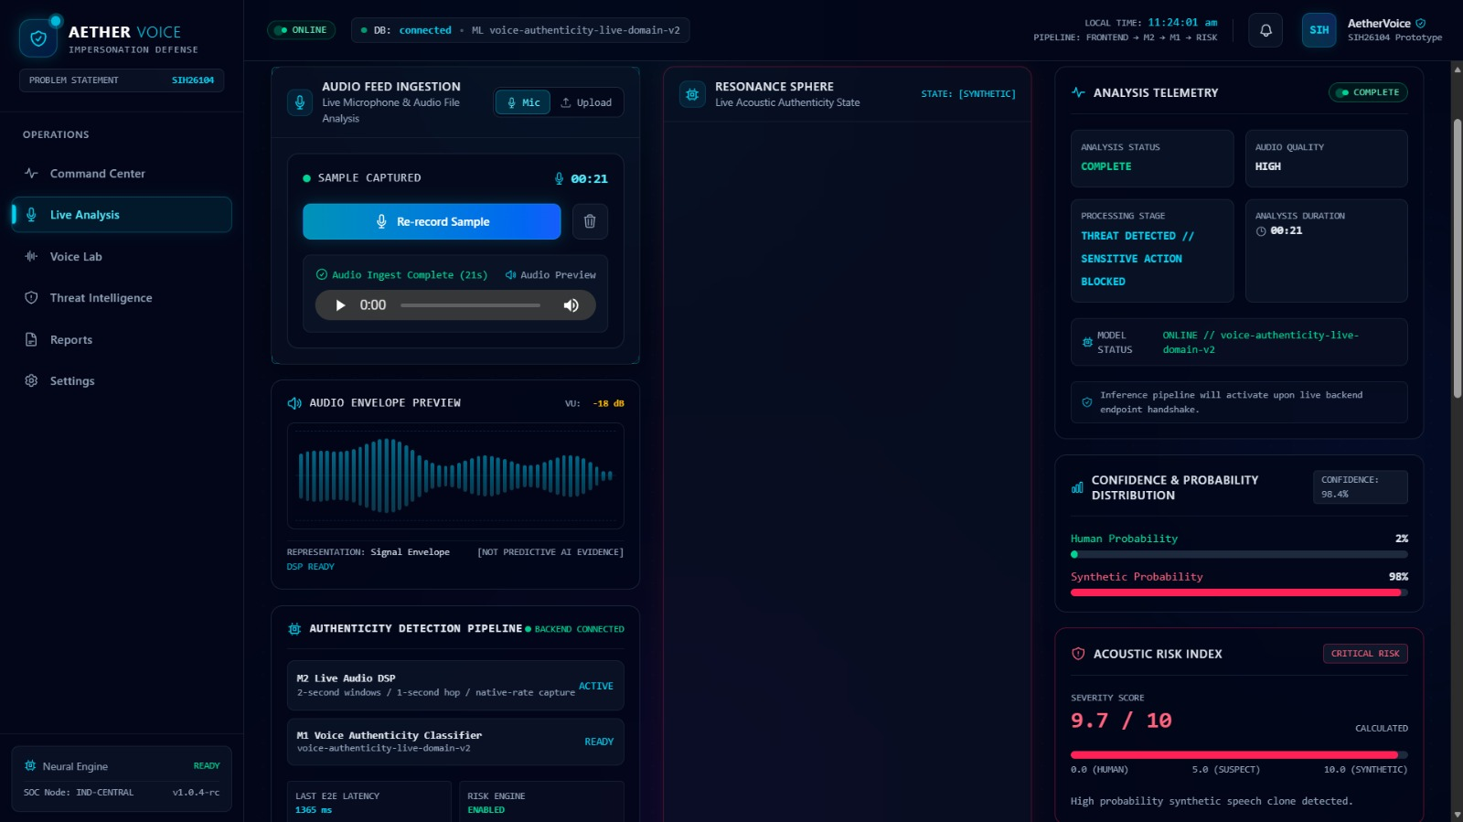
RESEARCH AND REFERENCES
Your Team Name
PROTOTYPE
RESEARCH
• [ASVspoof – Voice Anti-Spoofing Research](https://www.asvspoof.org/)
• [ASVspoof 2021 – Deepfake & Spoofed Speech Databases](https://www.asvspoof.org/)
• [ASVspoof 2019 – Spoofing & Countermeasures](https://www.asvspoof.org/)
• Research on speech synthesis, voice conversion, speaker verification
and audio deepfake detection.
• ASVspoof 2021 – DeepFake (DF),Logical Access (LA), Physical Access (PA)
• Real/Bona fide and spoofed/synthetic speech samples for training
• [PyTorch](https://pytorch.org)
• [FastAPI](https://fastapi.tiangolo.com)
• MongoDB / PostgreSQL for detection history and reports
RESEARCH
DATA
TOOLS

