Slide 1
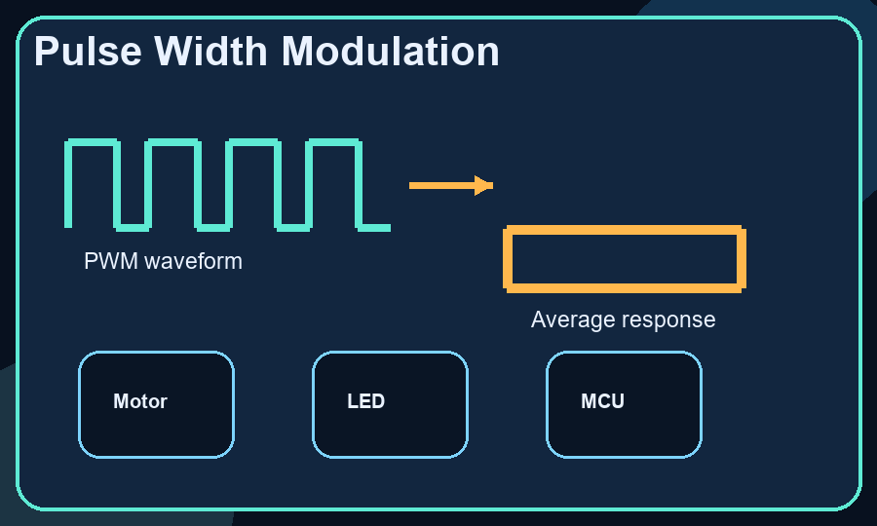
Overview
Pulse Width Modulation
From binary switching to analog-like control
Figure 01
Engineering presentation covering PWM fundamentals, mathematics, hardware generation, and embedded-system usage.
Duty cycle controls average delivered power.
Frequency choice affects ripple, switching loss, acoustic behavior, and EMI.
Engineering presentation covering PWM fundamentals, mathematics, hardware generation, and embedded-system usage.

Slide 2
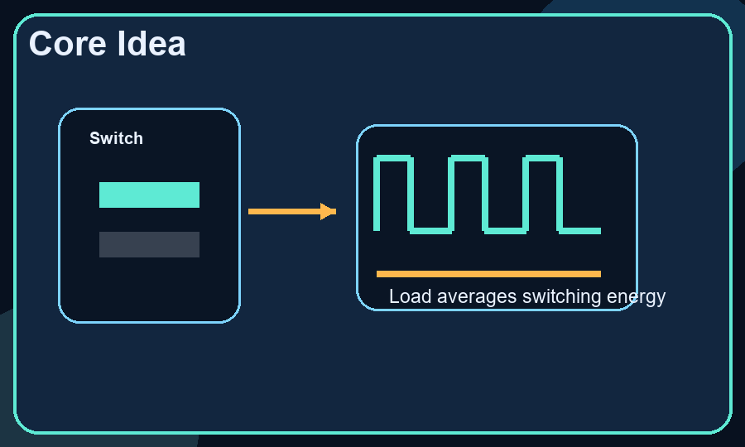
Concept
Core Idea
Figure 02
PWM approximates analog control by alternating between full ON and full OFF states.
Loads respond to average energy over each switching period.
For many practical loads, average output follows Vavg ~= Duty Cycle x Vsupply.
PWM approximates analog control by alternating between full ON and full OFF states.

Slide 3
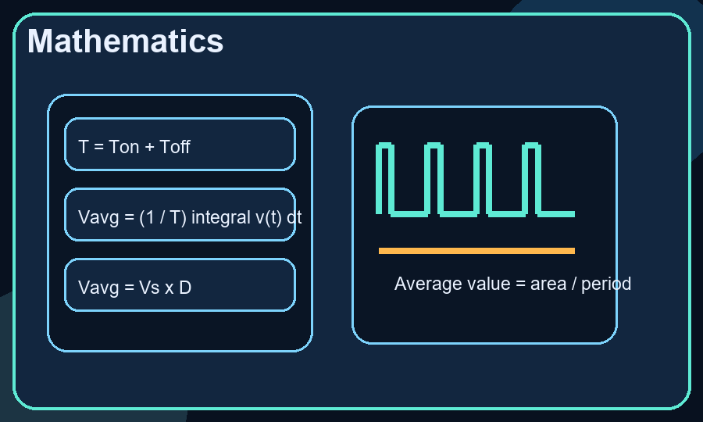
Math
Mathematics
Figure 03
T = Ton + Toff
Vavg = (1 / T) integral of v(t) over one period
For an ideal PWM waveform: Vavg = Vs x (Ton / T) = Vs x D
Example: 12 V x 0.25 = 3 V average for a filtered or averaging load
T = Ton + Toff

Slide 4
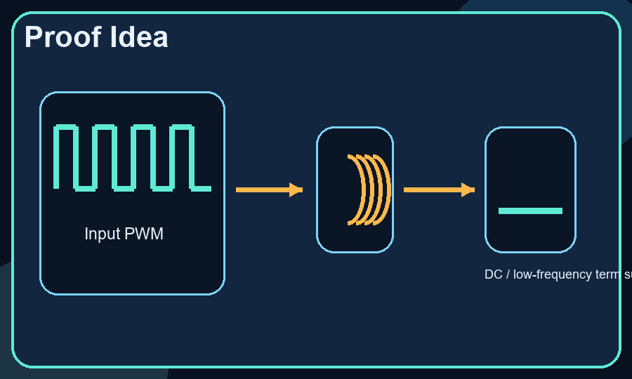
Reasoning
Proof Idea
Figure 04
The DC term of a rectangular periodic waveform equals its average over one period.
That average is proportional to duty cycle: Vs x D.
A low-pass filter or energy-averaging load suppresses high-frequency switching harmonics.
Observed low-frequency output therefore tracks duty cycle.
The DC term of a rectangular periodic waveform equals its average over one period.

Slide 5
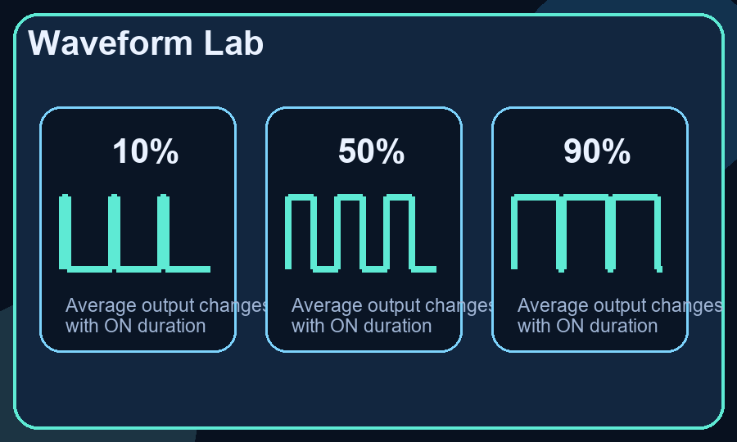
Duty Cycle
Waveform Lab
Figure 05
10% duty cycle: low average energy, low LED brightness, light motor torque demand.
50% duty cycle: equal ON and OFF intervals, common demonstration case.
90% duty cycle: near-full delivery, filtered loads respond almost like a steady high level.
10% duty cycle: low average energy, low LED brightness, light motor torque demand.

Slide 6
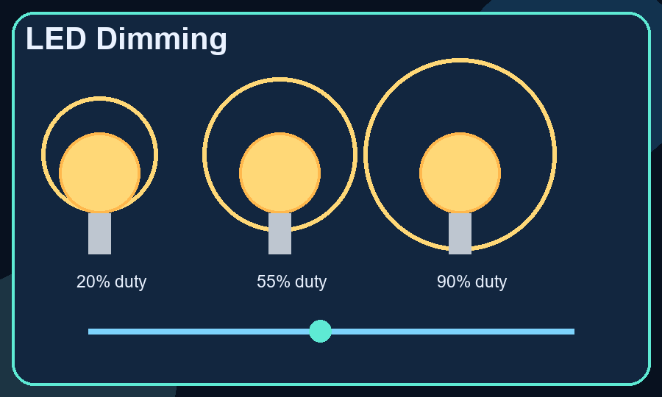
Optical Load
LED Dimming
Figure 06
Brightness control is illustrated through PWM-driven LED dimming.
Average optical output changes with duty cycle even though switching remains binary.
The same example supports discussion of timer resolution, flicker, current limiting, and thermal behavior.
Brightness control is illustrated through PWM-driven LED dimming.

Slide 7
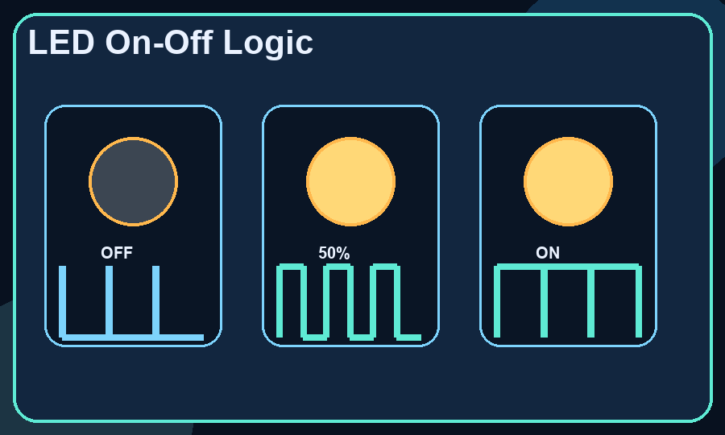
Binary State
LED On-Off Logic
Figure 07
0% duty cycle: LED remains OFF during the full period.
50% duty cycle: LED alternates fully ON and fully OFF; human vision integrates the switching.
100% duty cycle: LED remains ON for the full period.
Apparent brightness is created by ON-time variation, not by intermediate LED states.
0% duty cycle: LED remains OFF during the full period.

Slide 8
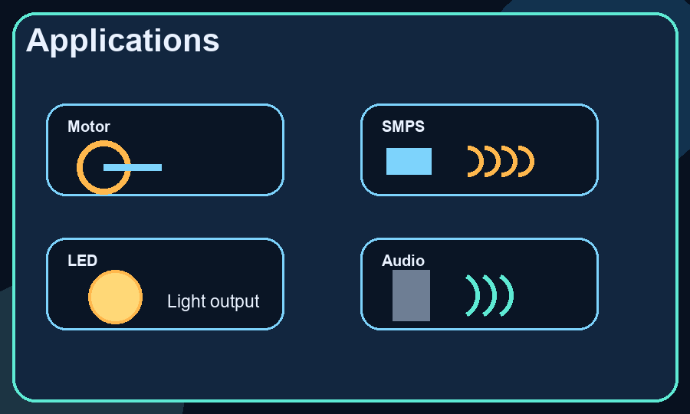
Use Cases
Applications
Figure 08
Motor control: duty cycle regulates average armature voltage, speed, and torque.
Switch-mode power supplies: PWM controls energy transfer in buck, boost, and inverter stages.
LED dimming: optical output tracks duty cycle while switching remains efficient.
Audio and actuation: used in class-D amplification, buzzers, and compact switching interfaces.
Motor control: duty cycle regulates average armature voltage, speed, and torque.

Slide 9
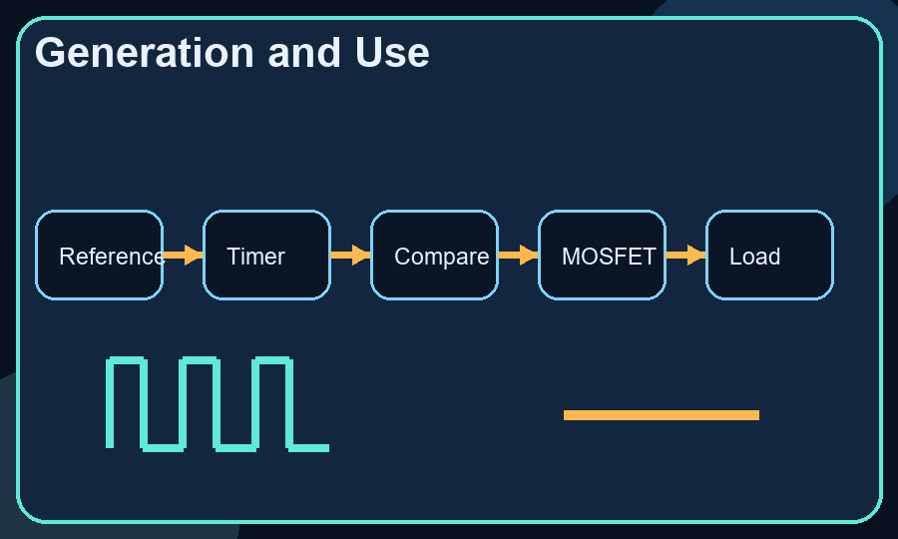
Signal Chain
Generation and Use
Figure 09
Reference target is converted into a timer/counter setting.
Compare logic keeps output HIGH while counter is below threshold.
Power stage applies the switching waveform to the load.
Filtering, inertia, or energy storage turns switching into useful electrical, optical, mechanical, or acoustic output.
Reference target is converted into a timer/counter setting.

Slide 10
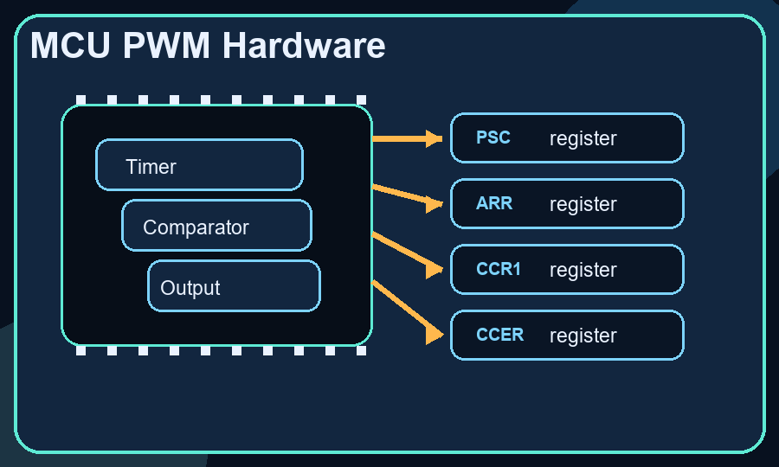
Registers
MCU PWM Hardware
Figure 10
Timer peripherals generate PWM using prescaler, counter, auto-reload, and compare registers.
Clock division: timer_clk = fclk / (PSC + 1)
Period setup: fpwm = timer_clk / (ARR + 1)
Duty setup: duty = CCRx / (ARR + 1)
Hardware action: output remains active while CNT < CCRx, then toggles automatically.
Timer peripherals generate PWM using prescaler, counter, auto-reload, and compare registers.
TIMx_PSC = 79;
TIMx_ARR = 999;
TIMx_CCR1 = 250;

Slide 11
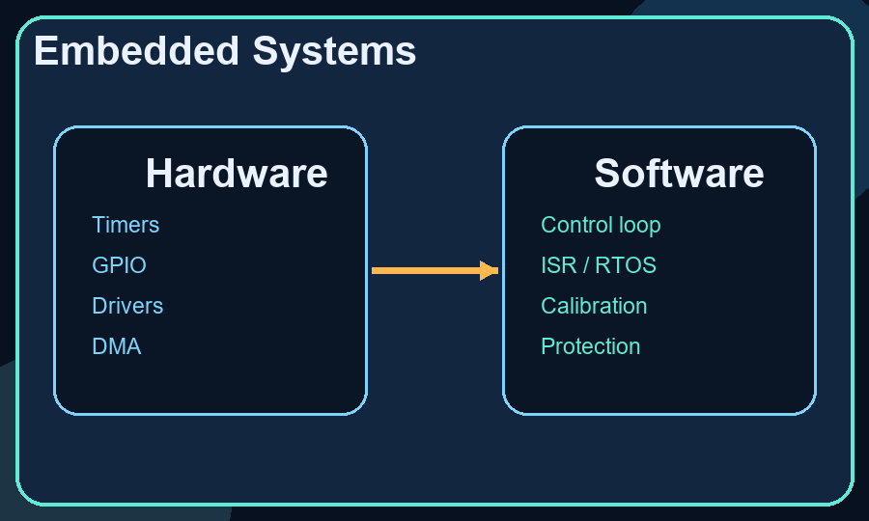
Embedded
Embedded Systems
Figure 11
Hardware side: MCU timers, compare units, complementary PWM, dead time, DMA-fed updates.
Software side: control loops, ISRs or RTOS tasks, calibration tables, and safety clamp logic.
PWM is a hardware/software boundary where control intent becomes deterministic switching behavior.
Hardware side: MCU timers, compare units, complementary PWM, dead time, DMA-fed updates.

Slide 12
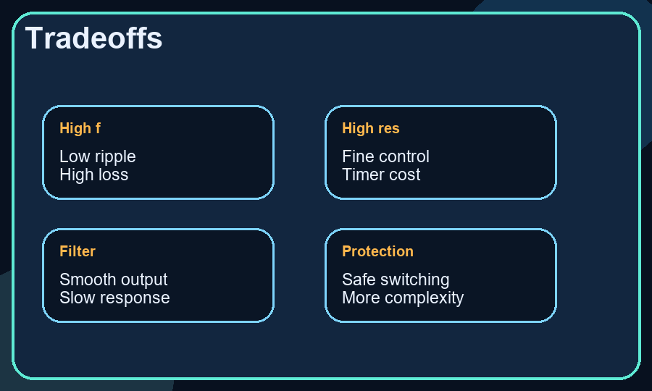
Tradeoffs
Tradeoffs
Figure 12
Higher frequency reduces ripple but increases switching loss and EMI stress.
Higher resolution improves control granularity but increases timer constraints.
Filtering smooths output but slows response and increases component size.
Protection features improve robustness but add timing and implementation complexity.
Higher frequency reduces ripple but increases switching loss and EMI stress.

Slide 13
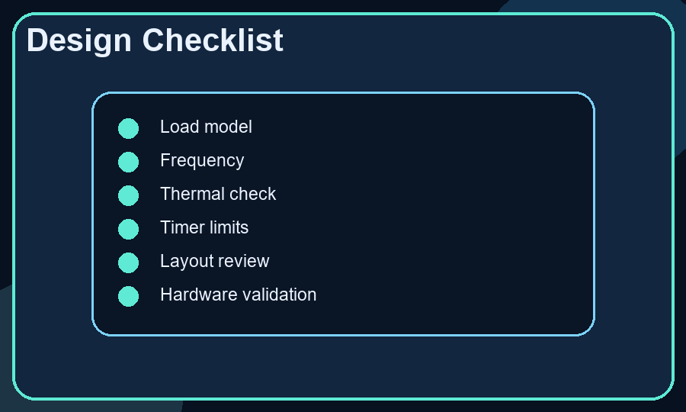
Checklist
Design Checklist
Figure 13
Define the load model clearly.
Choose frequency using ripple, acoustics, EMC, and switch capability.
Validate thermal behavior at worst-case duty cycle.
Review timer resolution, control-loop timing, layout, and waveform quality on hardware.
Define the load model clearly.

Slide 14
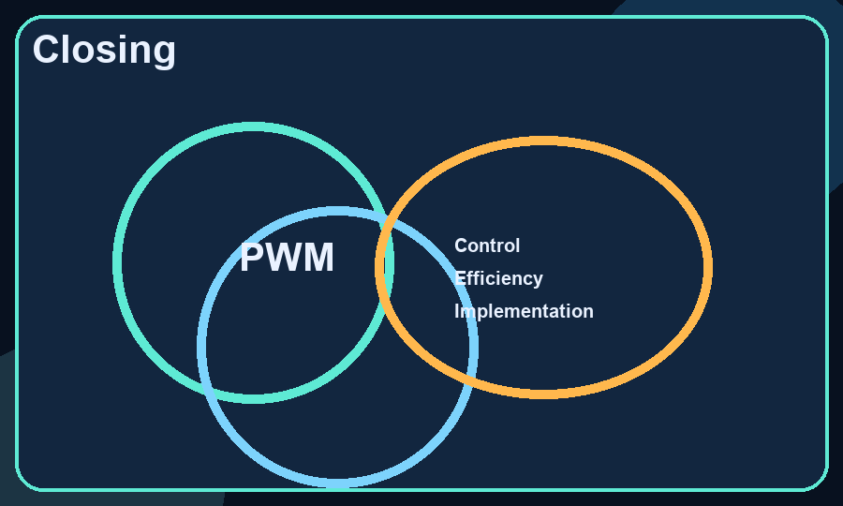
Summary
Closing
Figure 14
PWM is simple in principle and demanding in implementation.
It remains one of the most useful techniques in embedded systems and power electronics.
The core value lies in turning timing control into efficient energy control.
PWM is simple in principle and demanding in implementation.

Slide 15
Summary
Thank You
Presented by
- Keerthi Mallesh

