Slide 1
Power BI Business Intelligence Project
E-Commerce Business
Analytics Dashboard
ShopSphere Online
Dataset: Brazilian E-Commerce Public Dataset (Olist)
KEERTHI . N
BCA

Slide 2
Company Overview
Client: ShopSphere Online
ShopSphere Online operates a nationwide e-commerce marketplace, selling products across many categories to customers throughout Brazil. As the business grows, management needs accurate insight into sales performance, product popularity, customer behavior, and delivery quality to make confident, data-driven decisions.
Business Objectives
Improve customer experience and grow online revenue
Understand purchasing behavior and product performance
Identify top-performing products, categories and regions
Understand what drives customer satisfaction
Support decisions with a single, reliable dashboard
1

Slide 3
Business Problem
Problem Statement
Management lacks a single, centralized view of how the business is performing across products, customers and regions.
Challenges
Solution
Difficulty tracking revenue across products and categories
Develop an interactive Power BI dashboard that gives ShopSphere real-time insight into revenue, products, customers and regional performance, all in one place.
No clear view of top or underperforming customers
Limited visibility into regional purchasing patterns
Unclear which factors are driving customer satisfaction
2

Slide 4
Main Goal
Build an interactive Power BI dashboard answering:
Overall revenue generated
Purchasing patterns across regions
Top-performing products and categories
Frequently purchased products
Highest revenue-contributing customers
Categories that need business attention
Monthly sales trends throughout the year
Factors influencing customer satisfaction
Highest and lowest rated products
Data-driven business recommendations
3

Slide 5
Dataset Description
Brazilian E-Commerce Public Dataset
Source & Scope
Source: Kaggle — Brazilian E-Commerce Public Dataset by Olist. It contains real, anonymized orders from ShopSphere-style marketplace transactions, used here to analyze revenue, product performance, customer behavior and delivery satisfaction.
Dataset Includes
Orders & Items
Payments
Reviews
Order status, timestamps, prices and freight (olist_orders, olist_order_items)
Payment type, installments and value per order
Customer review scores linked to each order
Products
Customers & Sellers
Geolocation
Product category (translated to English), dimensions and weight
Customer and seller location (city, state)
Latitude/longitude by zip code, used for regional mapping
4

Slide 6
Data Cleaning
Preparing data for analysis in Power Query
Filtered order_status to exclude canceled and unavailable orders, so revenue reflects only completed sales
Merged product_category_name_translation to convert Portuguese category names into English
Converted data types and standardized date/timestamp columns across all tables
Added a calculated Delivery Delay (days) column: delivered date minus estimated delivery date
Built a Delivery Status bucket (Early / On Time / Slightly Late / Very Late / Not Delivered)
Removed unnecessary columns and handled blank category values to keep the model lean
5

Slide 7
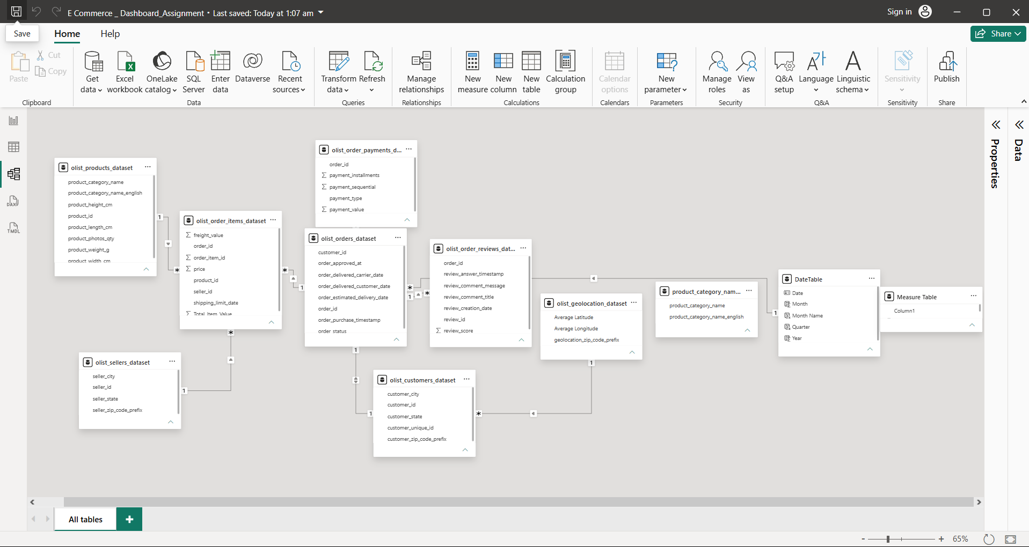
Data Modeling
Star schema built in Power BI
olist_orders_dataset is the central fact table, joined to order items, payments and reviews
Customers, products (with category translation), sellers and geolocation connect as dimensions
A dedicated DateTable supports month/quarter/year time-intelligence calculations
All relationships flow one-to-many from dimension tables into the fact table
6

Slide 8
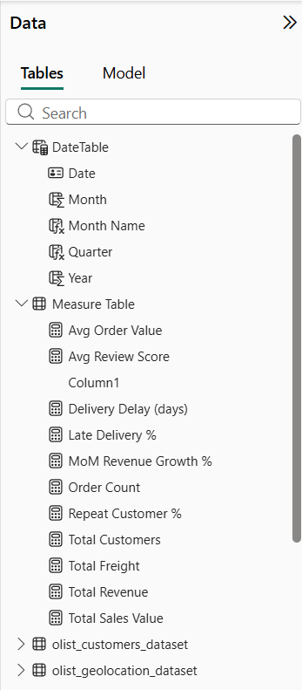
DAX Measures
Purpose-built calculations powering every visual
Purpose
Calculated key business metrics using DAX, built on top of the star-schema model
Total Revenue, Total Sales Value and Total Freight quantify overall business volume
Order Count, Total Customers, Avg Order Value and Repeat Customer % track engagement
Avg Review Score, Delivery Delay (days) and Late Delivery % surface satisfaction drivers
MoM Revenue Growth % tracks month-over-month momentum for trend reporting
Every measure was built once and reused across all three dashboard pages
7

Slide 9
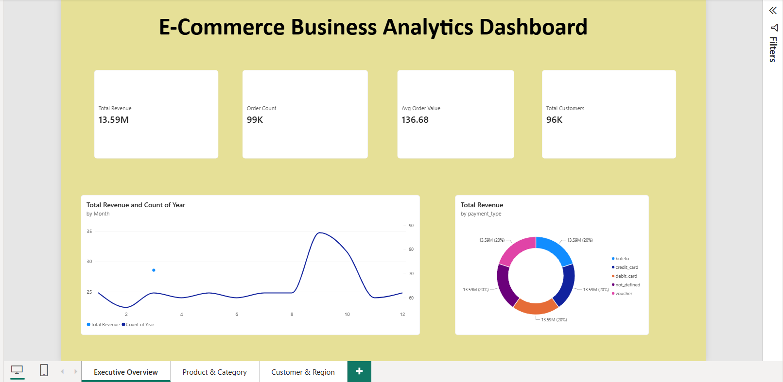
Dashboard: Executive Overview
Overall revenue and monthly sales trends
Total Revenue, order count, average order value and total customers, alongside monthly revenue trend and payment-type split.
8

Slide 10
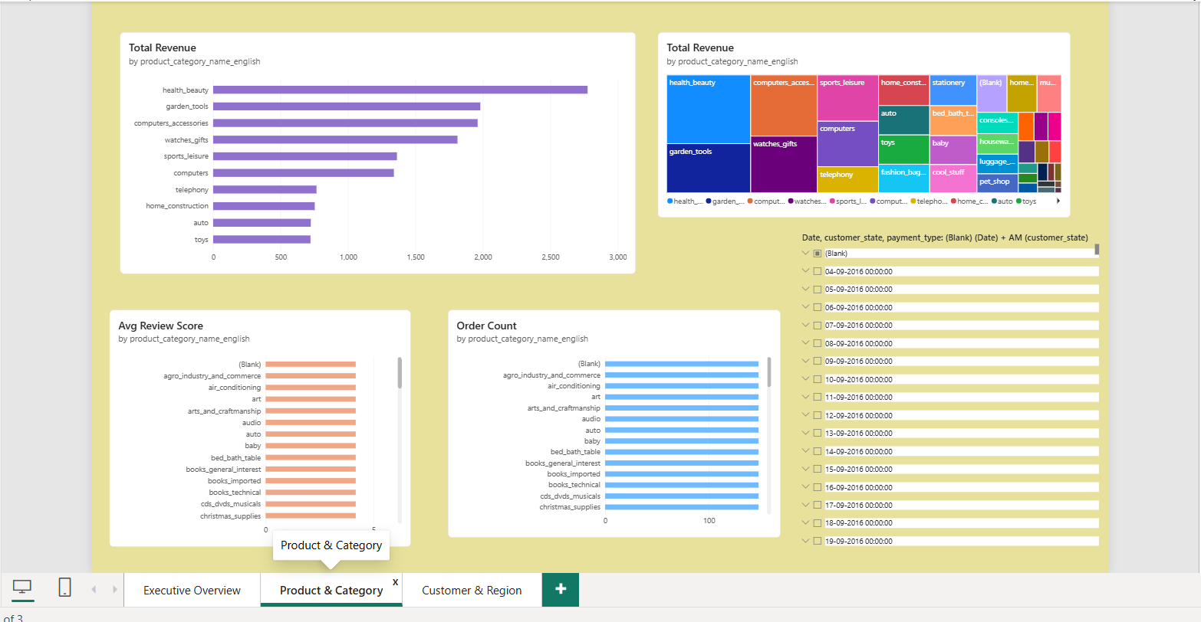
Dashboard: Product & Category
Which products and categories drive revenue and ratings
Revenue by category, treemap view, average review score and order count per category — highlighting top performers and categories needing attention.
9

Slide 11
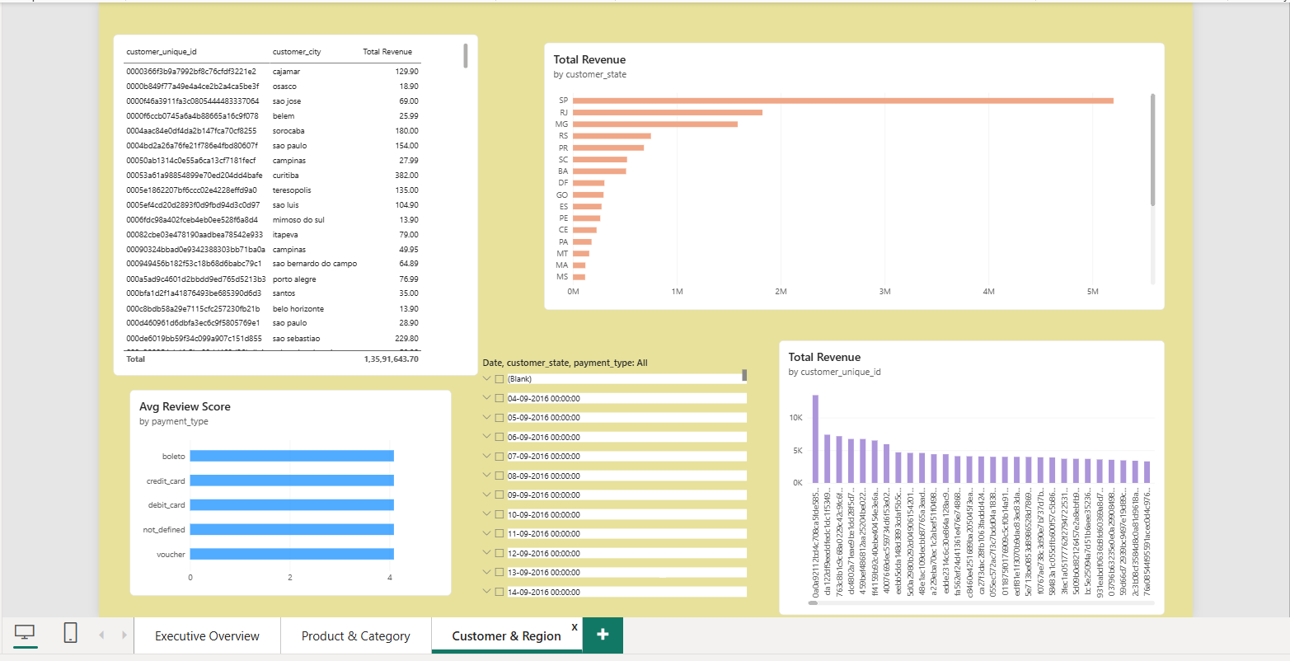
Dashboard: Customer & Region
Top customers, revenue by state, and payment satisfaction
Top revenue-generating customers, revenue by state , and average review score by payment type.
10

Slide 12
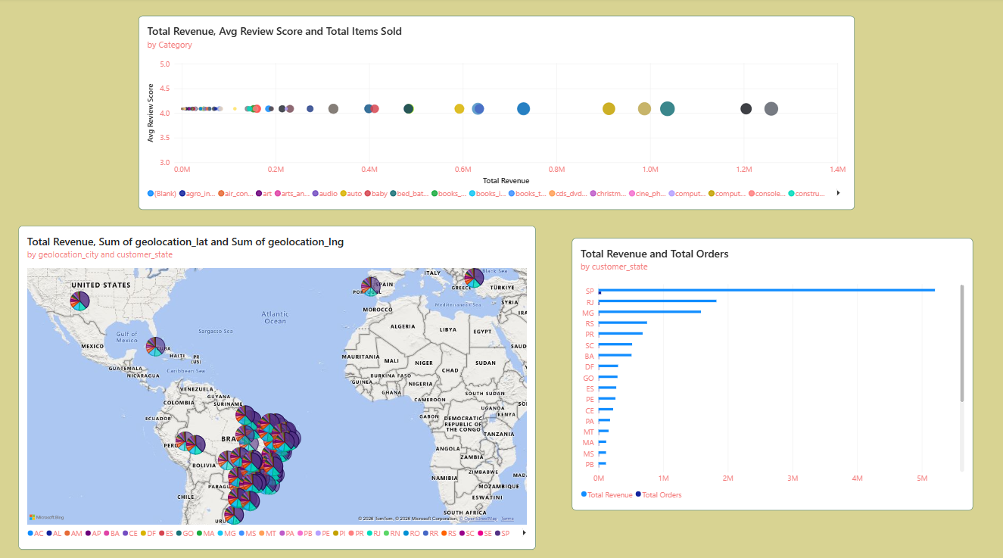
Dashboard: Geographic Distribution
Where ShopSphere's customers and revenue are concentrated
11

Slide 13
Business Requirements Addressed
Mapping each dashboard view to a client question
1
Overall revenue generated
6
Purchasing patterns by region
Executive Overview KPI cards
Geographic Distribution map
2
Top products & categories by revenue
7
Frequently purchased products
Product & Category page
Product & Category order count
3
Highest revenue-contributing customers
8
Categories needing attention
Customer & Region page
Category revenue vs. rating view
4
Monthly sales trend
9
Factors influencing satisfaction
Executive Overview line chart
Delivery delay & payment-type analysis
5
Highest / lowest rated products
10
Business recommendations
Product & Category ratings chart
Final Recommendations slide
12

Slide 14
Business Recommendations
Turning insights into action
Invest marketing and inventory focus on top-performing categories (health & beauty, garden tools, computer accessories) to compound existing demand.
Explore regional campaigns to grow underperforming states beyond the São Paulo / Rio de Janeiro / Minas Gerais core.
Improve logistics and delivery-time reliability for orders trending toward 'Very Late' status, since delay appears linked to lower ratings.
Investigate low-rated categories for product quality or listing-accuracy issues before scaling marketing spend on them.
Strengthen repeat-purchase incentives to grow the Repeat Customer % measure over time.
Use the Power BI dashboard for ongoing KPI tracking rather than one-time reporting.
13

Slide 15
Thank You!!!

