Slide 1

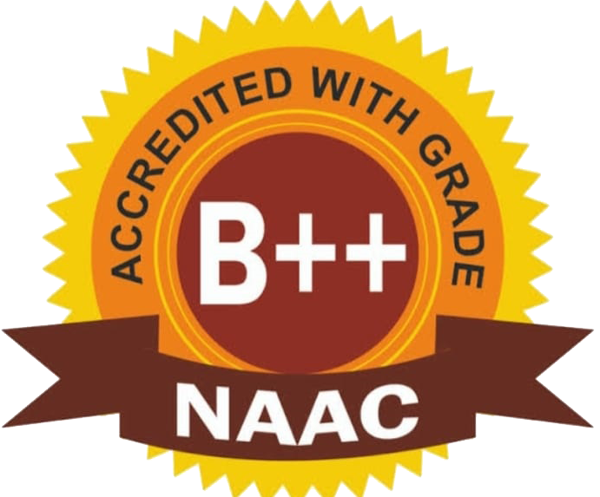
BAPATLA WOMENS ENGINEERING COLLEGE BAPATLA-522101,BAPATLA(Dt),A.P (Sponsered by Bapatla Education Society) Approved by AICTE-New Delhi,Affiliated to Acharya Nagarjuna University An ISO 9001:2015 Certified Institution DEPARTMENT OF COMPUTER SCIENCE AND ENGINEERING(CSE)
AI-enhanced Offline Notes Tutor With Intelligent Difficulty Heatmap
Batch-7
UNDER THE GUIDENCE OF: PRESENTED BY:
SHABANA KHANUM, M.Tech I.MOHANA NAGA SINDHUJA(Y22CS2651)
Asst.Prof,CSE Dept G.KEERTHI(Y22CS2644)
G.NANDINI(Y22CS2638)

Slide 2
LITERATURE SURVEY
Title | Author | Year
AI in Intelligent Tutoring Systems | Abdul AL-Emran | 2023
Adaptive AI Tutor Using KG-RAG | Chenxi Dong | 2023
Visualization of Intelligent Tutor Interactions | Yifan Guo | 2024
Personalized Learning with Intelligent Tutors | IGI Global | 2025

Slide 3
ABSTRACT
This project develops an ai-based offline notes tutor that uses NLP to analyze pdfs, calculate topic difficulty, and display an intelligent color-coded heatmap to highlight challenging areas. It works completely offline to minimize distractions, improve focus, and support efficient, targeted revision.

Slide 4
EXSITING SYSTEM
Existing systems are mostly online-based and rely on quizzes to estimate topic difficulty. They track student performance but do not analyze offline PDF notes. There is no intelligent difficulty heatmap to visually highlight hard topics.
Disadvantages
No difficulty-level identification.
Time-consuming revision process.
No offline platforms.

Slide 5
PROPOSED SYSTEM
The system uses AI to analyze offline PDF notes and study documents. It identifies important and difficult topics automatically. An intelligent difficulty heatmap highlights hard sections and provides personalized study guidance.
Advantages
Intelligent topic difficulty identification
Offline accessibility and privacy
Faster and focused revision
Improved learning effectiveness

Slide 6
THANK YOU

