Slide 1
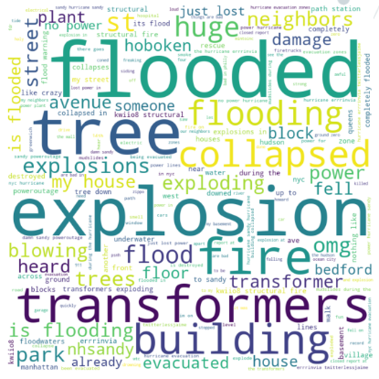
Disaster Tweets Classification using
Natural Language Processing (NLP)
By Keerthi Anand, Krupasankari
This presentation delves into the application of Natural Language Processing (NLP) in analyzing disaster-related tweets. We explored a Kaggle competition dataset containing real and non-disaster tweets. We built a machine learning model that predicts which tweets are about real disasters and which one’s aren’t.

Slide 2
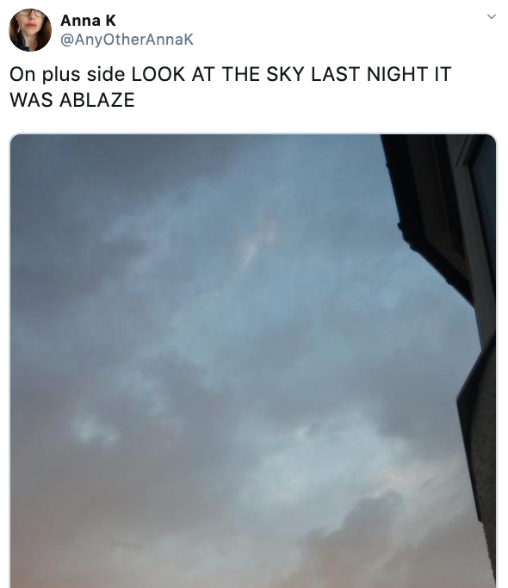
Data Overview: A Glimpse into Disaster Tweets
Dataset Description
The Kaggle competition dataset comprised over 10,000 tweets, each labeled as either a "disaster" or a "non-disaster" tweet. This diverse dataset provided valuable insights into how people communicate about real disasters and other events on social media. The dataset's distribution reflects real-world scenarios and showcases the variety of language used.
Source: Twitter

Slide 3
Natural Language Processing (NLP): Understanding the Power of Text
What is NLP?
Converts:
Natural Language Processing (NLP) is a field of artificial intelligence focused on enabling computers to understand and process human language. It involves techniques for analyzing, interpreting, and generating text data, bridging the gap between human communication and machine comprehension.
Unstructured Text Data
Structured Text Data

Slide 4
NLP STEPS
SEGMENTATION
STOP WORDS REMOVAL
I see a cup of coffee. I want to drink it.
I see a cup of coffee.
"I", "see", "a", "cup", "of", "coffee"
"I", "see", "a", "cup", "of", "coffee"
I want to drink it.
TOKENIZATION
I see a cup of coffee
"I", "see", "a", "cup", "of", "coffee"

Slide 5
NLP STEPS
STEMMING
LEMMATIZATION
Wanting
Want
Studies
Study
Studies
Studi
STEMMING | LEMMATIZATION
Stemming is a process that stems or removes last few characters from a word, often leading to incorrect meanings and spelling. | Lemmatization considers the context and converts the word to its meaningful base form, which is called Lemma.
Ex: "Caring" --> "Car" | Ex: "Caring" --> "Care"
Stemming is used in case of large dataset where performance is an issue. | Lemmatization is computationally expensive since it involves look-up tables and what not.

Slide 6
NLP STEPS
Part Of Speech (POS) Tagging
Named Entity Recognition (NER)
Need
verb
U.S. President Trump starts a cryptocurrency called $TRUMP coin.
one
digit
shot
verb
U.S.
LOCATION
espresso
noun
President Trump
PERSON
hot
adj
$TRUMP coin
PRODUCT

Slide 7
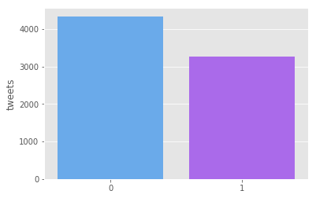
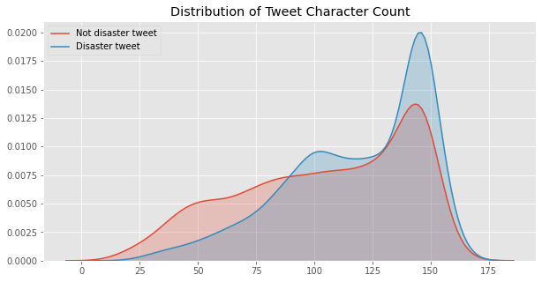
Exploratory Data Analysis:
The Majority class (Non-disaster tweets) has more samples than the Minority class (Disaster tweets), but the gap isn't too large.
Standard classification models should still work well without major adjustments.
1
This is insightful as it tells us that very few disaster tweets are less than 50 characters and that the majority of them are more than 125 characters long.
2

Slide 8
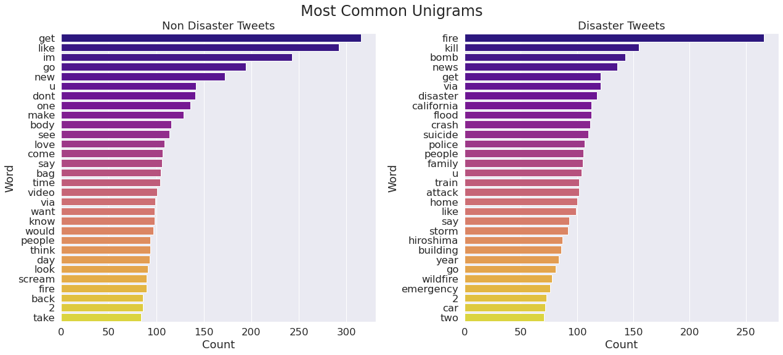
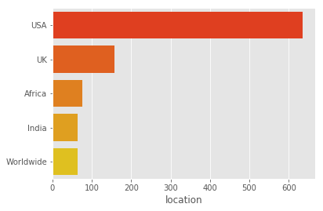
Exploratory Data Analysis:
3
Disaster:
"fire","kill"
Non-Disaster:
"get", "like"
4
The USA had the highest number of disaster-related tweets.
Followed by UK, Africa and India.

Slide 9
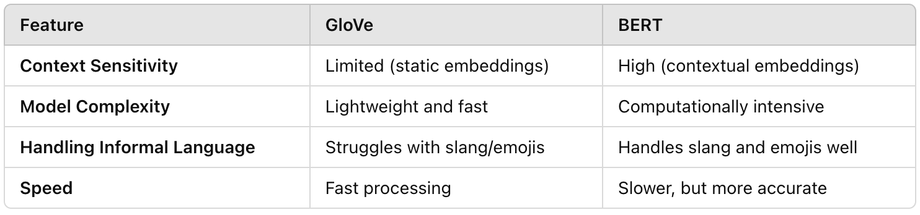
Word Embeddings
BERT (Bidirectional Encoder Representations from Transformers)
GloVE (Global Vectors for Word Representation)(
Static Word Embeddings:
Fixed representations for each word (e.g., “flood” is the same in all contexts).
Limitation:
Ignores word context (e.g., "flood" in "flooded road" vs. "flood warnings").
Best Use Cases:
Suitable for simple keyword-based classification tasks with limited context variation.
Contextualized Word Embeddings
Understands word meaning based on surrounding words (e.g., “fire” in “wildfire” vs. “fire truck”).
Advantages:
Captures context (e.g., urgency, tone, and meaning in disaster-related tweets).
Handles informal language, slang, hashtags, and emojis.
Best Use Cases:
Ideal for complex classification tasks with varying tone, sentiment, and meaning.
Source: Revisiting GloVe, Word2Vec and BERT: On the Homogeneity of Word Vectors

Slide 10
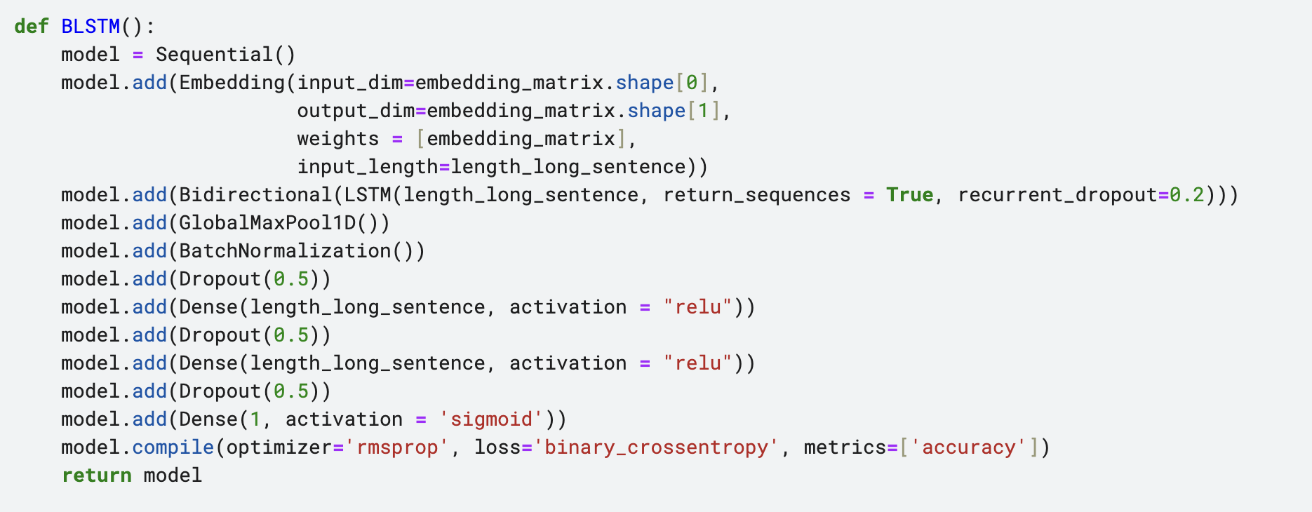
Long Short Term Memory (LSTM)

Slide 11
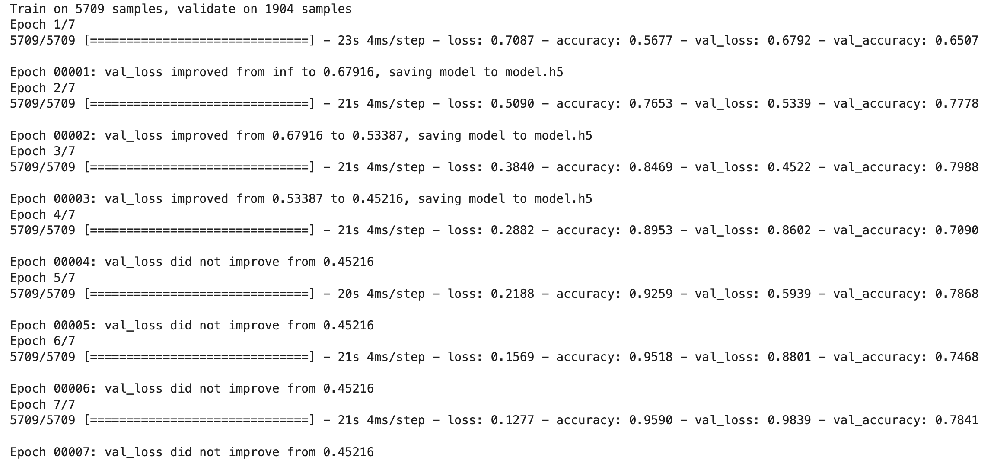
Model Performance

Slide 12
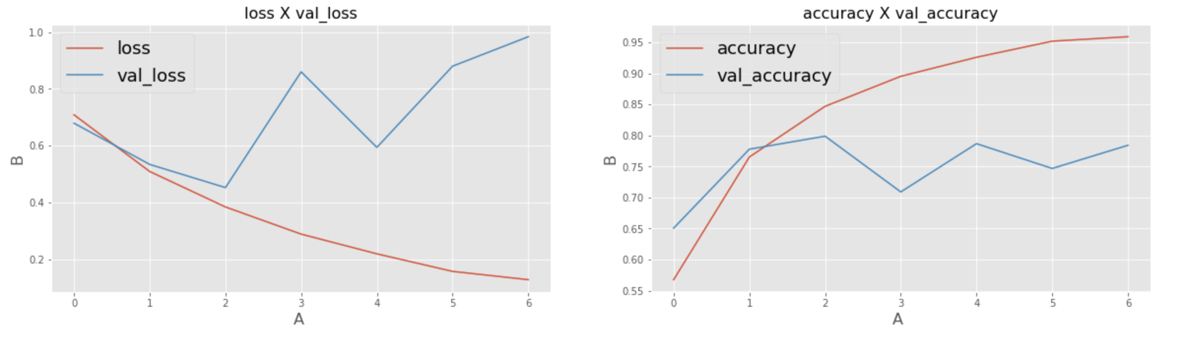
Model Performance

Slide 13
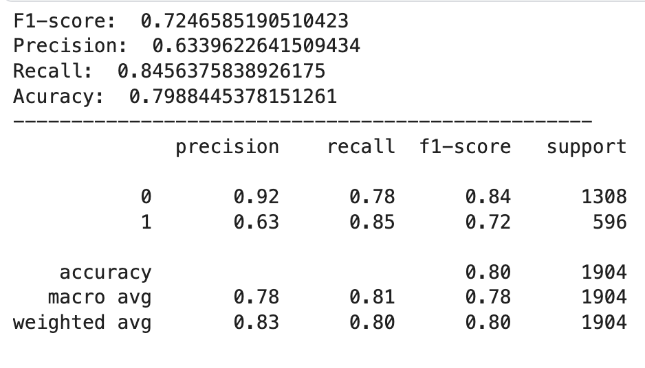
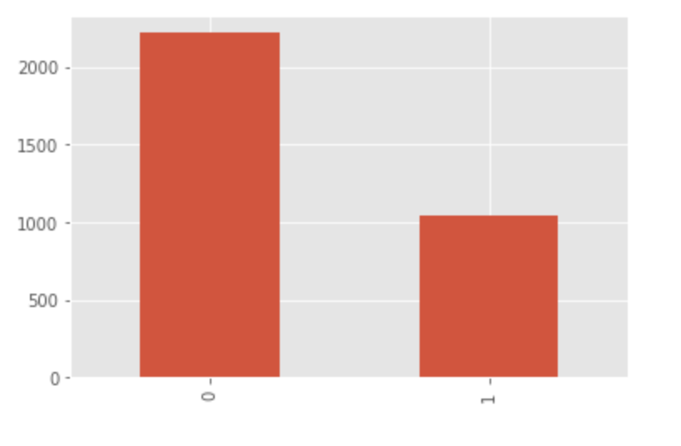
Model Performance
Performance Metrics
Submission class distribution

Slide 14
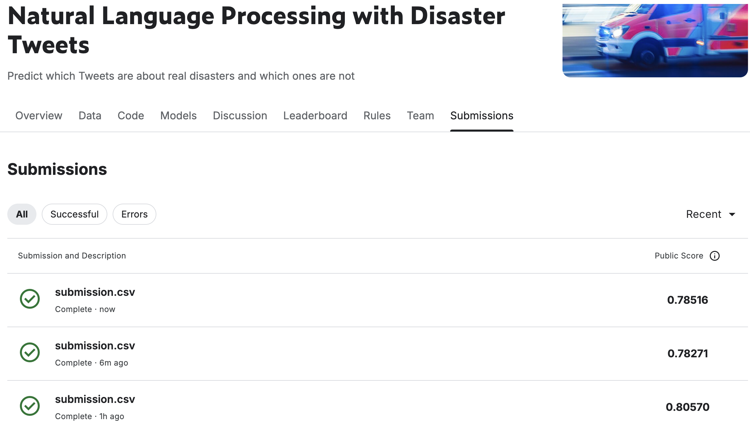
Kaggle Submission Scores
BERT + LSTM
GLoVE + LSTM
Stemming + Lemmatization + BERT + LSTM

Slide 15
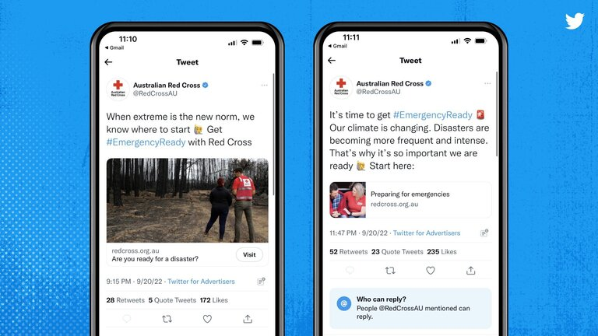
Summary
Objective:
Analyze disaster-related tweets using NLP techniques.
Key Techniques:
BERT: Contextualized word embeddings for understanding tweet content.
LSTM: Sequential modeling for accurate tweet classification.
Results:
Achieved high accuracy in distinguishing between real disasters and non-disaster events.
Impact:
Enables quick, accurate analysis of social media data.
Enhances disaster response efforts and decision-making.
Saves lives by providing actionable insights.
References:
https://www.kaggle.com/code/philculliton/nlp-getting-started-tutorial
http://nltk.org/

