Slide 1



SMART IRRIGATION SYSTEM USING MACHINE LEARNING
Presented by:
B. Keerthi – Malla Reddy Engineering College For Women

Slide 2

Learning Objectives
Understand the concept of smart irrigation systems.
Learn how to use sensor data to predict irrigation needs.
Apply machine learning algorithms for prediction.
Visualize and analyze pump activity and parcel usage.
Develop a basic irrigation model using Python and Scikit-learn.
GOAL
Source :
www.freepik.com/

Slide 3
Tools and Technology used
Python – Programming language for data analysis and machine learning
Pandas – For data manipulation and preprocessing
Matplotlib – For data visualization
Scikit-learn (sklearn) – For building the machine learning model
Jupyter Notebook – For writing and testing Python code
GitHub – For version control and project submission

Slide 4
Methodology
Data preprocessing (cleaning, scaling sensor values).
Model training using Random Forest Classifier.
Model evaluation and prediction of sprinkler status.
Deployment using Streamlit for user interaction.

Slide 5
Problem Statement:
Efficient irrigation is essential to avoid water wastage.
Farmers need an automated system to control sprinklers based on sensor data.
A smart irrigation model can optimize water usage and improve crop yield.

Slide 6
Solution:
GitHub Repository Link
https://github.com/keerthibandari167/smart-irrigation-internship

Slide 7
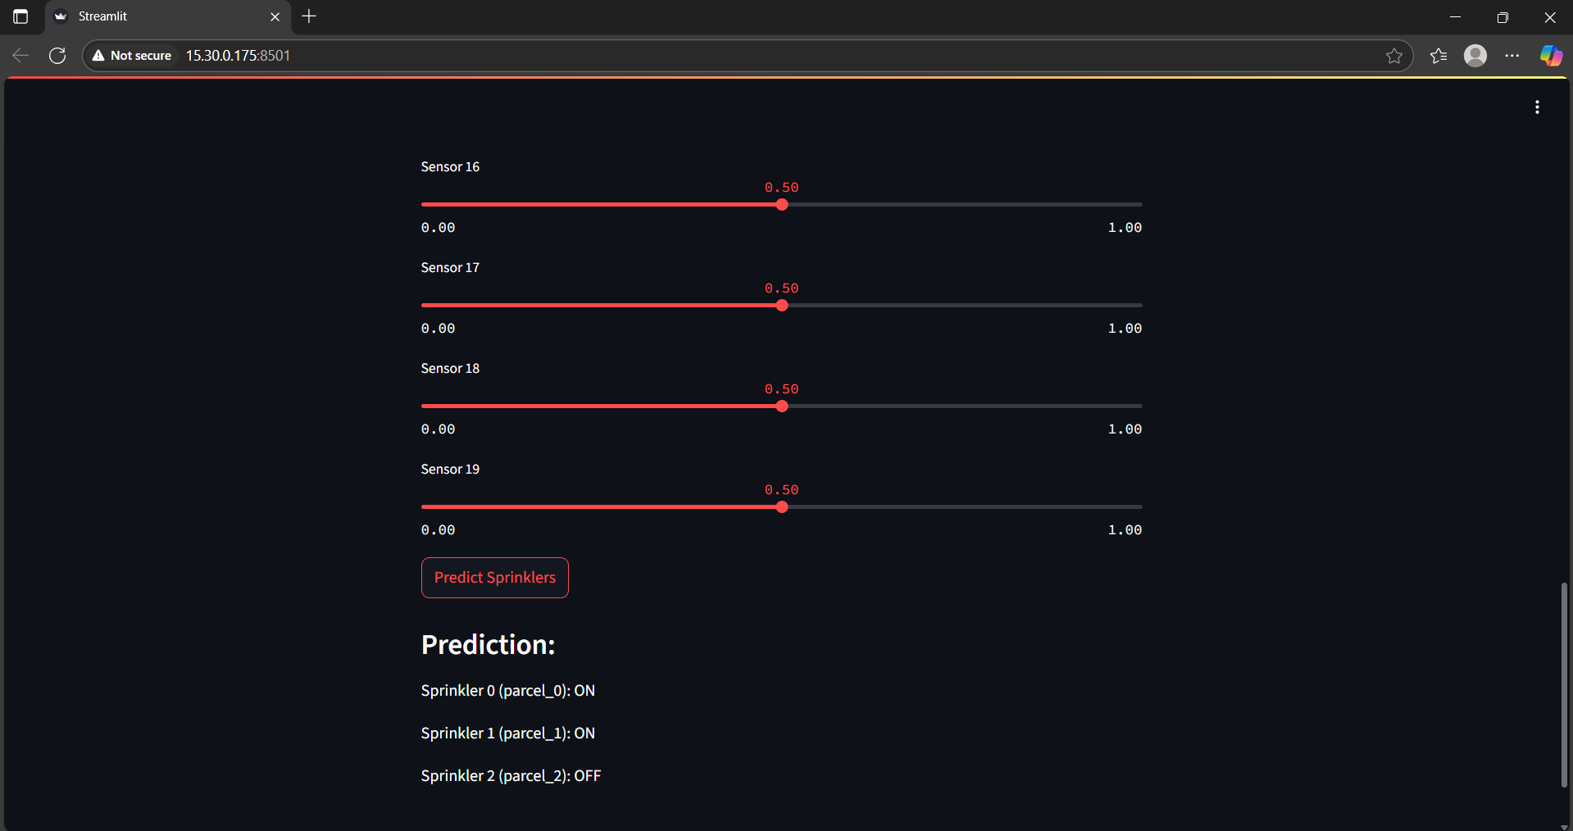
Screenshot of Output:

Slide 8
Conclusion:
The Smart Irrigation System successfully predicts sprinkler activation based on sensor data, ensuring water is supplied only when needed. This approach helps in conserving water, improving crop health, and reducing manual intervention, making irrigation more efficient and sustainable.

Slide 9
THANK YOU

