Slide 1
Securing the VMs in a cloud environment
Keerthi Bala Sundram & Aastha Dixit
Project – Securing the cloud

Slide 2
Motivation of this project
Security Concern #1: Who retains the data ownership and control ownership?
Security Concern #2: Who maintains the audit records of the data?
Security Concern #3: What is the mechanism in the delivery of this audit record to the customer?
Security Concern #4: As a real owner of the data, does the CSP allow customers to secure and manage access from end-users (customer’s client)?

Slide 3
Implementation
The complete experimentation was performed on the setup which had Ubuntu 14.04 64-bit LTS edition as native operating system.
After the successful deployment of Cloud (IaaS) infrastructure using AWS, few VMs with varying requirements were created.

Slide 4
Logs Subjected
The following are the list of system generated:
log files that were parsed for this investigation:
Zeitgeist Service:
syslog - /var/log/syslog
daemon.log - /var/log/daemon.log
auth.log - /var/log/auth.log
recently-used.xbel - /.local/share/recently- used.xbel.

Slide 5
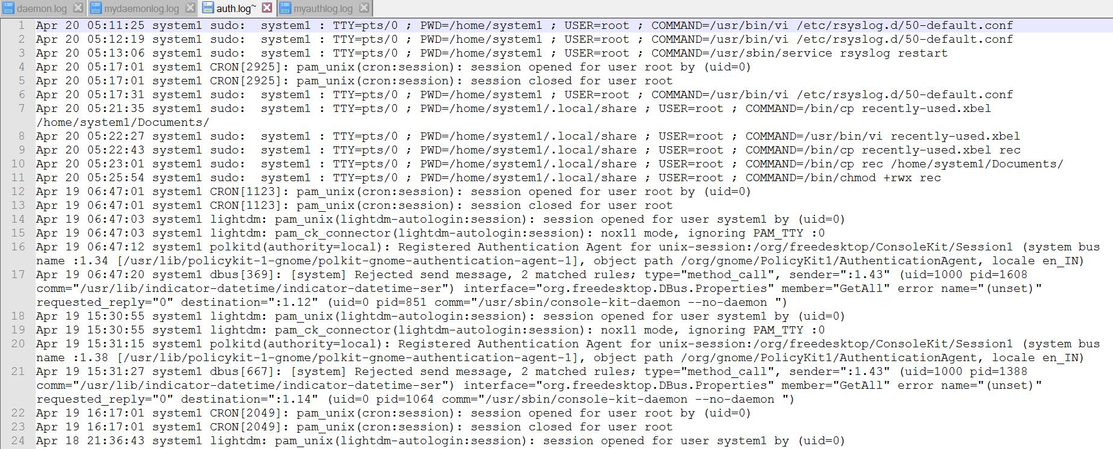
Auth Log

Slide 6
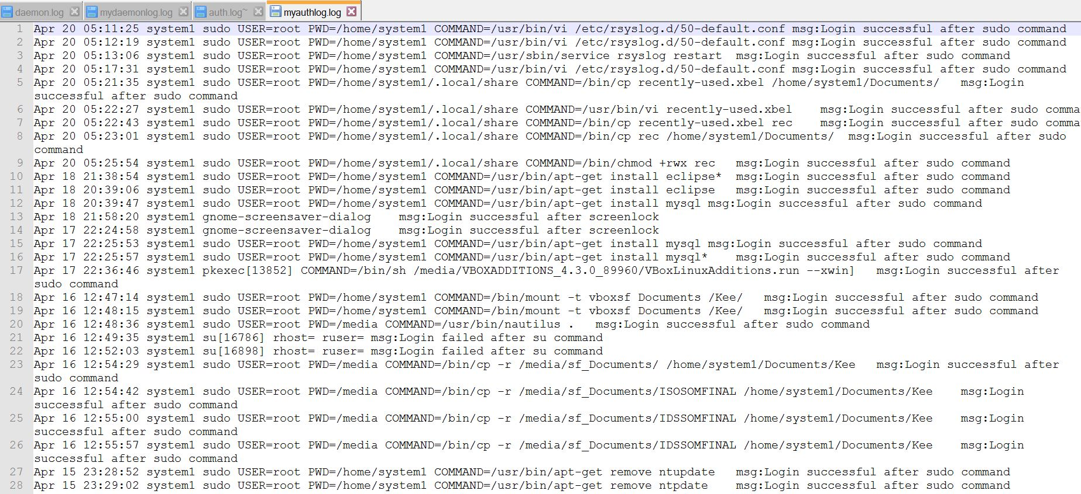
Auth Log – After processing

Slide 7
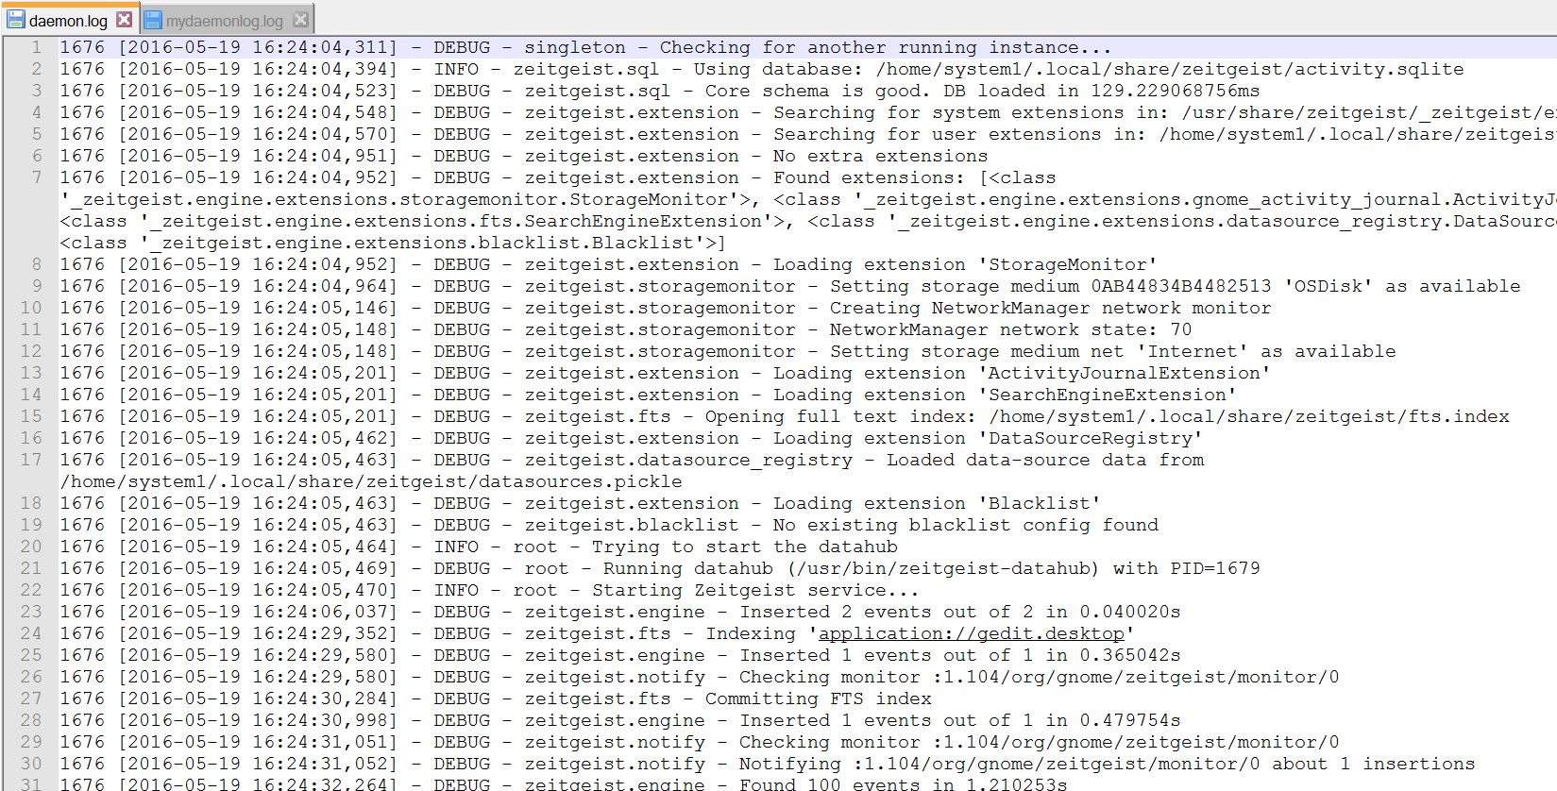
Daemon Log

Slide 8
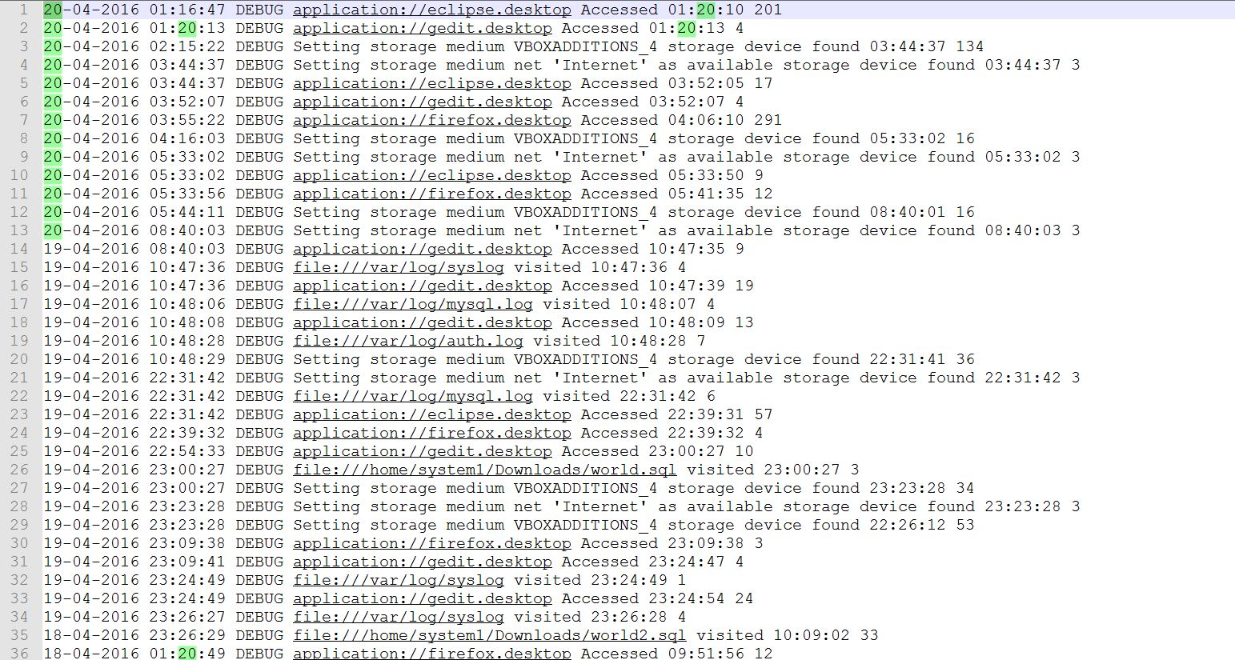
Daemon Log Processing

Slide 9
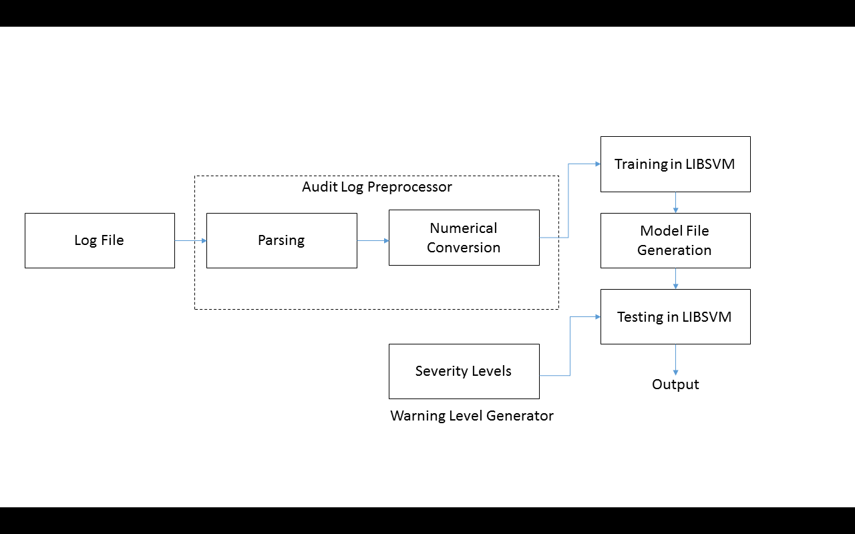
IDEA

Slide 10
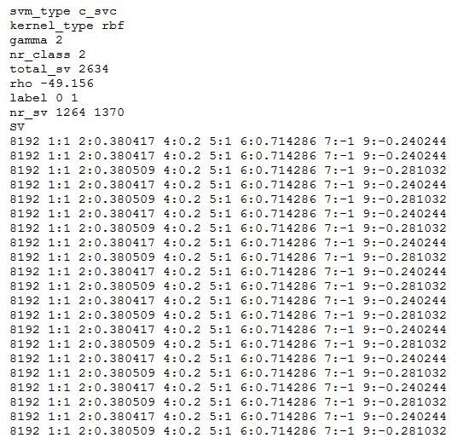
Model File

Slide 11
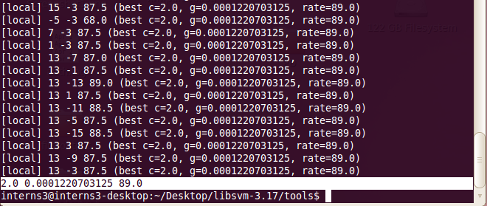
Training the Classifier

Slide 12
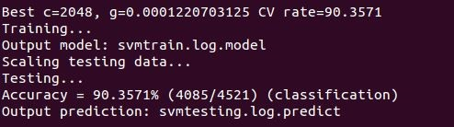
Cross Validation (10 fold)

Slide 13
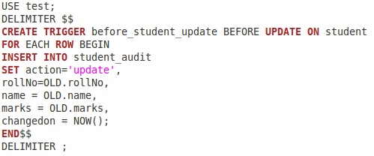
DB trigger – Log

Slide 14
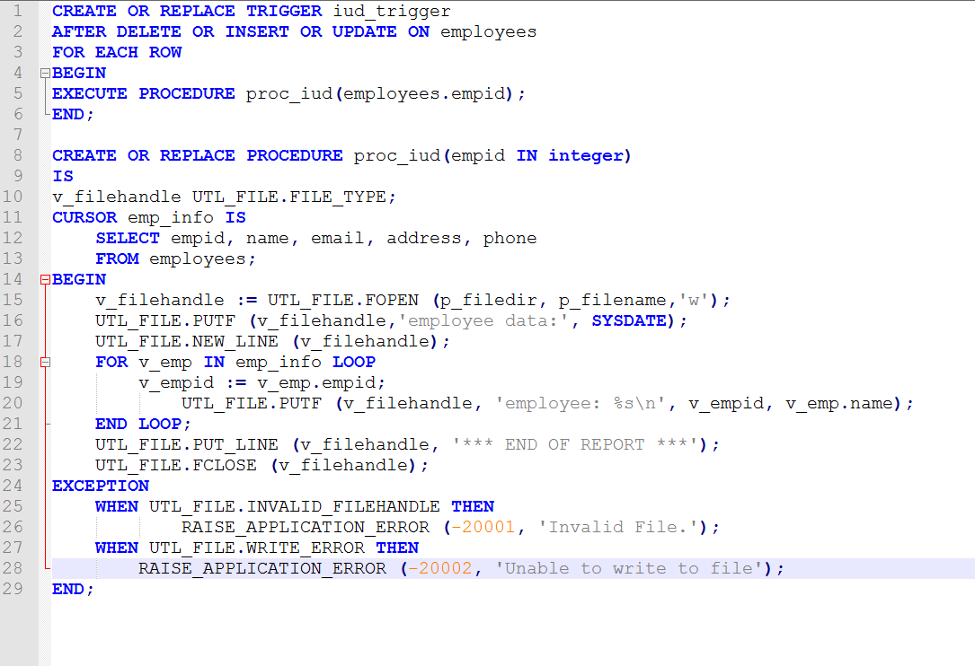
SQL Trigger (Method 2)

Slide 15
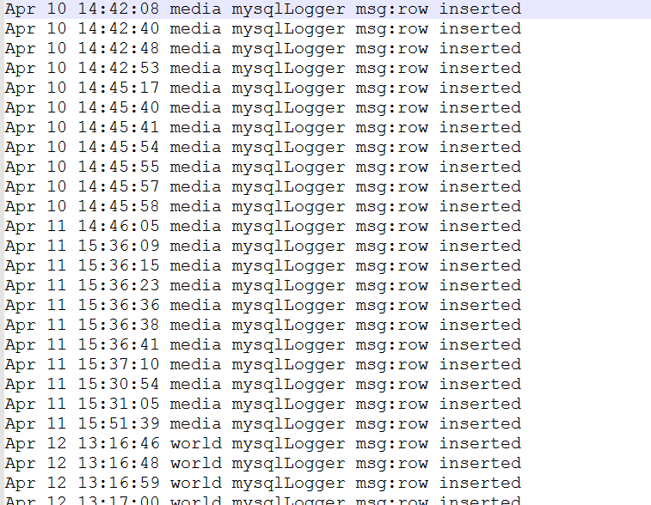
SQL Log

Slide 16
Base Paper Reference & Courtesy
http://link.springer.com/chapter/10.1007%2F978-3-642-34135-9_36

Slide 17
THANK YOU

