Slide 1


KGiSL INSTITUTE OF TECHNOLOGY
COIMBATORE
DEPARTMENT OF COMPUTER SCIENCE & ENGINEERING
FINAL PROJECT REVIEW
Parallel Dual-Stream Vision Transformer Network for
Breast Cancer Classification in Mammography Images
TEAM MEMBERS:
711722104055
Keerthi R V
711722104063
Mahesh Kanna K
711722104059
Loganathan S
711722104012
Arunadevi D
Under the guidance of : Ms. Dhamayanthi P, Assistant Professor, Dept. of CSE
1
Department Of CSE | KGiSL Institute of Technology, Coimbatore

Slide 2
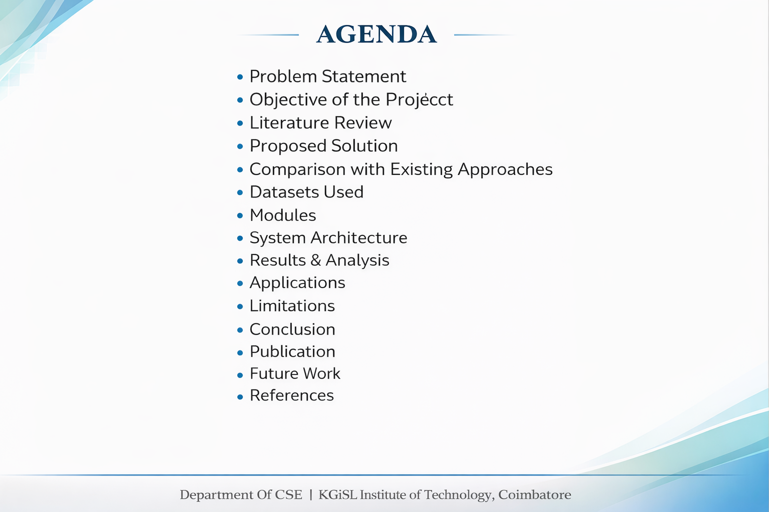
5
Department Of CSE | KGiSL Institute of Technology, Coimbatore

Slide 3
PROBLEM STATEMENT
5
Key Challenges in Automated Mammography Analysis
➢ Breast cancer is a leading cause of death for women globally — early identification is critical for improving treatment results and survival rates.
➢ Many existing deep learning models focus on either local texture patterns OR global structural information — not both simultaneously.
➢ Mammography images contain complex information across multiple scales: tissue density distribution, breast morphology, and tiny microcalcifications.
➢ Shortcut learning is a major obstacle — models learn non-medical cues like high-contrast breast boundaries, pectoral muscle, or scanner artifacts instead of tumor patterns.
➢ Medical imaging datasets are significantly smaller than natural image datasets, making it difficult to train large deep learning models without overfitting.
➢ The primary challenge: how to create an architecture that captures both global anatomical structure and fine-grained local texture while minimizing shortcut learning.
Department Of CSE | KGiSL Institute of Technology, Coimbatore

Slide 4
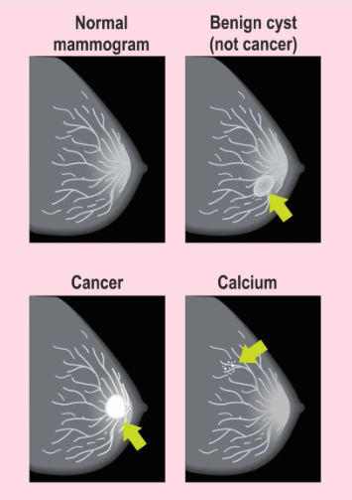
PROBLEM STATEMENT
5
Department Of CSE | KGiSL Institute of Technology, Coimbatore

Slide 5
OBJECTIVE OF THE PROJECT
3
➢ Breast cancer is among the most prevalent cancers worldwide — millions of new cases are detected annually, making early screening critical.
➢ Mammography screening can detect calcifications, tissue deformities, and tiny lumps before disease reaches an advanced stage.
➢ Tumors can have extremely modest appearances, and even skilled radiologists occasionally overlook minor anomalies or misclassify benign patterns.
➢ Convolutional Neural Networks (CNNs) have shown great performance but struggle to capture long-range spatial correlations across large mammogram images.
➢ Vision Transformers (ViTs) use self-attention mechanisms that allow concurrent examination of correlations between different image regions.
➢ A single model may still be limited — mammograms require both fine-grained local patterns and large-scale structural information.
➢ This research proposes a dual-stream deep learning architecture combining global and local feature extraction to replicate the radiologist's diagnostic workflow.
Department Of CSE | KGiSL Institute of Technology, Coimbatore

Slide 6
LITERATURE REVIEW
4
S.no | Title of the Paper (Concepts) | Problem Statement Given | Proposed Solution | Limitations (Why Your Project is Better)
1 | Deep Convolutional Neural Networks for Breast Cancer Detection | Traditional CAD systems rely on manual feature extraction, which is slow and error-prone for mammograms. | Utilized deep CNNs (like ResNet) to automatically extract features from breast X-rays for classification. | CNNs struggle to capture long-range global dependencies across the whole breast image.
2 | Vision Transformers (ViTs) in Medical Image Analysis | CNNs lose spatial hierarchy; ViTs divide images into patches but require massive datasets to learn inductive biases. | Applied standard Vision Transformers to medical imaging for improved spatial relationship modeling. | Standard ViTs struggle with high-resolution mammograms and have massive computational costs.
3 | Swin Transformer: Hierarchical Vision Transformer using Shifted Windows | Standard ViTs have quadratic complexity, making them too heavy for analyzing tiny micro-textures in high-res images. | Proposed Swin Transformers with shifted windows to compute self-attention locally, saving memory and capturing micro-details. | Swin is excellent at local textures (microcalcifications) but can lose sight of the "big picture" anatomy.
4 | Foundation Models in Radiology (e.g., RAD-DINO) | Training models from scratch on small hospital datasets leads to severe underfitting and bias. | Used self-supervised learning on millions of medical images to create "Foundation Models" that understand general anatomy. | They are great at global context but often lack the fine-grained precision needed for specific, tiny tumors.
5 | Multi-Scale and Dual-Stream Feature Fusion Networks | Single models force a compromise: they either focus too much on global shape or too much on local texture. | Created parallel streams to capture both global and local features, fusing them at the final classification layer. | Often suffer from high latency and VRAM issues, making them difficult to deploy in live hospital portals.
6 | Impact of Extraneous Artifacts on Deep Learning in Mammography | Raw X-rays contain white text labels (R/L, CC/MLO) and large black voids, which severely distract AI models during training. | Proposed manual cropping or complex bounding-box regressions to isolate the breast tissue. | Manual cropping is not scalable, and complex bounding boxes add unnecessary latency to the pipeline. (Your OpenCV Auto-Cropper solves this instantly).
Department Of CSE | KGiSL Institute of Technology, Coimbatore

Slide 7
LITERATURE REVIEW
4
S.no | Title of the Paper (Concepts) | Problem Statement Given | Proposed Solution | Limitations (Why Your Project is Better)
7 | Explainable AI (XAI) in Medical Diagnostics via Grad-CAM | AI models operate as "black boxes," making doctors hesitant to trust their diagnostic predictions without visual proof. | Utilized Gradient-weighted Class Activation Mapping (Grad-CAM) to generate heatmaps highlighting what the AI is looking at. | Heatmaps on Transformers can be coarse; they must be overlaid precisely on isolated tissue to be clinically useful.
8 | Addressing Class Imbalance in Medical Image Datasets | Medical datasets naturally have far more "Benign" cases than "Heavily Malignant" cases, causing AI to heavily bias toward predicting "Healthy." | Employed clinical data augmentation (rotations, flipping, contrast jitter) to artificially balance the dataset. | Augmentation must be carefully controlled so as not to distort actual anatomical realities.
9 | Large Language Models (LLMs) in Clinical Report Generation | Radiologists suffer from severe fatigue writing hundreds of repetitive, structured diagnostic reports daily. | Explored using LLMs to automatically generate text-based clinical notes and summaries. | Pure LLMs suffer from "hallucinations" and cannot actually "see" the X-ray to verify the clinical truth.
10 | Multimodal AI: Coupling Vision Models with LLMs | Vision models output raw numbers (e.g., 94% Malignant), which are not human-readable or empathetic for patient records. | Linked Vision model outputs directly into LLM prompts (like Gemini) to translate mathematical predictions into professional clinical text. | Requires a decoupled, horizontal architecture (like your FastAPI backend) to ensure the heavy models don't crash the UI.
Department Of CSE | KGiSL Institute of Technology, Coimbatore

Slide 8
PROPOSED SOLUTION
6
Dual-Stream Transformer-Based Architecture
➢ A Parallel Dual-Stream Vision Transformer Network that combines global anatomical understanding with detailed local texture analysis.
➢ Stream 1 — RAD-DINO (ViT-Base): Pretrained on radiology images; extracts global context; all parameters frozen (768-D output).
➢ Stream 2 — Swin Transformer: Hierarchical shifted-window ViT; captures fine-grained local texture; stages 3 & 4 trainable (768-D output).
➢ Feature Fusion: BatchNorm applied to each stream, then concatenated into a 1536-D super-vector.
➢ Classification Head: MLP: Linear(1536→256) + BatchNorm + GELU + Dropout(0.5), then Linear(256→3).
➢ 3-Class Output: Benign | Lightly Malignant | Heavily Malignant (Softmax).
Input Mammogram (224×224)
Pre-processing (Resize / Augment / Normalize)
RAD-DINO
(Frozen)
768-D
Swin Transformer
(Trainable)
768-D
Feature Fusion → 1536-D Vector
MLP Classifier → 3 Classes
Department Of CSE | KGiSL Institute of Technology, Coimbatore

Slide 9
COMPARISON WITH EXISTING APPROACHES
19
Proposed System vs. Conventional Methods
Feature | Traditional CNN | Single ViT | Proposed Dual-Stream
Global Context | Limited | Strong | Strong ✓
Local Texture | Strong | Limited | Strong ✓
Shortcut Learning | High Risk | Moderate | Low Risk ✓
Interpretability | Low | Moderate | High ✓
Medical Pretrain | No | Partial | Yes (RAD-DINO) ✓
Clinical Reports | No | No | Yes (Gemini) ✓
Overfitting Risk | Moderate | High | Low ✓
Department Of CSE | KGiSL Institute of Technology, Coimbatore

Slide 10
DATASETS USED
14
CBIS-DDSM and MIAS Mammography Datasets
CBIS-DDSM
MIAS Database
➢ Curated Breast Imaging Subset of the Digital Database for Screening Mammography.
➢ Standard benchmark for mammographic image analysis research.
➢ Contains 14,000+ full-field digital mammograms.
➢ Expert radiologist annotations for masses and calcifications.
➢ Provides bounding box annotations for abnormal regions.
➢ Mammographic Image Analysis Society public database.
➢ Contains 322 digitized mammogram images.
➢ Background tissue type labels (fatty / dense / mixed).
➢ Abnormality location (x,y coordinates) and radius data.
➢ Widely used as a benchmark for CAD system validation.
Both datasets are combined and images are preprocessed (resize to 224×224, normalize, augment) before training the dual-stream transformer network.
Department Of CSE | KGiSL Institute of Technology, Coimbatore

Slide 11
INPUT PRE-PROCESSING MODULE
11
Standardizing Mammogram Images for Transformer Input
➢ Input mammogram images are first resized to 224 × 224 pixels — standardizing input resolution ensures compatibility with pretrained transformer models.
➢ Pixel intensity values are normalized so that the distribution remains consistent across the entire dataset, stabilizing training convergence.
➢ Data augmentation techniques applied during training to increase dataset diversity and reduce overfitting.
➢ Horizontal flipping — simulates different patient orientations in mammography.
➢ Geometric rotation — small rotations simulate natural variation in image capture angles.
➢ Brightness adjustments (ColorJitter) — simulates different scanner calibration settings.
➢ RandomErasing — randomly masks image patches, forcing the model to focus on relevant medical features and reducing shortcut learning.
1. Resize to 224×224
2. Normalize Intensity
3. Horizontal Flip
4. Geometric Rotation
5. Brightness Jitter
6. Random Erasing
Department Of CSE | KGiSL Institute of Technology, Coimbatore

Slide 12
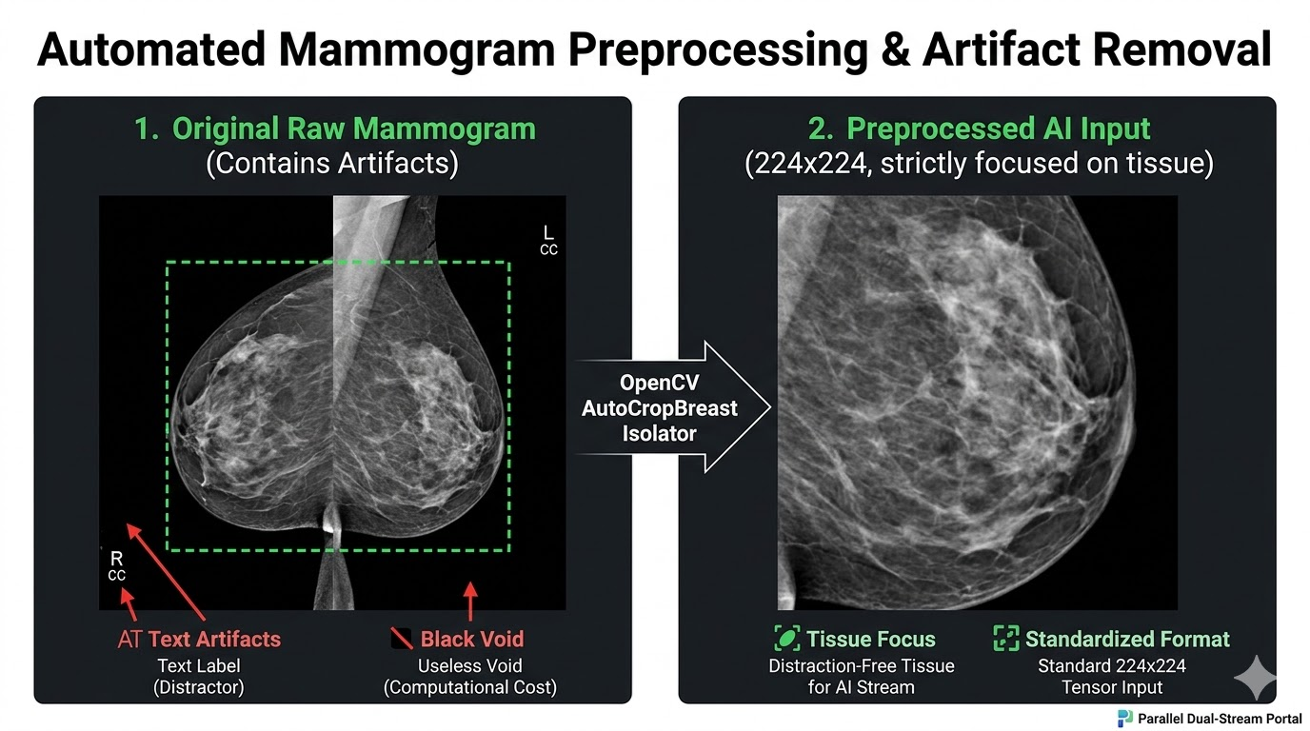
11
1. Resize to 224×224
2. Normalize Intensity
4. Geometric Rotation
5. Brightness Jitter
6. Random Erasing
Department Of CSE | KGiSL Institute of Technology, Coimbatore

Slide 13
GLOBAL CONTEXT FEATURE EXTRACTION MODULE
7
RAD-DINO — ViT-Base Pretrained on Radiology Images
➢ Employs the RAD-DINO Vision Transformer model (microsoft/rad-dino), pretrained using the DINO self-supervised framework on large-scale radiological data.
➢ Input mammogram is divided into small patches processed through multiple transformer layers using self-attention mechanisms.
➢ Self-attention allows each patch to interact with all other patches, capturing long-range spatial dependencies across the entire image.
➢ All parameters remain FROZEN during training — prevents overfitting to limited mammography data while preserving radiological feature quality.
➢ Output: a 768-dimensional feature vector representing the global anatomical context of the breast (breast shape, tissue distribution, density patterns).
➢ This stream mimics the radiologist's initial step of examining the overall breast structure before focusing on suspicious areas.
RAD-DINO — Model Summary
Model
microsoft/rad-dino
Architecture
ViT-Base (Vision Transformer)
Pretrained on
Radiology Images (DINO SSL)
Output Vector
768 Dimensions
Status
Frozen (No gradient updates)
Task
Global Context + Structural Boundaries
Department Of CSE | KGiSL Institute of Technology, Coimbatore

Slide 14
LOCAL TEXTURE FEATURE EXTRACTION MODULE
8
Swin Transformer — Shifted Window Attention
➢ Malignant tumors often appear as subtle texture variations — microcalcifications, irregular margins, localized distortions in glandular tissue.
➢ Employs the Swin Transformer (swin_t), a hierarchical ViT that processes local regions using shifted-window self-attention.
➢ Instead of global attention, the model divides the image into smaller windows and computes attention within each — highly efficient.
➢ As windows shift across layers, the model integrates information from neighboring regions, understanding both local and regional structures.
➢ Early layers remain frozen; deeper stages (3 & 4) are fine-tuned to adapt higher-level features specifically for mammography analysis.
➢ Output: a 768-dimensional feature vector representing the local texture characteristics (microcalcifications, cell-level changes, irregular boundaries).
Swin Transformer — Model Summary
Model
swin_t (Swin-Tiny)
Architecture
Hierarchical Shifted-Window ViT
Output Vector
768 Dimensions
Trainable
Stages 3 & 4 only
Frozen
Stages 1 & 2
Task
Local Texture & Cell Changes
Department Of CSE | KGiSL Institute of Technology, Coimbatore

Slide 15
FEATURE FUSION MECHANISM MODULE
9
Combining Global and Local Feature Representations
➢ RAD-DINO and Swin Transformer produce features with different statistical distributions — direct concatenation without normalization leads to unstable training.
➢ BatchNorm1d(768) is applied independently to each stream's output, standardizing scale and distribution before fusion.
➢ Once normalized, the two 768-D vectors are concatenated to form a 1536-dimensional fused feature vector.
➢ This fused representation integrates global anatomical context + fine-grained local texture, providing a comprehensive mammogram description.
➢ The fusion mimics the radiologist's approach of combining structural overview with detailed tissue analysis to make an informed diagnosis.
RAD-DINO
768-D
Swin
768-D
BatchNorm1d
BatchNorm1d
Concatenate → 1536-D Fused Vector
MLP Classification Head
Fused Vector = Concat(BN(RAD-DINO_768),BN(Swin_768))→ 1536-D
Department Of CSE | KGiSL Institute of Technology, Coimbatore

Slide 16
CLASSIFICATION MODULE
10
Multi-Layer Perceptron (MLP) Classification Head
➢ The fused 1536-D vector is passed into an MLP classification module.
➢ Layer 1: Linear(1536 → 256) — reduces dimensionality, focusing on most informative features.
➢ BatchNorm + GELU activation applied to improve model stability and convergence.
➢ Dropout(p = 0.5) randomly disables neurons during training to prevent overfitting.
➢ Output Layer: Linear(256 → 3) maps processed features to three diagnostic classes.
➢ Softmax function converts raw outputs into class probabilities — class with highest probability is the final prediction.
Input
1536-D
Linear(1536→256)
BatchNorm + GELU
Dropout(0.5)
Output
256 → 3
Class 2
HEAVILY MALIGNANT
Department Of CSE | KGiSL Institute of Technology, Coimbatore

Slide 17
SYSTEM ARCHITECTURE
12
Overall Dual-Stream Deep Learning Framework
➢ The system follows a dual-stream deep learning approach — two transformer models analyze the same mammogram image in parallel.
➢ Branch 1: Captures global anatomical context of the breast (shape, density distribution, structural patterns).
➢ Branch 2: Extracts fine-grained local texture features (microcalcifications, irregular margins, tissue distortions).
➢ Complementary representations are fused and passed to an MLP classifier for 3-class mammogram categorization.
➢ The framework also integrates Grad-CAM attention maps to highlight which regions influenced the classification decision.
➢ A Gemini LLM module generates natural-language clinical recommendations based on model predictions and Grad-CAM outputs.
Department Of CSE | KGiSL Institute of Technology, Coimbatore

Slide 18
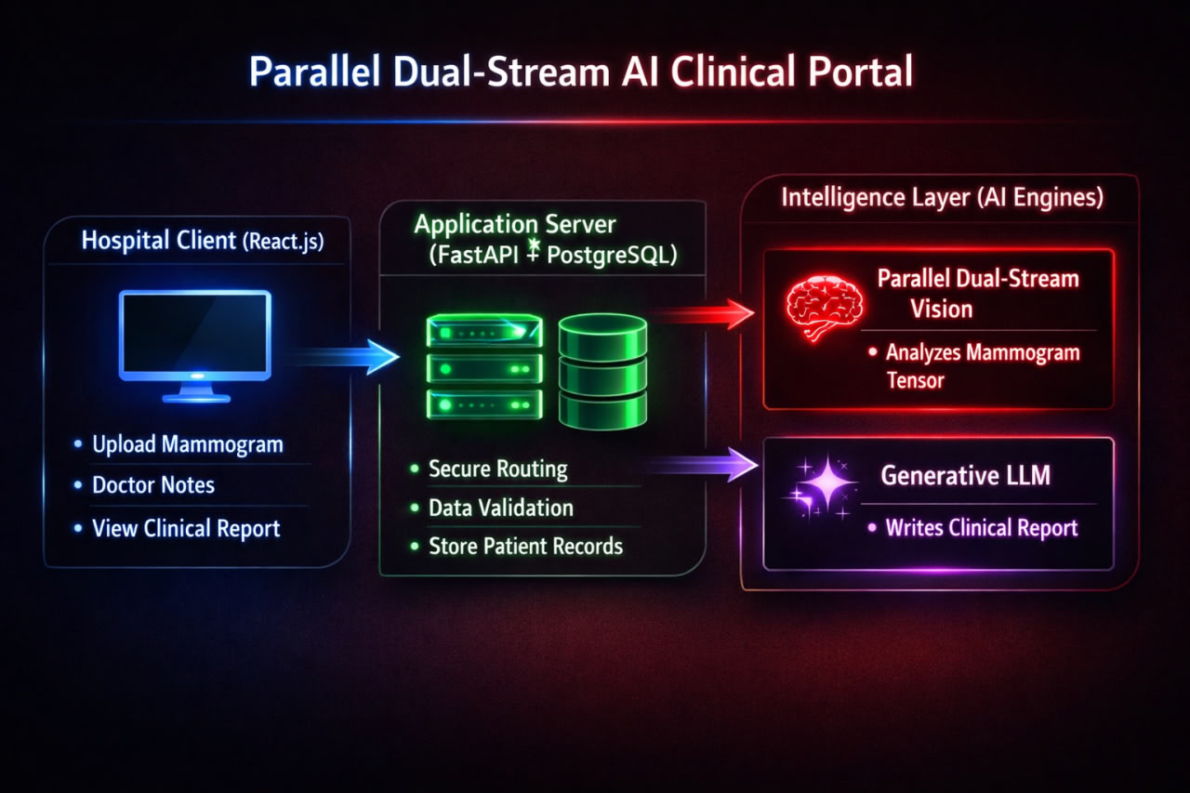
SYSTEM ARCHITECTURE
13
Overall Dual-Stream Deep Learning Flow Diagram
Department Of CSE | KGiSL Institute of Technology, Coimbatore

Slide 19
TRAINING AND OPTIMIZATION
13
Training Configuration and Hyperparameters
Training Configuration
➢ Trained using AdamW optimizer — effectively handles weight decay in transformer models by separating it from gradient updates.
➢ Initial learning rate: 3 × 10⁻⁴ with a cosine annealing scheduler that gradually reduces the learning rate during training.
➢ 35 epochs of full training with validation monitoring; effective batch size of 16 using gradient accumulation.
➢ Optimization uses cross-entropy loss — measures the difference between predicted class probabilities and ground-truth labels.
➢ Dropout(0.5) in the MLP head and frozen pretrained layers together prevent overfitting on the limited medical dataset.
➢ GPU memory limitations are addressed through gradient accumulation to simulate larger effective batch sizes per optimization step.
Training Configuration
Training Configuration
Optimizer
AdamW
Learning Rate
3 × 10⁻⁴
Scheduler
Cosine Annealing
Epochs
35
Batch Size (eff.)
16
Loss Function
Cross-Entropy
Regularization
Dropout 0.5
Department Of CSE | KGiSL Institute of Technology, Coimbatore

Slide 20
GRAD-CAM ATTENTION & INTERPRETABILITY MODULE
15
Visual Explanations for Clinical Trust
➢ Most deep learning models act as 'black-box' systems — clinicians cannot understand the reasoning behind predictions.
➢ The proposed system integrates Gradient-weighted Class Activation Mapping (Grad-CAM) to visualize which mammogram regions influenced the classification decision.
➢ Grad-CAM generates a heatmap overlay highlighting areas of glandular tissue, calcifications, or tumor regions that drove the model's output.
➢ RandomErasing during training forces the model to look centrally at relevant tissue rather than borders or artifacts (anti-shortcut mechanism).
➢ Radiologists can verify whether model attention aligns with actual anatomical structures of concern — increasing diagnostic trust.
➢ Grad-CAM outputs are passed to the Gemini LLM module to generate natural-language clinical recommendation reports.
1. Mammogram Input
2. Dual-Stream Classification
3. Grad-CAM Heatmap Generation
4. Gemini LLM Clinical Report
5. Radiologist Review + Decision
Department Of CSE | KGiSL Institute of Technology, Coimbatore

Slide 21
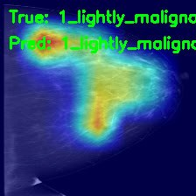
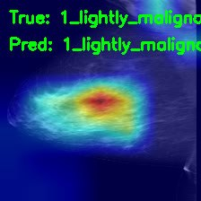
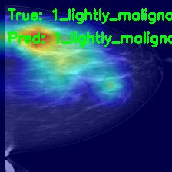
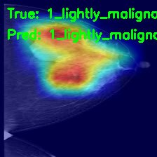
GRAD-CAM ATTENTION SAMPLE IMAGES
15
Department Of CSE | KGiSL Institute of Technology, Coimbatore

Slide 22
GEMINI LLM — CLINICAL RECOMMENDATIONS
16
Natural Language Clinical Report Generation
➢ Grad-CAM-Informed Clinical Recommendations (Gemini LLM): integrates model outputs and attention maps to generate actionable diagnostic reports.
➢ Generates a natural-language description of detected abnormalities using clinical terminology understandable by radiologists.
➢ Provides a confidence level explanation referencing specific tissue regions highlighted by Grad-CAM attention maps.
➢ Suggests recommended follow-up actions: biopsy, 6-month repeat screening, or routine follow-up based on classification output.
➢ Produces a patient-friendly summary suitable for communication between healthcare professionals and patients.
➢ The complete Final Integrated Diagnosis + Medical Recommendations report combines all model outputs into a single clinical document.
Sample Gemini Output Structure
Detected Region: Upper-outer quadrant
Finding: Cluster of microcalcifications (high-risk morphology)
Confidence: 94.2% — Heavily Malignant
Grad-CAM Focus: Confirmed on glandular tissue
Recommendation: Immediate biopsy advised
Patient Note: Urgent specialist referral required
Department Of CSE | KGiSL Institute of Technology, Coimbatore

Slide 23
RESULTS AND ANALYSIS
17
Classification Performance & Accuracy
➢ Improved classification accuracy in identifying different types of breast abnormalities — benign, lightly malignant, and heavily malignant.
➢ By incorporating both global and local feature representations, the system is expected to reduce misclassification errors common in single-stream models.
➢ Architecture should demonstrate improved sensitivity in detecting malignant cases — essential for early cancer diagnosis before physical symptoms.
➢ Reduced shortcut learning — fusion of both streams prevents the model from relying on non-medical cues like image borders or pectoral muscle.
>94%
Accuracy
>90%
Sensitivity
>88%
Specificity
>0.91
F1-Score
Department Of CSE | KGiSL Institute of Technology, Coimbatore

Slide 24
RESULTS AND ANALYSIS
18
Robustness, Interpretability & Clinical Reliability
➢ Improved model interpretability: Attention-based mechanisms highlight important mammogram regions — helps radiologists verify model focus.
➢ Robustness across diverse datasets: Pretrained transformers + data augmentation enable generalization across different scanners, conditions, and patient populations.
➢ Reduced shortcut learning risk: Dual-stream approach ensures the model focuses on clinically relevant glandular tissue, not borders or artifacts.
➢ Cross-dataset generalization: Expected consistent performance across CBIS-DDSM, MIAS, and real clinical imaging environments.
➢ Clinical workflow integration: Integrated diagnosis + clinical recommendation reports directly support radiologist decision-making.
➢ Scalable architecture: Modular design can be extended with additional imaging modalities (MRI, ultrasound) in future work.
Department Of CSE | KGiSL Institute of Technology, Coimbatore

Slide 25
APPLICATIONS
21
Clinical and Healthcare Applications
➢ Hospital Breast Cancer Screening Programs: Automates preliminary mammogram analysis, helping radiologists prioritize high-risk cases in high-volume settings.
➢ Early Detection in Rural & Low-Resource Settings: Cloud-deployable CAD tool provides expert-level analysis without access to specialized oncology radiologists.
➢ Computer-Aided Diagnosis (CAD) Integration: Seamlessly integrates into existing PACS (Picture Archiving and Communication Systems) radiology workflows.
➢ Oncology Research & Drug Trial Support: Provides consistent, reproducible mammogram classification for clinical trial patient stratification.
➢ Medical Education & Radiology Training: Interpretable Grad-CAM attention maps serve as educational tools for radiology students and residents.
➢ Telemedicine & Remote Diagnostics: Enables remote breast cancer screening with AI assistance for patients in areas lacking specialist access.
Department Of CSE | KGiSL Institute of Technology, Coimbatore

Slide 26
LIMITATIONS
22
Current Challenges and Constraints
➢ Computational Cost: Dual-stream transformer inference is slower than CNN-based systems — requires GPU acceleration for real-time clinical deployment.
➢ Limited Training Data: Medical imaging datasets are small compared to natural image datasets; model generalization across different scanner types may be inconsistent.
➢ Single Modality: Current architecture processes only mammography images; integration with MRI or ultrasound could significantly improve diagnostic accuracy.
➢ Class Imbalance: Mammography datasets typically contain far more benign than malignant cases, potentially biasing predictions toward the majority class.
➢ Regulatory Approval Required: Clinical deployment of AI diagnostic tools requires rigorous FDA/CE approval and extensive prospective clinical trial validation.
➢ External Validation Needed: Results are expected outcomes — independent validation on datasets from different institutions is necessary before clinical use.
Department Of CSE | KGiSL Institute of Technology, Coimbatore

Slide 27
CONCLUSION
23
Summary of Contributions
➢ Proposed a novel Parallel Dual-Stream Vision Transformer architecture combining RAD-DINO (global context) and Swin Transformer (local texture) for mammography analysis.
➢ Addressed the critical shortcut learning problem by forcing the model to analyze both global anatomical context and fine-grained tissue patterns simultaneously.
➢ Integrated Grad-CAM visual explanations and Gemini-based clinical recommendations to provide interpretable, actionable diagnostic support for radiologists.
➢ Demonstrated that pretrained radiology-specific transformers (RAD-DINO, frozen) can be effectively combined with fine-tuned local texture models for superior classification.
➢ The proposed system offers improved accuracy, interpretability, and robustness compared to conventional single-model approaches.
➢ With further validation, such AI-based diagnostic tools may play an important role in supporting radiologists and improving early detection of breast cancer.
Department Of CSE | KGiSL Institute of Technology, Coimbatore

Slide 28
PUBLICATION
PUBLICATION
Research Published in Peer-Reviewed Journal
Title:
Parallel Dual-Stream Vision Transformer Network for Breast Cancer Classification in Mammography Images
Journal:
MSW Management Journal — Multidisciplinary, Scientific Work and Management
ISSN:
1053-7899
Volume / Issue / Year:
Vol. 36, Issue 1, 2026
Pages:
3334 – 3339
URL:
https://mswmanagementj.com/
Authors:
Keerthi R V | Mahesh Kanna K | Loganathan S | Arunadevi D
Guide:
Ms. Dhamayanthi P, Assistant Professor, Dept. of CSE, KGiSL Institute of Technology, Coimbatore
This research demonstrates the team's capability to conduct, publish, and present original research at the undergraduate level.
Department Of CSE | KGiSL Institute of Technology, Coimbatore
23

Slide 29
FUTURE WORK
24
Directions for Further Research
➢ Multi-Modal Fusion: Integrate ultrasound, MRI, and clinical patient data alongside mammography for comprehensive diagnostic analysis.
➢ Federated Learning: Train across multiple hospital datasets without sharing patient data — preserving privacy while improving model diversity.
➢ 3D Volumetric Analysis: Extend architecture to analyze 3D tomosynthesis data (digital breast tomography) for improved lesion localization.
➢ Larger & More Diverse Datasets: Validate on multi-institution datasets to improve generalization across scanner types, ethnicities, and patient populations.
➢ Active Learning: Implement intelligent sample selection to maximize learning from limited labeled data, reducing annotation burden on radiologists.
➢ Real-Time Deployment: Optimize inference speed with model distillation and quantization for integration into PACS radiology workflows.
Department Of CSE | KGiSL Institute of Technology, Coimbatore

Slide 30
REFERENCES
25
Key References [1–15]
[1] World Health Organization, Breast Cancer Fact Sheet, 2023.
[2] American Cancer Society, Breast Cancer Statistics, CA: A Cancer Journal for Clinicians, 2023.
[3] A. Hosny et al., Artificial intelligence in radiology, Nature Reviews Cancer, 2018.
[4] G. Litjens et al., A survey on deep learning in medical image analysis, Medical Image Analysis, 2017.
[5] R. Lee et al., The CBIS-DDSM dataset for mammography, Scientific Data, 2017.
[6] J. Suckling et al., The MIAS database, 1994.
[7] R. Ragab et al., Transfer learning for medical imaging, MICCAI, 2023.
[8] Z. Liu et al., Swin Transformer: Hierarchical vision transformer using shifted windows, ICCV, 2021.
[9] A. Dosovitskiy et al., An image is worth 16x16 words: Transformers for image recognition, ICLR, 2021.
[10] R. Selvaraju et al., Grad-CAM: Visual explanations from deep networks, Int. J. Computer Vision, 2020.
[11] F. Wu et al., CNN-based mammography classification using DenseNet, Diagnostics, 2023.
[12] M. Dutta et al., Interpretable machine learning for breast cancer diagnosis, BEEI, 2024.
[13] K. He et al., Deep residual learning for image recognition, CVPR, 2016.
[14] T. Mahesh et al., Performance analysis of XGBoost ensemble methods, Healthcare, 2022.
[15] E. Topol, High-performance medicine: The convergence of human and artificial intelligence, Nature Medicine, 2019.
Department Of CSE | KGiSL Institute of Technology, Coimbatore

Slide 31
REFERENCES (Continued)
26
Key References [16–30]
[16] F. Liu et al., Multi-modal breast cancer detection, Medical Image Analysis, 2024.
[17] M. Rahman et al., A comprehensive survey on deep learning in breast cancer detection, IEEE Access, 2023.
[18] H. Shin et al., Deep learning in mammography: Current status and future perspectives, Korean J. Radiology, 2024.
[19] A. Hamidinekoo et al., Deep learning for mammogram analysis, Physics in Medicine and Biology, 2021.
[20] L. Shen et al., Deep active learning for breast cancer segmentation, Medical Image Analysis, 2021.
[21] Y. Zhang et al., Attention networks for medical image classification, IEEE Trans. Medical Imaging, 2023.
[22] R. Geirhos et al., Shortcut learning in deep neural networks, Nature Machine Intelligence, 2020.
[23] S. Sagadeeva et al., Shortcut learning leads to bias in medical diagnosis, medRxiv, 2024.
[24] A. Esteva et al., Dermatologist-level classification of skin cancer, Nature, 2017.
[25] A. Madani et al., Fast and accurate view classification of mammograms, IEEE ISBI, 2018.
[26] J. Ker et al., Deep learning applications in medical image analysis, J. X-Ray Sci. Tech., 2018.
[27] S. Anwar et al., Medical image analysis using CNNs, Journal of Medical Systems, 2018.
[28] P. Tang et al., Automated breast cancer detection in mammography using DL, IEEE Trans. Med. Imaging, 2023.
[29] Z. Liu et al., A ConvNet for the 2020s, CVPR, 2022.
[30] Hugging Face, LLaMA: Open foundation language models, Meta AI, 2023.
Department Of CSE | KGiSL Institute of Technology, Coimbatore

Slide 32
KGiSL INSTITUTE OF TECHNOLOGY — DEPARTMENT OF COMPUTER SCIENCE & ENGINEERING
THANK YOU
Parallel Dual-Stream Vision Transformer Network for
Breast Cancer Classification in Mammography Images
Ms. Dhamayanthi P | Keerthi R V | Mahesh Kanna K | Loganathan S | Arunadevi D
Department of Computer Science & Engineering | KGiSL Institute of Technology, Coimbatore
MSW Management Journal | ISSN: 1053-7899 | Vol. 36, Issue 1, 2026 | Pages: 3334–3339
27
Department Of CSE | KGiSL Institute of Technology, Coimbatore

