Slide 1
Job Portal Website
A Modern Job Search & Recruitment Platform
GUIDED BY
DR. K.K. SAVITHA, PhD.,
BARATHIAR UNIVERSITY PG EXTENSION & RESEARCH CENTRE, ERODE
BY
KEERTHIGA DEVI D (23CSEA84)

Slide 2
Abstract
• A job portal connecting job seekers and employers.
• Built using the MERN stack for a dynamic and responsive experience.
• Features job listings, applications, employer dashboards, and user authentication.

Slide 3
Tech stack
Frontend: React, Redux, Axios
Backend: Node.js, Express.js
Database: MongoDB
Image Storage: Cloudinary
API Testing: Postman

Slide 4
Key Features
User Authentication (login/signup)
Role based access (job seekers /employers)
Job Listings & Search Functionality
Employer Dashboard to Post & Manage Jobs
Candidate Profile Creation & Resume Upload
Job Applications & Status Tracking
Admin Panel for Moderation

Slide 5
Architecture
Frontend: React with Redux for state management
Backend: Node.js & Express.js APIs
Database: MongoDB for storing user and job data
Media Storage: Cloudinary for handling images
API Communication: Axios for frontend-backend communication

Slide 6
Database Schema
Users Collection: Stores job seekers and employers
Jobs Collection: Stores job postings
Applications Collection: Tracks applications submitted by users

Slide 7
API Implementation
Axios for API requests (GET, POST, PUT, DELETE)
Postman API testing:
User Authentication APIs
CRUD operations on Jobs
Job applications endpoints

Slide 8
Cloudinary Integration
Used for storing resumes and profile pictures
Secure image and file uploads
Cloudinary API for image retrieval and management

Slide 9
State Management with Redux
Why Redux? Efficient state handling across components
Store & Actions: Managing authentication, job postings, and applications
Reducers: Updating states based on actions

Slide 10
Challenges & Solutions
Handling Authentication: Implemented JWT securely
Managing State Efficiently: Used Redux to centralize data
Optimizing Image Uploads: Integrated Cloudinary for cloud storage

Slide 11
Future Enhancements
AI-based job recommendations
Live interview scheduling feature
More advanced filters for job search

Slide 12
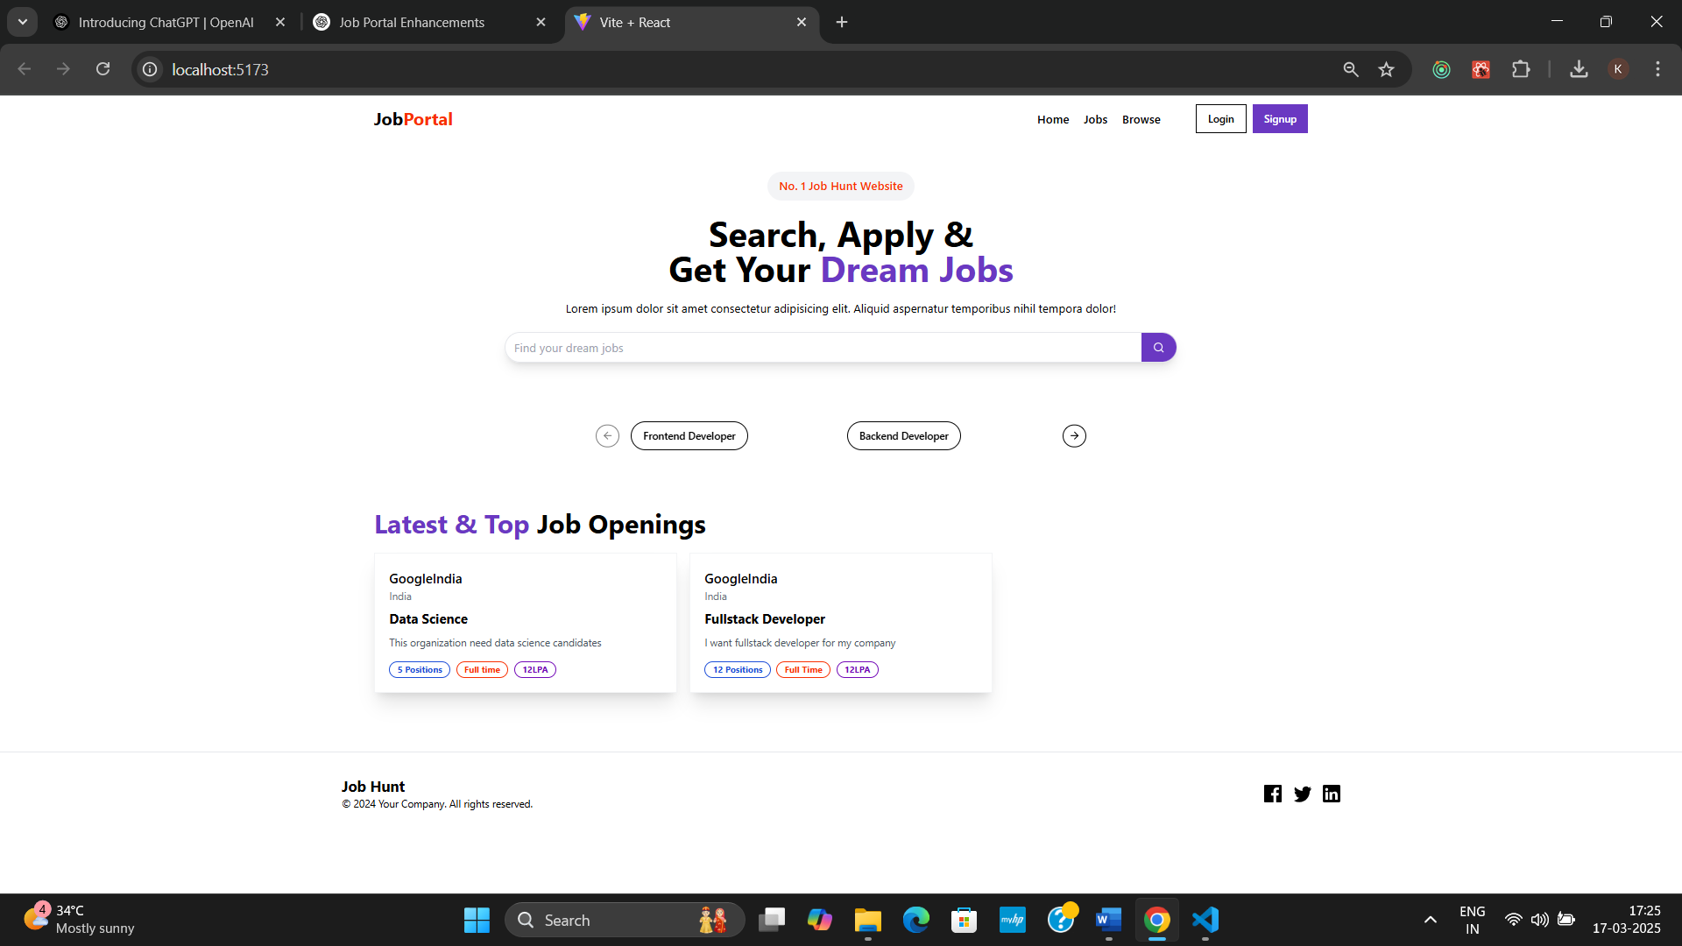
Screenshots

Slide 13
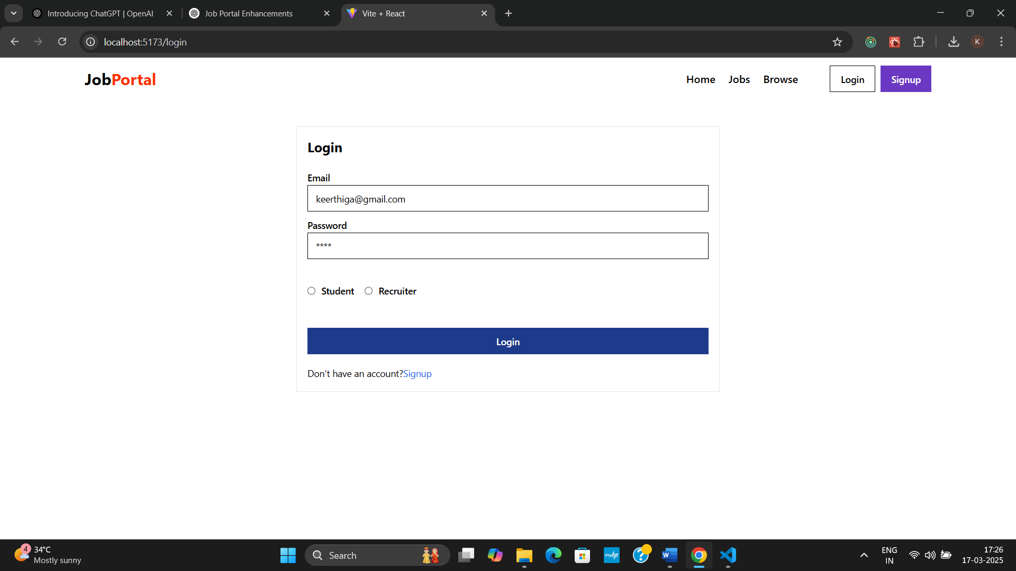

Slide 14
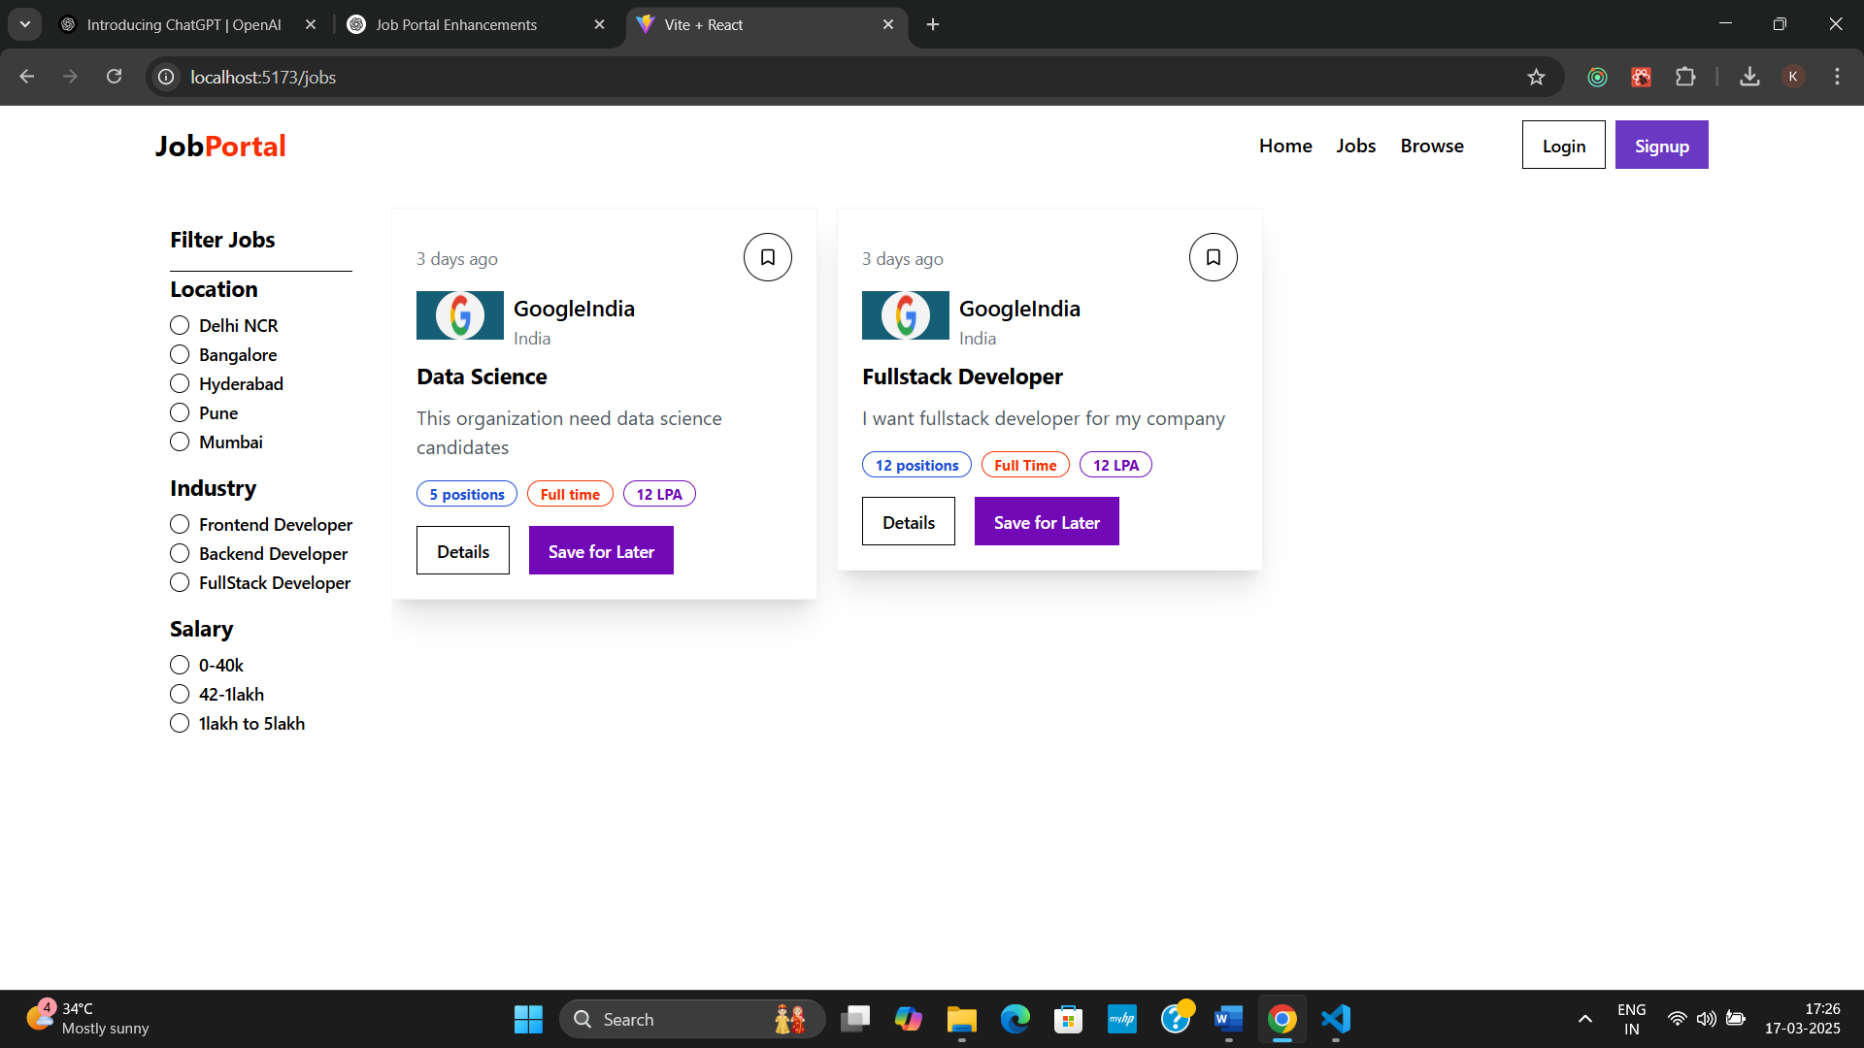

Slide 15
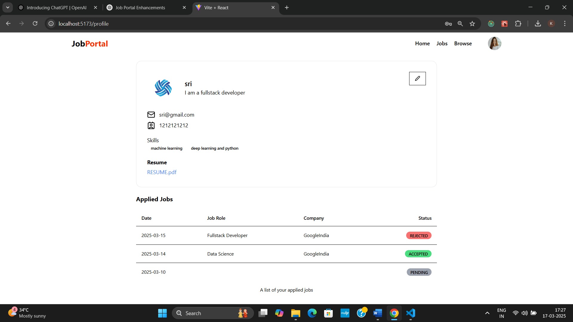

Slide 16
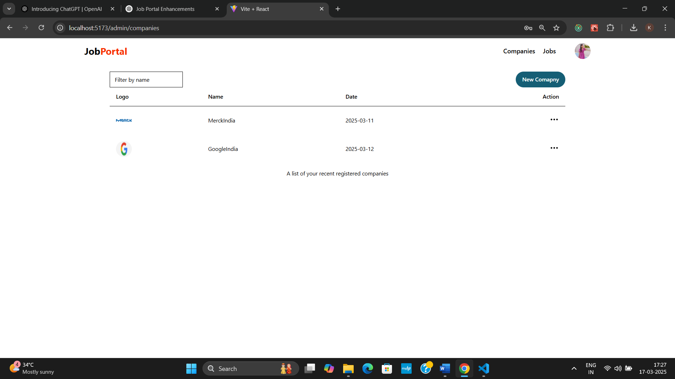

Slide 17
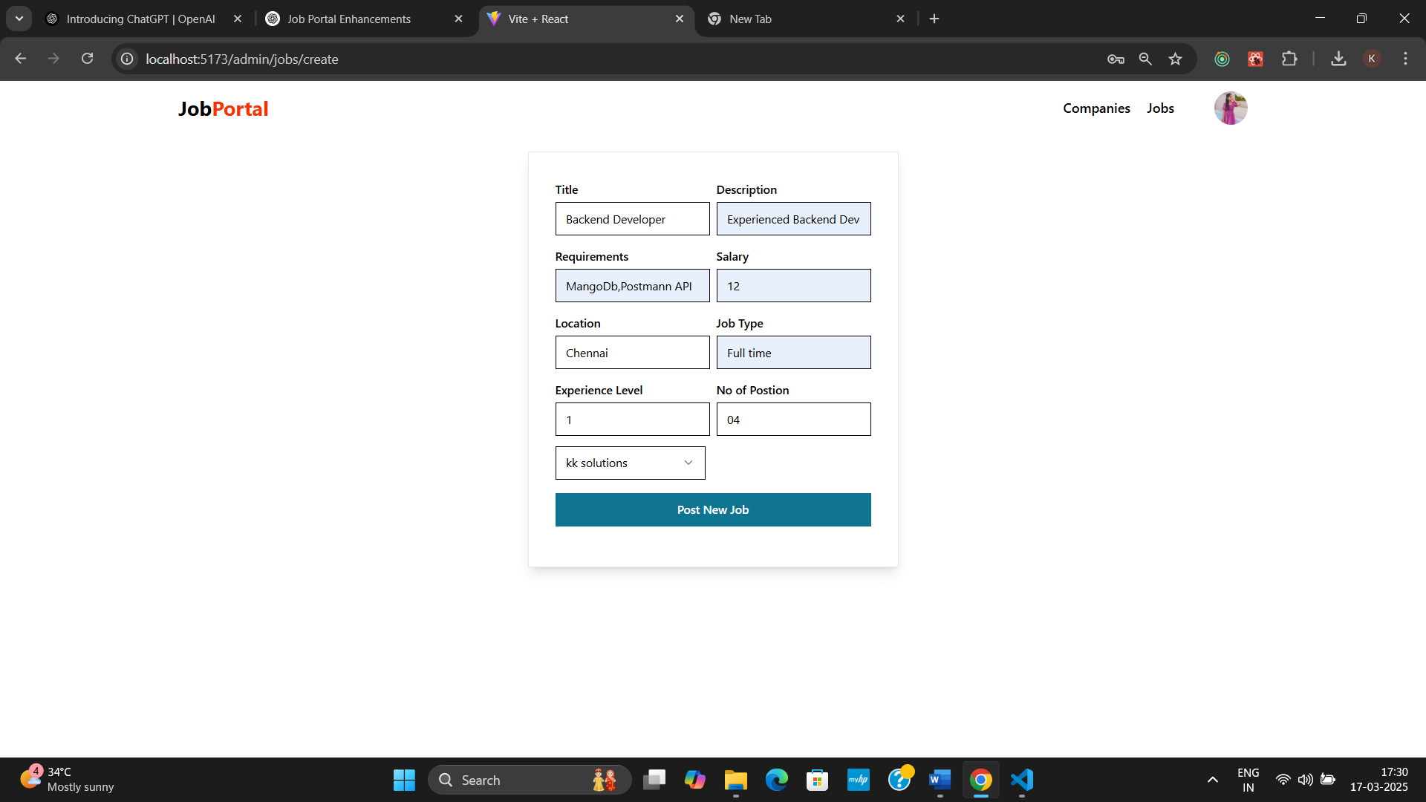

Slide 18
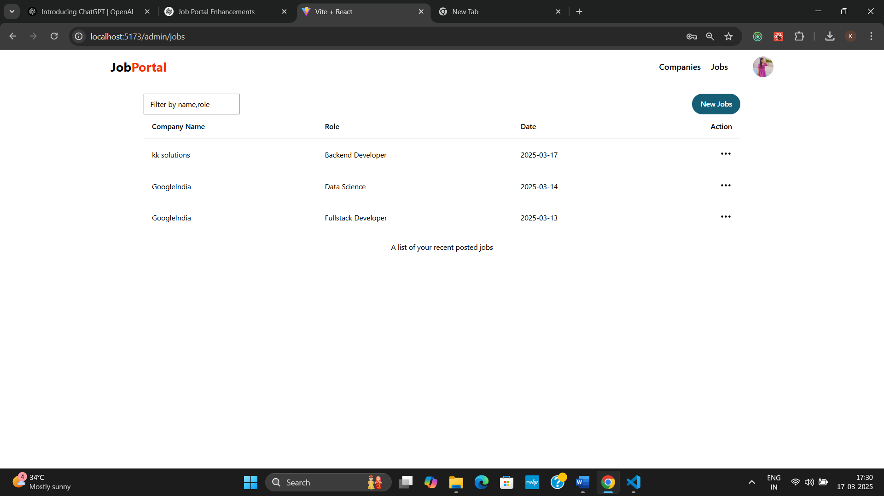

Slide 19
Thank you

