Slide 1


LUNG DISEASE CLASSIFICATION USING X-RAY IMAGES
SREENIDHI INSTITUTE OF SCIENCE AND TECHNOLOGY
DEPARTMENT OF CSE
K. Shivani
ROLL NO: 20311A05E8
MD Altaf
ROLL NO: 21315A0513
P. Praneeth
ROLL NO: 20311A05G3
GROUP PROJECT : 20-C4
INTERNAL GUIDE NAME & DESIGNATION
Mr. Devavarapu Sreenivasarao
Assistant Professor
HOD - CSE NAME & DESIGNATION
Dr. Aruna Varanasi
Professor

Slide 2
PROJECT SEMINAR CONTENTS
Introduction of the project
Existing System
Proposed System
Literature Survey
System Requirements
System Architecture
Modules
UML Diagrams for the Project/Coding Output Screenshots
Conclusion
Bibliography

Slide 3
INTRODUCTION
LUNG DISEASE CLASSIFICATION USING X-RAY IMAGES
Lung disease classification is one of the major issue facing in the world. In general, we see the classification of lung diseases are done by statistical data which is not that much accurate when compared to pictorial data.
Lung diseases like Tuber Culosis, Covid-19, Lung Cancer and other are difficult to classify using statistical data. Few problems can make it challenging to accurately classify lung diseases using statistical data alone, and it is important to carefully address these issues to develop robust classification models.
So, to overcome this we can improve lung disease classification using x-images by Machine Learning Algorithms.

Slide 4
EXISTING SYSTEM
Traditional diagnosis of lung diseases, including COVID-19 and other respiratory illnesses, often involves manual analysis of imaging modalities such as X-ray or CT scans. A radiologist visually inspects the images and makes a diagnosis based on their observations. However, this process is time-consuming, subjective, and prone to human error.
In case of COVID-19, imaging modalities such as chest X-rays or CT scans can be used to detect the characteristic features of the disease, including ground-glass opacities and consolidations in the lungs.

Slide 5
PROPOSED SYSTEM
The proposed system aims to address the limitations of statistical data by using pictorial data in the form of X-ray images to classify lung diseases using machine learning algorithms.
Specifically, the system will use convolutional neural networks (CNNs) to automatically learn features from the X-ray images and classify them into different lung diseases. The system will be trained on a large dataset of X-ray images and will have high accuracy, sensitivity, and specificity in detecting different types of lung diseases.

Slide 6
DESCRIPTION OF DATASET
Several datasets have been compiled to facilitate research on COVID-19 detection and analysis using chest X-ray images. These datasets typically consist of chest X-ray images obtained from individuals diagnosed with COVID-19, as well as images from individuals with other respiratory conditions or healthy individuals for comparison. The images are often labelled to indicate the presence or absence of COVID-19. This database consists of four different kinds of images for the four different lung related diseases :
Normal – 10192
Lung Opacity (Non COVID Lung Infection) - 6012
COVID - 3616
Viral Pneumonia – 1345
Formats - All the images are in Portable Network Graphics (PNG) file format and resolution are 299 - 299 pixels.

Slide 7
SYSTEM REQUIREMENTS
Hardware:
A computer with at least 8 GB of RAM and a multi-core CPU (e.g., Intel Core i5 or higher)
A dedicated GPU with at least 2 GB of VRAM (e.g., Nvidia GeForce GTX 1050 Ti or higher)
Software:
Operating System: Windows, Linux or macOS
Python libraries for machine learning such as TensorFlow, Keras, PyTorch, Scikit-learn, and OpenCV
Libraries for image processing and computer vision such as PIL,and Scikit-image
Jupyter Notebook or any other Python IDE or Google Colab

Slide 8
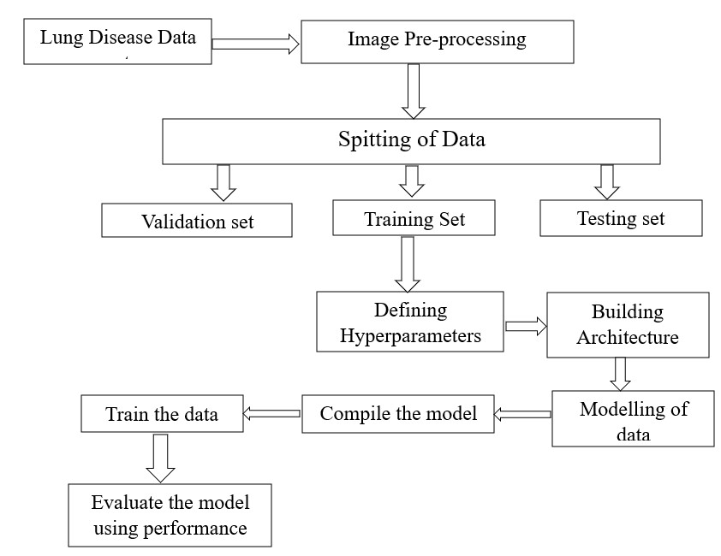
SYSTEM ARCHITECTURE

Slide 9
ARCHITECHTURE OF CNN
There are two main parts to a CNN architecture
A convolution tool that separates and identifies the various features of the image for analysis in a process
called as Feature Extraction.
The network of feature extraction consists of many pairs of convolutional or pooling layers.
A fully connected layer that utilizes the output from the convolution process and predicts the class of the
image based on the features extracted in previous stages.
This CNN model of feature extraction aims to reduce the number of features present in a dataset. It creates
new features which summarises the existing features contained in an original set of features. There are
many CNN layers as shown in the CNN architecture diagram.

Slide 10
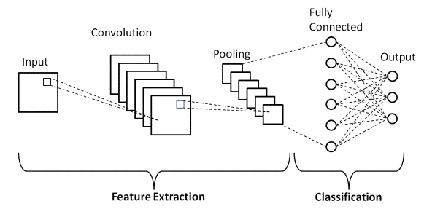
ARCHITECHTURE OF CNN
There are three types of layers that make up the CNN which are the convolutional layers, pooling layers, and fully-connected (FC) layers.
Convolutional Layer
Activation Function
Pooling Layer
Fully-Connected Layers
Flattening
Output Layer

Slide 11
ARCHITECHTURE OF INCEPTIONRESNET
The Inception-ResNet algorithm is a deep learning architecture that combines the ideas of the Inception network and residual connections from the ResNet architecture. It aims to leverage the benefits of both architectures to improve the performance and optimization of convolutional neural networks (CNNs) for image classification and other computer vision tasks.
Inception-ResNet-v2 is a convolutional neural network that is trained on more than a million images from the ImageNet database. The network is 164 layers deep and can classify images into 1000 object categories, such as the keyboard, mouse, pencil, and many animals. As a result, the network has learned rich feature representations for a wide range of images. The network has an image input size of 299-by-299, and the output is a list of estimated class probabilities.

Slide 12
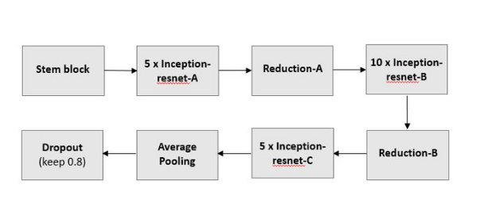
.
ARCHITECHTURE OF INCEPTIONRESNET
This architecture includes the following steps :
Stem
Inception Blocks
Residual Connections
Reduction Blocks
Global Average Pooling and SoftMax

Slide 13
ARCHITECHTURE OF EFFICIENTNET
The EfficientNet algorithm is a deep learning architecture that aims to achieve state-of-the-art performance while maintaining computational efficiency and model size. It introduces a novel approach called compound scaling, which uniformly scales the depth, width, and resolution of the network to balance model capacity and computational cost.
EfficientNet addresses the challenge of designing models that are both accurate and efficient. Typically, increasing the model size or depth improves accuracy but comes at the cost of increased computational resources. On the other hand, reducing the model size may compromise accuracy. EfficientNet seeks to find the optimal trade-off by scaling the network's dimensions in a principled manner.

Slide 14
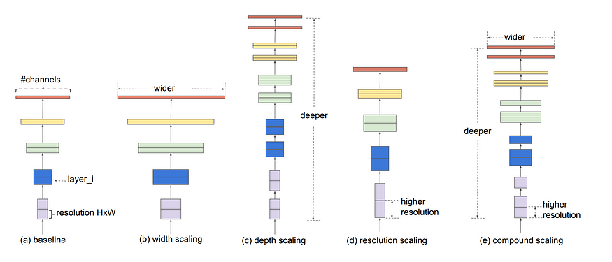
ARCHITECHTURE OF EFFICIENTNET
The EfficientNet algorithm architecture that aims to achieve state-of-the-art performance while maintaining efficiency in terms of model size and computational resources. This includes :
Base Architecture
Mobile Inverted Residual Blocks
Scaling
Stacked Blocks
Resolution Scaling
Global Average Pooling and
Fully Connected Layer

Slide 15
MODULES
Data Preparation Module
Algorithm Module
Training Module
Validation Module

Slide 16
MODULES
Data Preparation Module: This module is responsible for collecting, preprocessing, and augmenting the data used for training, validation, and testing.
Algorithm Module: This module is responsible for implementing and testing various machine learning algorithms for classification of lung diseases. This module will involve techniques such as convolutional neural networks (CNNs), transfer learning.
3. Pre-processing Module: The functionality of this module is to transform the datasets into
model specific suitable inputs. Transformations include Skewness correction,
Normalization, etc…
4. Visualization Module: The main functionality of this module is to visualize the images,
distribution of the images and skewness of the dataset

Slide 17
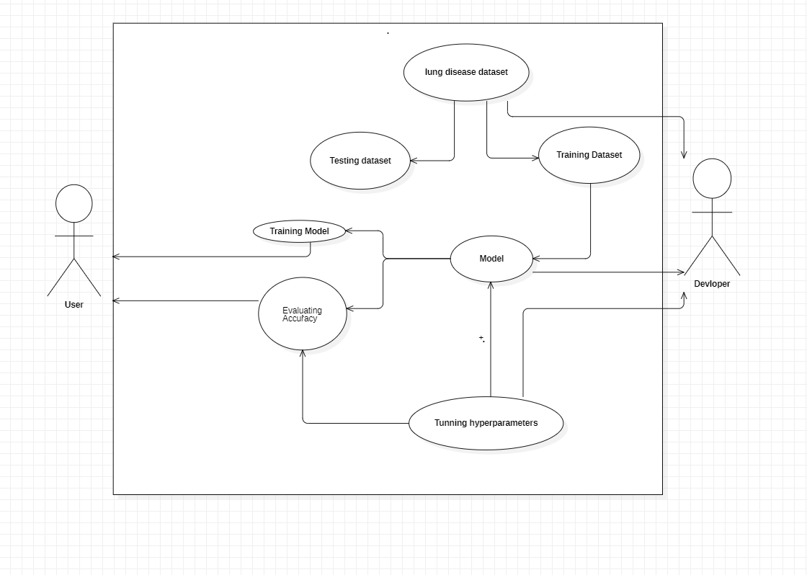
UML DIAGRAMS FOR PROJECT
USE CASE DIAGRAMS :

Slide 18
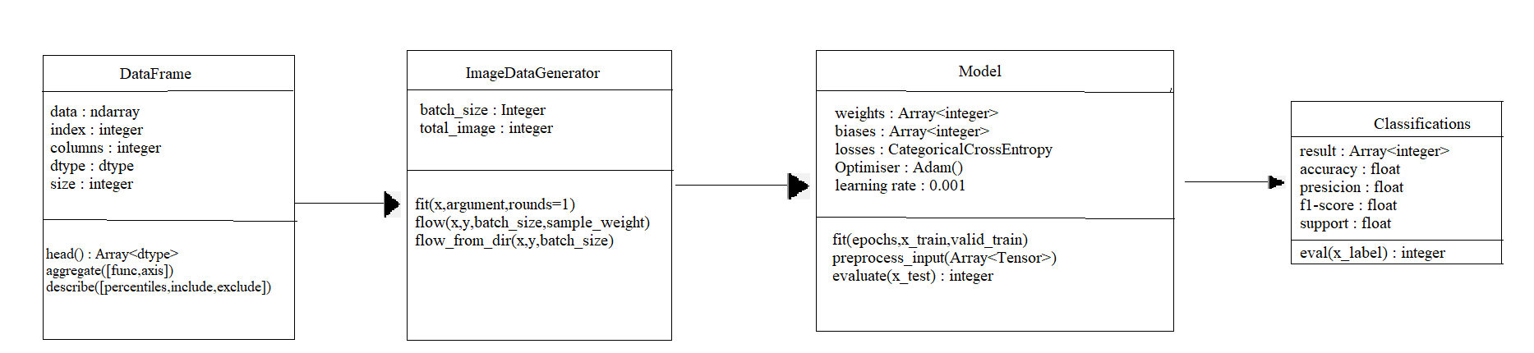
CLASS DIAGRAM :

Slide 19
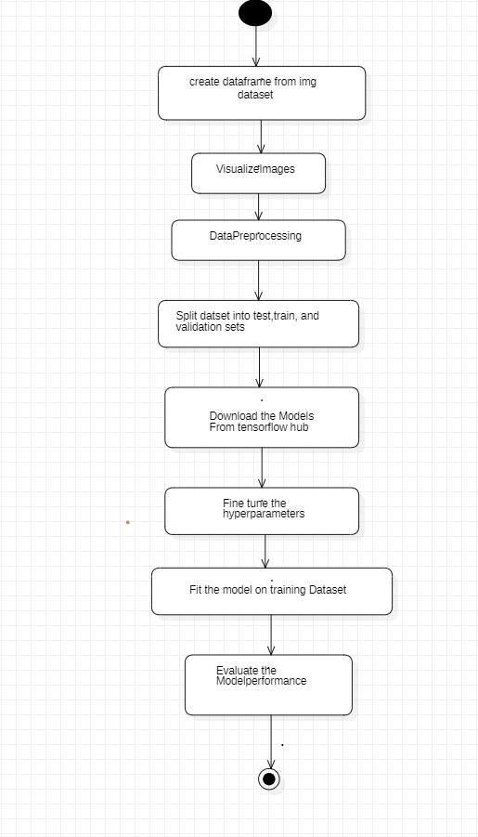
ACTIVITY DIAGRAM :

Slide 20
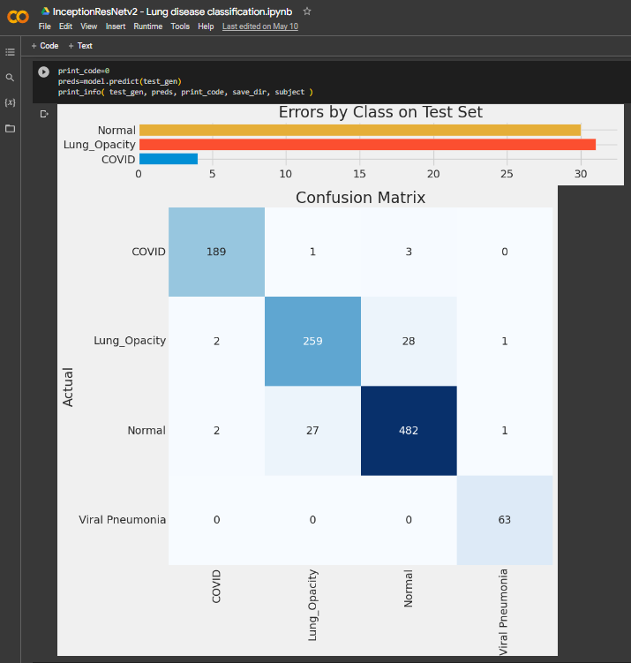
INCEPTIONRESNET EFFICIENTNET MODEL OUTPUT SCREENSHOTS

Slide 21
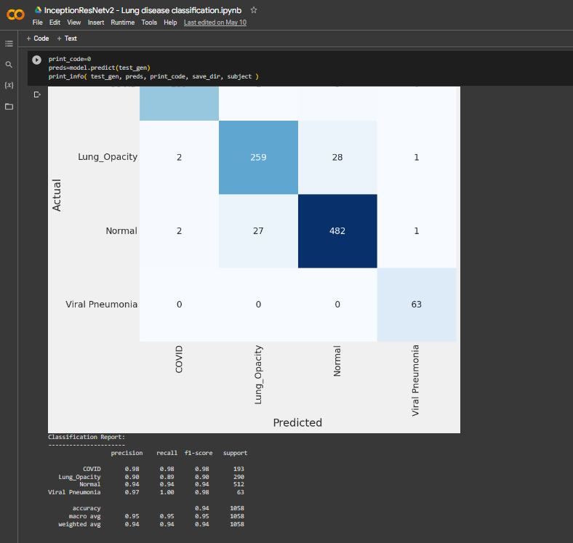
INCEPTIONRESNET EFFICIENTNET MODEL OUTPUT SCREENSHOTS

Slide 22
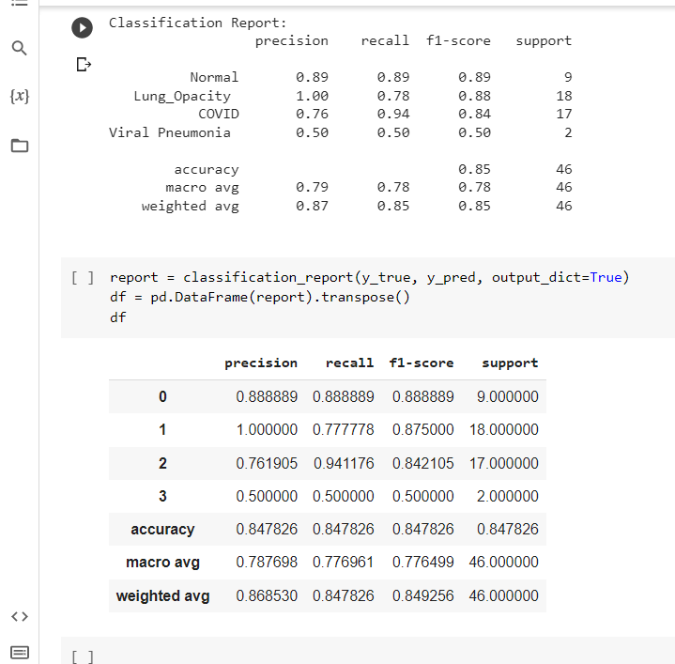
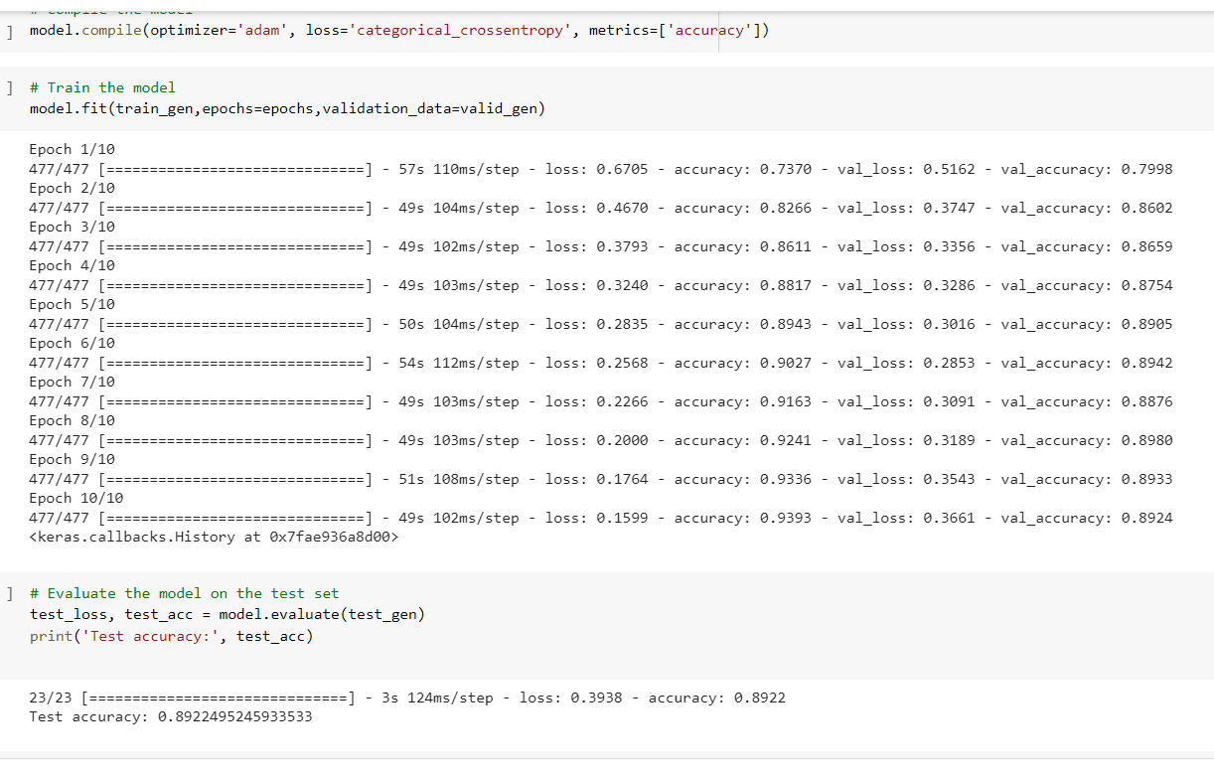
CNN MODEL OUTPUT SCREENSHOTS

Slide 23
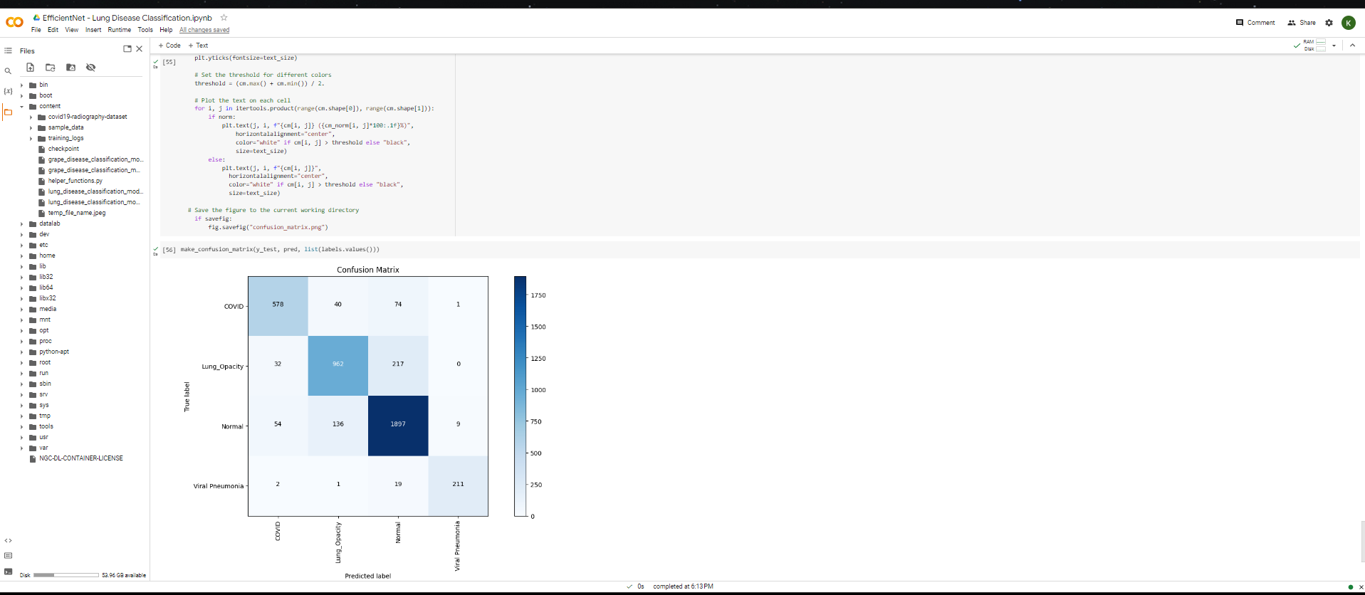
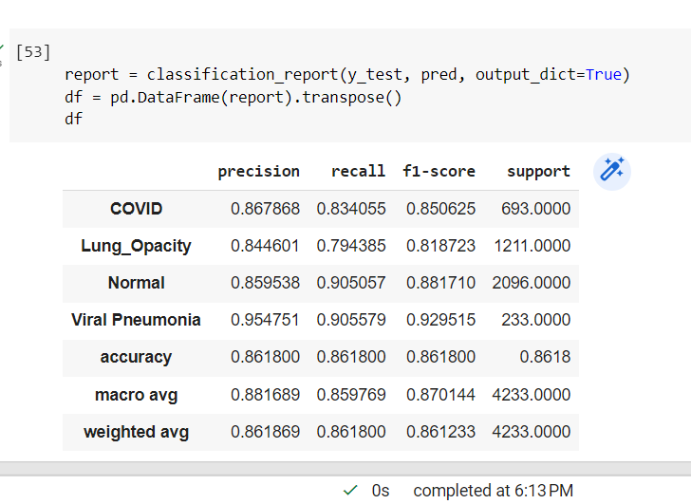
EFFICIENTNET MODEL OUTPUT SCREENSHOTS

Slide 24
CONCLUSION
In conclusion, lung disease classification using x-ray images is an important application of machine learning in the healthcare domain. By training machine learning algorithms on large datasets of x-ray images, we can develop accurate models that can assist radiologists in diagnosing and classifying various lung diseases such as viral pneumonia, lung opacity and covid.
Different machine learning algorithms such as Convolutional Neural Networks (CNN), InceptionResNet, and EfficientNet have been used for lung disease classification with varying degrees of success. The choice of algorithm depends on factors such as the size of the dataset, the complexity of the problem, and the computational resources available.
Overall, machine learning-based lung disease classification has the potential to improve the accuracy and efficiency of lung disease diagnosis and treatment. However, it is important to ensure that these algorithms are validated and tested on diverse and representative datasets to avoid bias and ensure their reliability and generalizability.
InceptionResNet achieves an accuracy of 91% , EfficientNet achieves an accuracy of 85.7% and CNN achieves an accuracy of 84.7%

Slide 25
BIBLIOGRAPHY
https://www.kaggle.com/datasets/tawsifurrahman/covid19-radiography-database
https://www.kaggle.com/code/arbazkhan971/image-classification-using-cnn-94-accuracy

Slide 26
ANY QUERIES?
THANK YOU

