Slide 1


Slide 2


Slide 3


Slide 4




BROKER

Slide 5
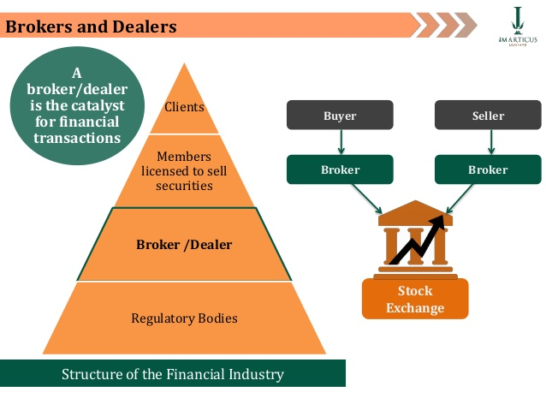

Slide 6


Slide 7


Slide 8

PERSHING

Slide 9


Slide 10

SECURITY CLEARANCE

Slide 11
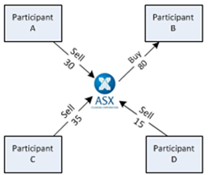
Netting

Slide 12

Settlement

Slide 13
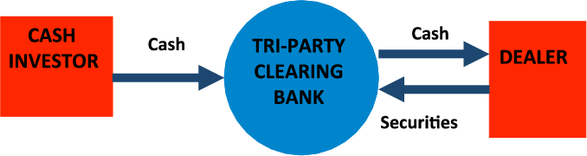

Slide 14
Clearing members
TM-CM
PCM
SCM

Slide 15


Slide 16


Slide 17
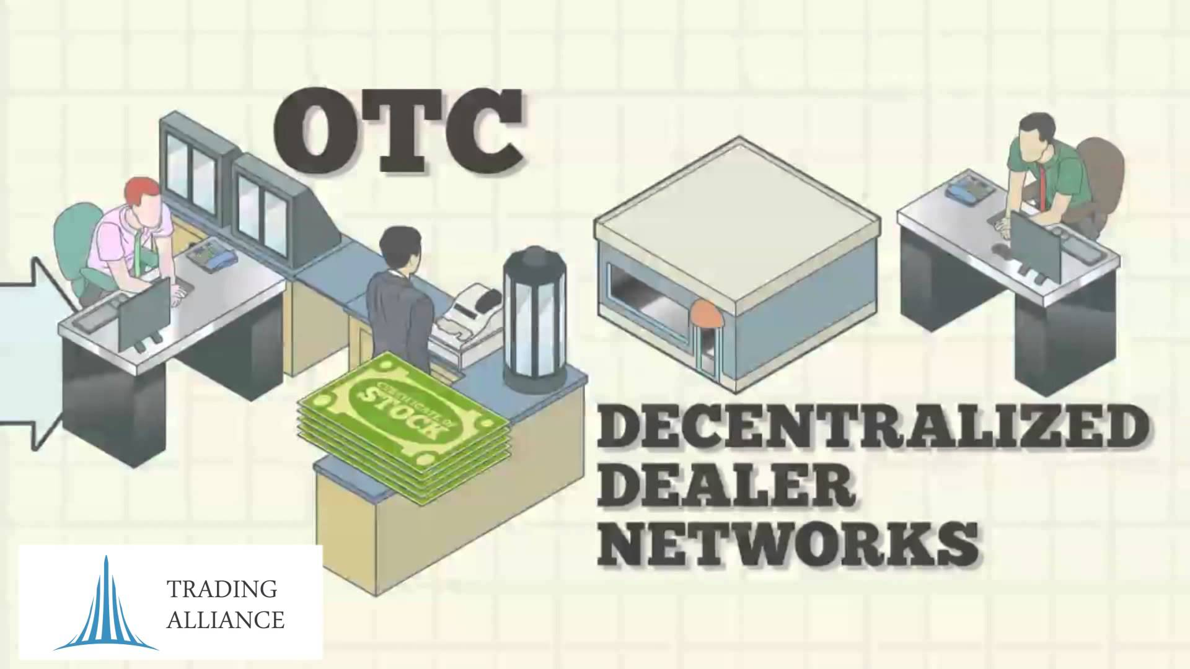

Slide 18
Primary dealer

