Slide 1
Employee Data Analysis using Excel
STUDENT NAME: KEERTHANA.J
REGISTER NO: 122202171(99C53BCEABE914D9F5D44B015D34C1F2)
DEPARTMENT: B.COM CORPORATE SECRETARYSHIP
COLLEGE: ANNA ADARSH COLLEGEFOR WOMEN

Slide 2
PROJECT TITLE
Employee Performance Analysis using Excel

Slide 3


AGENDA
Problem Statement
Project Overview
End Users
Our Solution and Proposition
Dataset Description
Modelling Approach
Results and Discussion
Conclusion
3/21/2024 Annual Review

Slide 4

PROBLEM STATEMENT
1.GOAL SETTING
2.PERFORMANCE REVIEW
3.PERFORMANCE IMPROVEMENT PROCESS
4.DECREASSED PRODUCTIVITY
5.DIFFICULTY PRIORITIZING TASKS
6.COMMITTING ERRORS IN PROJECT
7.MISSING DEADLINES

Slide 5

PROJECT OVERVIEW
1. Define your goals and objectives
2. Gather and analyze your data
3 .choose the right data visualization
4. Organize your data
5. Review and finalize your report

Slide 6

WHO ARE THE END USERS?
1.Human resources
2.Management and leadership
3.Finance department
4. Employees
5.It department
6.Legal and compliance teams
7.Data analysts and business
8.Marketing and communication

Slide 7

OUR SOLUTION AND ITS VALUE PROPOSITION
Filtering-missing value
Conditional formation- blank values
Pivot table
chart

Slide 8
Dataset Description
Employee data set-Kaggle
26 features
Feature-9features
Emp id
Gender-male,female
Performance
Business unit
Name
Rating- numerical

Slide 9
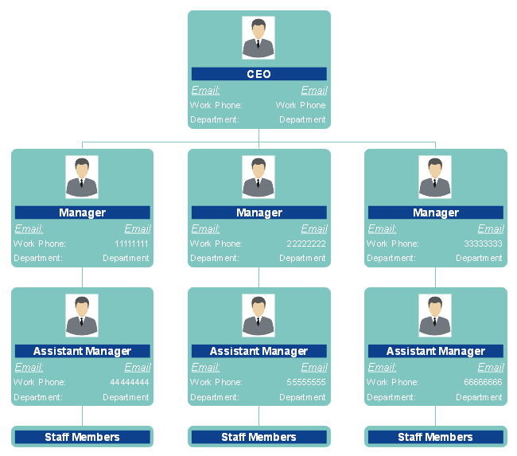

THE "WOW" IN OUR SOLUTION
3/21/2024 Annual Review
9

Slide 10

MODELLING
Data collection
Data cleaning
Techniques
Results
Pivot table
Chart graph
10

Slide 11
RESULTS
11

Slide 12
RESULTS
12

Slide 13
conclusion
Overall performance: the majority of employees are meeting or exceeding performance expectations and quality of work across the team
Top performance: these individuals might be considered for leadership roles or special projects
Areas for improvement: skills gaps that may require targeted training or coaching
Impact of training process : employees who have undergone recent training programs show noticeable improvement in their performance
Recommendations for management :refine training programs to address any identical skills gaps

