Slide 1

Smart Lender Project: Revolutionizing Loan Management
A next-generation lending platform that combines AI, secure distributed ledgers, and human-centered design to streamline credit decisions, reduce fraud, and expand access to fair capital.

Slide 2



The Current Landscape
Inefficient operations
Bias & data gaps
Fraud & opacity
Weighty manual reviews, long turnaround times, and high operational cost per application.
Traditional credit models exclude thin-file or informal-economy borrowers, perpetuating credit inequality.
Lack of transparent audit trails and weak data provenance increase fraud risk and regulatory friction.

Slide 3


Introducing Smart Lender
Vision: build a trusted, scalable platform that automates credit decisions while preserving human oversight. Core principles: fairness, explainability, security, and extensibility for diverse markets.
Focus: Make lending faster, fairer, and auditable — without sacrificing regulatory compliance.

Slide 4


Key Feature — AI-Powered Credit Scoring
Machine learning models combine traditional credit history with alternative signals (payment apps, cash flow patterns, utility records) to score applicants more inclusively.
1
2
Explainable models
Adaptive risk tuning
Transparent feature attributions for every decision so underwriters and customers see why a score was assigned.
Continuous learning with guardrails to prevent drift and preserve fairness across cohorts.

Slide 5


Streamlined Workflow
Apply
Verify
AI Score
Review
Disburse
End-to-end flow reduces decision time from days to hours. Human underwriters intervene only for flagged exceptions, improving throughput and accuracy.

Slide 6



Enhanced Security — Blockchain for Trust
Immutable transaction logs and verifiable document anchors ensure provenance of KYC, approvals, and repayments — simplifying audits and dispute resolution.
Auditability
Data integrity
Transparent, time-stamped records for regulators and partners.
Tamper-evident storage for critical borrower documents.

Slide 7
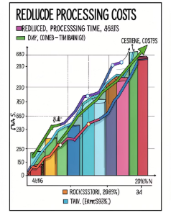
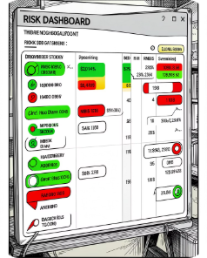

Benefits for Lenders
Operational efficiency
Reduced credit risk
Increased profitability
Lower cost per loan through automation and exception-based human review.
Improved accuracy in risk assessment using broader data and adaptive models.
Faster approvals and better pricing enable higher conversion and better portfolio returns.

Slide 8

Benefits for Borrowers
Faster approvals
Near real-time decisions for routine cases.
Fairer terms
Alternative data reduces bias against thin-file borrowers.
Greater accessibility
Mobile-first applications and multilingual support expand reach.

Slide 9
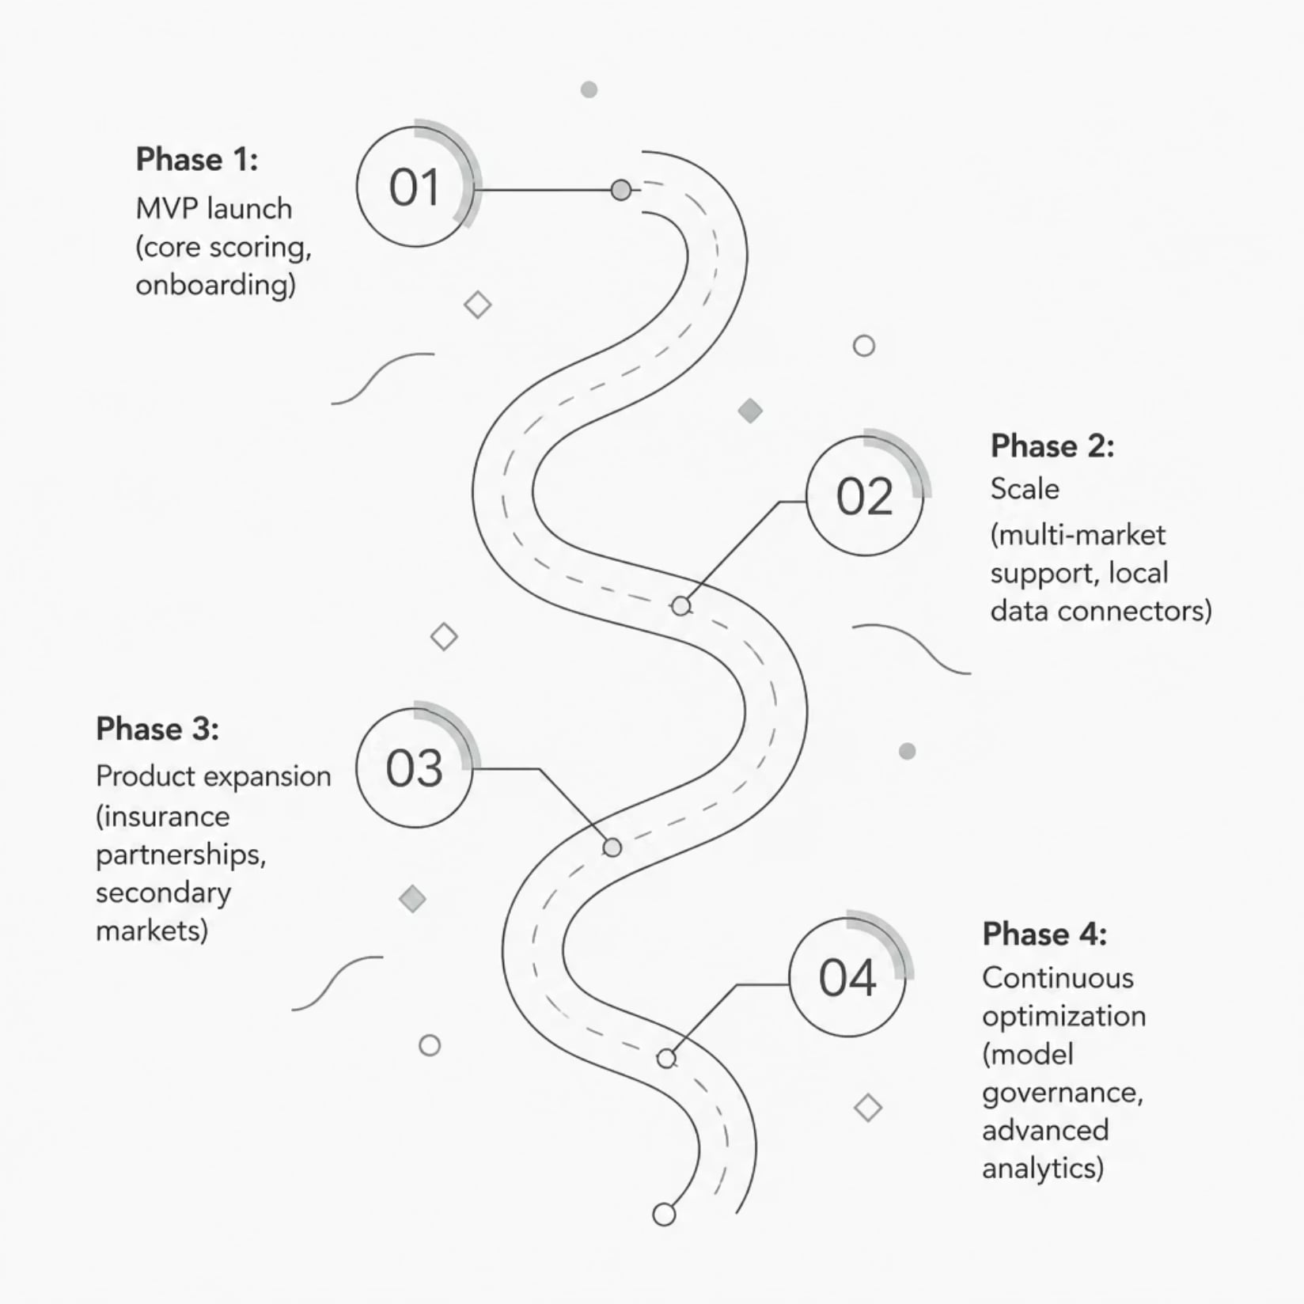

Our Roadmap
Immediate priorities: MVP deployment and regulated pilot partners. Next 12–24 months: geographic expansion, API integrations, and enhanced compliance tooling.
Scalability built-in: modular services and cloud-native infrastructure.

Slide 10

Call to Action
Partner with Smart Lender to modernize your credit lifecycle. Pilot opportunities available — collaborate on data, compliance, and product fit to unlock safer, fairer lending at scale.
Interested in a pilot?
Contact our partnerships team to design a tailored proof-of-concept.
Want a demo?
Schedule a hands-on walkthrough of underwriting, scoring explanations, and the admin console.

