Slide 1


Google play store analysis.
Name : Kolla Keerthik
Enrollment Id :

Slide 2


Business Objective
1.Jai is an app developer . He taught to develop an app from a category when it reaches to max installs with good rating and reviews
2.Help jai in selecting a category where he can develop an with max installing categories with good ratings and reviews .

Slide 3
Problem statements
1.what are the unique categories in the given data set ?
2.How many number of apps in each category ?
3.count of available apps based on category?
4.Display the Rating Distribution?
5.count the Types of Apps available ?
6.Display the avg rating of each category ?
7.Find out there are any outliers in rating category ?
8.Display the app with highest rating ?
9.Display the count of apps based on types?
10.What are the top 3 Android versions among the apps in the dataset?
11.Find out the relationship between reviews and rating columns?
12.Display the count of content rating over each type ?
13.Display the count categories for each type ?
14.Top 5 categories with highest rating ?
15.Top categories with highest no of reviews ?
16.Top categories with highest installs ?
17.Trend in years between paid vs free categories ?
18.How does category wise change over among years ?
19.Which has more installs among family and game categories ?
20.Design a dashboard for google play store analysis data set ?

Slide 4
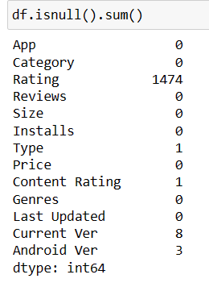
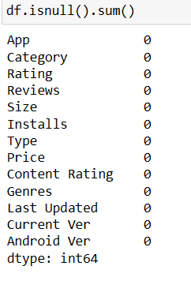
Finding the number of missing values in each column and filling with respective values .
Interpretation :
In the given dataset we found that there some null values. And we replaced those null values with mean or mode based on their data types .

Slide 5
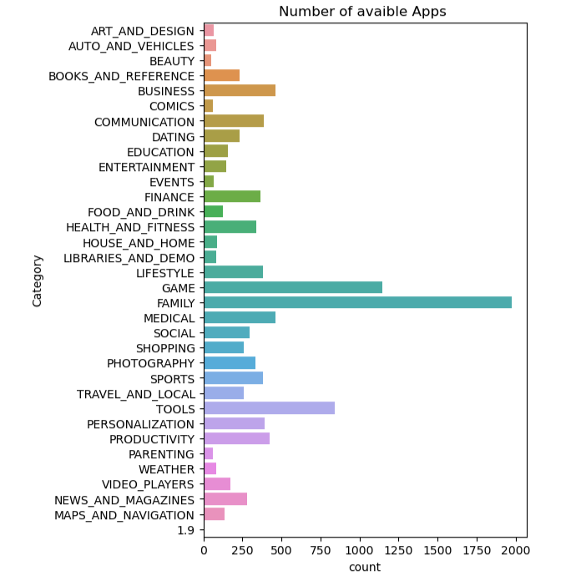
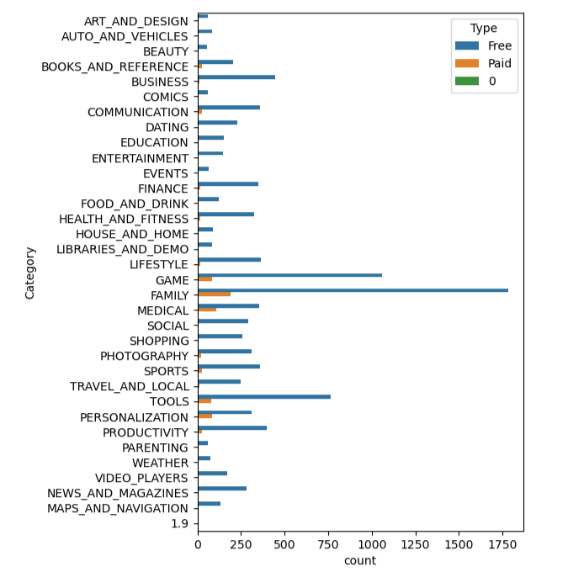
Count of available apps based on category
Count of categories over each type .
Interpretation1 :
There are more number of apps available on family category .
Interpretation 2 :
The Family category has highest free apps .

Slide 6
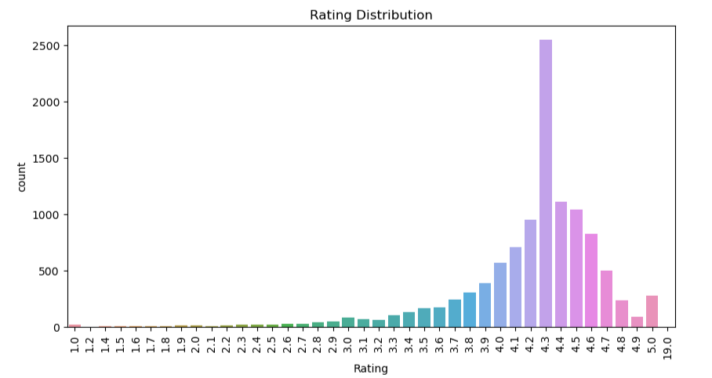
Distribution of rating .
Interpretation :
Here we can say that 4.3 is the overall highest rating on overall categories .

Slide 7
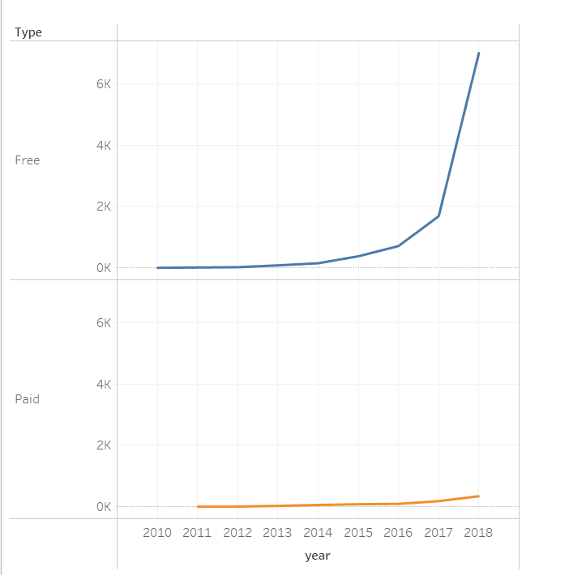
Trend between free and paid type categories from 2010-2018
Interpretation :
There is more trend for free type categories. There is an continuous increasing trend for free category apps from 2010 to 2018 and people started accepting free categories more from 2017 to 2018 .

Slide 8
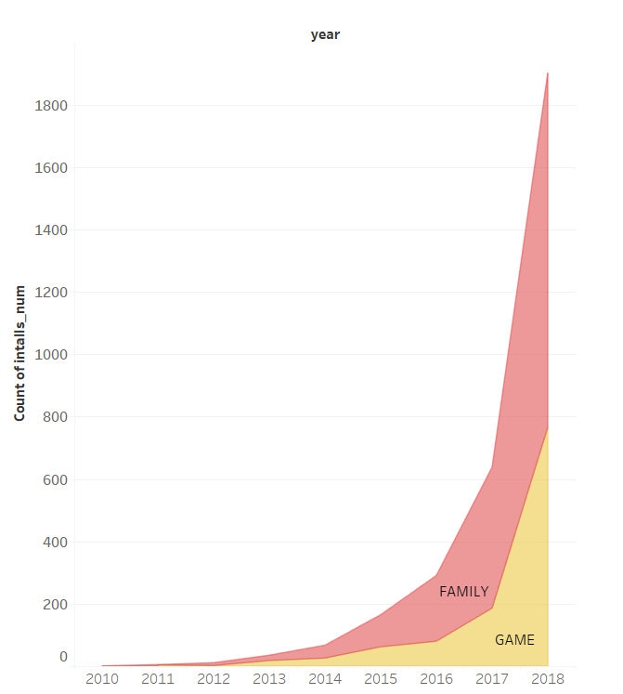
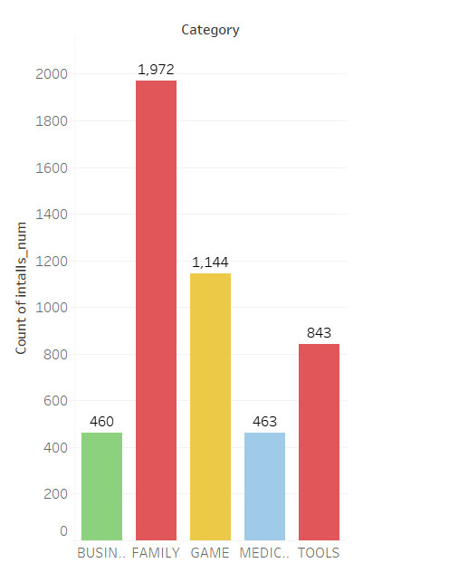
Top 5 installed categories .
Top 2 installed categories from year 2010 – 2018
Interpretation1 :
The top 5 categories based on number of installs are Family , Game , Tools , Business , Medical
Interpretation 2 : The Family type categories has more number of installs increasing from 2010 to 2018 .
In year 2018 the family category has 1,137 installs and The game category has 766 installs .

Slide 9
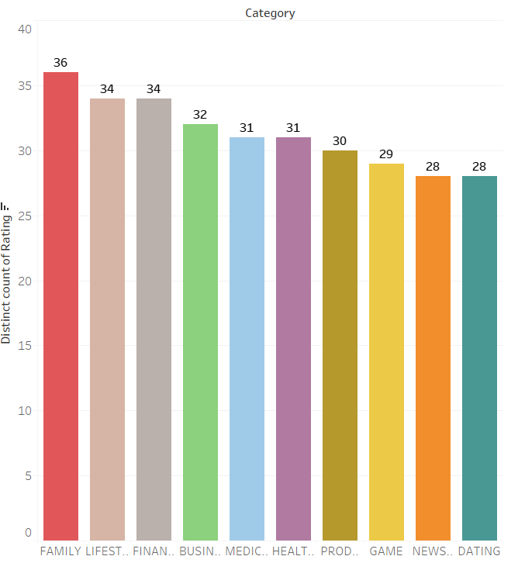
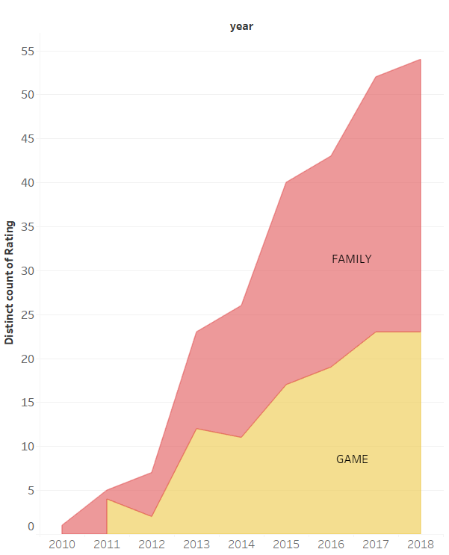
Top rated categories .
Top 2 rated categories from year 2010 – 2018
Interpretation1 :
The Family category has highest distinct count of ratings .
Interpretation 2 :
The Family type categories has more number of distinct ratings from 2010 to 2018 .

Slide 10
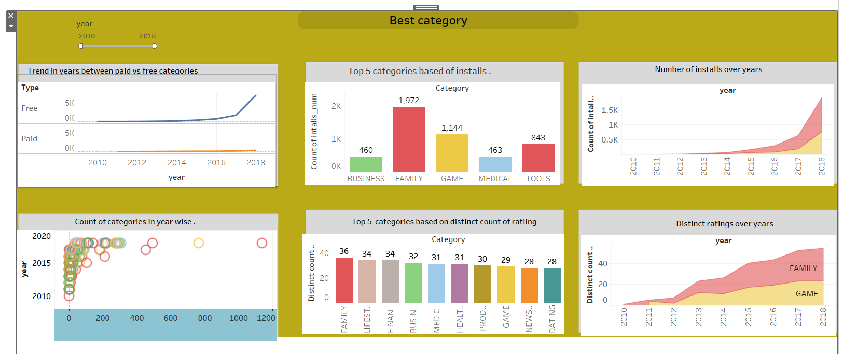
Dashboard

Slide 11
Conclusion
category | Family
No of distinct Ratings | 36
Reviews | 410 M
No of distinct Installs | 1,972 Installs
type | Free
Android Version | 4.1 and up
No of available apps | 1,972
From the above data I suggest jai to develop an app belongs to family category which is free type with Android version 4.1 and up .

