Slide 1


Department of Artificial Intelligence and Data Science
Enhanced Travel Recommendation System Using Hybrid Filtering
Supervisor
Dr J M Gnanasekar
(Head of the Department
AI& DS)
Devika C (221801009)
Keerthika P (221801027)

Slide 2
Problem Statement and Motivation
A travel booking website aims to enhance travel recommendation by analyzing customer travel preferences and booking history .They aim to provide tailored travel suggestions and improve booking conversions .
Enhancing personalized travel recommendations is crucial for improving user satisfaction and increasing booking conversions. By overcoming the limitations of traditional recommendation systems, our hybrid filtering approach aims to deliver more accurate and adaptive suggestions in personalized travel planning, driving higher engagement and customer loyalty.

Slide 3
Objectives
The project aims to enhance travel planning by offering personalized recommendations using a hybrid filtering approach. By analyzing customer preferences and booking history, we try to boost user satisfaction and booking conversions.
This will be achieved by combining collaborative and content-based filtering and refining the system with user feedback and data analysis.

Slide 4
Abstract
People nowadays are become more likely to rely on internet resources to plan their vacations. This has led to the development of TRS that can use large amounts of data to identify ideal travel destinations by satisfying the user experience . Existing systems rely on either collaborative or content-based filtering, which often result in suboptimal recommendations due to data sparsity .This travel booking website addresses these limitations by implementing a hybrid filtering approach, combining the strengths of both collaborative with SVD algorithm and content-based filtering with TF-IDF algorithm. This unique system analyzes customer travel preferences and booking history to provide highly tailored travel suggestions through adaptive recommendations, the suggestions remain relevant as up-to-date.

Slide 5
Introduction and Overview of the Project.
Our travel booking website uses hybrid filtering technology to provide personalized travel recommendations, addressing the limitations of traditional systems that struggle with personalization and data issues.
By analyzing customer travel preferences and booking history, we deliver tailored travel suggestions. Our unique hybrid filtering approach combines collaborative and content-based filtering to ensure highly relevant and adaptive recommendations. This method enhances user satisfaction, boosts booking conversions, and sets our platform apart in the travel industry.

Slide 6
Literature Survey
S.No | Author Name | Paper Title | Description | Jornal | Volume/ Year
1 | Xi Cheng | A travel route recommendation algorithm based on interest theme and distance matching | It discusses techniques such as collaborative filtering, hybrid methods, and social filtering, highlighting their applications and future potential in enhancing personalized travel experiences. | EURASIP Journal on Advances in Signal Processing volume 2021, Article number: 57 (2021 | 2021
2 | Hael Al-bashiri Mansoor Abdullateef Abdulgabber Abdulhak Awanis Romli Fadhl Hujainah | Collaborative Filtering Recommender System: Overview and Challenges | overview of collaborative filtering in recommender systems, detailing its methodologies (content-based, collaborative, hybrid) and challenges (data sparsity, cold start, scalability), with solutions like clustering and dimensionality reduction. | September 2017 Journal of Computational and Theoretical Nanoscience 23(9):9045-9049 DOI: 10.1166/asl.2017.10020 | 2017
3 | Deepjyoti Roy & Mala Dutta | A systematic review and research perspective on recommender systems | Recommender systems use algorithms like content-based filtering (e.g., cosine similarity), collaborative filtering (KNN), and hybrid methods to provide personalized suggestions. Advanced techniques such as, neural networks, further enhance accuracy. | Journal of Big Data volume 9, Article number: 59 (2022) | 2022
4 | Ms. Tejashri Sharad Phalle Prof. Shivendu Bhushan | Content Based Filtering And Collaborative Filtering: A Comparative Study | Content-Based Filtering (CBF) and Collaborative Filtering (CF) in recommendation systems. It discusses their strengths, weaknesses, and practical applications, emphasizing hybrid systems that combine both methods for robust and personalized suggestions. | Mar 2024 Journal Of Advanced Zoology 45(S4):96-100 DOI: 10.53555/jaz.v45iS4.4158 | 2014

Slide 7
Existing Sytem
Current travel booking platforms use:
Collaborative Filtering : Recommends based on other users' preferences and past behavior. Struggles with new users due to lack of data, leading to less accurate suggestions.
Ex :"Since User A booked trips to Paris and Rome, recommend Paris and Rome to User B who booked similar destinations."
Content-Based Filtering: Suggests items by matching features with user interests . Can lack deep personalization and miss individual user nuances.
EX:"User A booked a beach resort in Hawaii; recommend a beach resort in the Bahamas with similar features to User A."
Rule-Based Systems: Uses predefined rules or manual curation to recommend items. Not scalable or adaptive, resulting in a generic user experience.

Slide 8
Drawback of Existing System
Data Sparsity: Limited user interaction data can lead to less accurate recommendations. This makes it challenging to provide relevant suggestions, especially for new or infrequent users.
Limited Personalization: Recommendations may not fully align with individual user preferences. Systems often provide generic suggestions that fail to address specific user interests.
Cold Start Problem: New users or destinations with minimal data struggle to receive relevant recommendations. This results in less personalized experiences for newcomers to the system.
Scalability Issues: As the number of users and items grows, system performance can degrade. This can affect recommendation accuracy and response times.

Slide 9
Proposed System
Data Handling: To overcome data sparsity and cold-start issue, this system uses a combined collaborative and content-based approach.
Personalization: This system provides advanced, tailored recommendations using hybrid filtering.
Adaptability: Existing systems have static recommendations, this system adapts in real-time based on user feedback.
Accuracy: This system enhance accuracy using matrix factorization techniques.
Scalability: Existing systems face scalability issues, this system is designed for seamless expansion and feature integration.

Slide 10
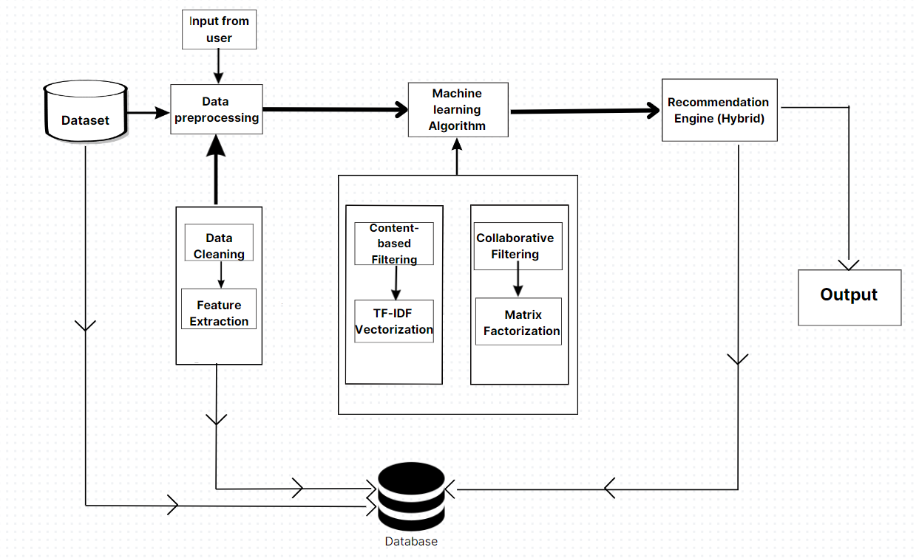
System Architecture

Slide 11
List of Modules
Data Preprocessing Module
Collaborative Filtering Module
Content-based Filtering Module
Recommendation Engine Module

Slide 12
Data Preprocessing Module Content
Collect Data: Gather raw data from various sources like user inputs or databases.
Clean Data: Remove errors, duplicates, and inconsistencies from the collected data.
Transform Data: Convert the cleaned data into a structured, usable format.
Extract Features: Identify and extract important attributes for model building.
Store Data for Model: Save the processed features in a format ready for machine learning models.

Slide 13
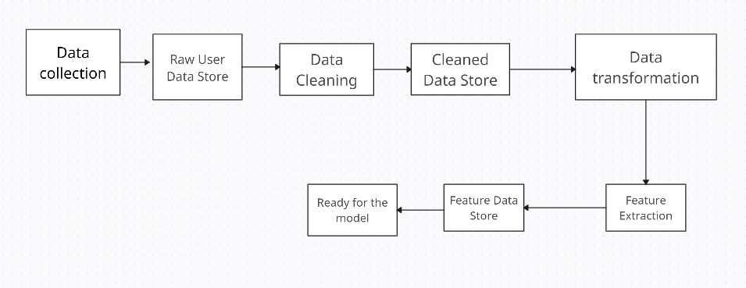
Data Preprocessing Module DFD

Slide 14
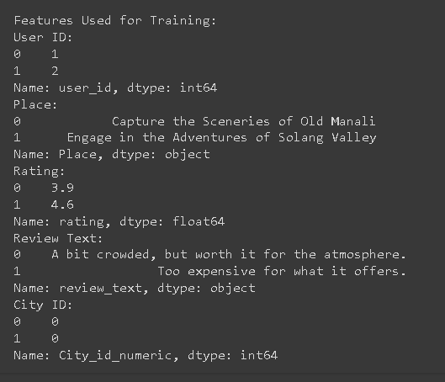
Data Preprocessing Module Output

Slide 15
Collaborative Filtering Module Content (SVD)
Input Matrix: Start with a user-item rating matrix 𝑅 that includes ratings from users for various items, with some ratings missing.
Decompose the Matrix: Use Singular Value Decomposition (SVD) to break down the matrix 𝑅 into three matrices: R=UΣV^T
Select Important Features: Choose the top 𝑘 singular values and truncate the matrices 𝑈, Σ and 𝑉 to create smaller matrices 𝑈𝑘,Σ𝑘, and 𝑉𝑘.
Predict Ratings: Calculate the predicted ratings for all user-item pairs by multiplying the smaller matrices: 𝑅 = 𝑈𝑘Σ𝑘𝑉𝑘^𝑇
Generate Recommendations: Recommend items to users based on the highest predicted ratings from the matrix 𝑅.

Slide 16
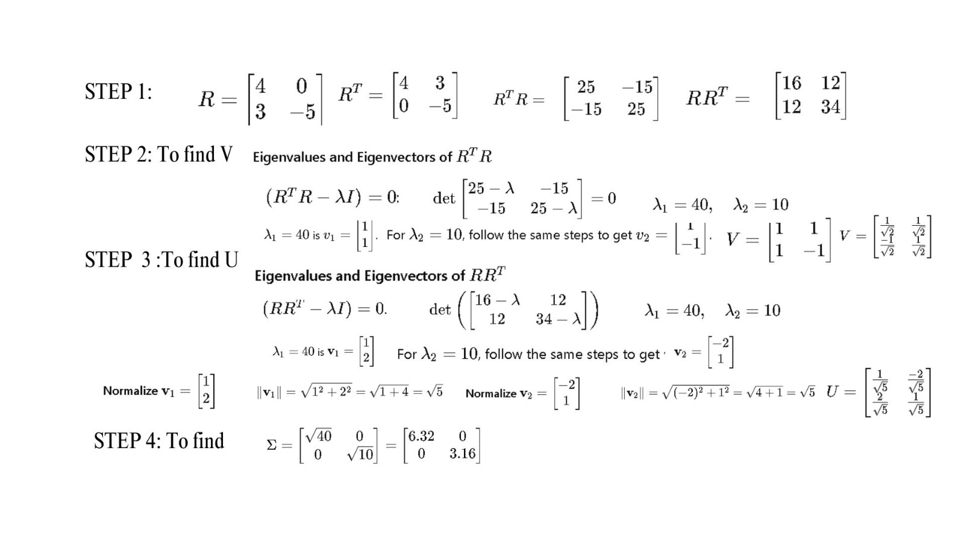
Collaborative Filtering Module Calculation (SVD)

Slide 17
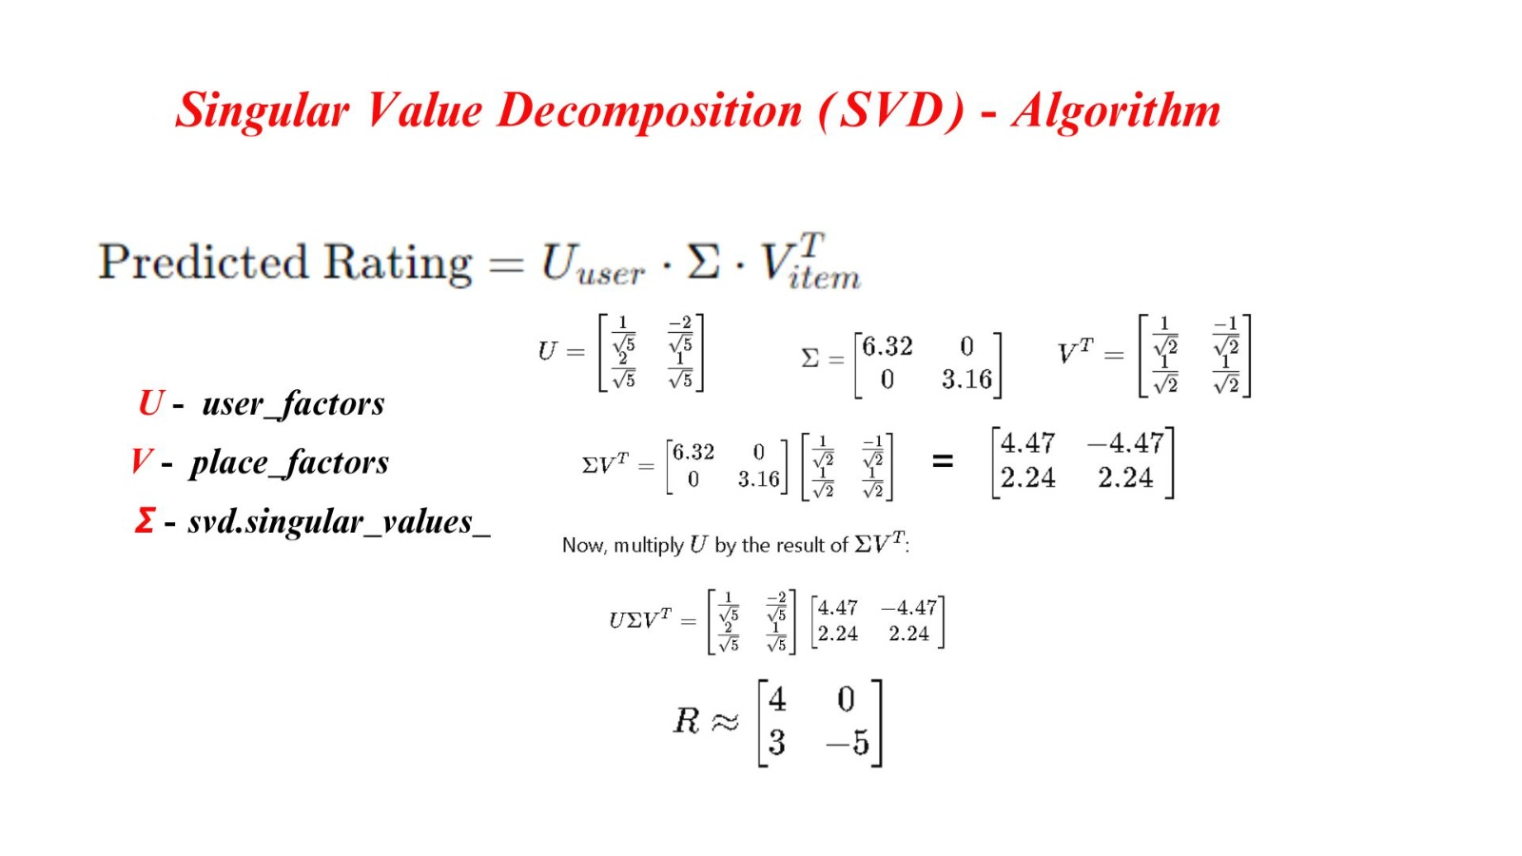

Collaborative Filtering Module Calculation (SVD)

Slide 18
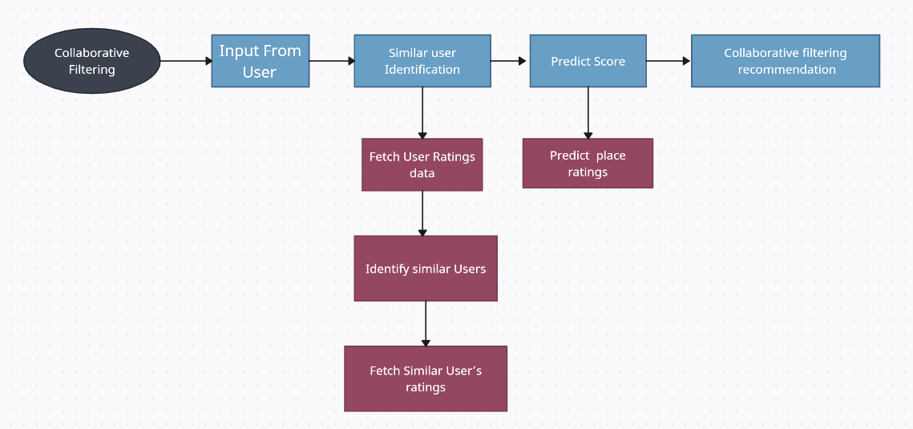
Collaborative Filtering Module DFD

Slide 19
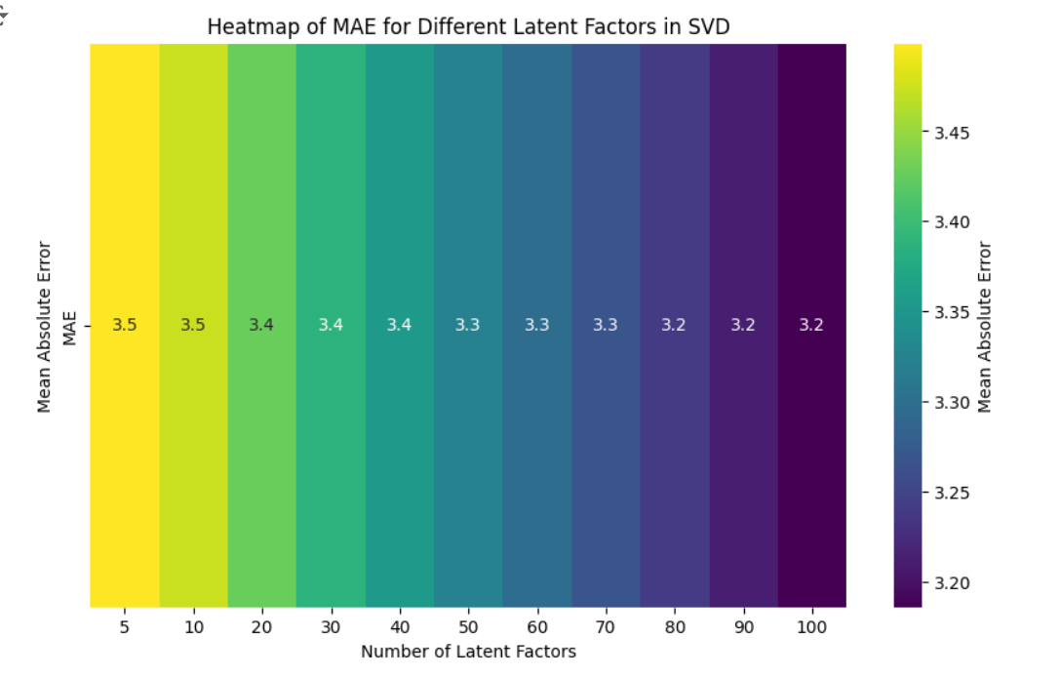
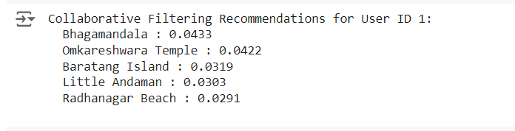
Collaborative Filtering Module Output

Slide 20
Content-based Filtering Module Content
Collect Documents: Gather a set of text documents to analyze.
Calculate Term Frequency (TF): Count how frequently each word appears in each document.
Calculate Inverse Document Frequency (IDF): Determine how important each word is by checking how often it appears across all documents.
Compute TF-IDF Score: Multiply the word's frequency in a document by its importance across all documents.
Create TF-IDF Matrix: Build a matrix where rows are documents, columns are words, and values are the TF-IDF scores.

Slide 21
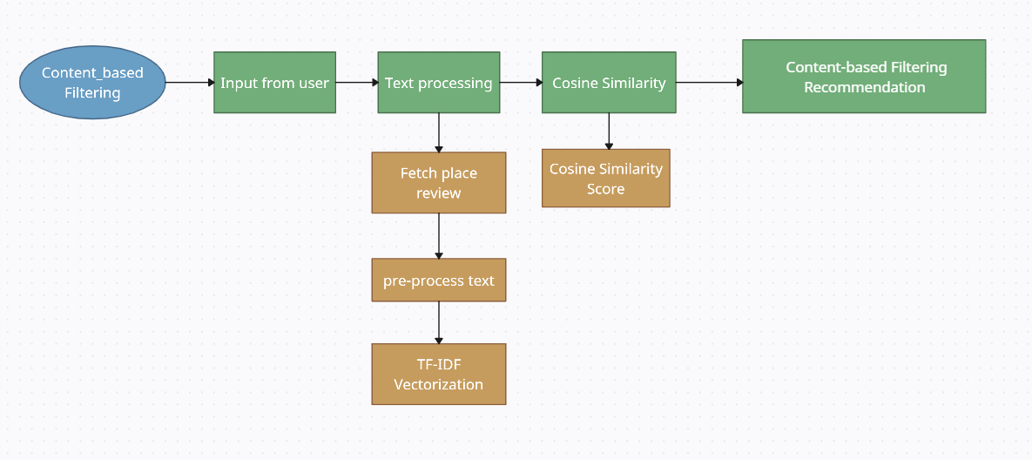
Content-based Filtering Module DFD

Slide 22
Content-based Filtering Module Calculation
Review 1 (Miami): "I loved the beach and the vibrant nightlife."
Review 2 (New York): "The art scene and museums in New York are amazing."
Review 3 (Ibiza): "Ibiza is known for its beaches and nightlife."
TF(t,d)=Number of times term t appears in document d /Total number of words in document d
Review 1 (Miami):​Total words = 8
TF(beach, Review 1) = 1/8=0.125 TF(nightlife, Review 1) =1/8=0.125
Review 2 (New York): Total words = 9
TF(beach, Review 2) = 0/0=0 TF(nightlife, Review 2) = 0/9=0
Review 3 (Ibiza):Total words = 7
TF(beach, Review 3) = 1/7=0.143 TF(nightlife, Review 3) = 1/7=0.143
Step 2: Inverse Document Frequency (IDF) IDF(t)=log(Total number of documents/Number of documents containing the term t​)
Total number of documents = 3
Documents containing "beach": Review 1 (Miami) and Review 3 (Ibiza)
IDF(beach)=log⁡(3/2)=log⁡(1.5)=0.176
Documents containing "nightlife": Review 1 (Miami) and Review 3 (Ibiza)
IDF(nightlife)=log⁡(3/2)=log⁡(1.5)=0.176

Slide 23
Content-based Filtering Module Calculation
Step 3: TF-IDF Calculation:
TF-IDF(t,d)=TF(t,d)×IDF(t)
TF-IDF for "beach":
Miami: TF-IDF(beach, Miami)=0.125×0.176=0.022
New York: TF-IDF(beach, New York)=0×0.176=0
Ibiza: TF-IDF(beach, Ibiza)=0.143×0.176=0.025
TF-IDF for "nightlife":
Miami: TF-IDF(nightlife, Miami)=0.125×0.176=0.022
New York: TF-IDF(nightlife, New York)=0×0.176=0
Ibiza: TF-IDF(nightlife, Ibiza)=0.143×0.176=0.025
Term | Miami (Review 1) | New York (Review2) | Ibiza (Review 3)
beach | 0.022 | 0 | 0.025
nightlife | 0.022 | 0 | 0.025

Slide 24
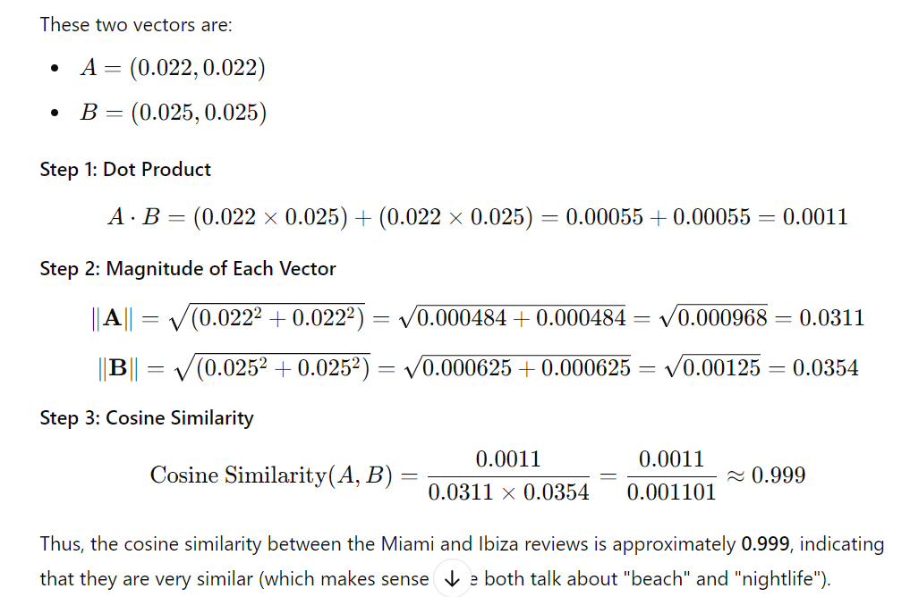
Content-based Filtering Module Calculation

Slide 25
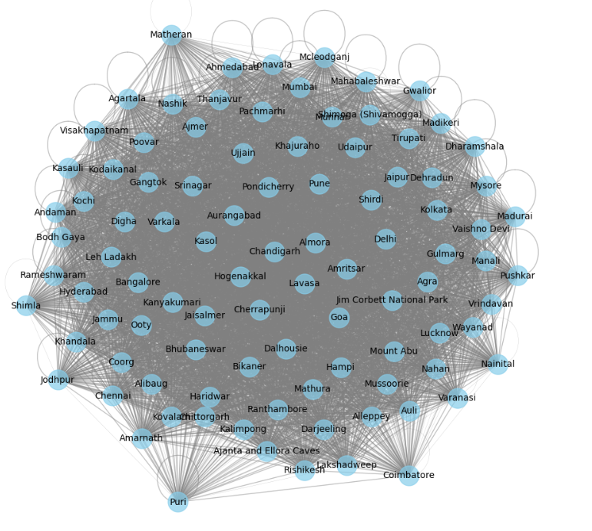
Content-based Filtering Module Output Relation

Slide 26
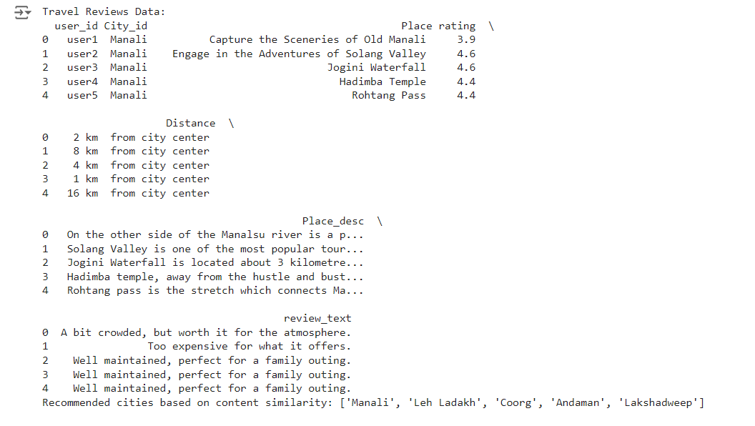
Content-based Filtering Module Output

Slide 27
Recommendation Engine Module Content
Collect User Input: Gather user preferences like desired activities, past travel history, or review data.
Apply Hybrid Filtering: Use both content-based filtering (e.g., analyzing review text) and collaborative filtering (e.g., recommending based on similar users' preferences).
Combine Scores: Assign and combine weighted scores from both content-based and collaborative filtering results.
Calculate Final Scores: Aggregate the scores for each destination using a weighted formula based on filtering results.
Generate Recommendations: Recommend the top travel destinations based on the final weighted scores.
Score from Content-Based Filtering (analyzing reviews, descriptions): 0.8
Score from Collaborative Filtering (similar users’ preferences): 0.6
Weights: w1=0.6w(content-based is more important), w2=0.4(collaborative filtering is less important)
The final weighted score is: (0.6×0.8)+(0.4×0.6)=0.48+0.24=0.72

Slide 28
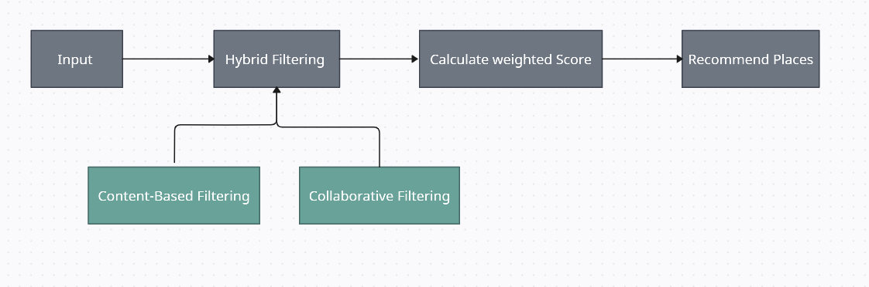
Recommendation Engine Module DFD

Slide 29
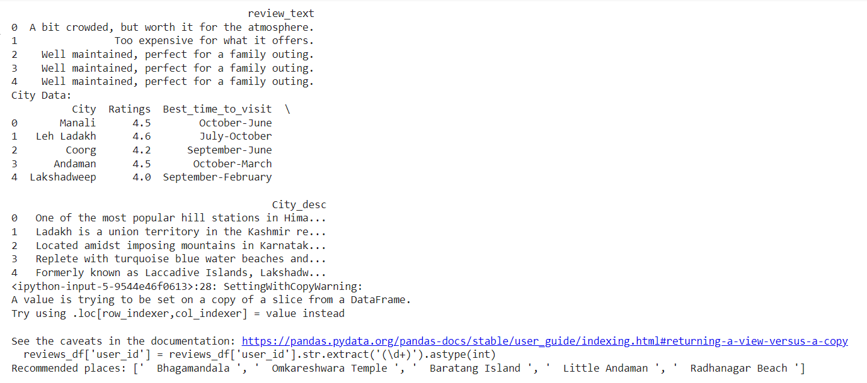
Recommendation Engine Module Output

Slide 30
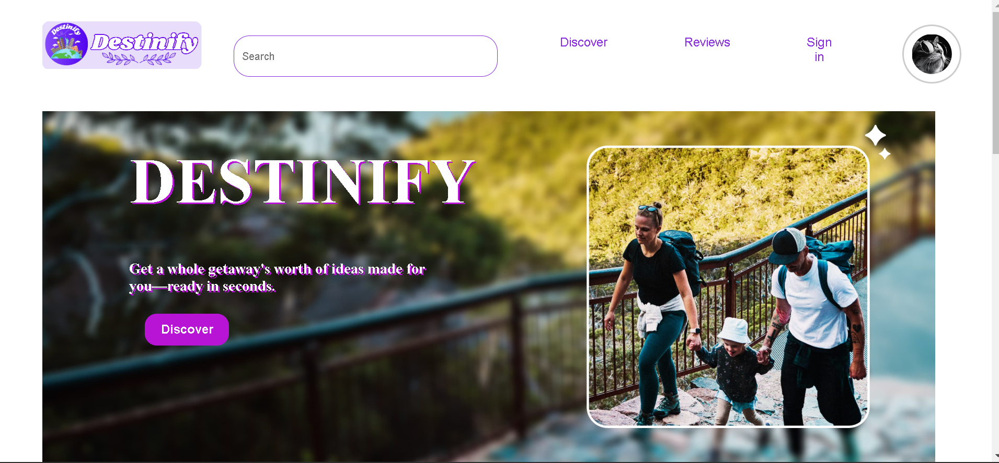
WEB INTERFACE

Slide 31
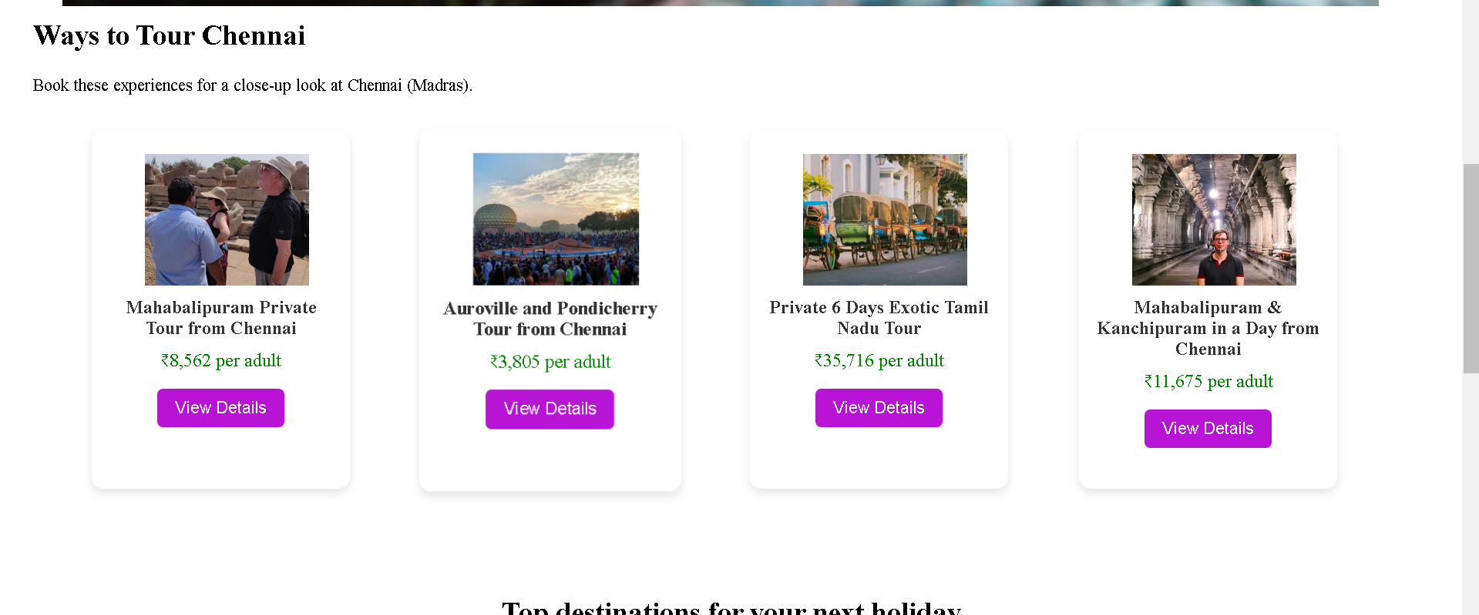
WEB INTERFACE

Slide 32
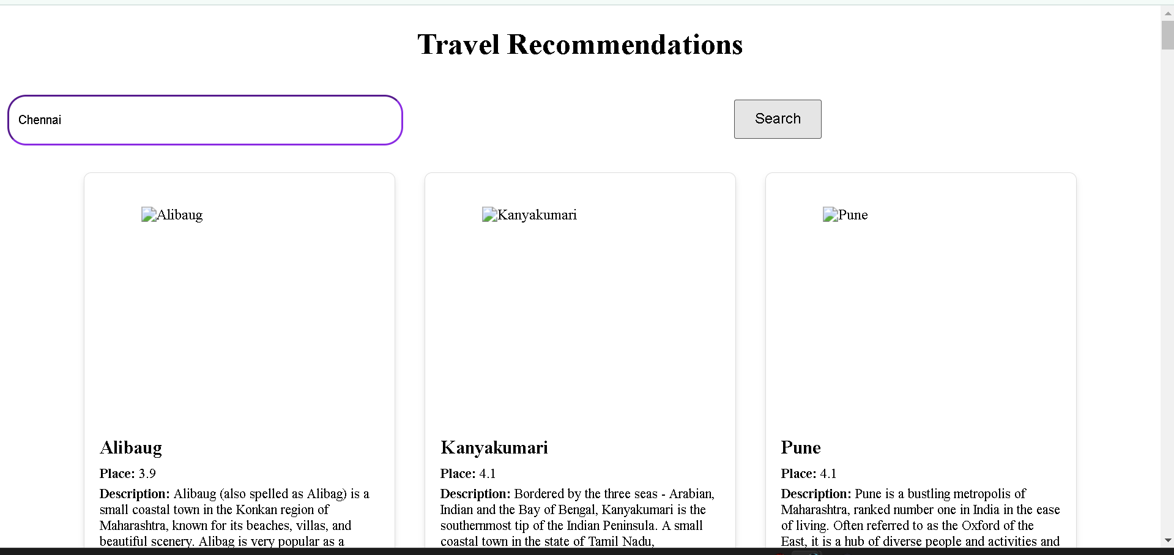
WEB INTERFACE

Slide 33
References.
Choirul Huda, Arief Ramadhan, Agung Trisetyarso, Edi Abdurachman, Yaya Heryadi, ”Smart Tourism Recommendation Model”,12 december 2022.
Pooja Hajare1, Hrushikesh Jarad2, Shabnam Jakate3, Rajkesh Nishad4 And Prof. Mrs. Nilufar Zaman5 ,”TOURS AND TRAVEL RECOMMEND SYSTEM USING MACHINE LEARNING TECHNIQUES”,07 july 2022
C. C. Aggarwal, ―An Introduction to Recommender Systems,‖ Recommender Systems: The Textbook. Springer International Publishing, pp. 1–28, 2016. doi: 10.1007/978-3-319-29659-3_1.
World Travel & Tourism Council, ―Economic Impact Reports,‖ 2020. https://wttc.org/Research/Economic-Impact (accessed Oct. 19, 2021).

Slide 34
Thank You

