Slide 1
Salary Analysis using Excel ​​
Student name : M.keerthika Register no:312204091
Naan mudhalavan id : 5F1565441706B07893D4345B1B18E04E
Department : B.com commerce
College : sriram college of arts and science
Mail id : keerthigak511@gmail.com

Slide 2
PROJECT TITLE​
Salary Analysis using Excel ​​

Slide 3
AGENDA​
Problem Statement​
Project Overview​
End Users​
Our Solution and Proposition​
Dataset Description​
Modelling Approach​
Results and Discussion​
Conclusion​​

Slide 4
PROBLEM STATEMENT​
Aggregating data for analysis (e.g., average salary by department or location) might be complicated due to inconsistent entries.
The data contains personal information, which needs to be handled according to privacy laws and regulations.
Some entries are missing gender or have ambiguous gender data ("NULL").

Slide 5
PROJECT OVERVIEW​
Gender Distribution
Female: 82
Male: 58
Unspecified/NULL: 6
Job Roles
Accounting: 23 (6 Male, 17 Female)
Business Development: 21 (12 Male, 9 Female)
Engineering: 20 (15 Male, 5 Female)
Human Resources: 15 (7 Male, 8 Female)
Legal: 15 (10 Male, 5 Female)
Marketing: 8 (5 Male, 3 Female)
Product Management: 21 (13 Male, 8 Female)
Research and Development: 21 (7 Male, 14 Female)
Sales: 8 (5 Male, 3 Female)
Services: 16 (10 Male, 6 Female)
Support: 18 (9 Male, 9 Female)
Training: 18 (8 Male, 10 Female)
Contract Types
Permanent: 125
Fixed Term: 23
Temporary: 18

Slide 6

Trends and Insights
Remote Work: A significant number of employees work remotely (34), reflecting a trend towards flexible working arrangements.
High Representation in Hyderabad, India: Hyderabad is a key location with a notable number of employees across various roles.
Gender Diversity: There is a notable gender imbalance in some roles, with female employees heavily represented in roles like Human Resources and Support.

Slide 7
WHO ARE THE END USERS?​
Human Resources Management: For tracking employee details, managing payroll, and understanding staffing needs.
Financial Planning: For budgeting purposes related to salaries and employment costs.
Workforce Analytics: Analyzing distribution of employees across departments, locations, and employment types. It can help in understanding the diversity of the workforce and the distribution of roles.
Performance and Retention Analysis: Assessing employment types and start dates could help in evaluating employee retention and performance trends.
Compliance and Reporting: Ensuring compliance with labor laws and regulations regarding employment types, locations, and salaries.

Slide 8
Our Solution and Its Value Proposition
By leveraging advanced analytics, customized engagement strategies, AI-driven recruitment tools, compliance management systems, and strategic compensation management, we provide a comprehensive solution to enhance workforce management and align it with organizational goals.
Feel free to adjust this proposition based on specific needs or additional details you may want to include.

Slide 9
Potential Actions Based on Data Analysis:
Review Unspecified Roles: Clarify job roles for the 6 employees marked as NULL.
Address Salary Gaps: Ensure that salary data is complete and address any discrepancies or missing entries.
Focus on Employment Type: Evaluate the need for Fixed Term and Temporary roles and their impact on overall staffing and budget.
Geographic Strategy: Consider the implications of having a high number of remote and international employees on company policies and support.

Slide 10

THE "WOW" IN OUR SOLUTION​
By presenting the data in a visually engaging way and focusing on these standout insights, you can effectively showcase the strengths and opportunities within your workforce, leaving a strong impression on your audience. If you need help creating visuals or specific reports, let me know!

Slide 11
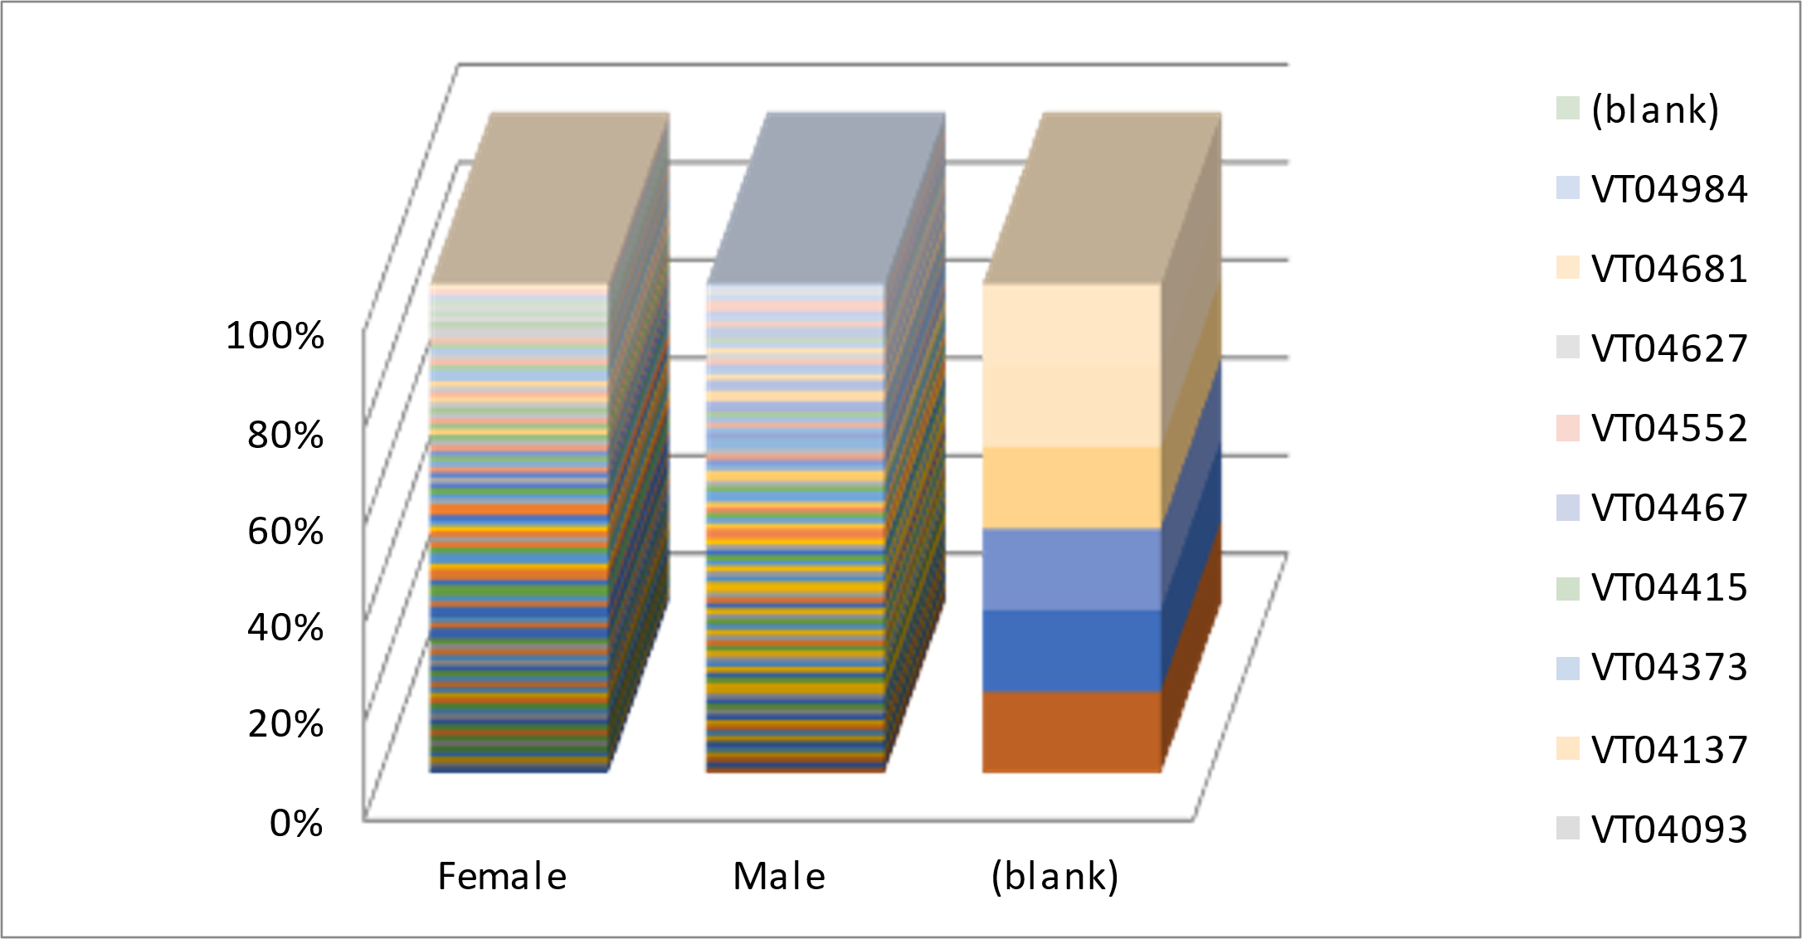
RESULTS​

Slide 12
conclusion​
It seems like you've pasted a list of employee data, including their names, gender, department, salary, employment dates, employment type, and locations. How would you like to proceed with this information? Would you like any analysis, filtering, or specific insights derived from it?

