Slide 1
Student portfolio
Student information
About me
Academic year
Skills
Technical skills
Soft skills
Portfolio website
Achivement
Extracurricular activities
Personal details

Slide 2
Student information
Name: A.keerthika
Course: Bsc (computer science)2nd year
College: Valliammai women’s college of arts and sciences
Email ID: keerthikasekar2006@gmail.com
Phone number: 9345329848

Slide 3
About me :
I am a 2nd year bachelor of computer science students with a passion for software engineer , problem solving and data analysis my academic journey has helped me develop strong technical and analytical.

Slide 4
Academic information:
Degree/course: Bsc computer science
Institute: Valliammai women’s college of arts and science
Year: 2023-2027
Grade: 75 percentage.

Slide 5
Skills :
Technical skills :
Python, DSA, HTML,c++,css, JavaScript,Java
Soft skills :
Communication, teamwork, problem solving, leadership.

Slide 6
Portfolio website:
Create a personal webs
ite using html,css, and javascript.

Slide 7
Achievement:
Secured 1st place in coding. Won best paper presentation on artificial intelligence consistently ranked among top 10 students in college.

Slide 8
Extracurricular activities :
Hobbies and interests:
Drawing , reading stories daily and writing daily daily, story writer also.
Member of the computer science club active participant in inter College cultural event
Personal details :
Date of birth: 21.11.2006
Language known: Tamil, English
Intrest: drawing, story book reading, story writer.

Slide 9
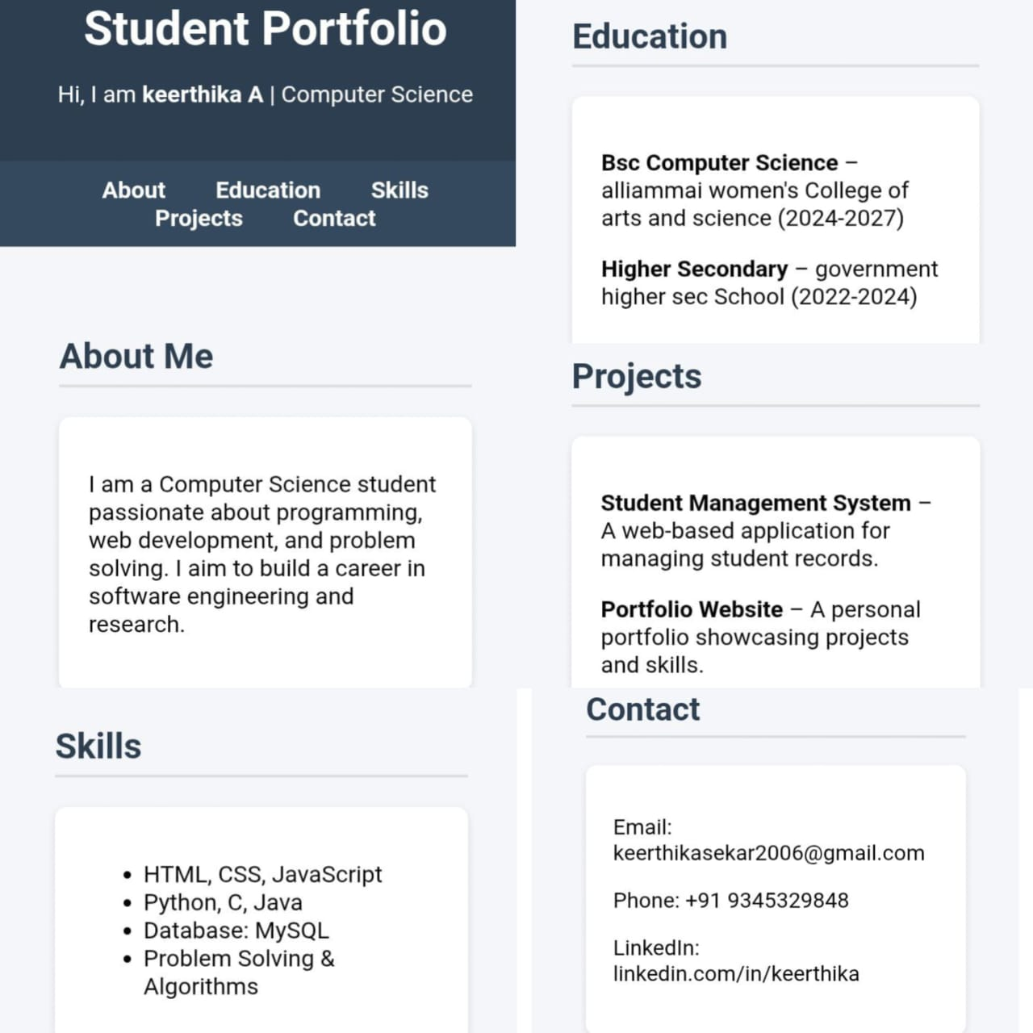

Slide 10
Git hub link:
https://github.com/keerthika200621

Slide 11
The end :
Thank you

