Slide 1
𝑰𝑵𝑻𝑹𝑶𝑫𝑼𝑪𝑻𝑰𝑶𝑵 𝒕𝒐 𝑯𝑻𝑴𝑳 𝑪𝑺𝑺 𝑱𝑨𝑽𝑨𝑺𝑪𝑹𝑰𝑷𝑻
𝑺𝒖𝒃𝒎𝒊𝒕𝒕𝒆𝒅 𝒃𝒚:
𝑲.𝒌𝒆𝒆𝒓𝒕𝒉𝒊𝒌𝒂
24524𝑼18043
𝑲𝒂𝒓𝒂𝒏 𝒂𝒓𝒕𝒔 𝒂𝒏𝒅 𝒔𝒄𝒊𝒆𝒏𝒄𝒆 𝒄𝒐𝒍𝒍𝒂𝒈𝒆
𝑻𝒉𝒊𝒓𝒖𝒗𝒂𝒏𝒏𝒂 𝒎𝒂𝒍𝒂𝒊

Slide 2
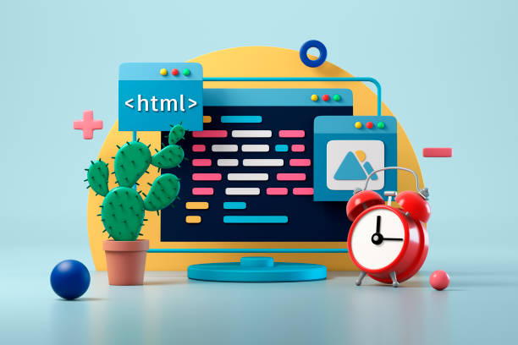
𝙄𝙉𝙏𝙍𝙊𝘿𝙐𝘾𝙏𝙄𝙊𝙉
HTML stands for 𝐇𝐲𝐩𝐞𝐫 𝐓𝐞𝐱𝐭 𝐌𝐚𝐫𝐤𝐮𝐩 𝐋𝐚𝐧𝐠𝐮𝐚𝐠𝐞, 𝐰𝐡𝐢𝐜𝐡 𝐢𝐬 𝐭𝐡𝐞core language used 𝐭𝐨 𝐬𝐭𝐫𝐮𝐜𝐭𝐮𝐫𝐞 𝐜𝐨𝐧𝐭𝐞𝐧𝐭 on the web. 𝐈𝐭 𝐨𝐫𝐠𝐚𝐧𝐢𝐳𝐞𝐬,𝐭𝐞𝐱𝐭,𝐢𝐦𝐚𝐠𝐞𝐬, links, 𝐚𝐧𝐝 𝐦𝐞𝐝𝐢𝐚 𝐮𝐬𝐢𝐧𝐠 𝐓𝐚𝐠𝐬 and 𝐞𝐥𝐞𝐦𝐞𝐧𝐭𝐬 that 𝐛𝐫𝐨𝐰𝐬𝐞𝐫𝐬 𝐂𝐚𝐧 𝐢𝐧𝐭𝐞𝐫𝐩𝐫𝐞𝐭. 𝐀𝐬 𝐨𝐟 2025, 𝐨𝐯𝐞𝐫 95% 𝐨𝐟 𝐰𝐞𝐛𝐬𝐢𝐭𝐞𝐬 𝐫𝐞𝐥𝐲 𝐨𝐧 HTML 𝐚𝐥𝐨𝐧𝐠𝐬𝐢𝐝𝐞 𝐂𝐬𝐬 and 𝐉𝐚𝐯𝐚𝐒𝐜𝐫𝐢𝐩𝐭.

Slide 3
𝙊𝙑𝙀𝙍𝙑𝙄𝙀𝙒 𝙊𝙁 𝙒𝙀𝘽 𝘿𝙀𝙑𝙀𝙇𝙊𝙋𝙈𝙀𝙉𝙏
Web development encompasses the process of building and maintaining websites and web applications accessible over the internet or an intranet. This focuses on the user-facing part of a website, including everything a user sees and interacts with in their browser.

Slide 4
𝙃𝙏𝙈𝙇 (𝙝𝙮𝙥𝙚𝙧 𝙩𝙚𝙭𝙩 𝙢𝙖𝙠𝙚𝙪𝙥 𝙡𝙖𝙣𝙜𝙪𝙖𝙜𝙚)
<! DOCTYPE html> <html> <body> <h1>My First Heading</h1> <p>My first paragraph.</ p> </body> </html> Try it Yourself » <h1>This is heading 1</h1> <h2>This is heading 2</h2> <h3>This is heading 3</h3> Try it Yourself » <p>This is a paragraph.</ p> <p>This is another paragraph.</ p> Try it Yourself »

Slide 5
𝙃𝙏𝙈𝙇 𝘽𝘼𝙎𝙄𝘾 𝙏𝘼𝙂𝙎& 𝙎𝙏𝙍𝙐𝘾𝙏𝙐𝙍𝙀
<!DOCTYPE html> <html> <head> <title>Page Title</title> </head> <body> <h1>My First Heading</h1> <p>My first paragraph.</p> </body> </html>

Slide 6
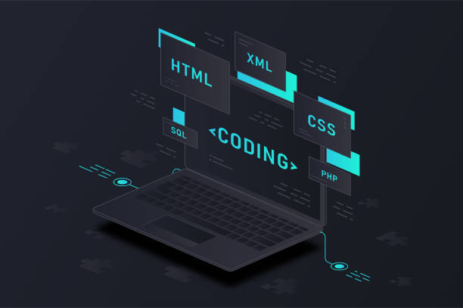
𝘾𝙎𝙎 (𝙘𝙖𝙨𝙘𝙖𝙙𝙞𝙣𝙜 𝙨𝙩𝙮𝙡𝙚 𝙨𝙝𝙚𝙚𝙩)
𝐓𝐲𝐩𝐞𝐬 𝐨𝐟 𝐂𝐒𝐒 CSS can be Implemented Three different ways: •Inline CSS
•Internal or Embedded CSS
•External CSS

Slide 7
𝘾𝙎𝙎 (𝙘𝙤𝙙𝙞𝙣𝙜);
𝐄𝐱𝐚𝐦𝐩𝐥𝐞:
Body { font-family: Arial, sans-serif; background-color: #f0f0f0; } h1 { color: #333; text-align: center; } .button { background-color: #007bff; color: white; padding: 10px 20px; border-radius: 5px; }

Slide 8
𝘾𝙎𝙎 𝙏𝙀𝙓𝙏 𝙎𝙏𝙔𝙇𝙀:
Unleash the power of typography with these stunning pure CSS text effects that turn ordinary words into visual masterpieces. From subtle shadows to mind-bending distortions, discover how CSS can make your headlines, quotes, and UI text pop — without images or JavaScript. Perfect for: hero headlines that demand attention, interactive hover-activated captions, brand slogans with personality, portfolio project titles.

Slide 9
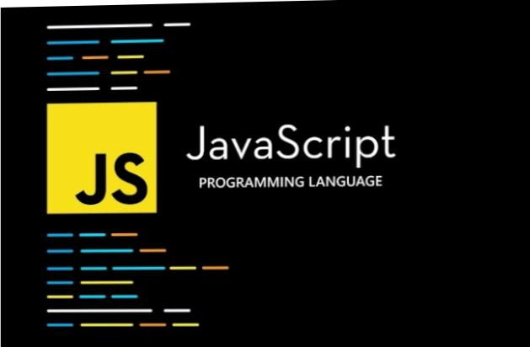
𝙄𝙉𝙏𝙍𝙊𝘿𝙐𝘾𝙏𝙄𝙊𝙉 𝙅𝘼𝙑𝘼𝙎𝘾𝙍𝙄𝙋𝙏
𝐉𝐚𝐯𝐚𝐒𝐜𝐫𝐢𝐩𝐭 (JS) is a programming language mainly used to make web pages interactive While HTML defines structure and CSS defines style, JavaScript controls behavior It runs directly in the browser, so you don’t extra software to start coding.

Slide 10
𝘽𝘼𝙎𝙄𝘾 𝙅𝘼𝙑𝘼𝙎𝘾𝙍𝙄𝙋𝙏 𝘾𝙊𝙉𝘾𝙀𝙋𝙏:
Variables: Declaring and assigning values using, let, and const. Data Types: Common types like numbers, strings, and objects. Operators: Arithmetic, assignment, comparison, and logical operators. Control Flow: Conditional statements (if/else, switch) and loops (for, while). Functions: Defining and calling reusable blocks of code.

Slide 11
𝙅𝘼𝙑𝘼𝙎𝘾𝙍𝙄𝙋𝙏 𝙁𝙀𝘼𝙏𝙐𝙍𝙀𝙎:
JavaScript is a highly popular and widely-used programming language for web development. It has a variety of features that make it powerful and flexible.
Some of the utilization of JavaScript in both frontend as well as backend development.
Let’s highlight some of the key features of JavaScript features include being dynamic.
Also, JavaScript can be executed in the browser without any interpreter or compiler setup.

Slide 12
𝙎𝙄𝙈𝙋𝙇𝙀 𝙋𝙍𝙊𝙂𝙍𝘼𝙈;
<!DOCTYPE html> <html> <head> <title>Hello World</title> </head> <body> <script> console. Log("Hello, World!"); // Prints to the browser's console alert("Hello, World!"); // Displays a pop-up alert </script> </body> </html>

Slide 13
𝘾𝙊𝙈𝙋𝘼𝙍𝙄𝙎𝙊𝙉 𝙤𝙛 (𝙃𝙏𝙈𝙇 𝘾𝙎𝙎 𝙅𝘼𝙑𝘼𝙎𝘾𝙍𝙄𝙋𝙏)
HTML is the skeleton: It provides the raw content and organization. CSS is the skin and appearance: It makes the content visually appealing and well-arranged. JavaScript is the brain and muscles: It brings the webpage to life with interactivity and functionality.
HTML provides the content and structure, CSS styles that content, and JavaScript adds the interactive functionality, working together to create a complete and dynamic web experience.

Slide 14
𝙍𝙀𝘼𝙇-𝙏𝙄𝙈𝙀 𝘼𝙋𝙋𝙇𝙄𝘾𝘼𝙏𝙄𝙊𝙉:
𝔼𝕩𝕒𝕞𝕡𝕝𝕖:
Communication: Instant messaging apps (WhatsApp, Slack)
Finance: monitoring stock and managing risk in real-time trading platform
Healthcare: Systems that monitor patient vital signs and provide critical alerts instantly.
Manufacturing: Applications that monitor and control industrial processes in real-time for greater efficiency.

Slide 15
𝘾𝙤𝙣𝙘𝙡𝙪𝙨𝙞𝙤𝙣:
These three technologies work in concert to create the rich, interactive web experiences users encounter daily. HTML provides the content, CSS styles its appearance, and JavaScript brings it to life with dynamic behavior. Mastering this combination is essential for anyone involved in front-end web development.

