Slide 1
Quantum Walks and Monte Carlo
Team name: Quantum Explorers
Members:
Keerthika Devi S
Devadharshika S S

Slide 2
Problem Statement
Simulating complex high-dimensional systems is computationally challenging for classical methods.
Monte Carlo methods, like the Galton Box simulation, approximate these systems but face scalability issues.
Quantum computing offers potential exponential speed-up, enabling efficient simulation of such stochastic processes.
Our project investigates how quantum circuits can model Monte Carlo problems, specifically using quantum walks to simulate the Galton Box.
This has applications in particle transport, quantum systems, and other areas requiring high-dimensional modeling.

Slide 3
Our Solution
Develop a scalable quantum circuit to simulate the Galton Box for any number of layers.
Modify circuits to produce different target distributions: Gaussian, exponential, and Hadamard quantum walk.
Incorporate realistic noise models to optimize circuit performance on noisy quantum hardware.
Evaluate simulation accuracy using statistical distance metrics like KL divergence and Jensen–Shannon distance.

Slide 4
Results and Impacts
Successfully simulated Gaussian, Exponential, and Hadamard quantum walk distributions with high fidelity, confirming the flexibility of our quantum circuit design.
Introduced realistic noise modeling on NISQ-era hardware, demonstrating robustness of the simulation framework under practical constraints.
Statistical distance metrics (KL divergence, Jensen–Shannon, Total Variation) consistently indicated close matches between simulated and target distributions.
Validated quantum walks as a powerful framework for Monte Carlo–style simulations, with potential for high-dimensional system modelling
.Opened new opportunities for applications in particle transport, quantum system simulation, financial modeling, and other stochastic processes.

Slide 5
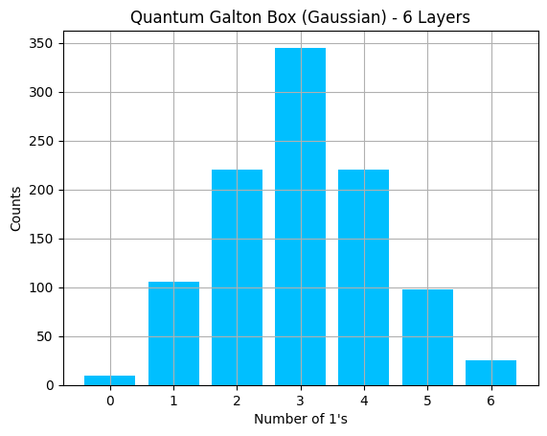
Gaussian (Quantum Galton Box) – The quantum circuit reproduced the expected Gaussian distribution, closely matching classical predictions.

Slide 6
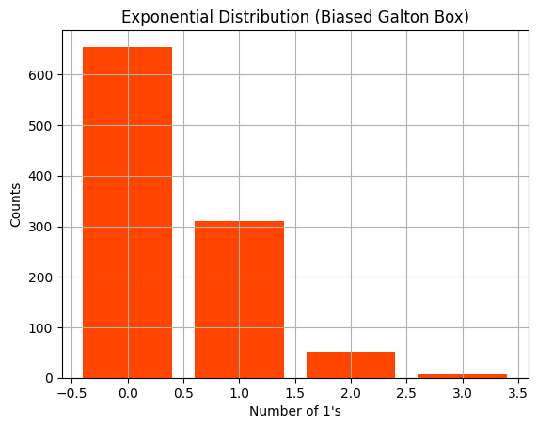
Exponential (Biased Galton Box) – Biasing rotation angles yielded an exponential distribution, demonstrating tunable outcome control.

Slide 7
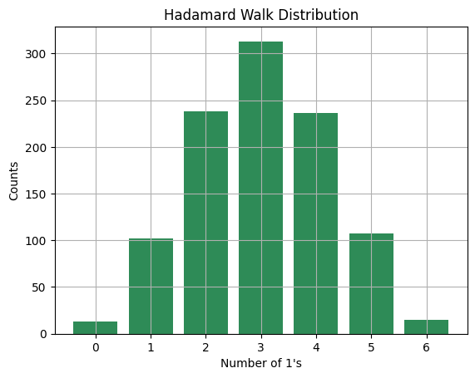
Hadamard Walk – Produced a symmetric interference pattern characteristic of quantum walks, validating quantum behavior.

Slide 8
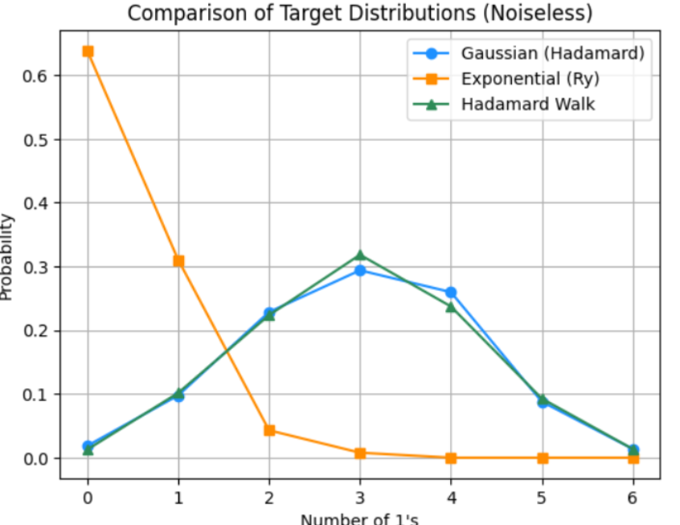
Gaussian shows slightly lower TVD than Exponential, with both closely matching their target distributions.

Slide 9
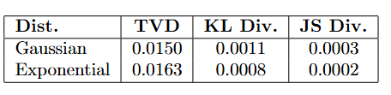
Gaussian has slightly lower TVD than Exponential, but both match their target distributions closely across all metrics.

Slide 10
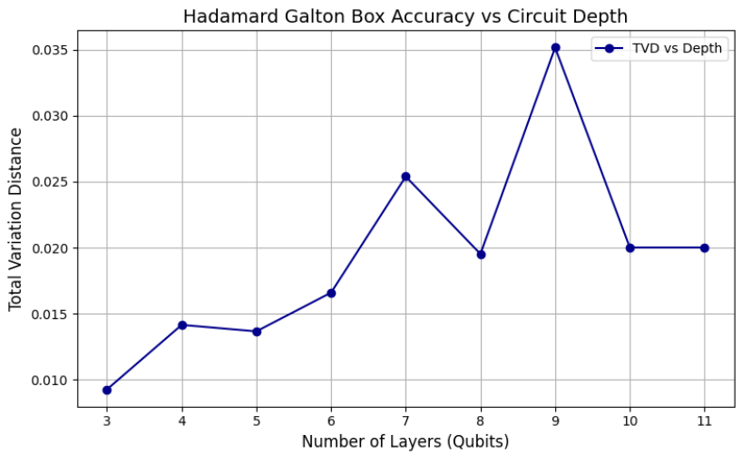
Accuracy in the Hadamard Galton Box peaks at shallow depths (~3 layers) and declines with increasing depth due to error accumulation.

Slide 11
Future Scope
Extend simulations to multi-particle quantum walks and higher-dimensional grids.
Integrate error mitigation and advanced noise-resilient techniques for improved NISQ performance.
Explore hybrid quantum–classical Monte Carlo methods for larger-scale problems.
Apply the framework to real-world domains like financial modeling, supply chains, and climate simulations.
Benchmark performance on emerging quantum hardware against classical supercomputers.

