Slide 1

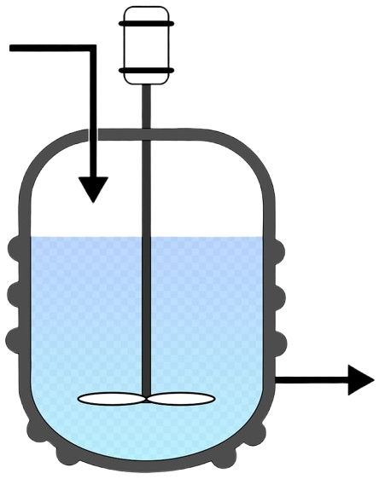


Real-Time Contamination Detection and Recovery Protocol for Continuous Bioprocessing Systems
Assignment 2- Bioprocess engineering
Faculty Name: Dr Sanjukta Banerjee
Semester: 6th Semester (6A2)
Team Members:
JOSHI HEER DEVANGKUMAR(2203051440102)
K JESHVANT ANJANAYA VARMA (2203051440103)
KADARLA KRISHNA VAMSHI(2203051440104)
KALRAV YAGNESHWAR(2203051440105)
KANISHK CHHIPANI(220301440106)
KASI REDDY VASAVI (2203051440107

Slide 2
ASSIGNMENT OVERVIEW
Objective:
To design a real-time contamination detection and recovery protocol for a continuous bioprocessing system that ensures product quality while minimizing production interruptions.
Problem Statement:
Continuous production systems are prone to microbial contamination, which can compromise product integrity. Developing real-time detection and recovery methods is essential to maintain sterility, minimize downtime, and ensure regulatory compliance.

Slide 3
BACKGROUND AND CONTEXT
Key concepts:
Sterilization Methods
Microbial and Detection Methods
Challenges behind Continous fermentation
Challenges addressed:
more effective sterilization process - pre treating steam pipes, air flow pipes, exhaust pipes and other valves
Rapid microbial detection
Trying to prevent contamination by not affecting the product quality

Slide 4


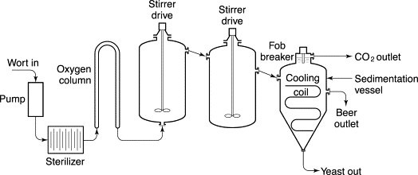

Figure: Continous fermentation flow diagram in Beer production

Slide 5
Real-Time Detection Methods
Biosensors and Flourescence probes: For impurity dectection and contamination detection (real time detection of microbes and impurities)
Flow Cytometry: Real-time analysis of microbial cells.
Spectroscopy: Raman and near-infrared (NIR) spectroscopy for detecting contamination signatures.
Automated Sampling Units: Aseptic, periodic sampling for rapid microbial culture or PCR analysis.

Slide 6




Sterilization Methods
Clean-in-Place(CIP):
Steam-in-Place(SIP):
CIP involves automated cleaning of pipelines, fermenters, and storage tanks without disassembling the equipment.
SIP sterilizes pipelines, fermenters, and other equipment using high-pressure steam (121–135°C) for 15–30 minutes.
Filtration sterlization:
UV-C Sterilization methods-
1)Removes microorganisms using pore sizes of 0.1–0.5 µm.
2)Used for removing particulate matter, including dead yeast cells, during beer clarification.
3)Ensures CO₂ and air used in beer production are free from contaminants.
UV-C light (wavelength: 200–280 nm) destroys microbial DNA, preventing replication.

Slide 7

Raw material Sterilization
UVC and SIP
Pipeline sterilization
(CIP)
Sterile Yeast (flow cytometry can be used) preparation for aseptic inoculation
Wort sterilization
Fermenter sterilization
Fermentation monitoring (probes and sensors) and continous cleaning
CONTAMINATION PREVENTION
PROCESS
Product transfer for further process

Slide 8
Future Prospects
1)Finding ways to operate with minimum human intervention to prevent contamination
2)Implementing advanced automation and control systems to monitor and adjust fermentation parameters in real-time can further enhance contamination prevention.
3)Developing new novel sensor technologies to detect and quantify contaminants in real-time can enable more proactive interventions.
4)Optimizing CIP and SIP cycles within the continuous fermentation process, potentially with real-time monitoring which would help in maximizing production and reducing contaminantion
5)Developing AI/ML programs specifically for a particular continuous production process( in this case Beer production). These developed programs can be utilized for optimizing of SIP(Steam In Pipe), CIP(Cleaning In Pipe) , Finding unsual patterns occuring during fermentation

Slide 9


CONCLUSION
Continuous fermentation in beer production presents a significant opportunity to enhance contamination prevention. By minimizing human intervention, maintaining stable conditions, Introducing AI/ML programs, new novel sensors for fast microbe and impurity detection and enabling real-time monitoring, this approach reduces the risk of introducing and spreading contaminants
However the increase in cost when solving the issues associated with contamination in beer production needs to be addressed

Slide 10

THANK YOU

