Slide 1
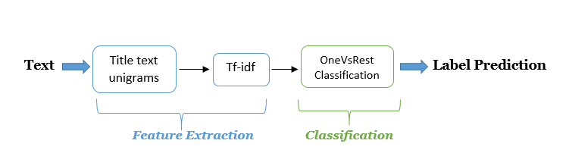
Multi-label Classification of Stack Overflow Questions using OneVsRest Classification Paradigm
Problem Statement
Tagging is central to the functionality of forums like Stack Overflow and Quora as it helps in easy retrieval of posts.
However, manually tagging a post is a burden for users which degrades the overall user-experience.
We implemented a multi-label classification system that predicts tags to questions to enhance user experience using one-vs-rest paradigm.
Data Set
Stack overflow data provided for kaggle Facebook competition for same problem domain.
Our experiments are on a incremental basis started with 10000 questions and increased to 50000 questions.
Methodology

Slide 2

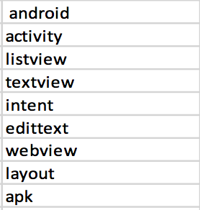
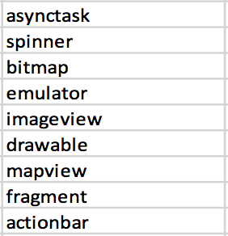
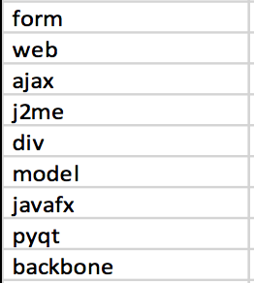
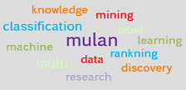

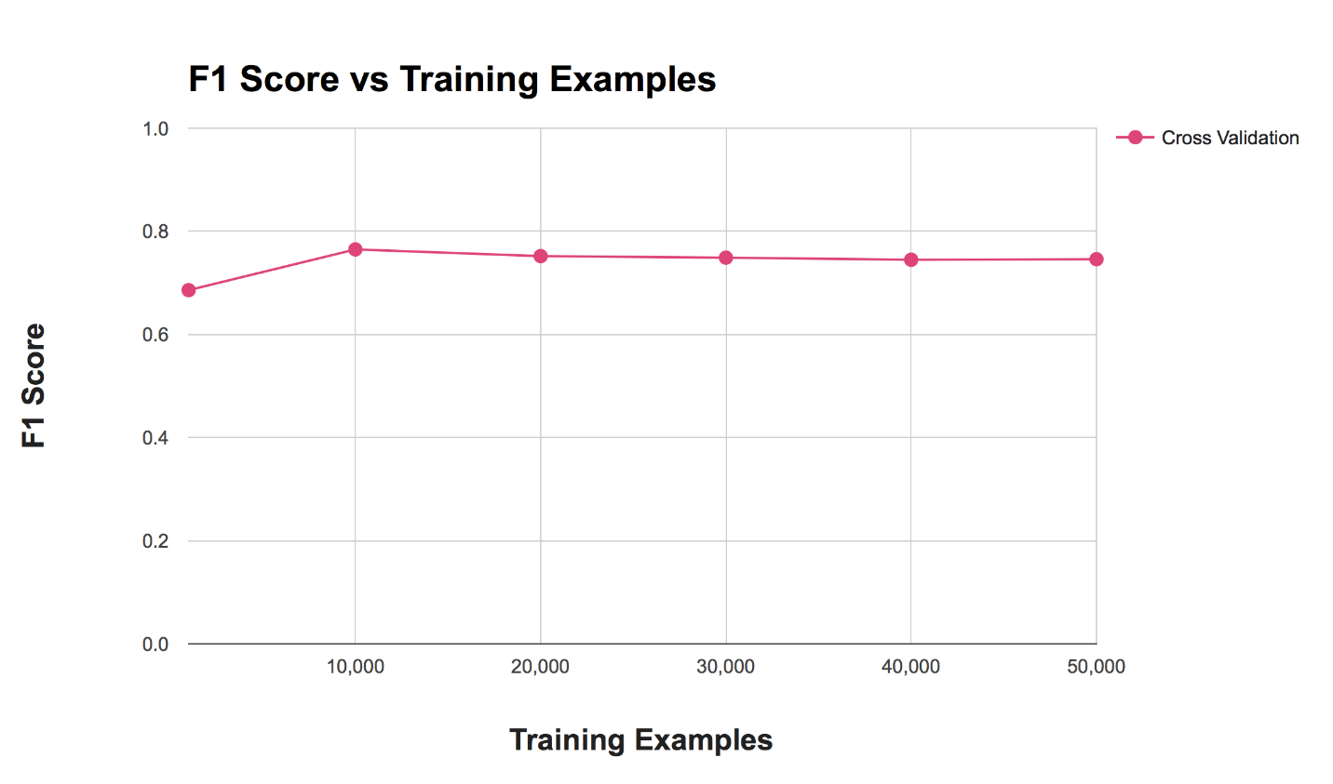


Tools
Features Identified
Evaluation Criteria
F1 Score

