Slide 1

OfflineWallet
Kanishk Ramanand
Keerthi Kumar Narayan
Amadeus Software Labs India Pvt Ltd.

Slide 2
Use Case - No / intermittent Network, wifi, Internet
Problem Statement
The future will be based on On-the-Go payment solutions and there is a need to process payments even when you are in a NO INTERNET / NETWORK zone.
There are occasions like a Book Fair / Petrol Stations where you may need to proceed paying without the need to wait in long queues. Solutions for such cases are missing today and we are proposing the solution.
Currently there are no Payment gateways that uses the OFFLINE Payment mode using NFC.

Slide 3
Why is this solution needed !!
The world is moving fast to using latest technologies. Every one now a days hold a smart phone.
 | 2007 | 2010 | 2015
World population | 6.5 billion | 6.9 billion | 7.2 billion
Not using the Internet | 84% | 70% | 60%
Mobile broadband Subscriptions | 4% | 11% | 32%
Developing world | 1% | 4% | 21%

Slide 4
Use Case - No / intermittent Network, wifi, Internet
Solution Overview
Use of NFC and Bluetooth technology to connect to the Merchant Device via the Payment App.
Create a file and store it on the Merchant device which can be parsed and synced to the server when online. Data Encryption policy need to be established.
Automatically Debit from the Customer Wallet when Payment Done.
DEMO.
Tools used : Demo app done using appery.io. Have used restapi’s provided by the tool. JSON, node.js is used inturn.

Slide 5
Use Case – No Network
Solution 2
Adapting Couchbase architecture which provides a feature for offline payments.
When there is no network, there is a sync established using couchbase lite on your device. This will sync back when n/w is available.
Adapting Couchbase architecture which provides a feature for offline payments.
When there is no network, there is a sync established using couchbase lite on your device. This will sync back when n/w is available.
APP Servers
LB
SYNC GATEWAY
SYNC
http/JSON
Lite
Lite
APP Servers
SYNC
LB
SYNC GATEWAY
http/JSON
Lite
Lite

Slide 6
Use Case - No wifi, Internet. Calls and SMS are working
Solution
Implement an IVR System.
Wallet Servers
IVR System
1
Customer Dials Toll Free
2
Welcome Message and Dial 1 for Payment to Merchant
3
Customer Dials 1
CACHE Servers
SYNC
4
Enter Merchant ID
5
Customer Enters Merchant ID
6
Validate Merchant
8
Enter Amount to Pay
7
Authenticate
9
Input Amount
10
Check Balance
11
Send SMS on payment to Customer and Merchant

Slide 7
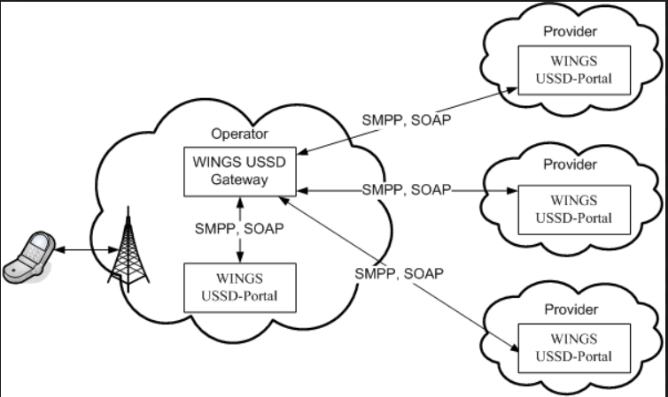
Use Case - No wifi, Internet. Calls and SMS are working
Solution
Implement USSD (Unstructured Supplementary Service Data ) architecture.
With this any notifications, alerts or sms acknowledgement can be sent to a phone even the phone is not available over the network range for a week or so.

Slide 8
The Solution
Use RSA Cryptography, both Private and Public key can encrypt a message and the opposite key to decrypt it.
Data transferred from USER device to Merchant can be a XML file.
As soon as the user taps the merchants device, the other device receives the encrypted data and stores it on the device folder.
When the Merchant device is ONLINE, the XML transaction files are decrypted to the server and the devices (Merchant, user) updated accordingly.
Assumptions
Merchant and User use the same OFFLINE Payment App.
The application design should address the issue of installing on different devices.

Slide 9


Slide 10
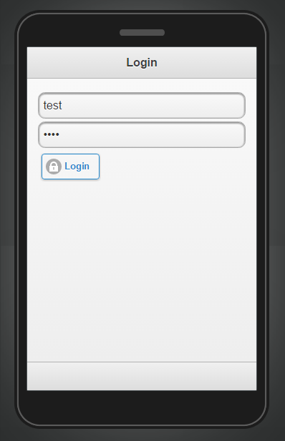
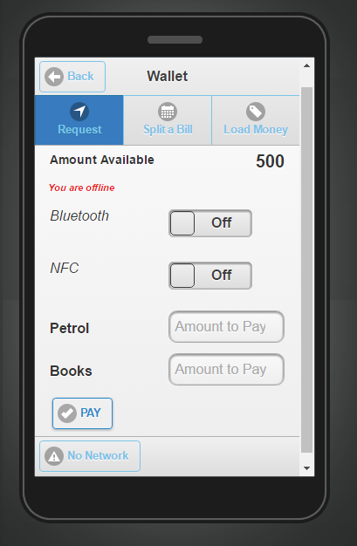
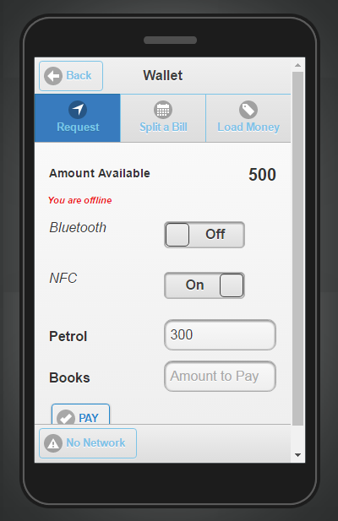
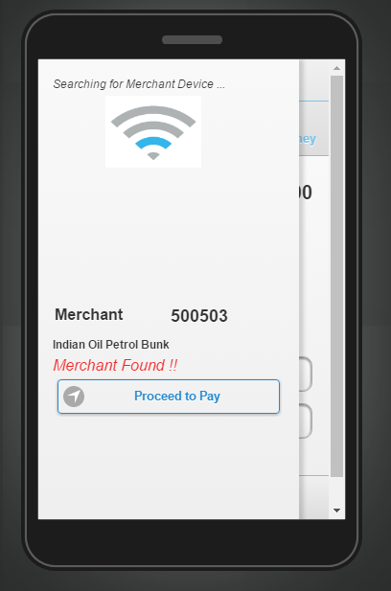
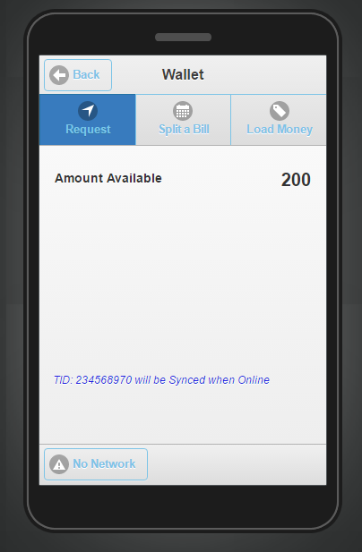
Login to the Application
During Payment the Application identifies if you are OFFLINE / Online
A message is shared on the APP, that you are OFFLINE.
Your are requested to use NFC to pay your bill
The device looks for the Nearest NFC Device (Likely the Merchant)
The amount deducted is displayed on USER device
The Merchant devices stores the encrypted file.
The file is synced when the Device is ONLINE

Slide 11


