Slide 1
MOVIE STREAMING PLATFORM DATABASE
EVERWATCH
KEERTHI LATHA S M
DBMS PROJECT
MAY 14 2026
SE504S50

Slide 2
TABLE OF CONTENTS
01
02
03
04
05
06
OVERVIEW
OBJECTIVES
DATABASE MODULES
INTRODUCTION
GOALS OF THE PROJECT
IMPORTANT ENTITIES
ER DIAGRAM
FEATURES
CONCLUSION
ENTITY RELATIONSHIP DESIGN
ADVANTAGES
SUMMARY

Slide 3
ABOUT PROJECT
01
INTRODUCTION

Slide 4
EVERWATCH
EverWatch is a movie streaming platform database designed to provide users with a seamless and personalized entertainment experience.

Slide 5

PROJECT OVERVIEW
A Movie Streaming Platform database is used to manage:
Users and subscriptions
Movies and TV shows
Watch history
Ratings and reviews
Revenue and reports

Slide 6
OBJECTIVES
A
B
C
TO STORE
TO MANAGE
TO RETRIEVE
To store data we use INSERT, comes under DML.
Used To Manage the Database Structure, we use DDL.
We use SELECT to retrieve Data. It comes under DQL.

Slide 7
DATABASE TABLES
TABLE NAME
PURPOSE
Users
Content
Subscription
Payments
Watch History
Reviews
Stores User Details.
Stores Movies/Shows.
User Subscription Plan.
Stores Payment Record.
Tracks Watched Content.
Stores Rating and Reviews.

Slide 8
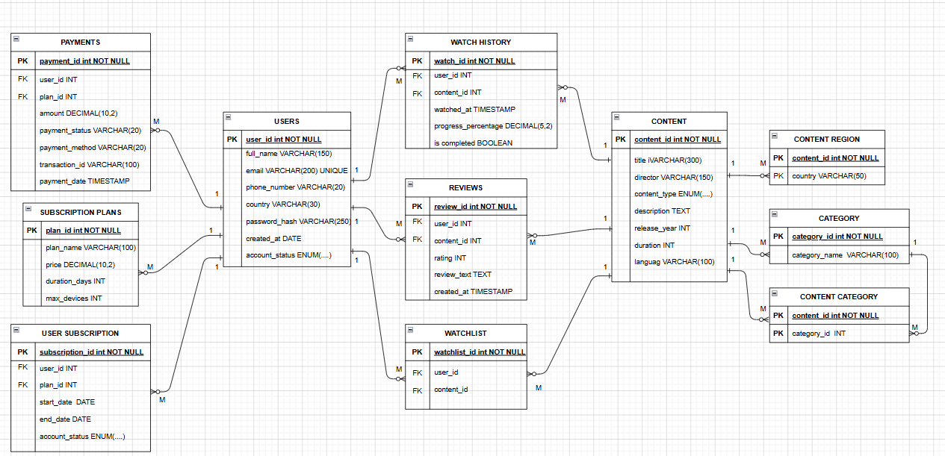
ER DIAGRAM

Slide 9
FEATURES
Fast data retrieval
Secure data management
Easy subscription handling
Reduces data redundancy
Supports analytics and reports
Efficient recommendation systems.

Slide 10

A PICTURE IS WORTH A THOUSANDS WORDS
conclusion

Slide 11
THANK YOU!

