Slide 1
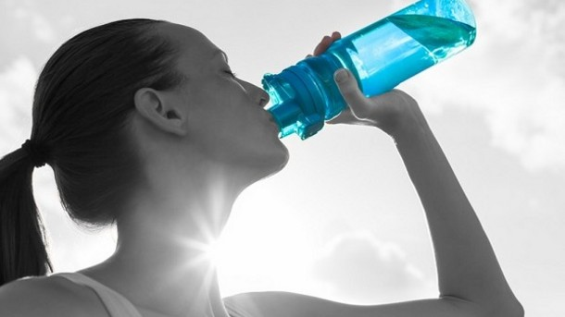
CRESCENT PURE
CASE STUDY

Slide 2
HISTORY OF CRESCENT PURE
Portland Drake Beverages (PDB) is a manufacturer of organic juices and sparkling waters, which bought Crescent that is founded in 2008 by Peter Hooper whom already realized a market opportunity for a healthy energizing drink.
Although he has started that production and selling of Crescent as a hobby, later on it became a business because of growing local demand.
Crescent Pure Case is mainly about acquisition of Crescent by PDB in which market researches and customer surveys are realized in order to identify the best category for Crescent to be successful in United States.

Slide 3

Peter Hooper

Slide 4
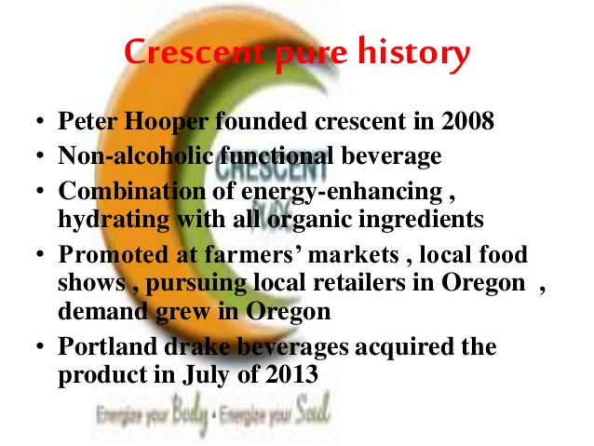

Slide 5
Energy Drink Benefits
More Energy
Standardized caffeine amount
Fast caffeine delivery
A variety of flavors
Additional supplements
Refreshing

Slide 6
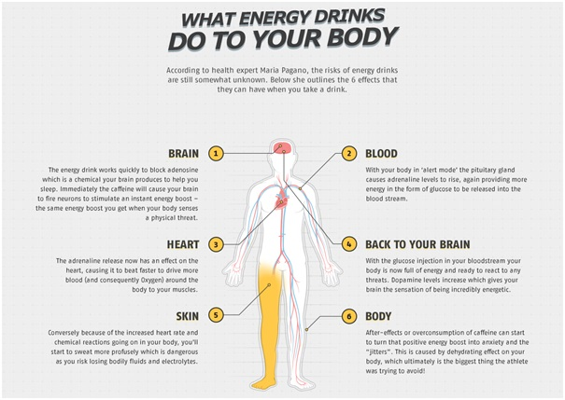

Slide 7
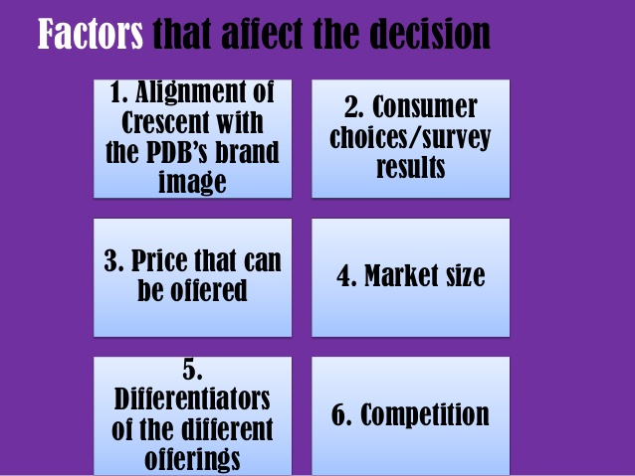

Slide 8
PROS OF SPORTS DRINK
Sports drinks can offer a bit more in terms of energy replacement when you exercise.With so many choices of sports drinks on the market, you need to understand the benefits and negative effects of sports drinks.
Pro: Electrolyte Replacement
Most sports drinks come packed full of sodium, potassium and other electrolytes to keep you replenished. This is one major advantage they have over water.
Pro: Taste
One of the best advantages a sports drink can offer is taste. A delicious sports drink will make it more likely that you'll consume it more often, helping you prevent dehydration.

Slide 9
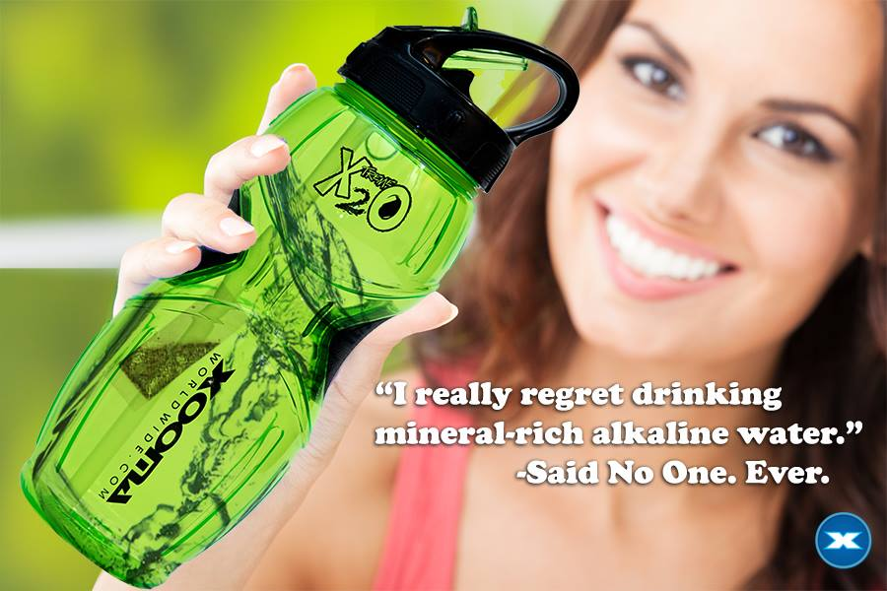

Slide 10
CONS OF SPORTS DRINK
Con: Tooth Decay
Ssports drinks can cause more tooth decay than sodas because of their high sugar content and added artificial flavoring and coloring.
Con: Weight Gain
Sports drinks can work to replenish fluids and electrolytes when you exercise regularly or for long periods at a time. On the other hand, if you drink sports drinks casually or hardly exercise while you drink them, you could be setting yourself up for some unwanted weight gain. Most sports drinks contain the same -- or higher -- amount of sugar as sodas, making them high in carbohydrates.

Slide 11
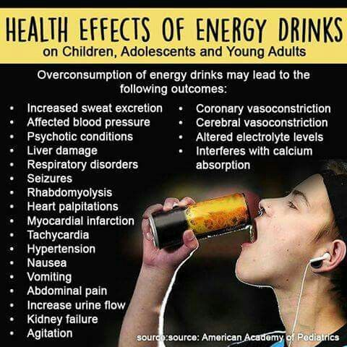

Slide 12
ENERGY DRINK VS SOFT DRINK
Soft drinks and energy drinks are often consumed by teenagers and young adults primarily because of their caffeine content.
When comparing the two products side by side, on average, energy drinks contain substantially more caffeine than soft drinks.
While excessive amounts of sugar and caffeine are being consumed by teenagers and young adults through both energy drinks and soda, the side effects are becoming more and more evident in our society.
Multiple studies and evidence have unveiled that there is an extreme lack of nutrient value in both soft drinks

Slide 13
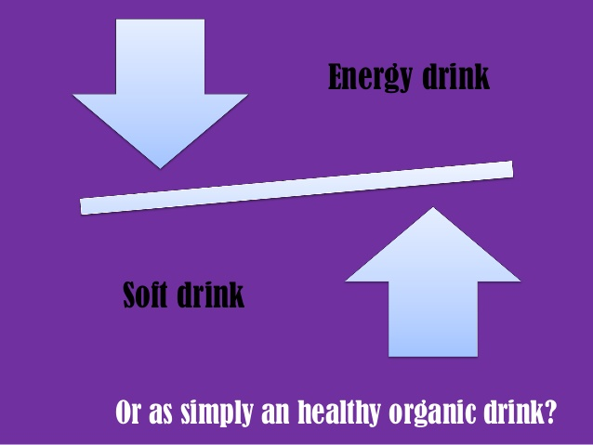

Slide 14
PROS OF SOFT DRINK
One positive thing about drinking pop is that it usually has caffeine, a natural stimulant
found in the kola nut, coffee beans, and tea leaves. Caffeine makes you feel more alert and
energized, especially when you're tired. Because of this, it might increase your performance
when you are working on certain things.

Slide 15
CONS OF SOFT DRINK
Pop has a very high amount of calories, mostly coming from
sugar. People who drink soda on a regular basis tend to consume more
calories each day than those who do not, and typically experience weight
gain. Drinking two cans of soda per day can lead to a 2 lb. weight gain
over a month.

Slide 16
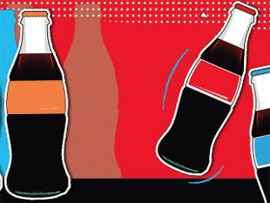

Slide 17
ORGANIC FOOD
The organic food industry is booming.
Organic food is made without:
synthetic fertilizers and pesticides
genetic engineering
sewage sludge
Radiation

Slide 18
PROS OF ORGANIC FOOD
Organic foods are free of harmful pesticides, antibiotics, GMOs, and additives.
They have less of an environmental impact than conventional farming.
The nutritional value is typically higher in organic foods.
CONS OF ORGANIC FOOD
Organic foods are more expensive.
All foods, including organic, are prone to food-born illnesses likeE. coli and salmonella.
Organic fruits and vegetables may have a shorter shelf life.

Slide 19


Slide 20
REFERENCES
http://www.livestrong.com
http://elliewithers.weebly.com
https://prezi.com

Slide 21

Under
Prof .Sameer Mathur
IIM Lucknow
Created by
Ponnuru.Meghana
VNIT

