Slide 1


Slide 2
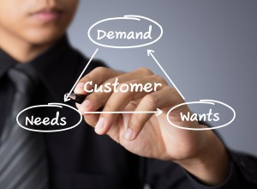

Marketing Strategies

Slide 3

Marketing Scheme-Layout

Slide 4


Slide 5


Slide 6
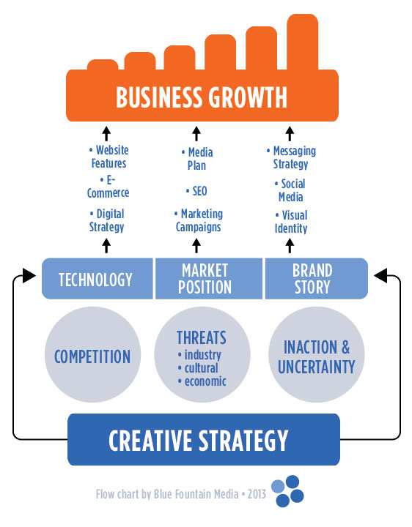

Slide 7
Health Memo

Slide 8

BRIEF DESCRIPTION
Health Wallet, a user-friendly and practical application for us to get our health information organized. It is a powerful tool that lets us build up our personal health information database at our own pace.

Slide 9
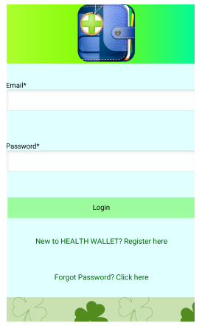

Slide 10

PURPOSE
Maintain Health Records as images in a more secure server with advance encryption technology.
Access health records during any hospital visit or in a case of an emergency.
Capture and upload the health records using the phone’s camera from within the app or choose from the phone’s gallery.
Access the medical records , modify them , add/delete more records
Mail the documents to yourself, or download it to your mobile phone

Slide 11

TARGET
Target audience
Hospitals
Industries that connect Doctors and Patients
Private labs.

Slide 12

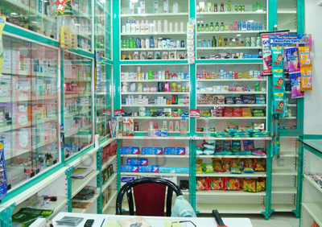

Medical Centre

Slide 13

TECHNOLOGY
This project can be done Android Studio and Geny Motion
Operating System : Windows 8.1
It can be handled by Computer Monitoring Department in the Organization

Slide 14

SECURITY
“Health Wallet" account is personal to us and is secured. After login with valid credentials on the Mobile Device Application we are directed to our information .

Slide 15

SPECIAL REQUIREMENTS
Device should have 2g/3g/Wifi Connectivity
The User should have an android mobile to run this app
Shielding passwords and other account information is necessary.

Slide 16
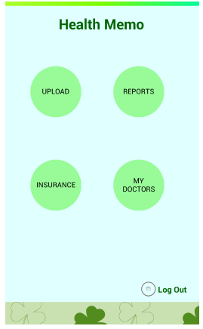

Slide 17

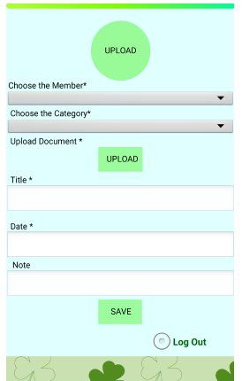
UPLOAD
Upload option is to upload medical health report using gallery or phone’s camera.
We have various options like Choose the Member ,Category etc in this module.
After uploading a new report we shall get a Success message

Slide 18

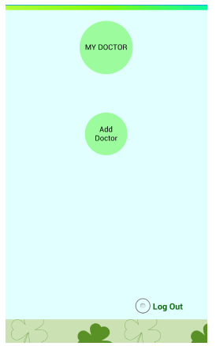
MY DOCTORS
My doctor’s module is created to add details
of Family doctors or who treat us regularly.
We can add new doctors through ADD DOCTOR
option.

Slide 19
References
AndroidHive.com
Customerthink.com
Regel Networks
Play Store

Slide 20
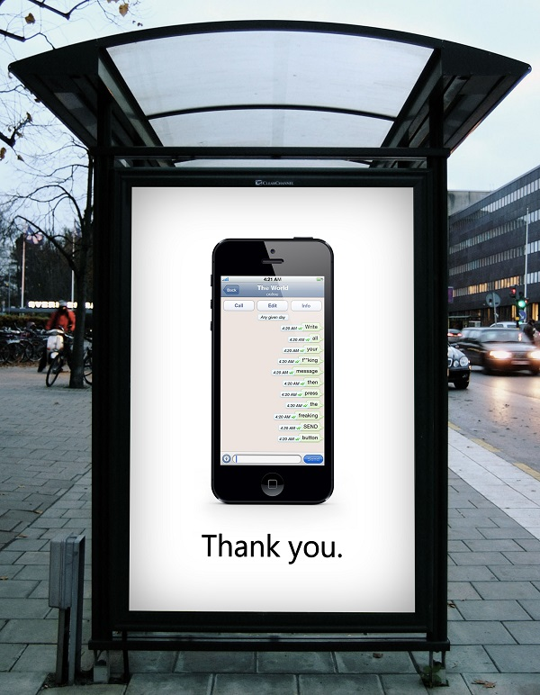
Under
Prof .Sameer Mathur
IIM Lucknow
By
Ponnuru.Meghana
VNIT

