Slide 1

BIG DATA ANALYTICS
UNIT-1

Slide 2
UNIT-1
Big Data Analytics:
Define Big Data
Affects of Big Data on our daily lives
Data Sizes
Source of Big Data
Challenges of Big Data
5 V’s of Big Data
Types of Digital Data
Structured/Unstructured data- Advantages and Sources
Business Intelligence
Comparison business intelligence from traditional big data
Architecture of data warehouse
Analytical tools used for big data analytics
Hadoop environment and its components
2

Slide 3
Define Big Data
What is Data?
The quantities, characters, or symbols on which operations are performed by a computer, which may be stored and transmitted in the form of electrical signals and recorded on magnetic, optical, or mechanical recording media.
What is Big Data?
Big Data is a collection of data that is huge in volume, yet growing exponentially with time. It is a data with so large size and complexity that none of traditional data management tools can store it or process it efficiently. Big data is also a data but with huge size.
Big Data: Large diverse sets of information that grow at ever-increasing rates.

Slide 4
Following are some of the Big Data examples-
The New York Stock Exchange is an example of Big Data that generates about one terabyte of new trade data per day.
Social Media
The statistic shows that 500+terabytes of new data get ingested into the databases of social media site Facebook, every day. This data is mainly generated in terms of photo and video uploads, message exchanges, putting comments etc.
A single Jet engine can generate 10+terabytes of data in 30 minutes of flight time. With many thousand flights per day, generation of data reaches up to many Petabytes.

Slide 5
Affects of Big Data on our daily lives:
Health care: A life changing application
Retail: Understanding consumer behavior
Banking: Security and personalization
Transportation: Smoothing your commute
Agriculture: Feeding the future
Entertainment: Curating your content
Smart Cities: Enhancing urban living
Education: Personalized learning experiences
Driving Business strategies
Enhancing Decision making
Improved Efficiency and Productivity
Risk and Fraud detection

Slide 6
Conclusion: The impact of big data on our lives
Big data is more than a technological innovation; it’s a transformative force reshaping every aspect of our lives. From enhancing healthcare and retail experiences to optimizing transportation and agriculture, real-life big data examples illustrate its vast potential. As we continue to generate and analyze more data, its impact will only grow, offering new insights and opportunities across all sectors. While the concept might seem daunting, its real-world applications show how big data makes our world smarter, more efficient, and more personalized.
Big data is a powerful tool, but it’s essential to navigate its use carefully, considering privacy and ethical implications. As we embrace its benefits, we must also advocate for responsible data practices, ensuring that big data serves the greater good without compromising individual rights. The future of big data is bright, and its possibilities are as vast as the datasets it comprises. By understanding and harnessing its power, we can unlock innovations that, until now, we could only imagine.

Slide 7
Data Sizes
Data Storage Units of Measurement Table: Smallest to Largest
Data Storage Unit | Short Form | Capacity
Bit | b | 1 or 0 (on or off)
Byte | B | 8 bits
Kilobyte | KB | 1024 bytes
Megabyte | MB | 1024 kilobytes
Gigabyte | GB | 1024 megabytes
Terabyte | TB | 1024 gigabytes
Petabyte | PB | 1024 terabytes
Exabyte | EB | 1024 petabytes
Zettabyte | ZB | 1024 exabytes
Yottabyte | YB | 1024 zettabytes

Slide 8
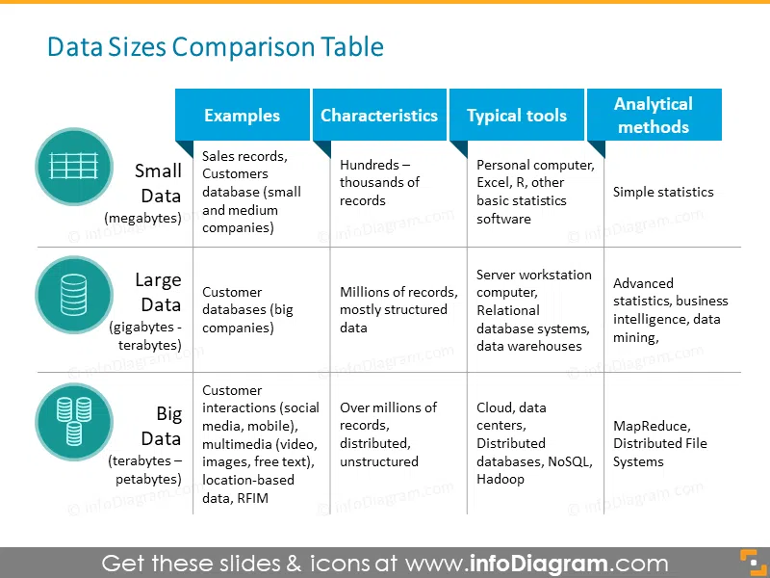

Slide 9
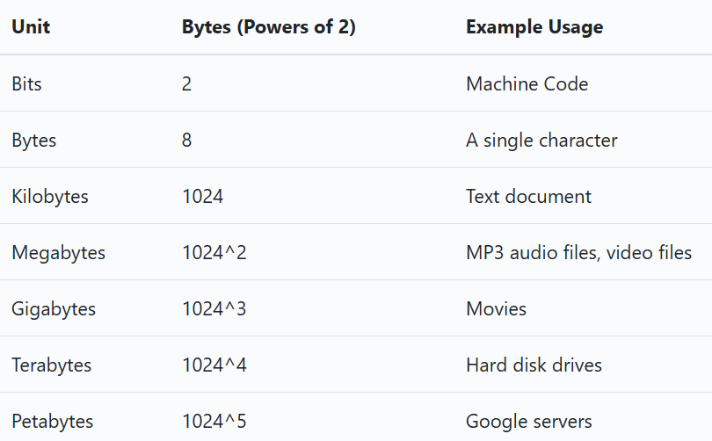

Slide 10
Exabytes, Zettabytes, and Yottabytes
An exabyte (EB) is 1,000 petabytes, or one quintillion bytes. 2004 was the first time that monthly internet traffic across the world passed 1EB. In 2017, the internet handled some 122EB of data every month. You could fit around 11 million 4K movies in an exabyte of storage.
Next up is a zettabyte (ZB), which is equivalent to 1,000 exabytes or one sextillion bytes. The International Data Corporation calculated that the global datasphere was somewhere around 33 zettabytes in 2018. As another way of looking at it, the continent of Australia is about 2.97 million square miles. If each square mile represented one terabyte, you could fit almost 337 copies of Australia into a zettabyte.
The largest currently defined data size is a yottabyte (YB). This staggering unit is equal to 1,000 zettabytes, or one septillion bytes. Comparisons with today's data sizes are a bit ridiculous, but it's estimated that you could fit 257.054 trillion DVDs or 288.230 quadrillion average MP3 songs in a yottabyte.

Slide 11
Source of Big Data:Where does it come from?
All most all fields generate big data. Some major fields where big data plays a major role is
Social networking sites: social media that carry information, posts, links etc of different peoples from all over world like Facebook twitter etc.
Search engines: there are lots of data from different databases that retrieve from search engines.
Medical history : medical history of patients for various health issues from hospitals
Online shopping: shopping online help to know the preferences of customers on different products.
Stock exchange: shares of different companies hold by stock

Slide 12
The Primary Sources of Big Data:
A significant part of big data is generated from three primary resources:
Machine data
Social data, and
Transactional data.
1. Machine Data
Machine data is automatically generated, either as a response to a specific event or a fixed schedule.
smart sensors, SIEM logs, medical devices and wearables, road cameras, IoT devices, satellites, desktops, mobile phones, industrial machinery, etc.
2. Social Data
It is derived from social media platforms through tweets, retweets, likes, video uploads, and comments shared on Facebook, Instagram, Twitter, YouTube, Linked In etc.

Slide 13
3. Transactional Data
As the name suggests, transactional data is information gathered via online and offline transactions during different points of sale. The data includes vital details like transaction time, location, products purchased, product prices, payment methods, discounts/coupons used, and other relevant quantifiable information related to transactions.
The sources of transactional data include:
Payment orders
Invoices
Storage records and
E-receipts
Transactional data is a key source of business intelligence.

Slide 14
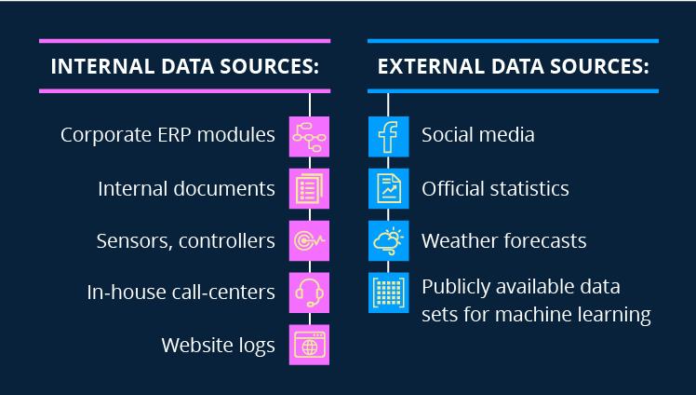
Big data sources: internal and external
There are two types of big data sources: internal and external ones. Data is internal if a company generates, owns and controls it. External data is public data or the data generated outside the company; correspondingly, the company neither owns nor controls it.
Let’s look at some self-explanatory examples of data sources.

Slide 15
Challenges of Big Data
Managing massive amounts of data
2. Integrating data from multiple sources
3. Ensuring data quality
4. Keeping data secure
5. Selecting the right big data tools
7. Scaling systems and costs efficiently
8. Lack of skilled data professionals
9. Organizational resistance

Slide 16
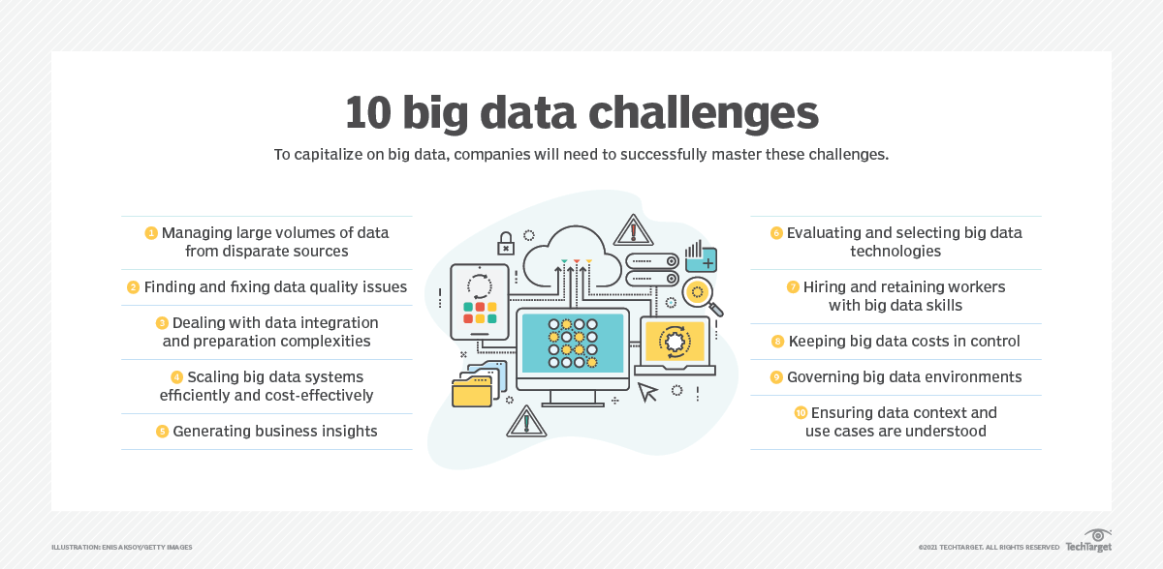

Slide 17
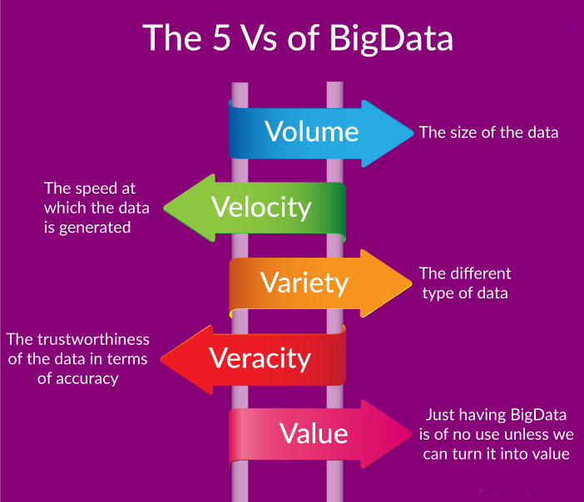

Slide 18
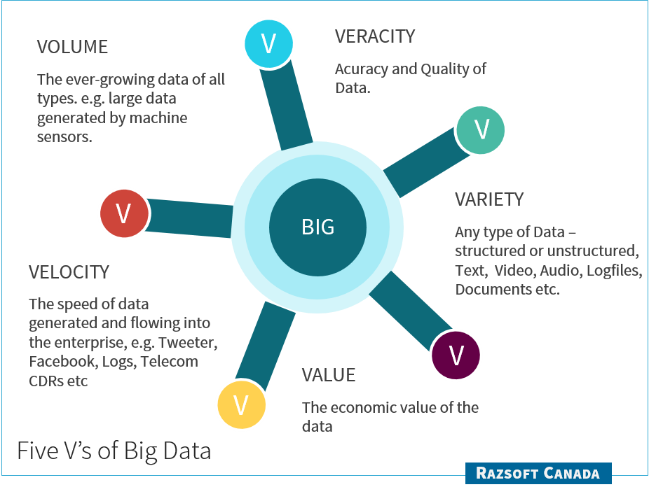

Slide 19
Types of Digital Data:
Structured
Unstructured
Semi Structured Data
Structured Data:
Structured data refers to any data that resides in a fixed field within a record or file.
Having a particular Data Model.
Meaningful data.
Data arranged in a row and column.
Structured data has the advantage of being easily entered, stored, queried and analyzed.
E.g.: Relational Data Base, Spread sheets.
Structured data is often managed using Structured Query Language (SQL

Slide 20
Sources of Structured Data:
* SQL Databases
* Spreadsheets such as Excel
* OLTP Systems
* Online forms
* Sensors such as GPS or RFID tags
* Network and Web server logs
* Medical device
Advantages of Structured Data:
* Easy to understand and use
* Consistency
* Efficient storage and retrieval
* Enhanced data security
* Clear data lineage

Slide 21
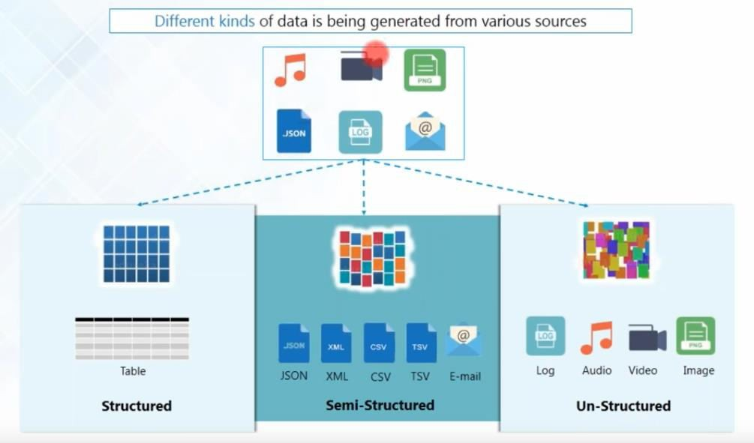

Slide 22
Unstructured Data:
Unstructured data can not readily classify and fit into a neat box
Also called unclassified data.
Which does not confirm to any data model.
Business rules are not applied.
Indexing is not required.
E.g.: photos and graphic images, videos, streaming instrument data, webpages, Pdf files, PowerPoint presentations, emails, blog entries, wikis and word processing documents.
Sources of Unstructured Data:
Web pages
Images (JPEG, GIF, PNG, etc.)
Videos, Memos, Reports ,Word documents and PowerPoint presentations, Surveys

Slide 23
Semi structured Data:
Self-describing data.
Metadata (Data about data).
Also called quiz data: data in between structured and semi structured.
It is a type of structured data but not followed data model.
Data which does not have rigid structure.
E.g.: E-mails, word processing software.
XML and other markup language are often used to manage semi structured data.
Sources of semi-structured Data:
E-mails
XML and other markup languages
Binary executables
TCP/IP packets
Zipped files
Integration of data from different sources
Web pages

Slide 24
Business Intelligence(BI)
BI: Data-Driven Decision Making
Business intelligence (BI) is the art and science of using data to make better decisions for a business.
BI tools collect, store, and analyze data from various sources, such as transactions, social media, surveys, and sensors.
BI tools present the data in user-friendly formats, such as reports, dashboards, charts, and graphs, that help users understand trends, patterns, and insights.
BI is constantly evolving with new technologies, such as artificial intelligence, cloud computing, and big data analytics.

Slide 25
Big Data vs. Traditional Business Intelligence
Big Data and Traditional Business Intelligence are two approaches to analyzing and utilizing data in business settings. Traditional Business Intelligence focuses on structured data, typically stored in relational databases, and uses predefined queries and reports to extract insights. It is primarily concerned with historical data and provides a retrospective view of business operations. On the other hand, Big Data encompasses a broader range of data types, including unstructured and semi-structured data, and leverages advanced analytics techniques to uncover patterns, trends, and correlations. It enables real-time or near-real-time analysis, allowing businesses to make more proactive and data-driven decisions. While Traditional Business Intelligence is more established and structured, Big Data offers greater flexibility and scalability in handling large volumes of diverse data.
Copy This URL

Slide 26
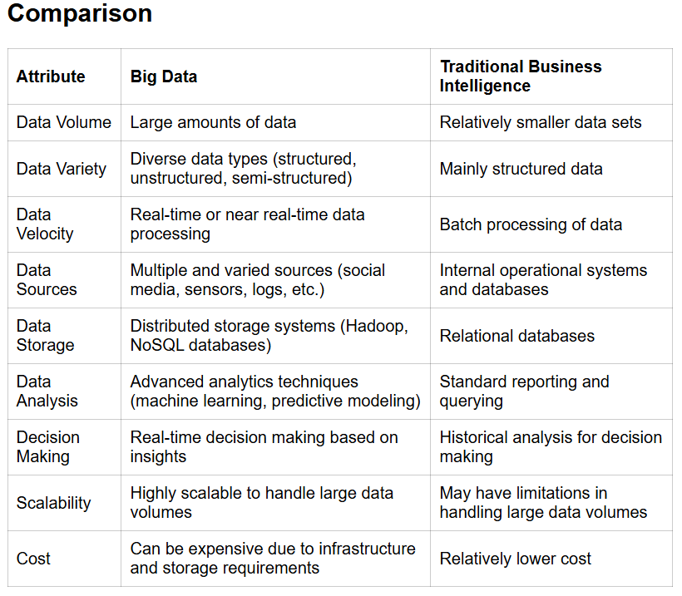

Slide 27
Architecture of Data Warehouse
Data warehouse architecture is the design of how data is stored, processed, and accessed in a data warehouse system.
It involves three main components: data sources, data integration, and data analytics, each with its own subcomponents and tools.
Data sources are the heterogeneous and diverse systems that generate and collect data, such as databases, applications, web logs, sensors, etc.
Data integration is the process of extracting, transforming, and loading (ETL) data from the sources to the data warehouse, where it is cleansed, standardized, and organized under a unified schema.
Data analytics is the layer that provides users with access to the data warehouse, using various tools and techniques, such as query languages, reporting, dashboards, data mining, machine learning, etc.
Data warehouse architecture can be classified into different types, such as single-tier, two-tier, or three-tier, depending on the complexity and separation of the components.

Slide 28
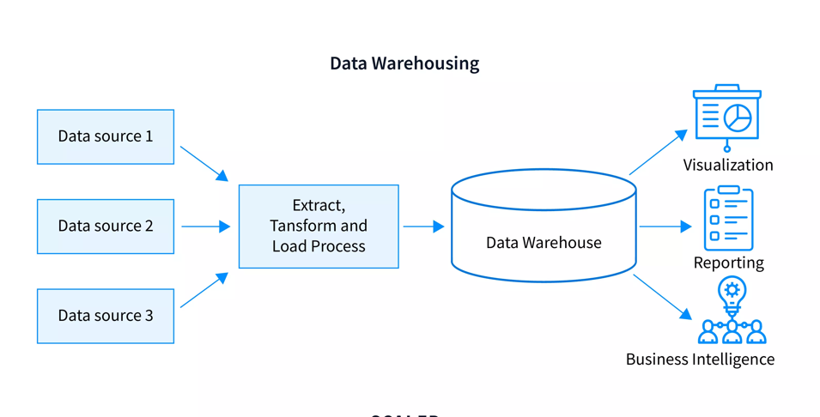

Slide 29
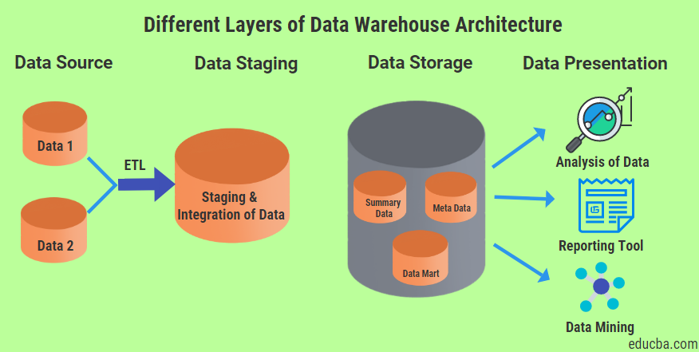

Slide 30
Analytical tools used for Big Data Analytics
Here are some of the key big data analytics tools :
Hadoop - helps in storing and analyzing data
MongoDB - used on datasets that change frequently
Talend - used for data integration and management
Cassandra - a distributed database used to handle chunks of data
Spark - used for real-time processing and analyzing large amounts of data
STORM - an open-source real-time computational system
Kafka - a distributed streaming platform that is used for fault-tolerant storage

Slide 31
Hadoop environment and its components
Hadoop is an open source framework based on Java that manages the storage and processing of large amounts of data for applications. Hadoop uses distributed storage and parallel processing to handle big data and analytics jobs, breaking workloads down into smaller workloads that can be run at the same time. Following are the components that collectively form a Hadoop ecosystem:
HDFS: Hadoop Distributed File System
YARN: Yet Another Resource Negotiator
MapReduce: Programming based Data Processing
Spark: In-Memory data processing
PIG, HIVE: Query based processing of data services
HBase: NoSQL Database
Mahout, Spark MLLib: Machine Learning algorithm libraries
Solar, Lucene: Searching and Indexing
Zookeeper: Managing cluster
Oozie: Job Scheduling

Slide 32
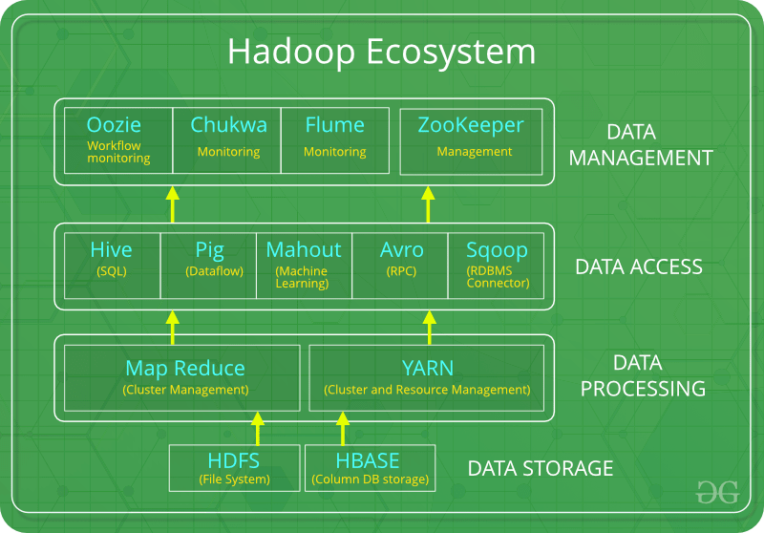

Slide 33


