Slide 1
Smart Women
🛡
Safety App
A Mini Project | Group G-4
Under the Guidance of: Dr. M Archana
Group Members
Peddiboina Keerthi Mytreya
245623733170
Kotte Manvitha
245623733156
Ragam Sindhu
245623733175

Slide 2
Abstract
Smart Women Safety App — Project Overview
Women’s safety remains a major concern, especially during emergency situations where immediate communication and assistance are required. Traditional safety applications often depend on manual interaction, which may not be possible when a victim is under stress or unable to access their phone. To address this challenge, the proposed Smart Women Safety App provides a fast, reliable, and hands-free emergency response system.
The application includes a secure login system and a user-friendly dashboard featuring a dedicated SOS Emergency Button for instant assistance. Users can register up to three emergency contacts and set a custom secret safe-word for emergency activation. The application is designed to operate continuously in the background, even when the device screen is locked.
The system continuously monitors for predefined danger words such as “help” or the user’s secret safe-word. Once the keyword is detected, the application immediately retrieves the user’s live GPS location and sends an emergency SMS containing a Google Maps location link to all registered emergency contacts. The application automatically initiates a phone call to the primary emergency contact after a short delay of two seconds.
The proposed system enables women to request help without physically interacting with their mobile device, making it particularly useful during kidnapping attempts, harassment, accidents, or other dangerous situations.
Keywords: Women Safety Application • Voice-Based Emergency Activation • SOS Alert System • GPS Location Tracking • Emergency Contact Notification • Automated Calling System

Slide 3
System Requirements
Software & Hardware
💻 Software Requirements
📱 Hardware Requirements
OS: Windows 10/11 or Linux
Language: Python / Java
IDE: Android Studio / VS Code
Libraries: OpenCV, TensorFlow, MediaPipe
Database: Firebase / SQLite
APIs: Google Maps, SMS, WhatsApp API
Processor: Intel i3 or higher
RAM: Minimum 4 GB (8 GB recommended)
Storage: At least 500 MB free space
Device: Android Smartphone
Camera: Required for gesture detection
GPS Module: Inbuilt mobile GPS
Internet: For sending alerts & APIs

Slide 4
Methodology — System Flow
START
1. Secure Login — User authenticates via SharedPreferences
2. Contact Setup — Save 3 contacts & set custom secret safe-word
3. Background Listening — App silently listens for danger keyword
Keyword / SOS Triggered?
NO ↺ Keep Listening
YES
4. GPS Capture + SMS Alert + Auto Call — Google Maps SMS to 3 contacts; auto-call after 2s
ALERT SENT

Slide 5
Literature Survey
Related Work & Research
Reference / Year
Title of Paper
Methodology
Tools
Results
Bengare et al. (2025)
Android-Based Women Safety App
One-tap SOS & multi-channel alert
Java, Android Studio, SQLite
2-3s alert; 5-10m GPS accuracy
Bhowmik et al. (2025)
Women Security App – Smart Response
Google Maps + auto SMS/call triggers
Android Studio, XML, Java
High reliability dual-channel messaging
Shokeen & Mittal (2025)
AI Gesture Recognition for Emergency
MediaPipe hand tracking + SVM
Android Studio, Python/Android
95.19% gesture classification accuracy
Zhang et al. (2025)
Real-time IoT-based Public Safety
Distributed sensor + edge computing
IoT Platforms, Edge Computing
Large-scale real-time monitoring

Slide 6
Key Features
🔴
🎙️
🤲
SOS Button
Voice Keyword
Hands-Free Operation
One-tap big red emergency button. Instantly triggers GPS + SMS + auto-call. Works every time, OS-proof.
Listens in background for danger words like "help" or a custom secret safe-word set by the user.
Works even when screen is locked. No physical interaction needed — voice or SOS triggers full alert pipeline.
📍
📞
💾
Live GPS Tracking
Auto Call
Offline Storage
Captures exact GPS on trigger. Sends Google Maps link via SMS within 2–3 seconds, 5-10m accuracy.
After 2-second buffer, auto-dials primary contact. Completely hands-free — no phone interaction needed.
Uses SharedPreferences to store contacts & login locally on device. No internet required for setup.

Slide 7
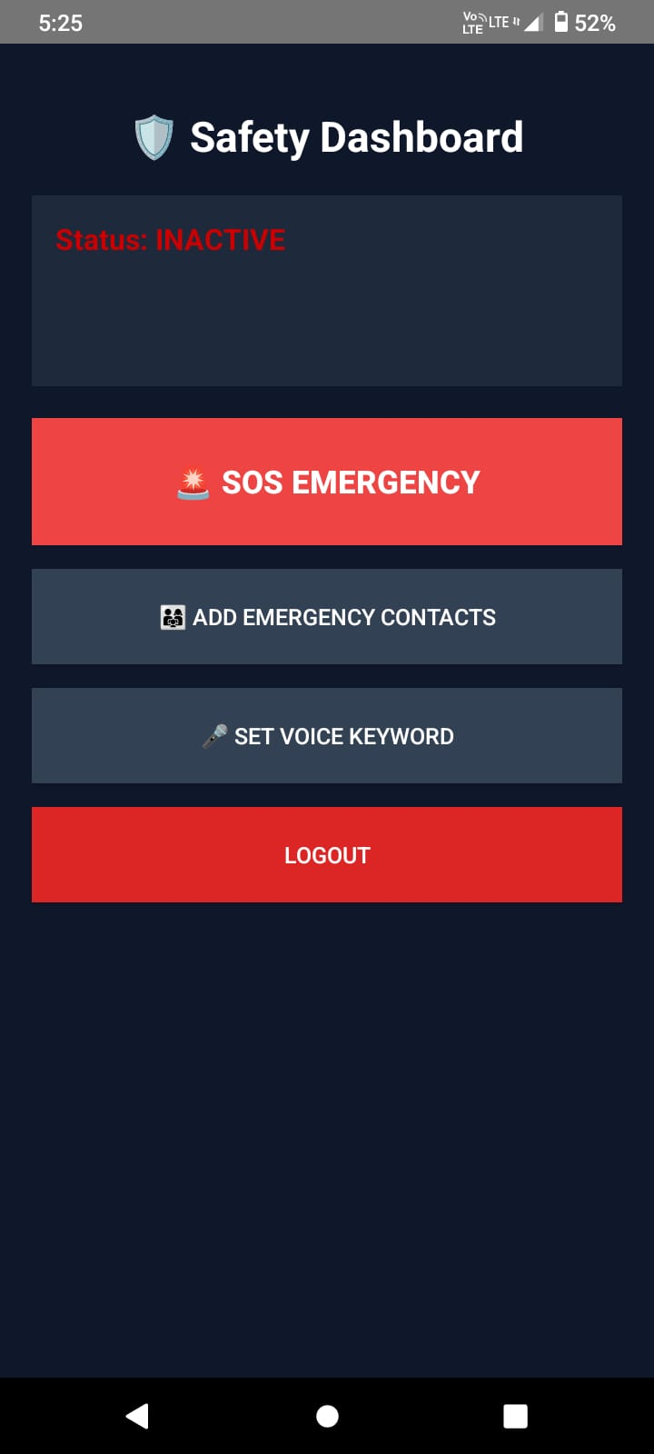
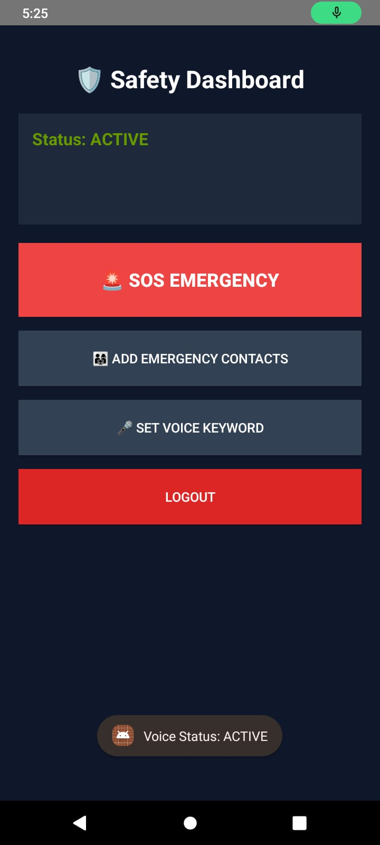
App Screenshots — Dashboard Views
Dashboard — Status: INACTIVE
Dashboard — Status: ACTIVE (Voice On)

Slide 8
App Screenshots — Voice Detection Active
Voice Status: ACTIVE — Green mic indicator
Safety Dashboard — Default State

Slide 9
Final Result — App Screenshots
⚡ < 3s
🛡 Safety Dashboard
Alert Response Time
Status: INACTIVE
📍 5-10m
🚨 SOS EMERGENCY
GPS Accuracy
📲 3
👥 ADD EMERGENCY CONTACTS
Contacts Alerted
🎤 SET VOICE KEYWORD
🛡 100%
LOGOUT
SOS Reliability
Login Screen
Safety Dashboard

Slide 10
Summary
Project at a Glance
📌
A Smart Women Safety Android App that provides immediate, hands-free emergency assistance.
🔴
Two-trigger system: a manual SOS Button and an AI-powered background Voice Detector.
🤲
Completely hands-free — voice keyword or SOS button triggers the full emergency pipeline without phone interaction.
📍
Instantly tracks live GPS and sends a Google Maps link to 3 saved emergency contacts via SMS.
📞
Auto-calls the primary contact 2 seconds after the SOS trigger — completely hands-free.
💾
Uses SharedPreferences for local, offline storage of contacts — no server or internet needed for setup.
⚡
Sends emergency alerts within 2–3 seconds with 5–10 metre GPS accuracy.

Slide 11
🛡️
Conclusion
The Smart Women Safety App is a practical, lightweight, and life-saving mobile solution. By combining a fail-safe SOS Button and AI-powered Voice Keyword detection, the app ensures that no victim needs to waste precious seconds unlocking their phone. The automatic GPS tracking, instant SMS alert to 3 contacts, and auto-call pipeline — all completing within 2–3 seconds — make it one of the most comprehensive and reliable personal safety tools built on Android.
Thank You
Under the Guidance of Dr. M Archana | Group G-4

