Slide 1

Illinois Integrated Eligibility System
Work Verification Module Overview
March, 2015

Slide 2
Agenda
Background
IES and Work Verification Module Overview
Family Assessment
Responsibility Service Plan (RSP)
Activity Tracking
Eligibility / Sanctions and Non Cooperation Integration
Provider Functions
Performance Management and Reporting
Gaps/Feature Not Supported
Next Steps

Slide 3
Background
The Illinois Integrated Eligibility System (IES) project is modernizing administration of Medicaid, SNAP and TANF.
As part of the modernization effort, a number of Department of Healthcare and Family Services (HFS) and Department of Human Services (DHS) legacy systems are being retired including the Client Database (CDB).
The current Work Verification System (WVS) operates on the HSDB system using Adobe LiveCycle technology. Its source data originates on the CDB and a complex integration is in place between CDB and HSDB.
The current WVS supports TANF work participation requirements only. SNAP is currently supported by different technology in different offices.
The State determines it would be more beneficial to have WVS related functionality integrated into, and improved in, IES versus implementing a complex synchronization process between IES and the HSDB.
The functional design of the system is 90% complete and development is in progress.
WVS module will go live in September 2015 with the IES phase .

Slide 4
IES and Work Verification Module Overview
Public Facing Capabilities
Worker Facing – Front Office
Worker Facing –
Back Office Capabilities
Technology Capabilities
Apply for Benefits
Partner and Provider Portal
Application Registration
Search and Inquiry
Caseload Management
Dashboard
Rules Mgt.
Am I Eligible Screening
Renew My Benefits
Application Intake
Clearances
Business Reporting
Mass Change
Search/MCI
Manage My Case
Report My Changes
Eligibility Determ.
Benefit Confirmation
Quality Control Workflow
Federal Reporting
Security
Long Term Support Screening
Renewals
Client Scheduling
Appeals & Hearings
Benefit Issuance
Reference Tables
Case Changes
Notices & Forms
Benefit Recovery
Business Intelligence
Audit Trail
Assessment
Visitor Information System
Service Planning (RSP)
Activity Tracking
Phase 1
Phase 2
Phase 2 – Work Verification

Slide 5
Work Verification System Overview
The Work Verification module is within IES that is used to support Work and Training (W&T) activities.
Participation in the W&T activities has a direct impact on the TANF benefits issued to the customer.
IES
Intake / Data Collection
Eligibility Determination
Authorization and Benefits Issuance
Request for TANF
Clients Details Processed
Eligibility Results
TANF
Eligibility
Eligibility Referral
Family Assessment
Intensive Case Review
Workforce Verification
System
Initial Assessment
Initial RSP
Responsibility & Services Plan
Reports & Notices
Customer Summary
Provider Referrals
Tasks & Alerts
Attendance & Activities
Sanctions
Benefit Payments

Slide 6
Family Assessment
The Family Assessment feature contains 18 screens to allow workers to:
To identify participants’ barriers to work
To determine participants’ work skills and work readiness
To link participants to pertinent development and work activities
To track and monitor participant activities
Employment Skills / History
Manage Family Assessment
Education and Training
Individual and Family Health
Barrier Reduction Services
Housing
Mental Health Services
General
Transportation
Substance Abuse
Pregnancy
Disabling Health Condition
Family Violence
Infant, Child and Teen
DCFS
Teen Parenting Services

Slide 7
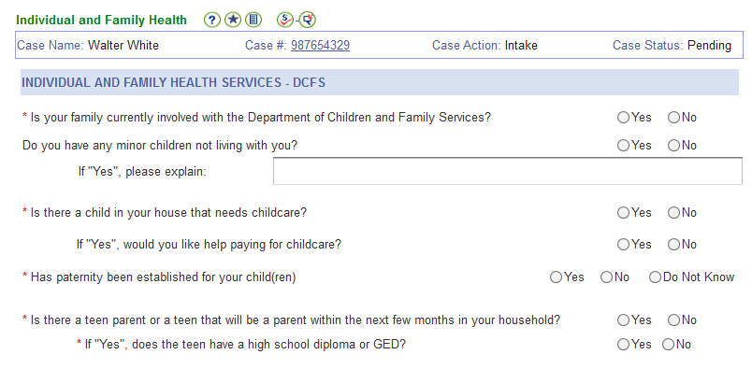
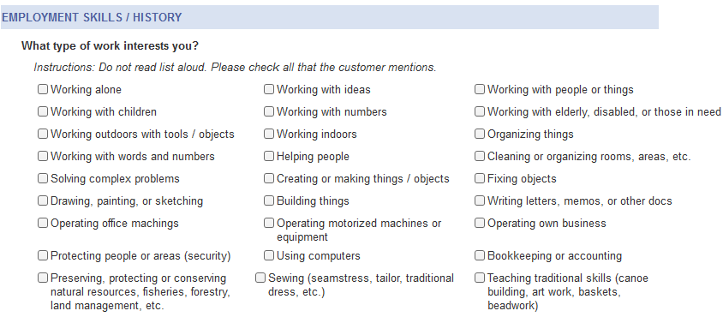
Family Assessment – OWRA Questions
The Assessment was modeled on the federal Online Work Readiness Assessment (OWRA) tool.
Child Support
Adult GED
Work First Activities

Slide 8
Responsibility and Services Plan (RSP)
The RSP contains 10 screens used to assign activities to the adults and teen parents in a TANF case
Create RSP
Primary CORE Activities
Secondary NON-CORE Activities
Other Activities
Employment
Job Skills Training
Vocational Rehab Services
Work First
Education Related to Employment
Alcohol / Substance Abuse
Work Experience
Mental Health
Community Service
Medical Family Care Services
Job Search / Job Readiness
Domestic Violence
Child Support / Financial Resources
TPS High School / GED
Child Safety
Vocational Training
Basic Needs
Bachelor / Associate Degree
Health
Adult GED
Child Under 1

Slide 9
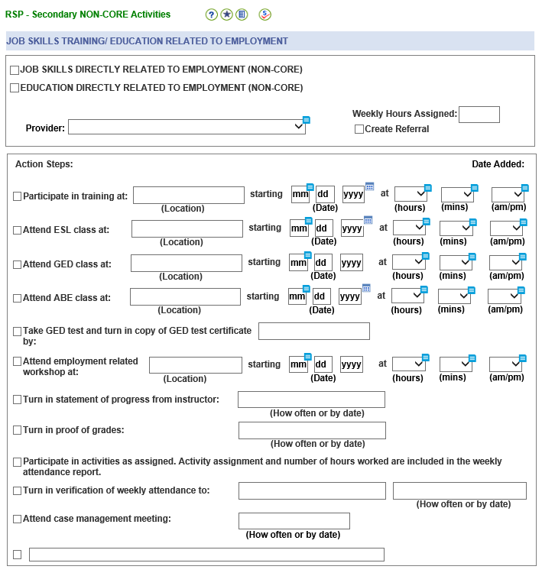
RSP Activities
The RSP allows case worker to assign the customers to providers for Work & Training (W&T), education, and other activities.

Slide 10
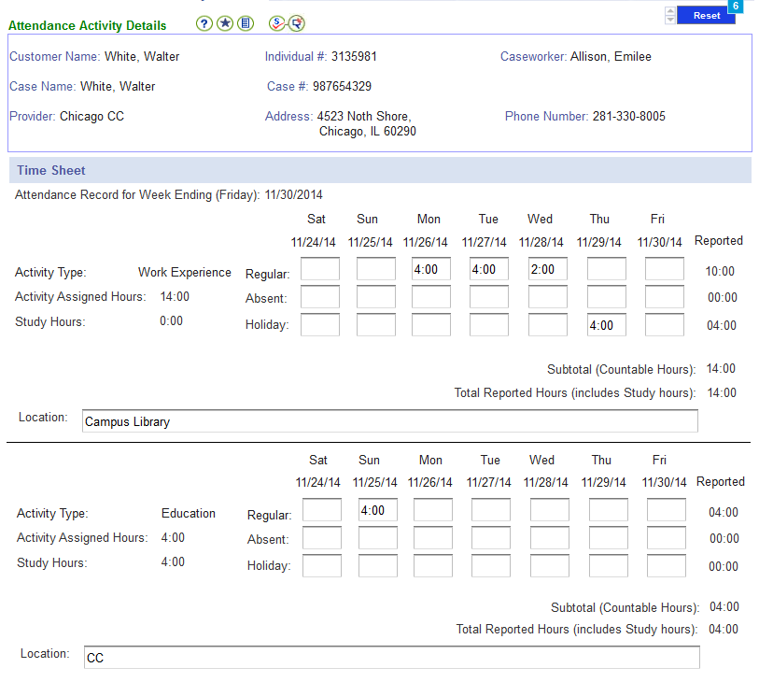
Attendance & Activity (A&A)
The A&A tracking functionality allows the case workers and the providers to record and update hours spent on RSP activities.

Slide 11
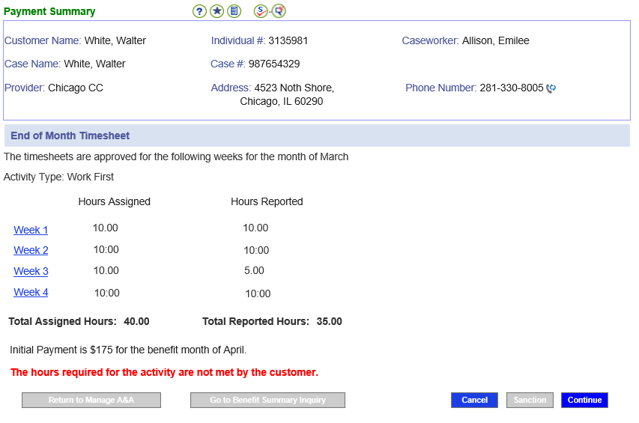
Attendance Tied to Benefit Issuance
The A&A tracking functionality allows the case workers and the providers to record and update hours spent on RSP activities.
The case worker can sanction the customer if the required hours are not met.
Sanction Customer

Slide 12
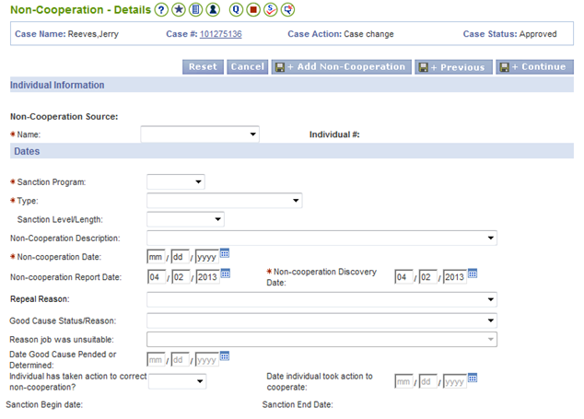
Eligibility / Sanctions and Non-Cooperation Integration
The case worker can enter the sanction in the below Non-Cooperation page.
The sanction will reduce the customer TANF benefits by 50% or 100% based on the sanction level entered. (enter information on this screen)

Slide 13




Provider Functions
Case Worker
Conducts
Family Assessment
Provider
Activity Referral
Assigns
RSP Activities
Accepts the
Activity Referral
Meets with Customer
Update Activities
Updates RSP Activities
Approves
A&A Timesheet
Completes and Submit
A&A Timesheet
Issue TANF Benefits
Customer
Notes:
This flow chart gives a more detailed look at how an application is processed and passed between the FFM and IES. In the figure, IES refers to both ABE and Worker Portal.
Walk through flow chart with students. Make sure to explain that APTC and CSR are federal subsidies applied to health insurance policies for eligible applicants. Mention that applicants to the FFM can also shop for commercial, non-subsidized insurance.

Slide 14
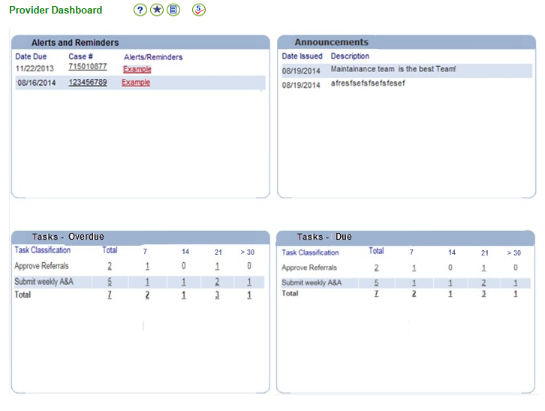
Performance Management
The case worker dashboard provides an overview of the office workload, and display due and overdue tasks associated with a specific office.
The tasks are label by categories, this gives the office the flexibility to manage tasks using specialized workers for each task type.
Show the drill down. (Add inbox next slide)

Slide 15
Reporting
There are several federal and state reports available to assess how the TANF program is performing.
Crystal Reports will be used in generating these reports.
The following reports will be generated as part of the WVS System
Intensive Interview Overdue Dates
Work and Training Master Listing
TANF State Work Participation Rate
TANF Federal Work Participation Rate
Employment and Training Activity Count
TANF State Participation
Teen Parent Services
Referral Count to Providers / Contractors
Cases Referred to a Community Provider / Contractor
TANF Progress Report
Supportive Services Billing Summary
CAU TANF Customers Report
CAU TANF Summary Report
Provider Management – Outstanding Tasks Report
Lets just the reports we support… don’t need screen shot
Should also mention BO universe for adhoc reporting

Slide 16
Gaps/Feature Not Supported
SNAP work requirements
Automatic sanctioning
Outcomes measurement
Job retention

Slide 17
IES Project Goal
This project’s goal is to improve access to programs providing service to economically disadvantaged people by providing a simple, efficient, seamless, and traceable system for people to access and manage their health coverage, insurance, or aid.

Slide 18
Program Overview: TANF
Name | Temporary Assistance for Needy Families
Description | Provides cash assistance and supportive services to assist the family, helping them achieve economic self-sufficiency.
Funding sources | Block Grants for the federally approved state plan State funding
Eligibility | Families with children who are deprived of parental care and support of one or both parents due to unemployment, absence, incapacity (disability), or death.
Time limit | 60 months
Other eligibility criteria | Adults must be working, preparing to work (school), or looking for work. Typically has an asset limit between $1,000-$3,000.

Slide 19



Meeting ACA Timelines and Leveraging Federal 90/10 Funding through a Phased Approach
Implementation 1
Implementation 2
Previously
October 2013
September 2015
Worker
Worker
Clients
Clients
Clients
Worker
State of Illinois
Integrated Eligibility System
State of Illinois
Integrated Eligibility System
TECHNOLOGIES
Modern JEE, DB2, Server-based
BENEFITS
Integrated, Maintainable, Modern, Flexible
AIS
IPACS
ACM
PACIS
AIS
IPACS
ACM
PACIS
CDB
HSDB
CDB
HSDB
TECHNOLOGIES
Legacy COBOL, Mainframe-based

Slide 20




IES and the Federally Facilitated Marketplace in Detail
Federal Health Benefits Marketplace
HIX
Assess Medicaid/CHIP Eligibility
Eligible
Application available in IES office Inbox
Ineligible
Application for Subsidies
Worker processes application
IES processes FFM application if predefined criteria are met
Eligibility Determination
Eligibility Determination
If financially ineligible for Medicaid/CHIP, but potentially eligible for subsidies, refer to FFM
Ineligible
If eligible, select Health Plan and enroll
If eligible, enroll in Medicaid/CHIP
Ineligible
Notes:
This flow chart gives a more detailed look at how an application is processed and passed between the FFM and IES. In the figure, IES refers to both ABE and Worker Portal.
Walk through flow chart with students. Make sure to explain that APTC and CSR are federal subsidies applied to health insurance policies for eligible applicants. Mention that applicants to the FFM can also shop for commercial, non-subsidized insurance.

Slide 21
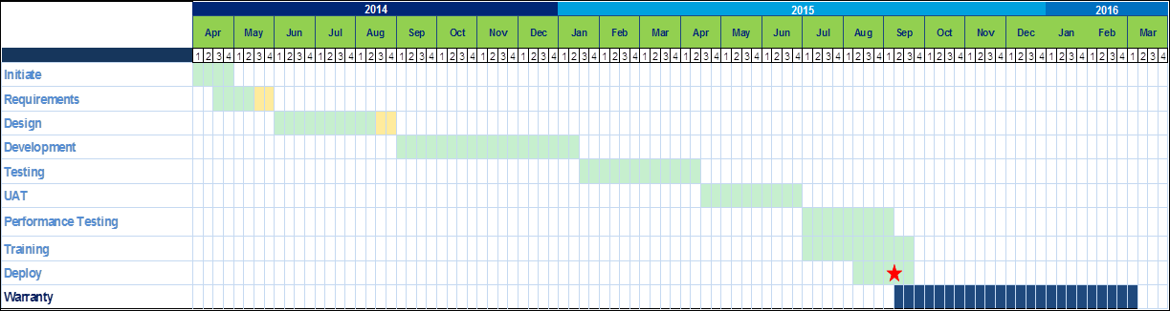
Project Timeline

Slide 22
Implementation 1 Overview
Overall Project/Proposal Summary In 2012, the Illinois Department of Human Services (DHS) and Healthcare and Family Services (HFS) contracted Deloitte to build the Illinois Integrated Eligibility System (IES - worker portal) and Application for Benefits Eligibility (ABE - customer portal). IES and ABE are customized from the Michigan Bridges eligibility system to meet Illinois’ specific requirements. IES successfully went live to all 82 DHS and HFS offices (~2,700 staff) on October 1, 2013. ABE successfully went live October 1, 2013 allowing all customers, providers and community partners to apply for benefits online. Over the lifecycle of the project, IES will replace multiple systems, meet the healthcare reform mandates, timelines and increasing program usage demands. | Challenge The State of Illinois was required, under the Affordable Care Act (ACA), to meet the requirements of ACA for real time eligibility determinations using new Modified Adjusted Gross Income (MAGI) rules, and a sophisticated integration with a yet to be developed Illinois HIX with limited workers and a very aggressive timeline to implement changing federal guidelines. ACA significantly increased the number of individuals Illinois needs to serve by expanding Medicaid eligibility for adults under 65 to one hundred and thirty three (133 percent) percent of the Federal Poverty Limit.
Approach Used phased approach for transferring Michigan BRIDGES solution to implement IL Integrated Eligibility Systems. Phase 1 implemented customer Self Service portal, front and back office worker portal, eligibility determination rules and interfaces to state exchanges and the FFM in Oct 2013. Applications were configured to suit IL technical environment and meet functional requirements to accommodate IL business rules. Phase 2 will implement additional functionality such as Benefit Issuance, Notices, Appeals and Advanced Reporting | Value Delivered/Results Improved client access to benefits and services; Extended State’s capacity to serve newly eligible 340,000 + customers in addition to existing customer base for medical assistance as of October 1, 2013. Implemented electronic document management system, clearing out need for overcrowded storage rooms, allowing better organization of case records and move toward paperless workflow. Improved caseworker ability to serve clients by streamlining policy and operational procedures.

