Slide 1
Operating system and system programming (25CS2104E)
Argument Passing
Review-2
Under the Esteemed Guidance of
Raghupathi M
CSE Department
Team Members:
Keerthi Priya Ande 2520090177
A.Jhansi Priya 2520090205

Slide 2
Contents
Abstract
Introduction
Hardware and Software requirements
System Architecture
Conclusion

Slide 3
Argument Passing is an important Operating Systems and Systems Programming concept used to provide input to a program during execution. This project demonstrates how command-line arguments are passed from the Linux shell to a C program using argc and argv.
The project is implemented in a Linux/Ubuntu environment and focuses on program execution and process-related concepts. It accepts different numbers of arguments, identifies them, and displays or processes their values. Linux/POSIX mechanisms such as fork(), exec(), and wait() can also be used to demonstrate process creation and program execution.
The project helps in understanding how the Linux shell interacts with a program and how input arguments are transferred during execution.
Abstract

Slide 4
Argument Passing is the process of providing input values to a program when it is executed.
In C, command-line arguments are received using argc and argv.
argc represents the number of arguments passed to the program.
argv is an array containing the actual argument values.
Arguments are provided through the Linux terminal.
The project demonstrates program execution and basic Linux process concepts.
It provides practical understanding of Systems Programming using C and Linux/POSIX mechanisms.
Introduction

Slide 5
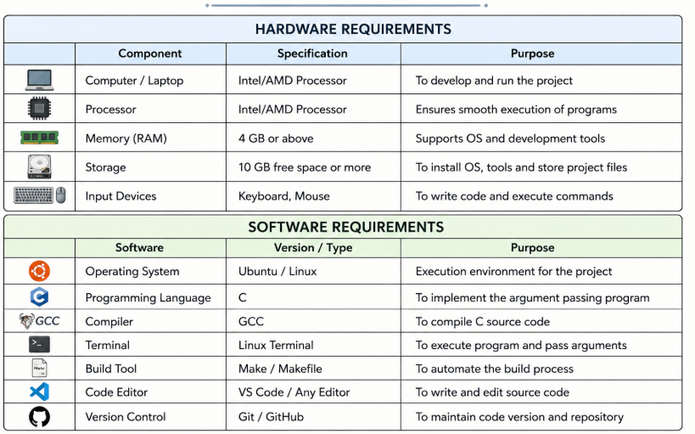
Hardware and Software requirements

Slide 6
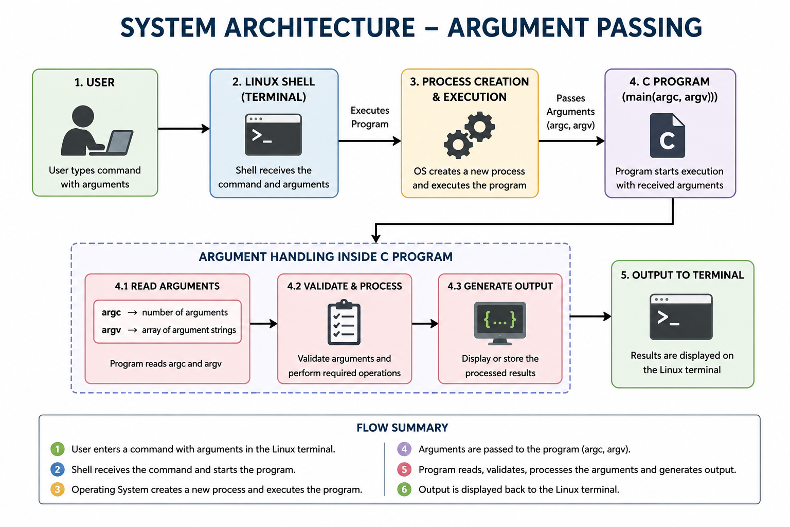
System Architecture

Slide 7
The project successfully demonstrates command-line argument passing in Linux.
It explains the use of argc and argv in C programs.
It provides practical understanding of how the Linux shell interacts with a running program.
Process-related concepts such as program execution and Linux/POSIX system calls can be demonstrated.
The project improves understanding of Operating Systems and Systems Programming concepts.
The implementation can be tested with different numbers and types of arguments to verify correct execution.
Conclusion

Slide 8
Thank you

