Slide 1



CREDIT CARD FRAUD DETECTION
Keerthi Priya Jakku | Fundamentals of Machine Learning

Slide 2
Millions of Transactions
The
Problem
Manually reviewing millions of daily transactions is impossible — automation is the only solution.
Historical Data Training
Models learn from past transactions to automatically identify suspicious patterns in real time.
Billions of dollars loss
Risk Management
Fraud probability scores help banks prioritize reviews, reducing analyst workload and speeding up decisions
Due to credit card fraud annually
(FTC Consumer Sentinel 2023)

Slide 3
Kaggle Dataset | 1,296,675 transactions | Sample: 10,000 | Features: amt · gender · category · city_pop
KNN
THE APPROACH
Naive Bayes
✓ Finds K=6 nearest transactions
✓ Calculates fraud probability
✗ FAILED on imbalanced data
✓ No balancing needed
✓ 59 fraud + 100 legit balanced
✓ Full 10,000 dataset used
✗ Struggles when fraud cases are extremely rare
✓ Works well even when fraud cases are extremely rare
✗ Distance based — dominated by majority class
✓ Probability based — not affected by class dominance
Data was split into 70% training / 30% testing. KNN required under sampling to handle severe class imbalance (0.59% fraud).
Naive Bayes applied directly to full dataset
Dataset was preprocessed through transformation, normalization and class imbalance handling before model development

Slide 4
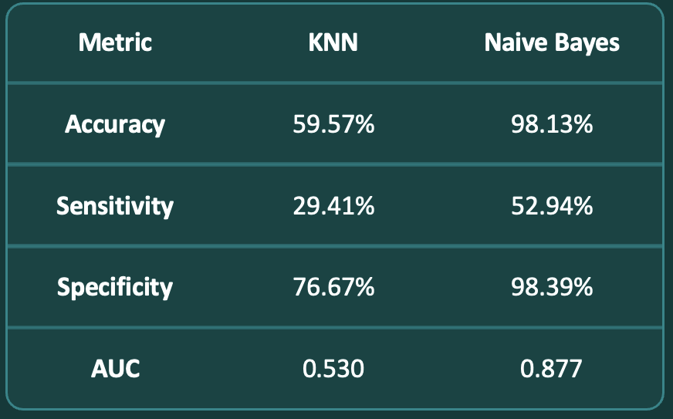
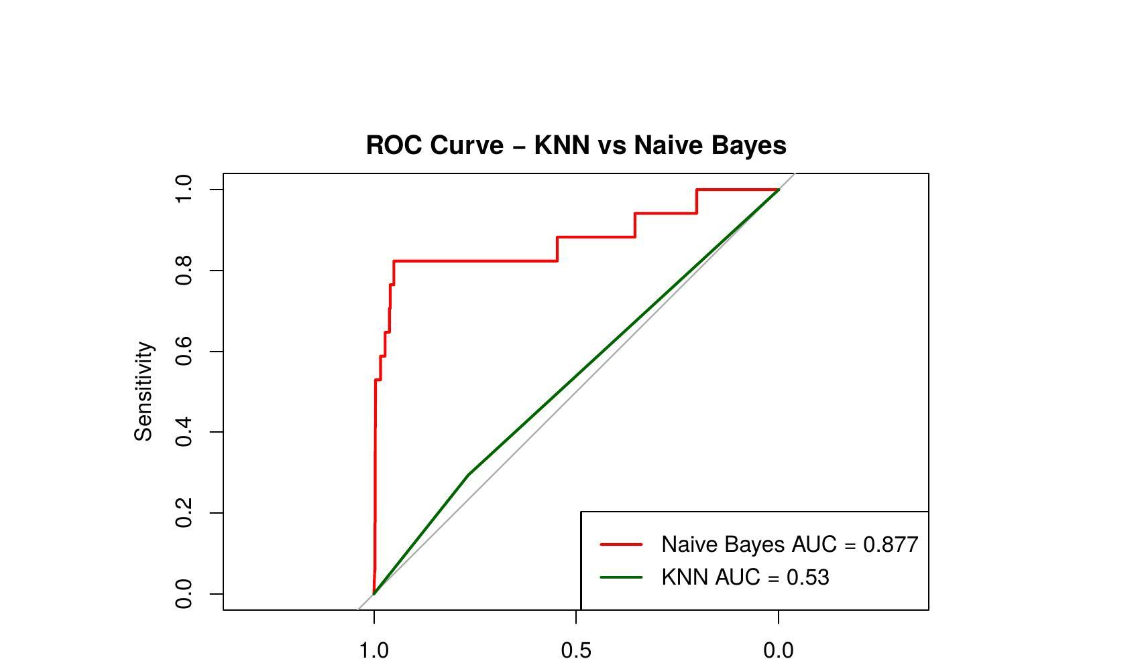
Class Imbalance
Only 0.59% fraud — KNN failed on imbalanced data and needed undersampling.
RESULTS & FINDINGS
Naive Bayes Wins
Naive Bayes detected 9 out of 17 fraud cases versus KNN's 5 — 80% better fraud detection rate.
Amount = Key Predictor
Transaction amount had highest fraud correlation (0.308).
Naive Bayes is recommended as the superior model for real-world credit card fraud detection.

Slide 5
THANK YOU
.

