Slide 1


Department of Computer Science and Engineering
24GEP31 - MINI PROJECT // REVIEW–1
Annam – Smart Food Distribution and Food Waste Reduction System
SDG 2 - Zero Hunger | SDG 12 - Responsible Consumption & Production | SDG 13 - Climate Action
Team Members Details:
25CSR138 - KIRUTHIKA S
25CSR160 - MANASA J
25CSR179 - MOHD AKRAM KHAN T
KEERTHIRAM G R
Mentor Details:
MS.N.KEERTHINI

Slide 2
Problem Definition & Scope
Commercial food providers (restaurants, hotels, college canteens, banquets) produce large volumes of pristine, unserved surplus food that is routinely dumped into municipal landfills, causing severe methane emissions.
Concurrently, local destitute shelters, orphanages, and care homes face acute daily meal shortages, relying on uncoordinated manual donations.
Traditional food redistribution is fragmented: without dynamic routing and strict perishability tracking, food spoils before reaching beneficiaries, and delivery vehicles are either overloaded or underutilized.
Commercial Kitchens
& Banquets
Food Surplus
+ Perishability Window
Unoptimized
Manual Dispatch
Delayed Delivery
& Food Spoilage
Annam Smart Food
Distribution System
PROJECT SCOPE
15 Erode
Sectors
3 Fleet
Vehicles
17+ Donors
& Shelters
3 Constraints
(FEFO, Capacity, ETA)

Slide 3
Objectives & Expected Outcomes
OBJECTIVES
EXPECTED OUTCOMES
1. Prioritize surplus batches via First Expired, First Out (FEFO) based on use-by deadlines.
2. Represent the urban transport network as a Directed Weighted Graph with real road metrics.
3. Compute least-time delivery paths using Dijkstra's algorithm factoring vehicle speed multipliers.
4. Enforce automated multi-constraint feasibility checks (portions, vehicle payload, freshness window).
1. Rapid, zero-waste food allocation to verified shelters within safety freshness windows.
2. Dynamic routing avoiding traffic delays, minimizing travel times and transport CO2 footprint.
3. Live GPS telemetry with turn-by-turn navigation for drivers and accurate ETA for shelters.
4. 100% auditable closed-loop delivery handover confirming meal receipt at beneficiary docks.
PROCESSING FLOW
Surplus Food
Donation
Admin Safety
Verification
Portion Request
& PriorityQueue
Feasibility
Check Engine
Dijkstra's
Algorithm
Optimal Route
& Fleet Dispatch
GPS Tracking &
Handover

Slide 4
Technical Approach & Feasibility
JAVA — OOP CONCEPTS
DATA STRUCTURES
Classes & Objects
Encapsulation
Inheritance
Directed Weighted Graph
PriorityQueue (FEFO)
ArrayDeque (FIFO Events)
Polymorphism
Abstraction
Composition
HashMap (O(1) Lookups)
Min-Heap (Dijkstra)
Algorithm
Dijkstra's Shortest Path
Purpose
Calculate least-time delivery routes across Erode sectors within the food freshness window.
Feasibility
Dual Mode: Standalone Java console application (com.annam.Main) + Full-stack Web GIS (Express + Leaflet).
IMPLEMENTATION FLOW
Java Core
OOP
Concepts
Data
Structures
FEFO & Stock
Allocation
Dijkstra's
Algorithm
Optimal Route
Calculation
Driver Telemetry
& Output
Hybrid architecture: Pure Java DSA console application benchmarking Dijkstra/FEFO, complemented by Express.js REST API & real Leaflet Erode map.

Slide 5
System Architecture & Complete Workflow
COMPLETE WORKFLOW
ARCHITECTURE FLOW
1. Donor lists surplus batch (portions, use-by time, pickup location). Status: Pending.
2. Super Admin verifies food safety and approves batch into active recipient catalog.
3. Recipient Shelter requests portions; previews Dijkstra distance and transit time.
4. Super Admin runs Feasibility Check (demanded <= avail, capacity >= portions, travel <= use-by).
5. Allocation is locked; system assigns optimal fleet vehicle and triggers 1-click dispatch.
6. Driver navigates along Dijkstra coordinates, completes handover, and logs delivery.
Food Logistics Command
Input Entities
Donors • Shelters • Fleet Vehicles • 15 Erode Sectors
Allocation & Feasibility Engine
PriorityQueue (FEFO) + ArrayDeque (Requests) + HashMap
Route Planner
Dijkstra's Algorithm + Min-Heap (graphData.js)
Optimal Route & GPS Telemetry ➔ Live Driver Handover

Slide 6
Java OOP Class Diagram & Data Structures
UML CLASS STRUCTURE
DATA STRUCTURE ROLE
DeliveryVehicle
vehicleId, name, plateNumber,
capacityPortions, speedMultiplier
assignMission(), updatePosition()
BookingRequest
requestId, donationId, recipientId,
portionsRequested, status
validate(), compareTo()
Directed Weighted Graph
15 Erode sectors & travel times
FoodBatch
batchId, donorId, foodName,
portions, useByDateTime, status
isExpired(), deductPortions()
AllocationService
foodBatches, requests, vehicles,
policy, evaluateFeasibility(),
allocateBooking(), processFEFO()
PriorityQueue
FEFO food batches by use-by deadline
ArrayDeque
Booking requests queue (FIFO)
RoutingService
roadNetwork, findShortestRoute(),
dijkstra(), calculateTravelTime()
DijkstraResult
path, totalDistanceKm,
travelMinutes, fullCoordinates
HashMap
O(1) Vehicle, donor & location lookup
UserAccount «abstract»
id, name, email, role
authenticate()
Donor
extends UserAccount
fssaiLicense, locationId
Recipient
extends UserAccount
capacity, verified
Dijkstra + Min-Heap
Least-time shortest route calculation
Donor and Recipient inherit from abstract UserAccount.
AllocationService manages FEFO priority queue and vehicle fleet allocation.
RoutingService executes Dijkstra algorithm on the 15-node RoadNetworkGraph.
DeliveryVehicle state transitions from Available ➔ In-Transit ➔ Delivered.

Slide 7
Project Planning & Timeline
Our development roadmap spans from Review-1 (Core Foundation & DSA) to Review-3 (Full-Scale Testing & Deployment):
• Review-1 (Completed Foundation): Problem definition, stakeholder workflow mapping, directed weighted graph modeling (15 Erode sectors, 24 edges), core Java OOP architecture, and Dijkstra shortest path algorithm.
• Review-2 (Current Milestone): Multi-constraint feasibility engine (FEFO, vehicle capacity, use-by deadlines), interactive 4-door web portal, real Leaflet road map integration, and one-click fleet dispatch.
• Review-3 (Planned Final): Dynamic traffic delay simulation, multi-stop delivery route optimization, environmental impact metrics (CO2 savings & food rescued analytics), and end-to-end stress testing.

Slide 8
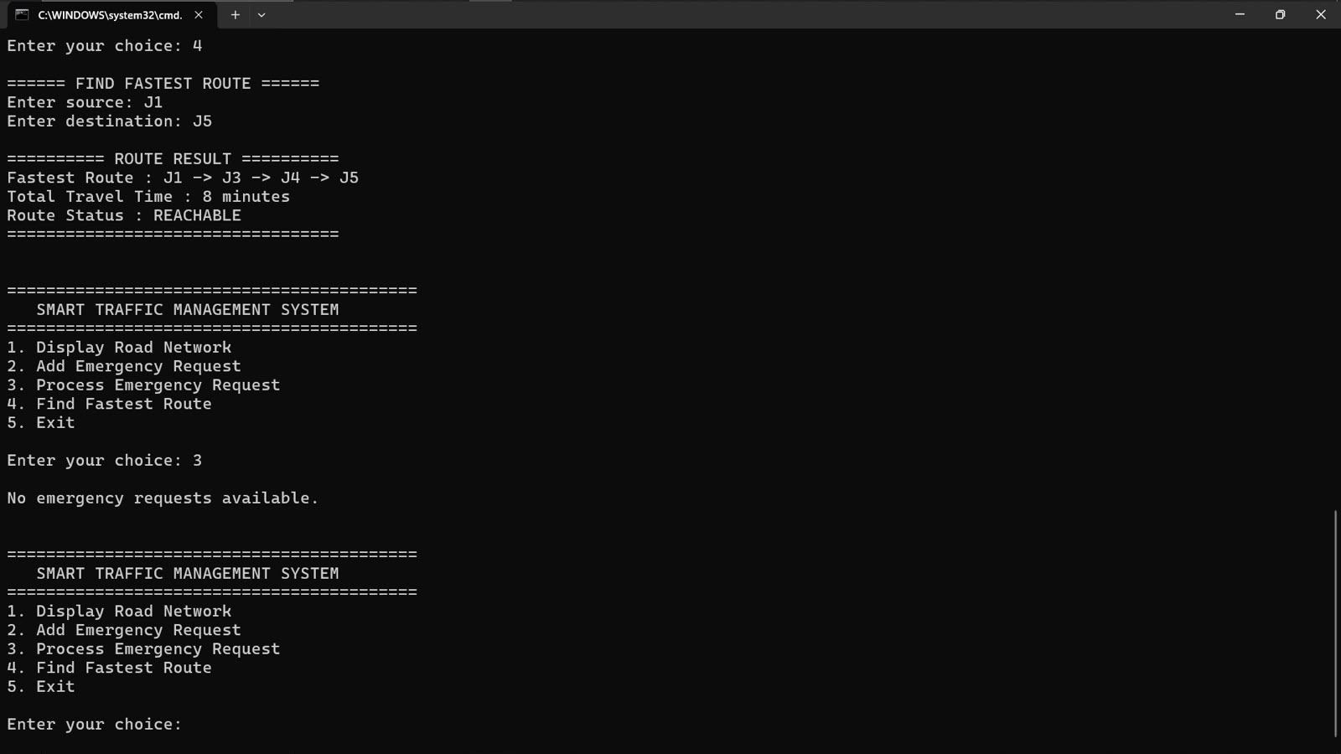
Implementation Status & Unique Features
COMPLETED FOUNDATION
• Core Java OOP architecture & data structures
• 15-node directed weighted road network (Erode)
• Dijkstra shortest path algorithm implementation
• Multi-constraint feasibility evaluation engine
• Full-stack 4-door web platform with Leaflet GIS
PLANNED ENHANCEMENTS
• Dynamic traffic delay simulation (road closures)
• Multi-stop TSP batch routing for multi-donor pickups
• Automated temperature-sensor telemetry integration
• Push notification service for drivers and shelters
OUR UNIQUE FEATURE — Perishability-Aware Dynamic Routing & Safety Enforcement
Surplus Food
Donation
FEFO Freshness
Evaluation
Dijkstra Route
Computed
Vehicle Speed
Factor Applied
Freshness Check
(Travel <= Shelf-Life)
Safe Delivery
Handover
Concept: Unlike standard logistics where only distance is considered, Annam validates whether the Dijkstra travel time fits strictly within the food's remaining freshness window (Travel Time + Buffer <= Shelf-Life). If the deadline cannot be met, the allocation is safely blocked.
Additional Proposed Enhancement: Dual Execution Architecture — Pure Java Data Structures CLI for academic benchmarking + Web GIS interface with real Leaflet tiles for field usability.

Slide 9
THANK YOU
Questions & Feedback Welcome
Annam - Smart Food Distribution System

