Slide 1
FUNCTION HALL BOOKING SYSTEM
by
Keerthi N-51897497

Slide 2
Introduction
Objective
Technologies used
Outlay of project
Functionalities
features

Slide 3
Introduction
The “Function Hall Booking System” has been developed to overide the problems of existing system.
This system is designed for the paritcular need to carry out operations in smooth and effective manner.
The purpose of “Function Hall Booking System” is to automate the existing system by the help of computerized equipments and full-pledged computer software.

Slide 4
objective
The main objective of Function Hall Booking System is to manage the details of booking,customer,adding halls. It manages all the information about booking .
The purpose of the project is to build an application program to reduce the manual work for managing the booking,customer.It tracks all the details about the customer,halls.

Slide 5
Java
Html
Css
Javascript
MySQL

Slide 6
Project outlay
admin
roles
user

Slide 7
Add hall
admin
Customers list
Log out
Bookings list

Slide 8
register
login
booking
customer
logout
payment

Slide 9
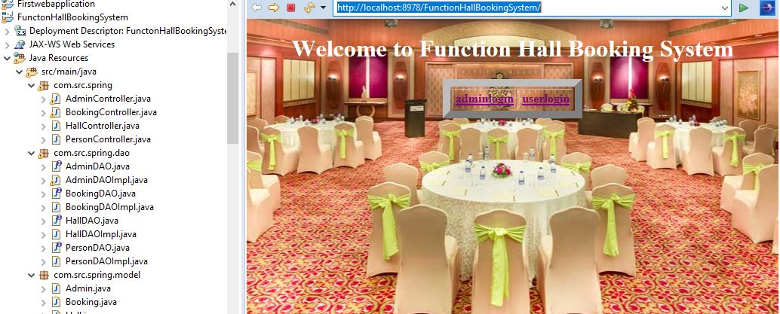
functionalities

Slide 10
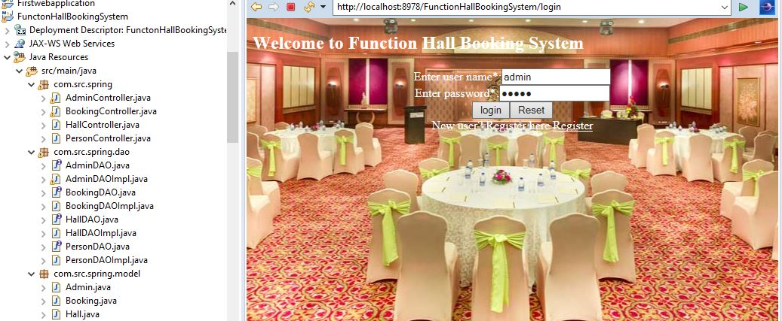

Slide 11
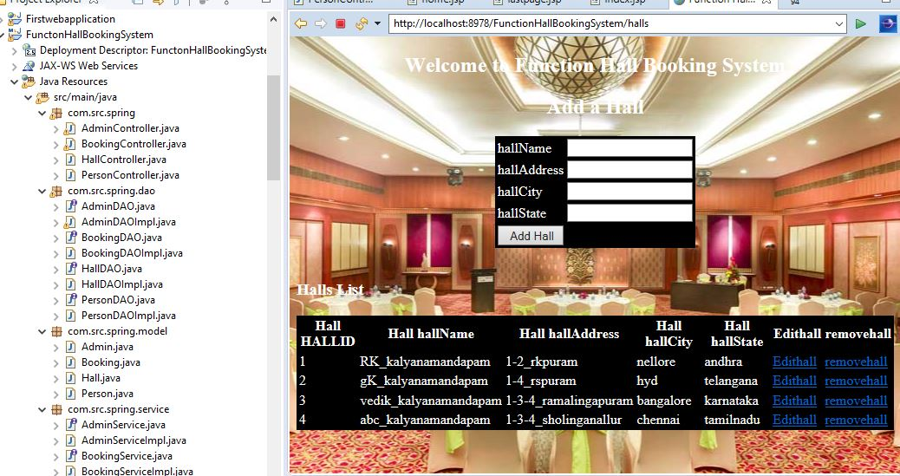

Slide 12
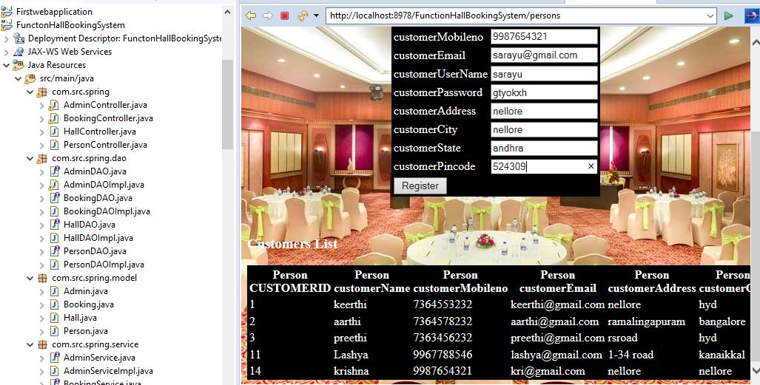

Slide 13
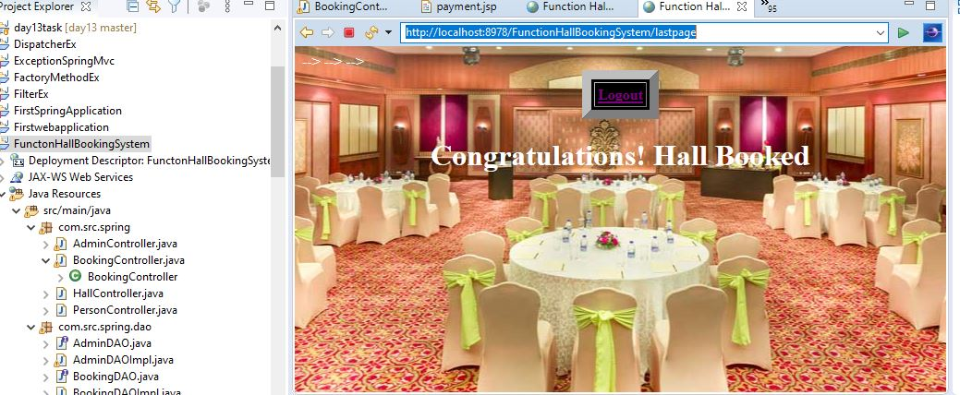

Slide 14
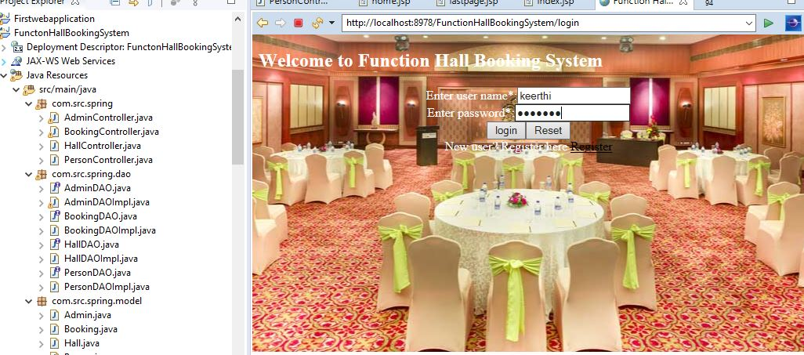

Slide 15
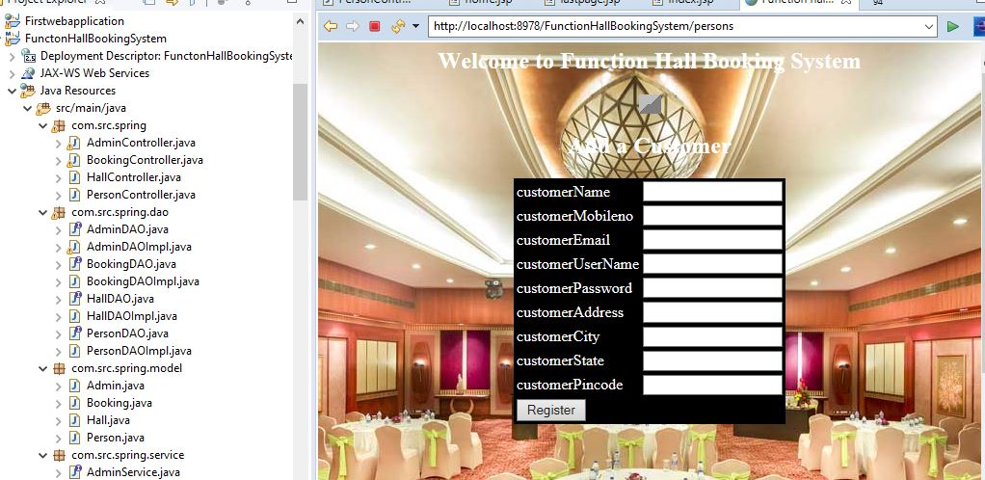

Slide 16
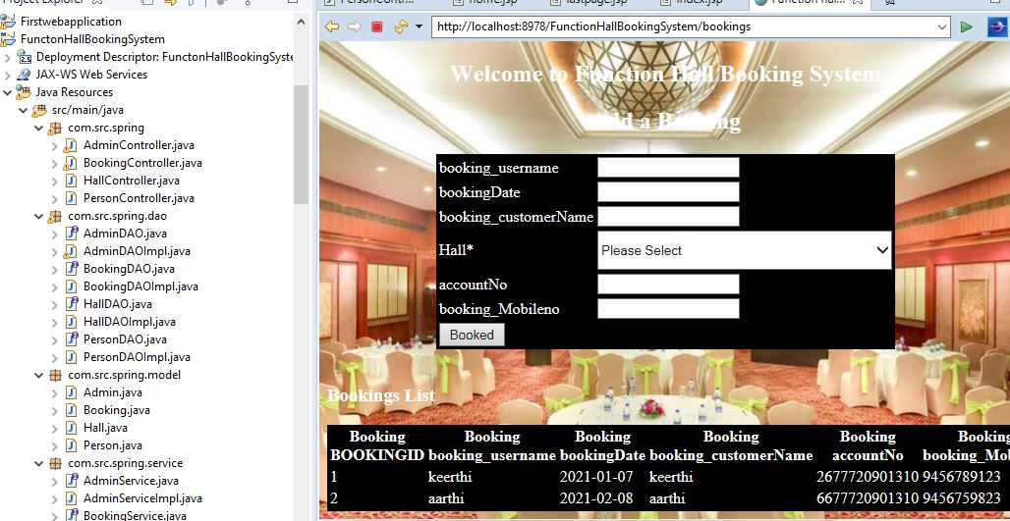

Slide 17
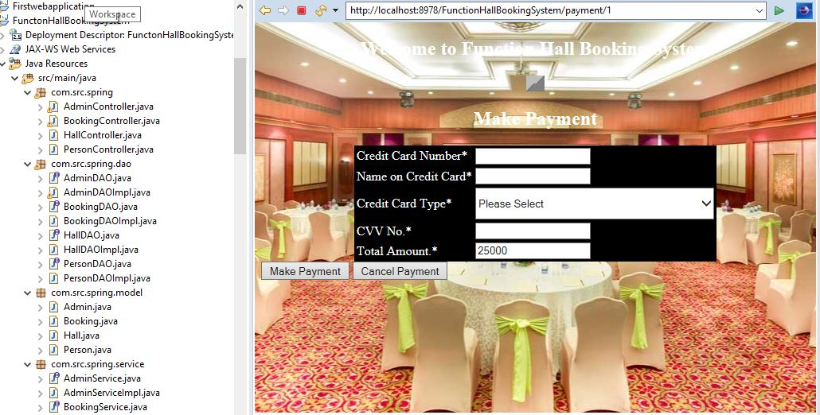

Slide 19
features
Robust database backend.
Creating and changing issues at ease
Accuracy in work
Decrease the load of the person involve in existing manual system
Work becomes very speedy
Easy to update information
Easy and fast retrieval of information

Slide 20


