Slide 1


MAJOR PROJECT PHASE II
REVIEW – 1 PRESENTATION
Explainable AI-Based Clinical Decision Support for Preliminary Dermatological Disease Diagnosis
Keerthana H R : 1VE23CS077
Keerthi Reedy M V : 1VE23CS079
Neha S D : 1VE23CS115
Prakruthi C R : 1VE23CS124
Guide : Rajesh.s
Department of Computer Science & Engineering
ACY_2026–27

Slide 2
Problem Genesis and Relevance to Advances in Technology
Problem Genesis
Relevance to advances in technology
Dermatological diseases are widespread and early diagnosis is important for timely treatment.
Conventional diagnosis primarily depends on visual examination and dermatologist expertise.
Access to dermatologists is limited in rural and underserved regions.
Different skin diseases may exhibit similar visual characteristics, making preliminary identification difficult.
Manual examination of large numbers of dermatological images is time-consuming.
AI and deep learning can automate image-based analysis, but high classification accuracy alone does not guarantee clinical usefulness.
Deep learning enables automated analysis of dermatological images.
Transfer learning supports effective classification using pretrained models.
Explainable AI improves interpretation of model predictions.
Confidence estimation provides additional information with classification results.
Web-based deployment can improve accessibility of preliminary assessment.

Slide 3
Literature Synthesis
Reference | Approach | Main Focus | Limitation / Gap
[1] | Deep Learning | Skin disease diagnosis across skin tones | Variation across skin-tone groups
[2] | AI Point-of-Care | Real-time clinical support | Clinical deployment challenges
[3] | Feature Fusion + XAI | Classification and interpretability | Integration complexity
[4] | Transformer + XAI | Classification and explainability | Computational requirements
[5] | CNN + Grad-CAM | Explainable skin disease detection | Limited integrated decision support
[6] | EfficientNet + Attention | Multimodal skin disease classification | Complex architecture
[8] | AI-based CDSS | Melanoma detection in primary care | Further clinical validation needed
[9] | Deep Learning Review | Skin disease recognition | Broad review rather than integrated system

Slide 4
Research Gap & Problem Definition
Research Gap
Many studies focus mainly on classification performance.
Prediction reasoning is often difficult to interpret.
Confidence information is not consistently presented.
Classification and clinical decision support are often treated separately.
Performance across different skin-tone groups requires further evaluation.
Problem Definition
To develop an explainable clinical decision-support system that combines skin-lesion classification, prediction confidence, visual explanations, and web-based access for preliminary dermatological assessment

Slide 5
Project Objectives
Primary Objective:
Preprocess skin-lesion images and classify them using EfficientNet-B0.
To develop an explainable AI-based clinical decision support prototype for preliminary classification of dermatological skin lesions.
Specific Objectives:
Address class imbalance during model training using class-weighted loss.
Generate prediction scores and assess model performance using standard classification metrics.
Visualize model attention using Grad-CAM.
Integrate image assessment, visual explanations, and research evaluation metrics into a web interface.
Communicate model limitations and emphasize that predictions do not replace professional medical diagnosis.

Slide 6
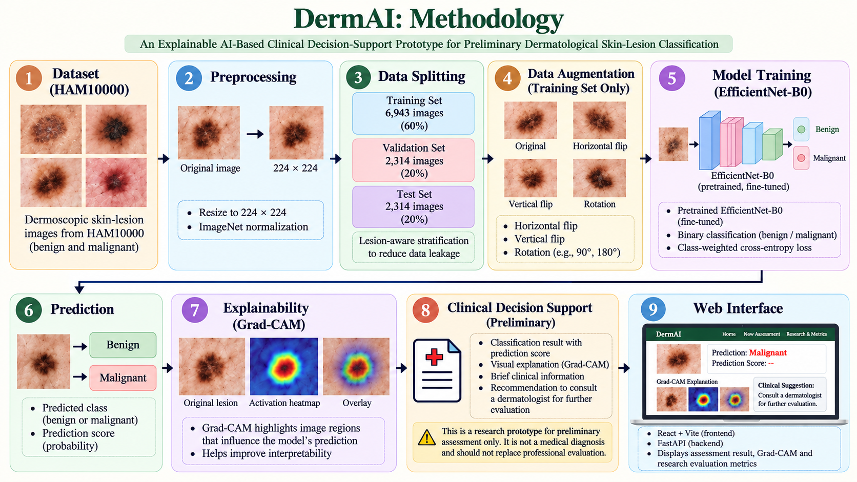
Project Methodology ( System architecture)

Slide 7
Project Methodology (Tools , Algorithms Used)
Technique | Purpose
Transfer Learning | Fine-tuning pretrained EfficientNet-B0 for binary skin-lesion classification.
Lesion-aware Data Splitting | Reducing leakage between training, validation, and test sets.
Image Preprocessing | Resizing images to 224 × 224 and applying ImageNet normalization.
Class-weighted Loss | Addressing class imbalance during training.
Binary Classification | Predicting benign or malignant labels.
Grad-CAM | Highlighting image regions that influence the model's prediction.
REST API Integration | Connecting the trained model to the web interface.
Independent Test Evaluation | Assessing classification performance on the held-out test set.
Tool / Technology | Purpose
Python | Model implementation
PyTorch | Deep learning framework
Google Colab | Model training
EfficientNet-B0 | Skin-lesion classification
Grad-CAM, NumPy | Visual explanation, Data processing
LIME , Web Interface | Local explanation, System deployment

Slide 8
Data & Validation
Test Set Composition
Evaluation Metrics
Class | Number of Images
Benign | 1,883
Malignant | 431
Total | 2,314
Class | Number of Images
Metric | Purpose
Accuracy | Measures overall classification correctness.
Malignant-class Recall (Sensitivity) | Measures the proportion of actual malignant cases correctly identified.
F1-score | Harmonic mean of precision and recall.
Confusion Matrix | Summarizes correct and incorrect predictions by class.
ROC-AUC | Measures the model's ability to distinguish between the two classes across classification thresholds.
Dataset and Data Split
Parameter | Details
Dataset | HAM10000
Total Images | 11,571
Training Set | 6,943 images
Validation Set | 2,314 images
Independent Test Set | 2,314 images
Split Strategy | Lesion-aware stratification

Slide 9
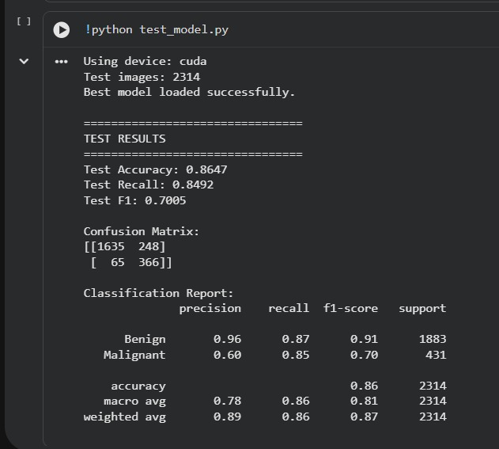
Progress Achieved
Progress Achieved
Dataset filtering and preparation
Lesion-aware train/validation/test splitting
Image preprocessing and augmentation
EfficientNet-B0 implementation and training
Class-weighted training
Model selection using validation F1-score
Independent test evaluation
FastAPI backend and React web interface integration
Grad-CAM visual explanation integration
Research metrics and confusion matrix presentation
Confusion Matrix:
True Negatives (TN): 1,737
False Positives (FP): 146
False Negatives (FN): 123
True Positives (TP): 308

Slide 10
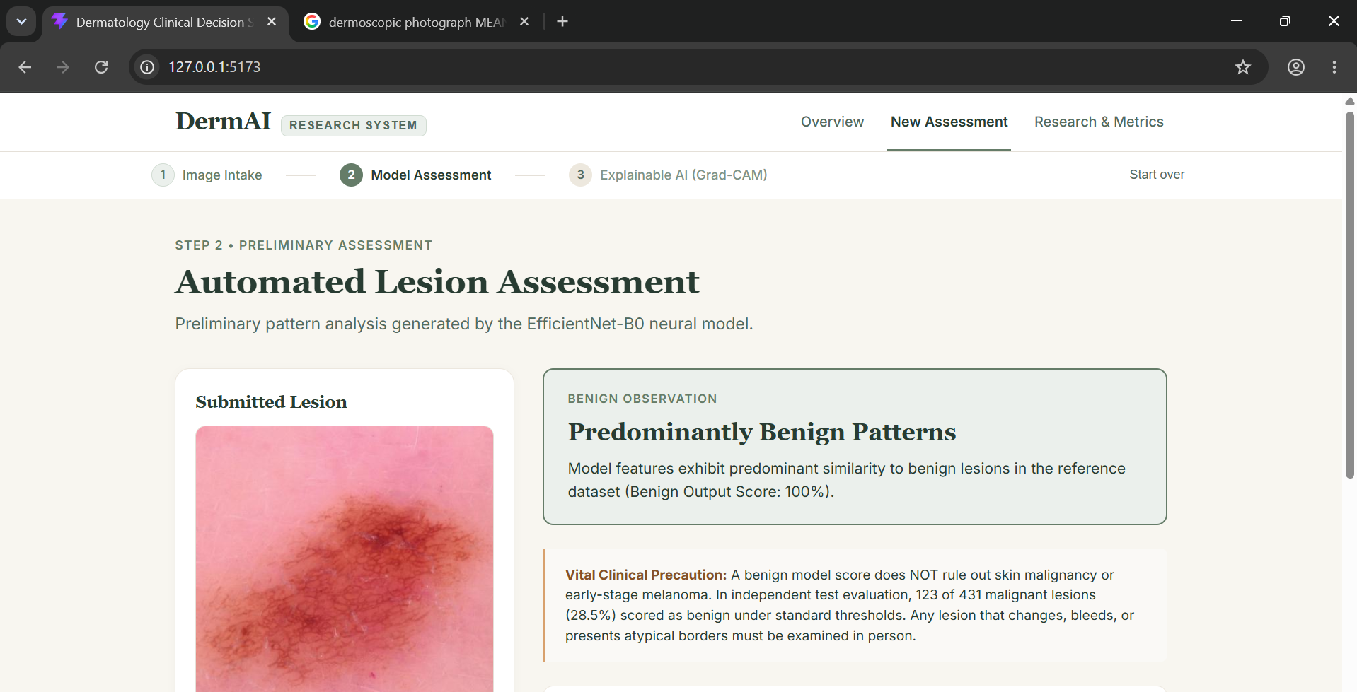
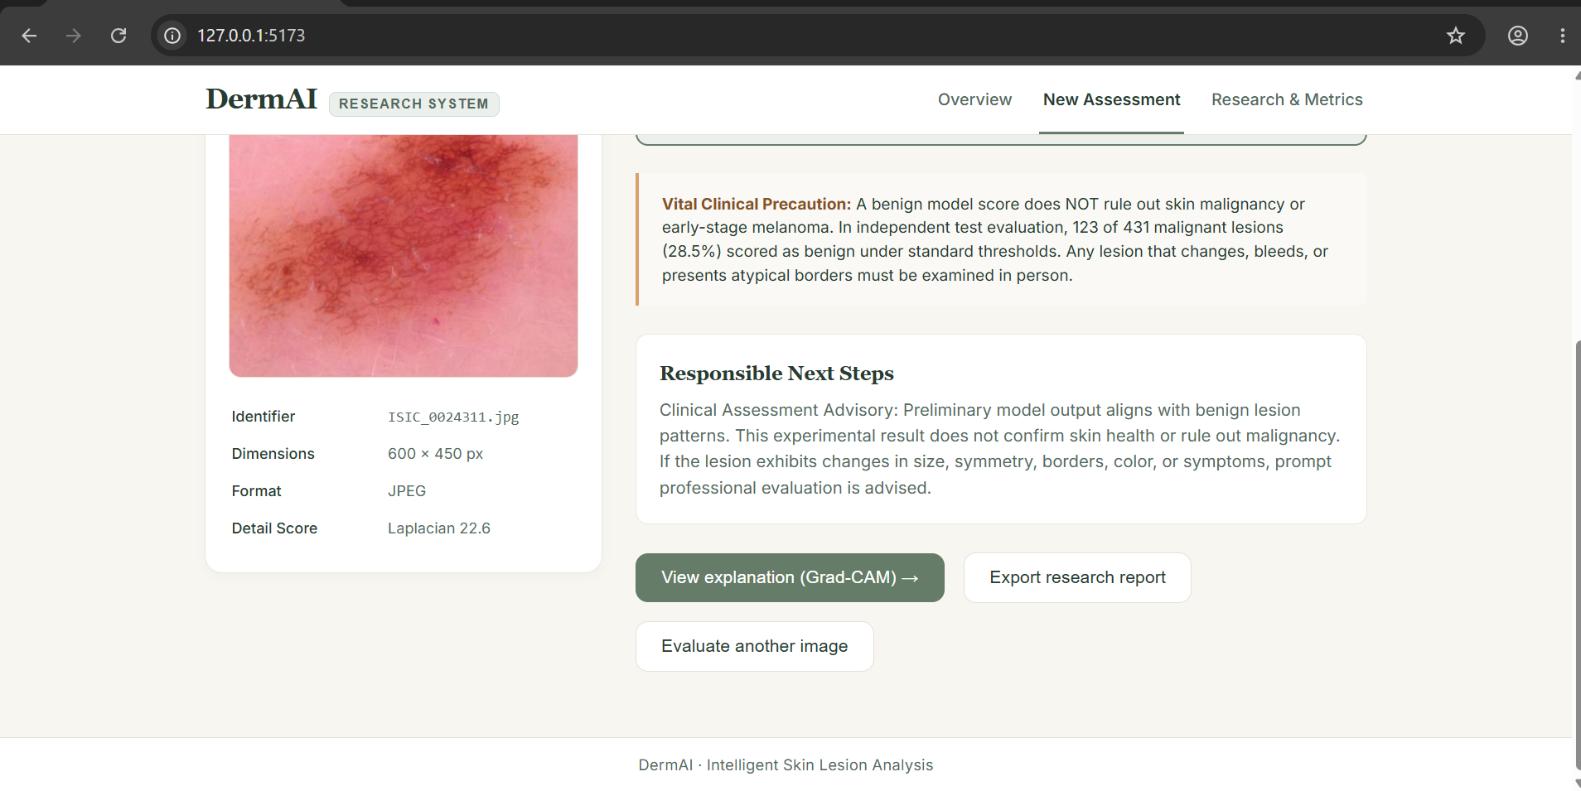
Progress Achieved(Implementation, Initial outputs)
Baseline Test Results — Threshold 0.50
Metric | Result
Accuracy | 88.38%
Malignant Precision | 67.84%
Malignant Recall | 71.46%
Malignant F1-score | 69.60%
Test Images | 2,314
Baseline predictions use a threshold of 0.50. The results are derived from the saved test prediction arrays.

Slide 11
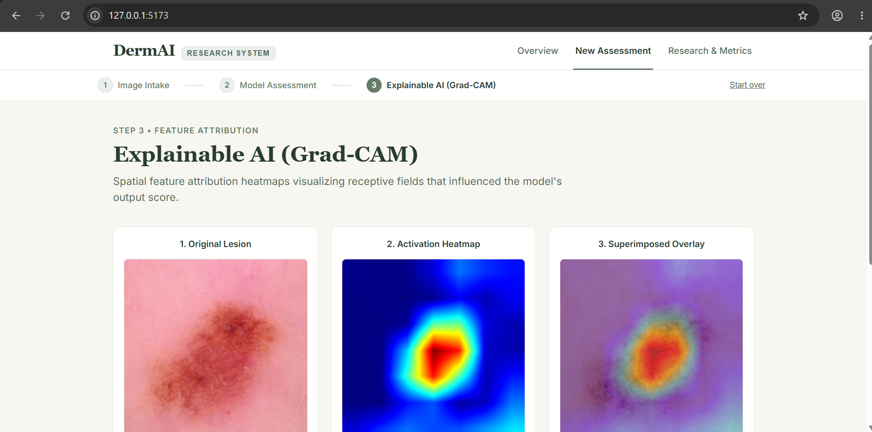
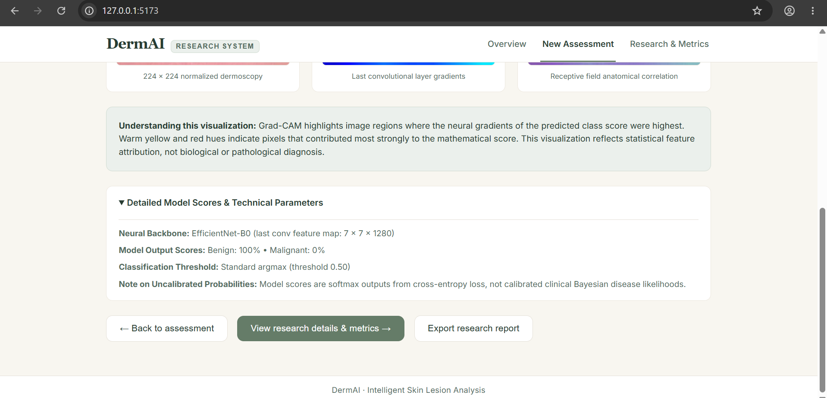
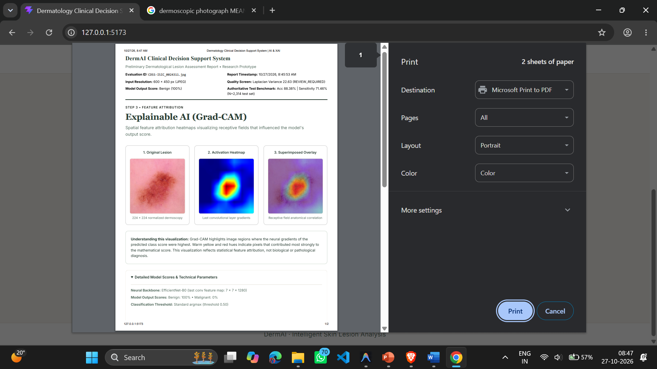
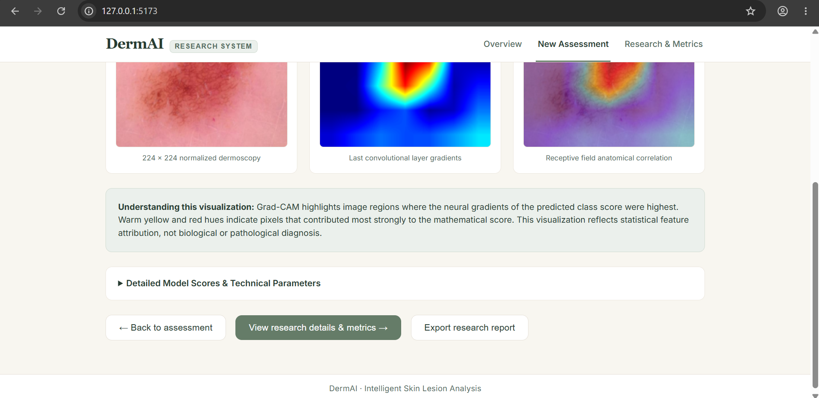
Progress Achieved(Design & Implementation,Initial outputs)

Slide 12
Results and Discussion
Classification Result | Baseline (0.50) | Sensitivity-oriented (≈ 0.31, reported)
True Negatives (TN) | 1,737 | 1,635
False Positives (FP) | 146 | 248
False Negatives (FN) | 123 | 65
True Positives (TP) | 308 | 366
🟢Benign → generally non-cancerous
🔴 Malignant → cancerous skin lesion
Discussion:
The results illustrate the trade-off between overall classification performance and malignant-case sensitivity. The 0.50 baseline provides a reproducible reference point. The lower-threshold results should be interpreted cautiously because the threshold-selection procedure is undocumented. Neither operating point establishes clinical readiness.
This prototype supports research and preliminary assessment only; it is not a substitute for professional diagnosis.
Observations
The 0.50 baseline correctly classified 308 of 431 malignant cases and missed 123.
The reported lower-threshold operating point reduces false negatives to 65 while increasing false positives.
Lowering the threshold prioritizes sensitivity but reduces specificity and precision.
The method used to select the historical lower threshold could not be verified from the available project records.

Slide 13
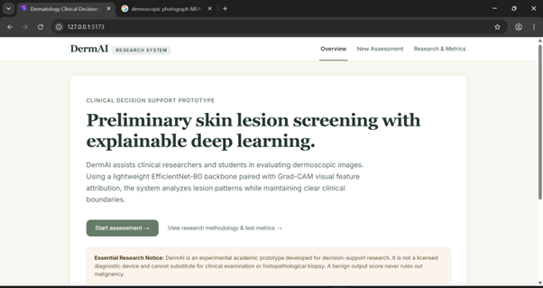
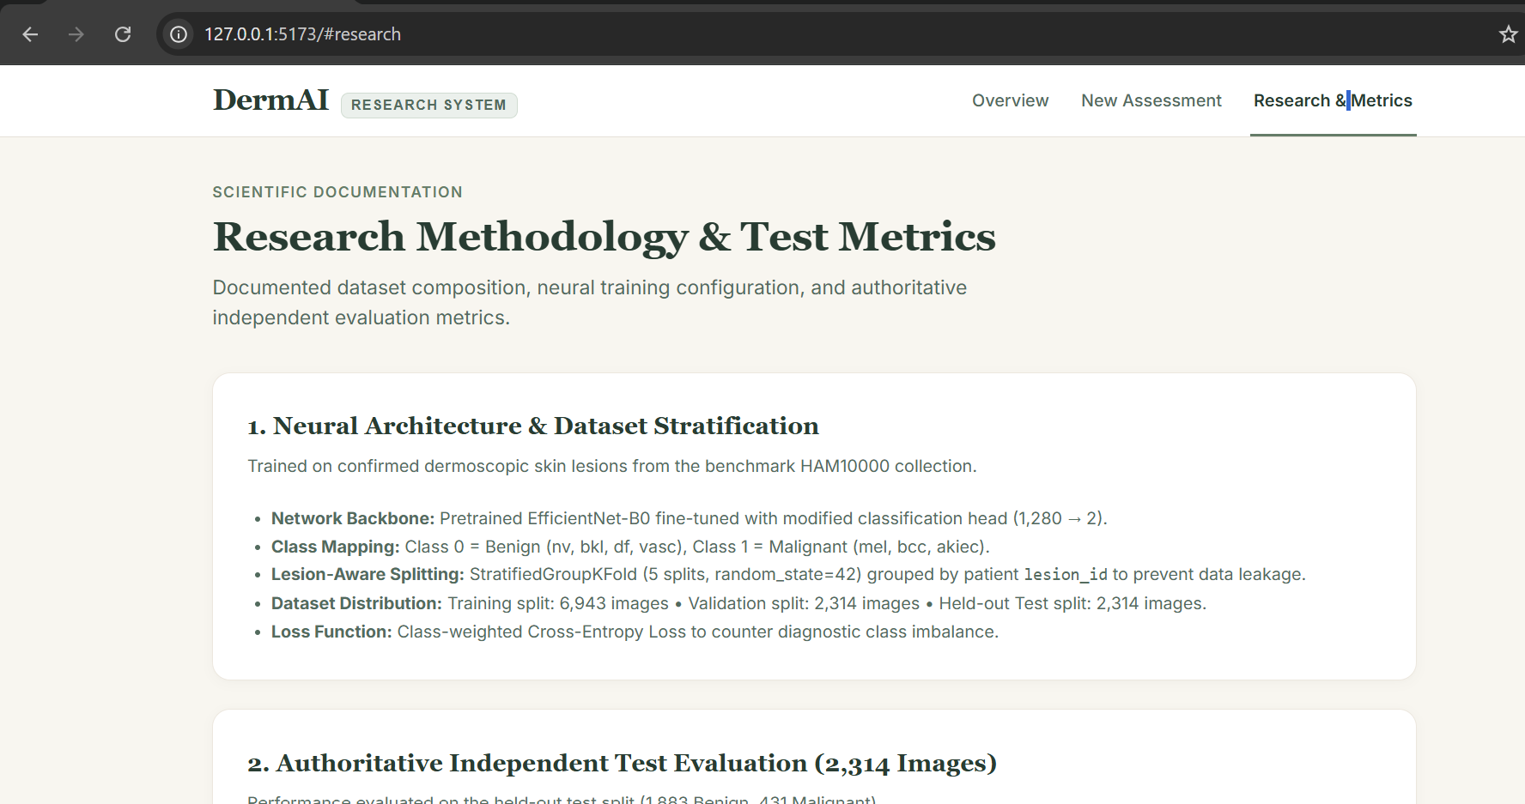
Current Status
CURRENT STATUS
✓ Literature review and dataset preparation
✓ Lesion-aware data splitting and preprocessing
✓ EfficientNet-B0 training and independent testing
✓ Evaluation metrics and confusion matrix
✓ FastAPI model-serving integration
✓ React-based multi-page web interface
✓ Grad-CAM visualization and explanation view
✓ Research metrics and limitation disclosure

Slide 14
Future Work & Conclusion
FUTURE WORK
Verify threshold selection using a separate validation set.
Evaluate generalization across skin tones and external datasets.
Improve sensitivity while monitoring false-positive rates.
Conduct further testing and clinical validation before any real-world use.
Conclusion:
The project demonstrates an integrated AI-based prototype for preliminary skin-lesion classification using EfficientNet-B0, with Grad-CAM explanations and a web-based interface. The reproducible 0.50 baseline achieved 88.38% accuracy and 71.46% malignant recall on the 2,314-image test set. The 123 false negatives highlight the need for further evaluation and improvement. The historical sensitivity-oriented operating point requires documented threshold-selection provenance before being treated as a definitive result.

Slide 15
References
[1] Deep learning-aided decision support for diagnosis of skin disease across skin tones
[2] A Point-of-Care, Real-Time Artificial Intelligence System to Support Clinician Diagnosis of a Wide Range of Skin Diseases
[3] Feature Fusion and Explainable Deep Learning Framework for Intelligent Skin Disease Classification Using Clinical Dermatology Images
[4] Enhancing Skin Disease Classification Leveraging Transformer-based Deep Learning Architectures and Explainable AI
[5] Explainable CNN Framework with Grad-CAM Analysis for Real-Time Skin Disease Detection
[6] Attention-guided Multimodal Skin Disease Classification Using Discounted Dempster-Shafer Fusion and EfficientNet
[7] FUSCA Net: Enhancing Skin Disease Classification Through Feature Fusion and Spatial-Channel Attention Mechanisms
[8] Exploring the Feasibility of an Artificial Intelligence Based Clinical Decision Support System for Cutaneous Melanoma Detection in Primary Care – A Mixed Method Study
[9] Skin Disease Recognition Based on Deep Learning Algorithms: A Review
[10] A Machine Learning Model for Skin Disease Classification Using Convolution Neural Network
[11] The HAM10000 Dataset, a Large Collection of Multi-Source Dermatological Images of Common Pigmented Skin Lesion

Slide 16
Q&A
THANK YOU
Questions & Answers

