Slide 1






Job Market Analysis
SDG 8: Decent Work and Economic Growth
Project name: Job market Analysis
Unique ID : IBM2239 Team Name : AI Avengers
College Name : KG Reddy College of Engineering and Technology

Slide 2


Our Team Members
M Keerthi
N Lokesh
M Manish Reddy
S Pramod
P Vishnu
R Vishal

Slide 3
Overview
Title | 1
About the Team Members | 2
Overview | 3
Introduction | 4
Problem Statement & significance of the problem | 5
Purpose of the project
Flow of the Project Data Cleaning , Preprocessing & Visualization | 11
Model training and Analysis | 15
Conclusion | 16
Project Summary 6
7
8

Slide 4

INTRODUCTION
India's job market has transformed dramatically, evolving from an agrarian economy to a tech-driven landscape. Economic liberalization in 1991 spurred growth in the service sector, and the 21st century's tech revolution positioned India as a global IT hub. Despite these advancements, challenges such as skill mismatches and job displacement persist. This project aims to analyse job market trends, identify skill gaps, and propose solutions, aligning with Sustainable Development Goal 8 (SDG 8) to promote inclusive economic growth and decent work for all.

Slide 5

Problem Statement
Significance of The Problem Statement
The job market is influenced by numerous factors such as technological advancements, economic shifts, and educational outcomes. These factors can lead to mismatches between available jobs and the skills of the workforce, resulting in unemployment and underemployment. Despite various efforts to improve employment rates, challenges persist in effectively aligning education and training with market demands. This project seeks to address this issue by analyzing job market data to identify trends, skill gaps, and sectoral demands, and by proposing targeted interventions to improve job market outcomes.
Skills Mismatch: Addresses unemployment due to skill-job mismatch.
Economic Growth: Helps in aligning skills boosts economic and employment growth.

Slide 6
Analyze job market trends using machine learning.
Import and preprocess datasets for analysis.
Project Summary
Utilize visualization tools like Matplotlib and Seaborn.
Employ NumPy and Pandas for data manipulation.
Identify skills and employment gaps in the market

Slide 7


Identify skill gaps
to align education with job market demands.
Enhance training programs
Purpose of The Project
to improve employment prospects and skills.
Support economic growth
by matching workforce skills with employer needs.

Slide 8
Flow Of The Project
Creating a Streamlit based website
Data Cleaning & Preprocessing
Data Visualization
Data Collection

Slide 9
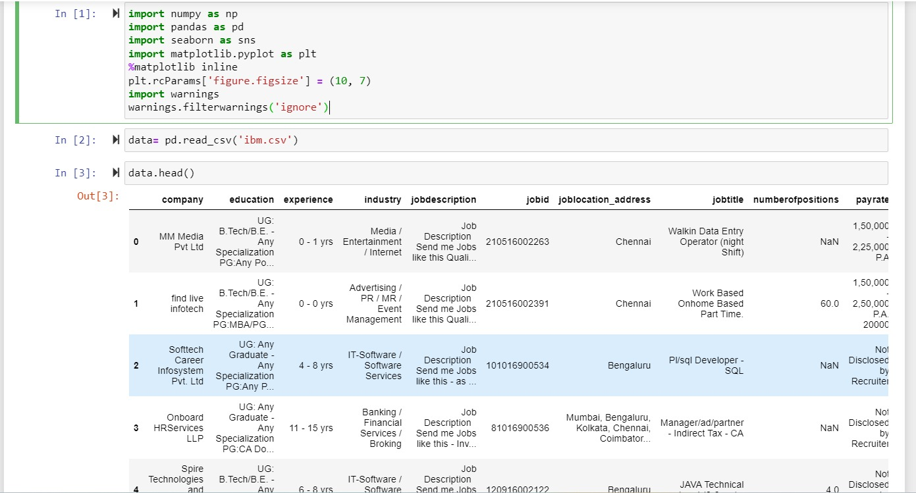
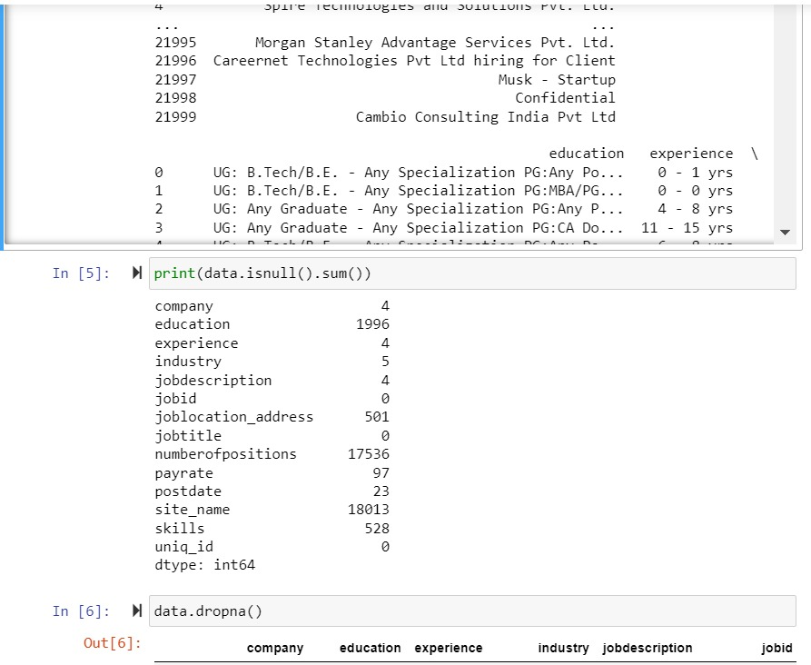
Data Collection
Data Source1: Click Here
Data Source2: Click Here
Data source is obtained from Kaggle which has several attributes which we use for predicting analyzing and visualizing the Job market.
Data Cleaning
After collecting the data cleaning steps like dropping the null values were performed.

Slide 10
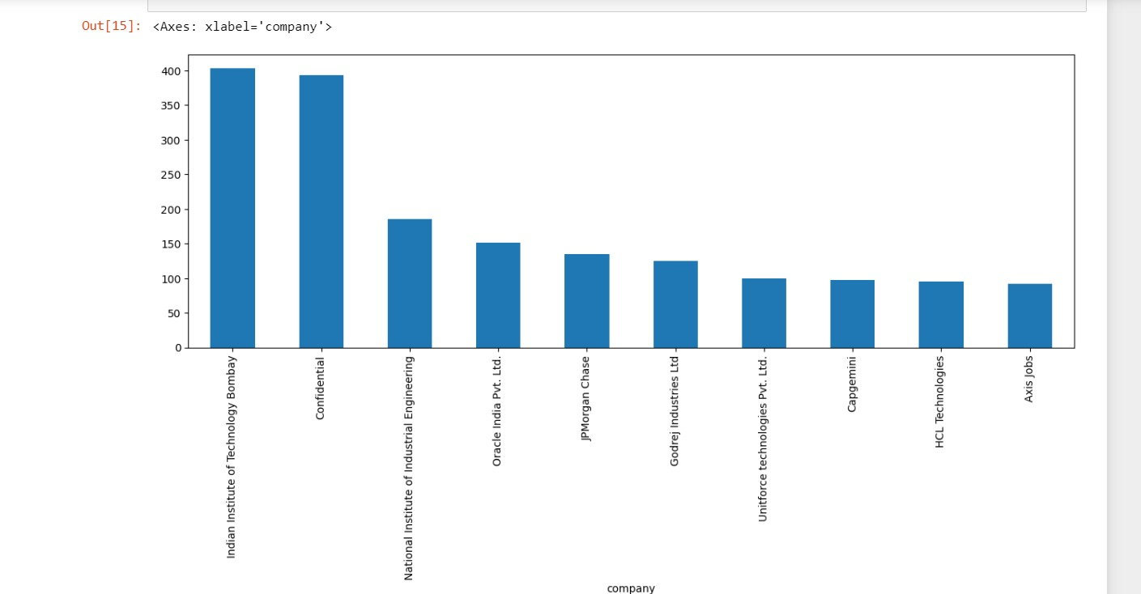

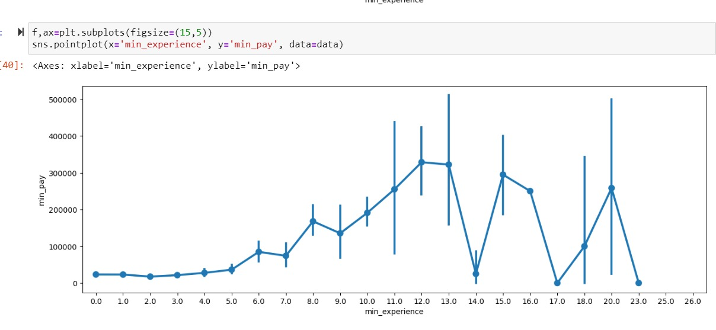
Companies hiring and their counts
Data Visualization
Min Exp VS Min Pay In The Job Market

Slide 11
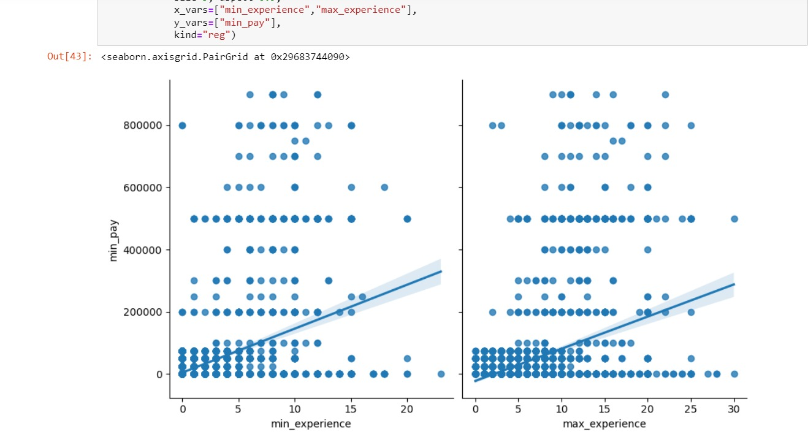
Min Exp & Max Experience VS
Min Pay In The Job Market
Data Visualization
Pair Plot

Slide 12
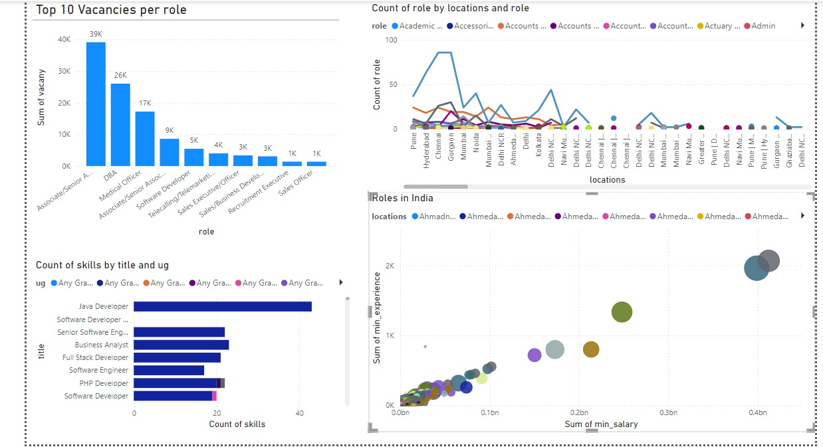
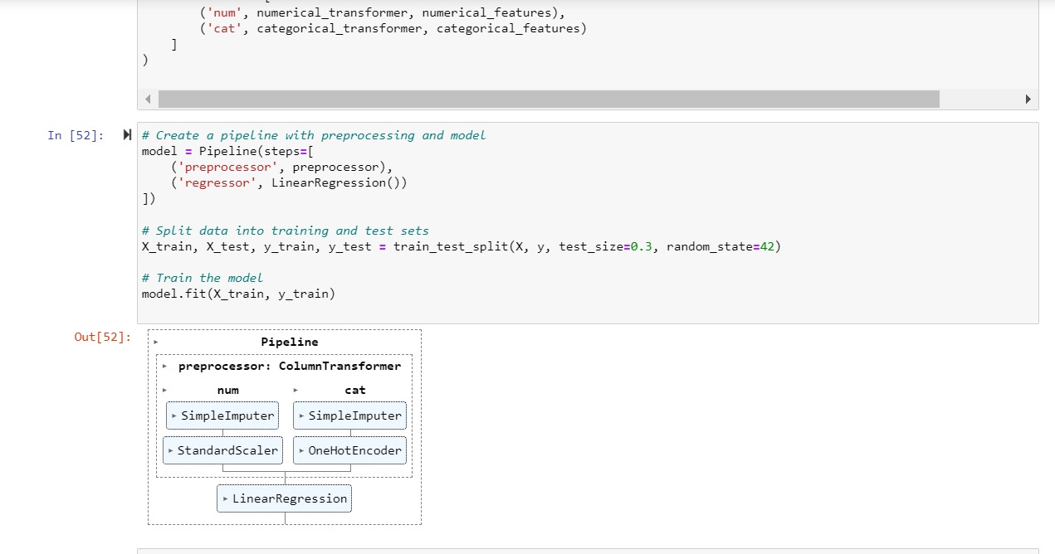
Pipe Line:
PowerBI
Created a linear regression based model to predict the pay rate based on input columns
Created a PowerBI Dashboard in order to better understand the job market data

Slide 13


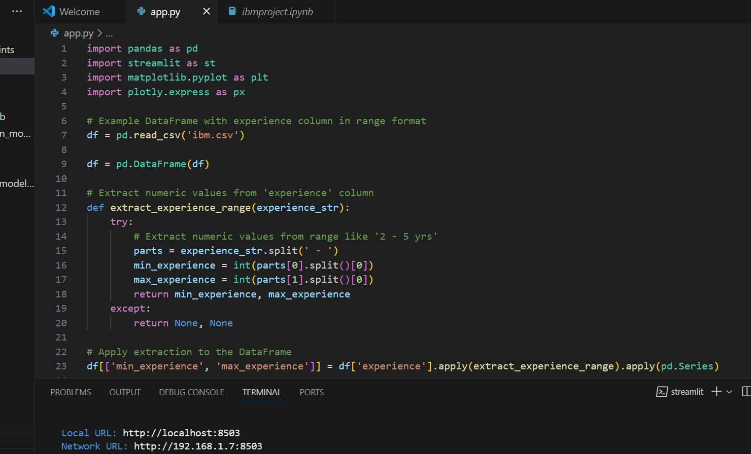
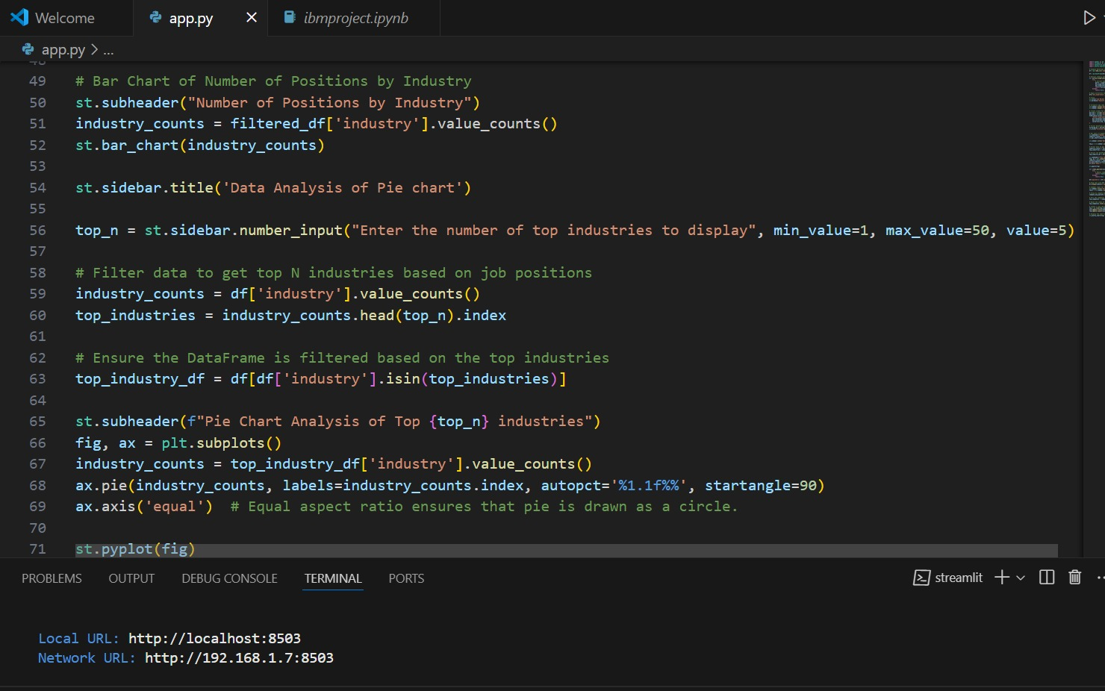
Frontend For The Data Analysis
Sample of the code used for frontend development using streamlit for displaying data analysis

Slide 14
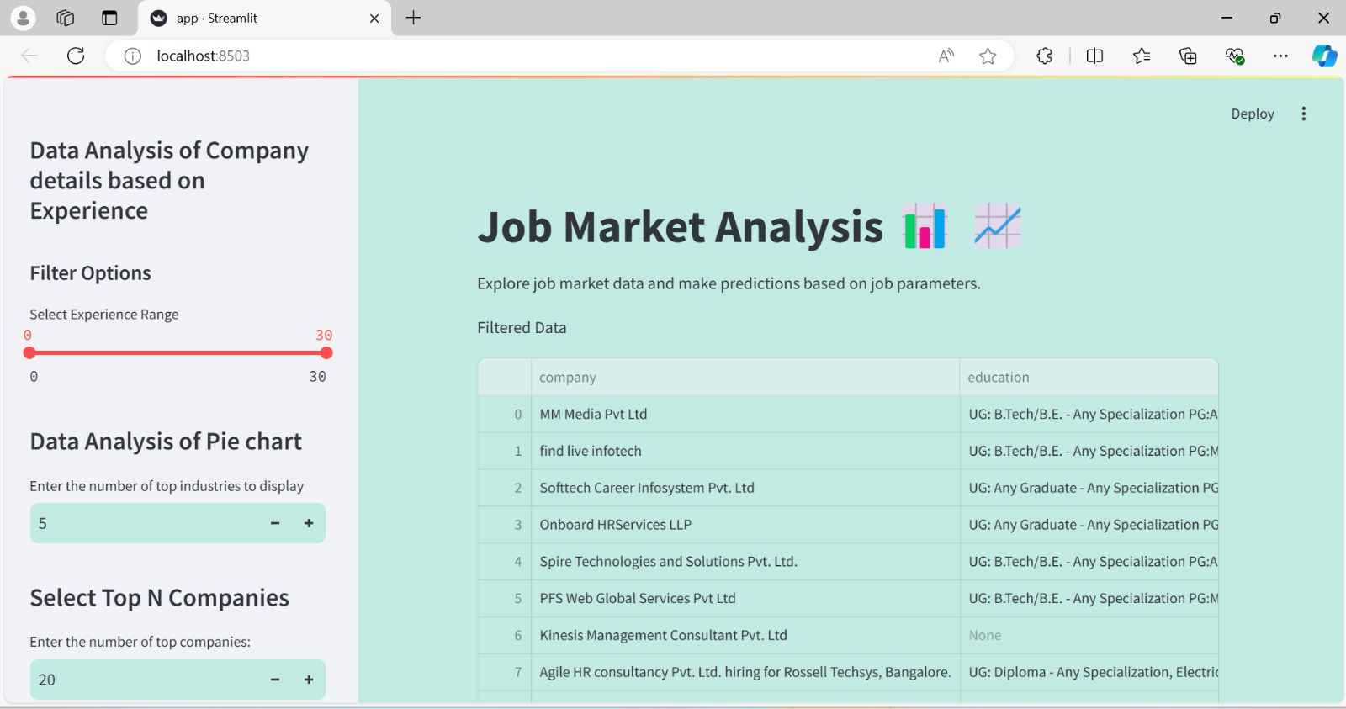

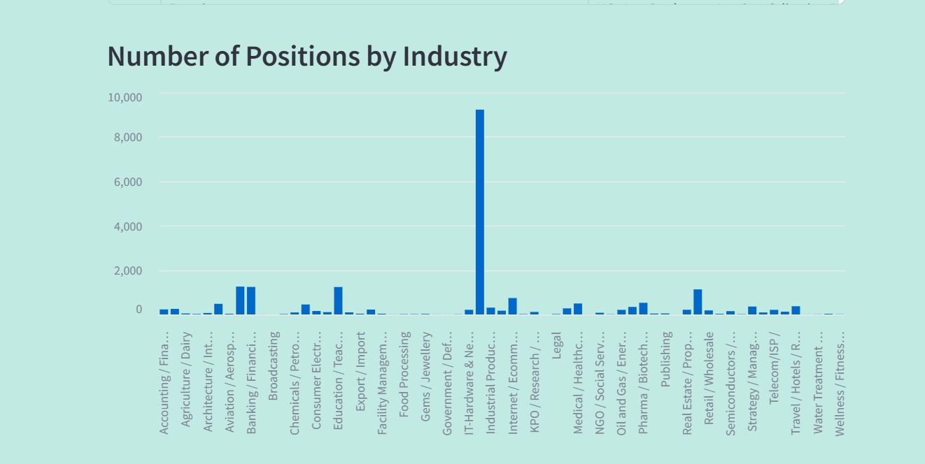

Frontend For The Data Analysis

Slide 15
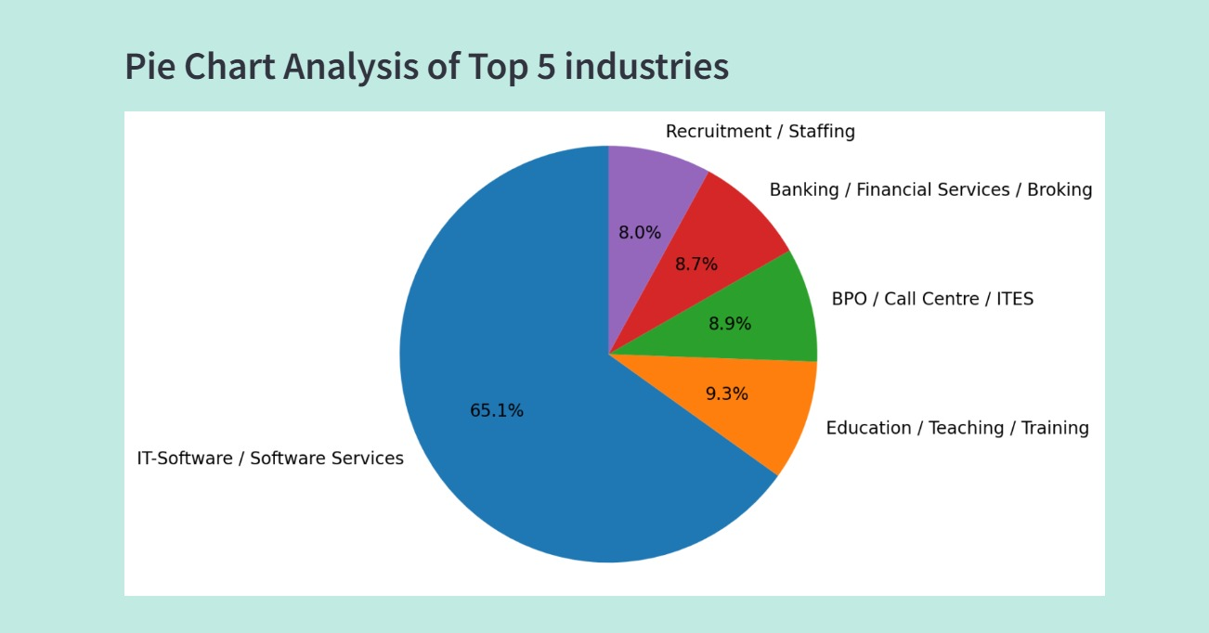
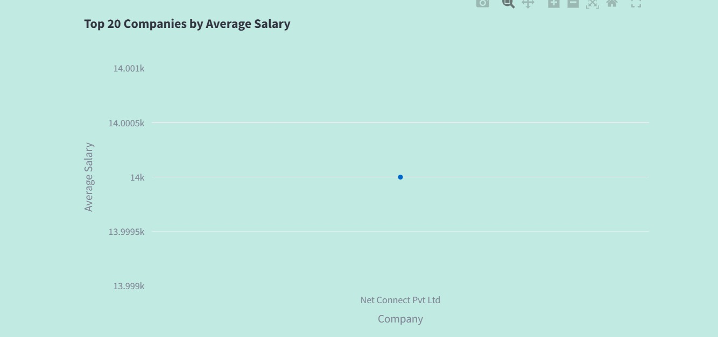
Frontend For The Data Analysis

Slide 16
Conclusion
According to our problem statement Job Market Analysis we have used the dataset obtained from Kaggle to visualize the data based on users input.
For this we have developed a user interface using streamlit which helps in visualizing data through machine learning model which we have trained.
On addition to deriving insights from the interface we have visualized data using PowerBI too.

Slide 17



Thank You

