Slide 1
Project Title
Crafting Compelling Web Presences
M.keerthika sabariraja

Slide 2
WEBSITE NAME
ADI -THE TODDLER HOUSE
https://thetoddlerhouse.in
2

Slide 3
PRODUCT DETAILS
MONTESSORI QUIET BOOK (ONE YEAR +):
Engage your child's curiosity with our Montessori quiet book! Handcrafted from Velcro type, it offers interactive activities to stimulate learning and creativity, perfect for quiet playtime at home or on-the-go."
ALPHABET MAZE (3 TO 4 YEARS) :
Explore the ABCs with our Alphabet Maze Book! Kids navigate through letter-themed mazes for an engaging and educational adventure."
PHONICS ACTIVITY BINDER (5 YEARS):
Enjoy learning with our CVC Word Game! Match letters to form simple words, promoting early literacy skills in a fun way."
3

Slide 4
ONLINE TOOLS:
Builtwith.com-The website is developed in wordpress.com
https://responsivedesignchecker.com/-website responsive
design.
1.Not optimizing white space.
2.Ignoring mobile responsiveness.
Common website design mistakes
Forgetting about seo
No call to action
Slow loading page
Having blurry image
4

Slide 5
BEST PRACTICE FOR CREATING USER FRIENDLY WEBSITE :
Choose simple fonts.
Focus on website speed.
Clear call to action
Imporing website security.
5

Slide 6
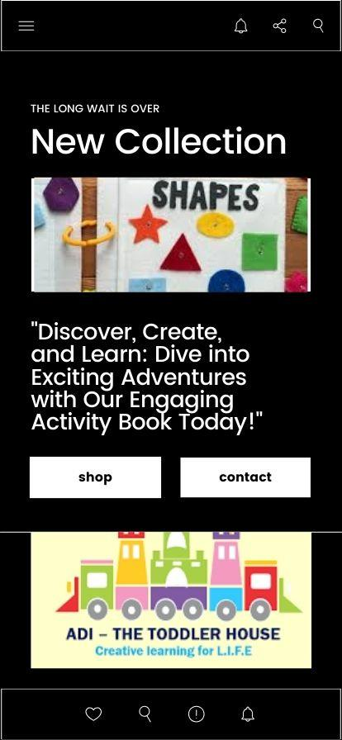
LANDING PAGE:
6

Slide 7
Thank you
for listening!

