Slide 1
Retail Inventory Forecasting System
AI-powered demand forecasting for supply chain decisions
Project presentation

Slide 2
Project Overview
Objective: build a forecasting-driven system to improve retail inventory planning and reduce stock imbalances.
Scope: 5 stores, 30 products, 15 categories, and multivariate demand signals including price, weather, and promotions.
Delivery: end-to-end pipeline with data ingestion, feature engineering, model training, API services, and dashboard outputs.
Outcome: daily demand forecasts that support category-level replenishment and operational decision-making.

Slide 3
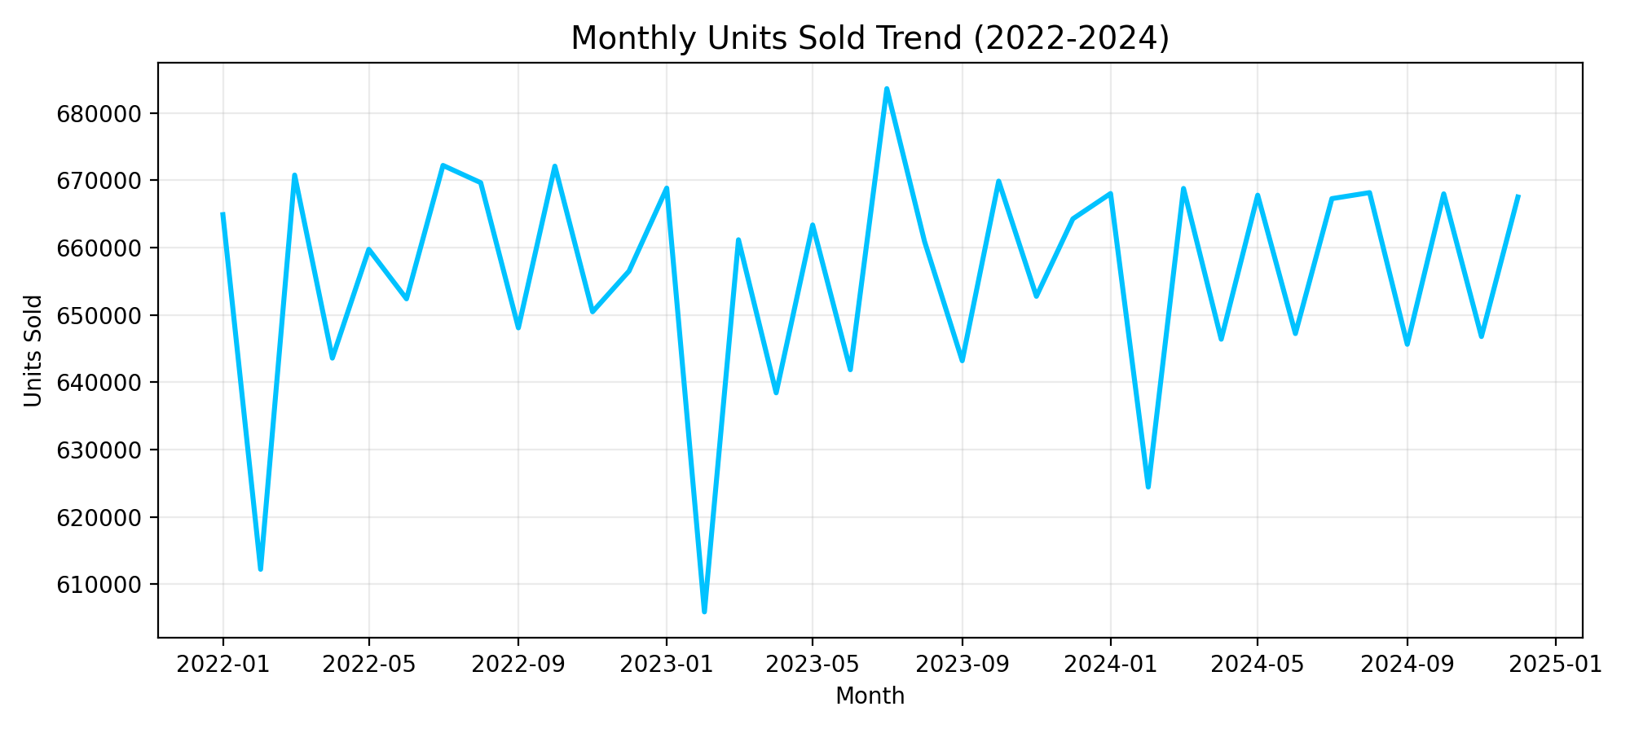
Dataset Profile
Records: 164,400 rows with 15 attributes from 2022-01-01 to 2024-12-31.
Core variables: inventory level, units sold, units ordered, demand forecast, price, discount, seasonality, and promotion flag.
Sales volume: 23,612,231 total units sold, with an average of 21,544 units/day.
Inventory status: mean inventory 447.2; low-stock observations (<80 units) are 25.5% of all records.
Figure: Monthly demand trend used to identify seasonality and long-term movement.

Slide 4
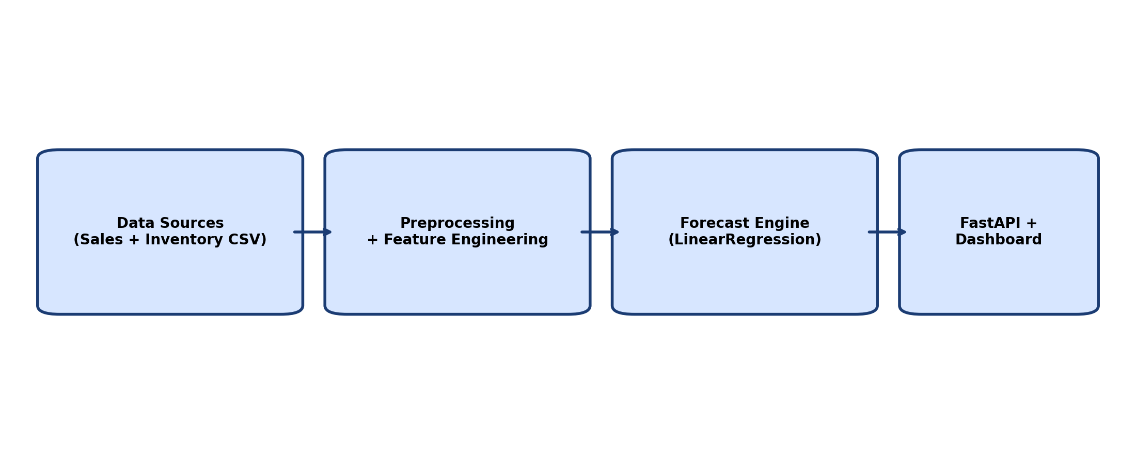
System Architecture
Data layer loads CSV uploads and standardizes columns, dates, and category identifiers.
Feature layer creates lag, rolling, and seasonal calendar signals for each category-level daily series.
Model layer uses LinearRegression to learn demand behavior and generate multi-day forecasts.
Service layer (FastAPI) exposes forecast endpoints and powers a role-based dashboard for business users.
Figure: End-to-end architecture from raw data to dashboard consumption.

Slide 5
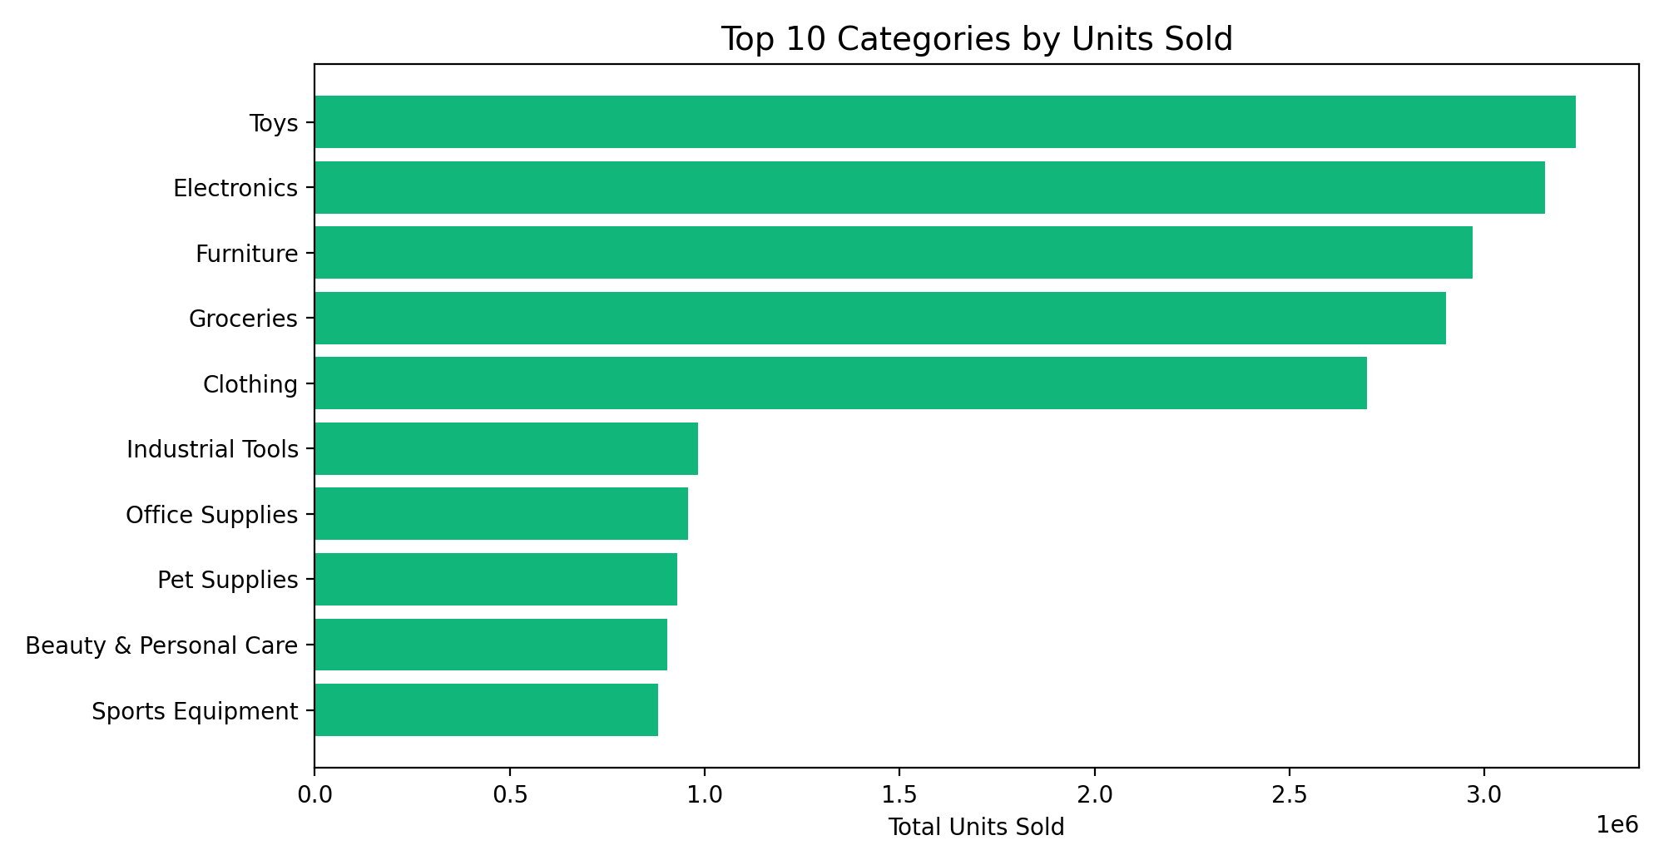
Exploratory Insights
Category demand is concentrated: Toys, Electronics, and Furniture contribute the largest share of unit sales.
Regional differences are visible, with East and West driving the majority of demand volume.
Price, discount, and holiday/promotion variables exhibit measurable influence across categories.
These patterns justify feature-rich forecasting rather than simple moving-average baselines.
Figure: Top category contribution highlights demand concentration by product group.

Slide 6
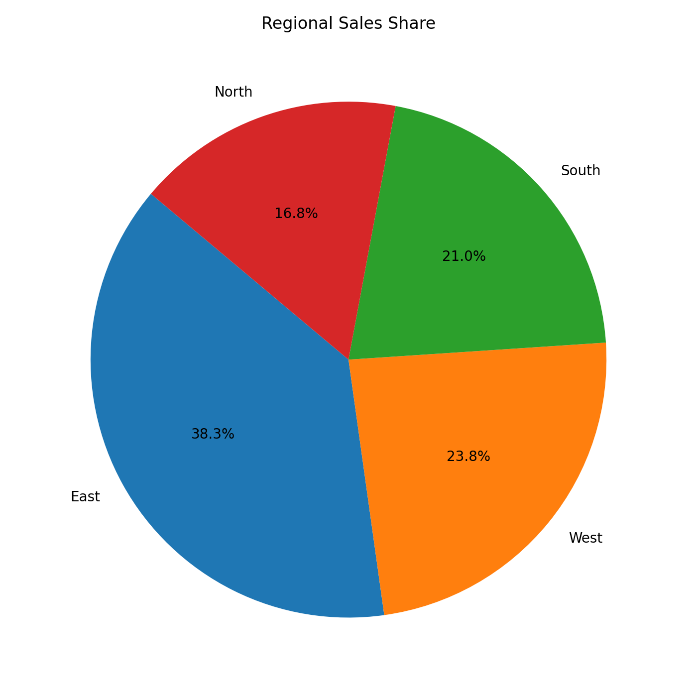
Regional Demand Distribution
Location-level sales share indicates uneven demand distribution across operating regions.
This supports location-sensitive replenishment rather than a uniform inventory policy.
Forecast outputs can be combined with warehouse allocation constraints for region-aware planning.
The same framework can be extended for store-level service-level targets.
Figure: Regional share of units sold across North, South, East, and West.

Slide 7
Forecasting Methodology
Model: LinearRegression with lag-1/7/14/28 features, rolling statistics, and cyclical calendar encodings.
Adaptive controls: holiday-aware adjustments and exogenous indicators such as price and promotions.
Baseline quality indicator: mean absolute gap between historical demand forecast and actual sales is 6.54 units.
Operational use: generate next-day to next-week category forecasts for replenishment and procurement planning.

Slide 8
Business Impact
Improves replenishment timing by giving planners forward visibility into likely demand surges and dips.
Reduces stockout risk and overstock by aligning purchase quantities with predicted consumption patterns.
Creates a single decision workflow that combines forecasting outputs with inventory-health indicators.
Supports measurable KPIs: service level, stockout rate, holding cost, and forecast error trend over time.

Slide 9
Implementation Challenges
Data quality variation across uploads required robust date parsing and column-alias normalization.
Irregular observations demanded daily resampling and missing-value handling before model fitting.
Model governance requires continuous monitoring to detect drift across categories and seasons.
Role-based access and audit history were integrated to improve operational reliability and accountability.

Slide 10
Conclusion & Next Steps
The project demonstrates a complete demand-forecasting workflow from raw data to actionable dashboard insights.
Current system is production-ready for category-level planning and can scale to store-SKU granularity.
Next steps: add probabilistic intervals, automated retraining, and optimization-based reorder recommendations.
Result: a practical AI-enabled supply chain decision support platform for retail operations.

